Slide 1
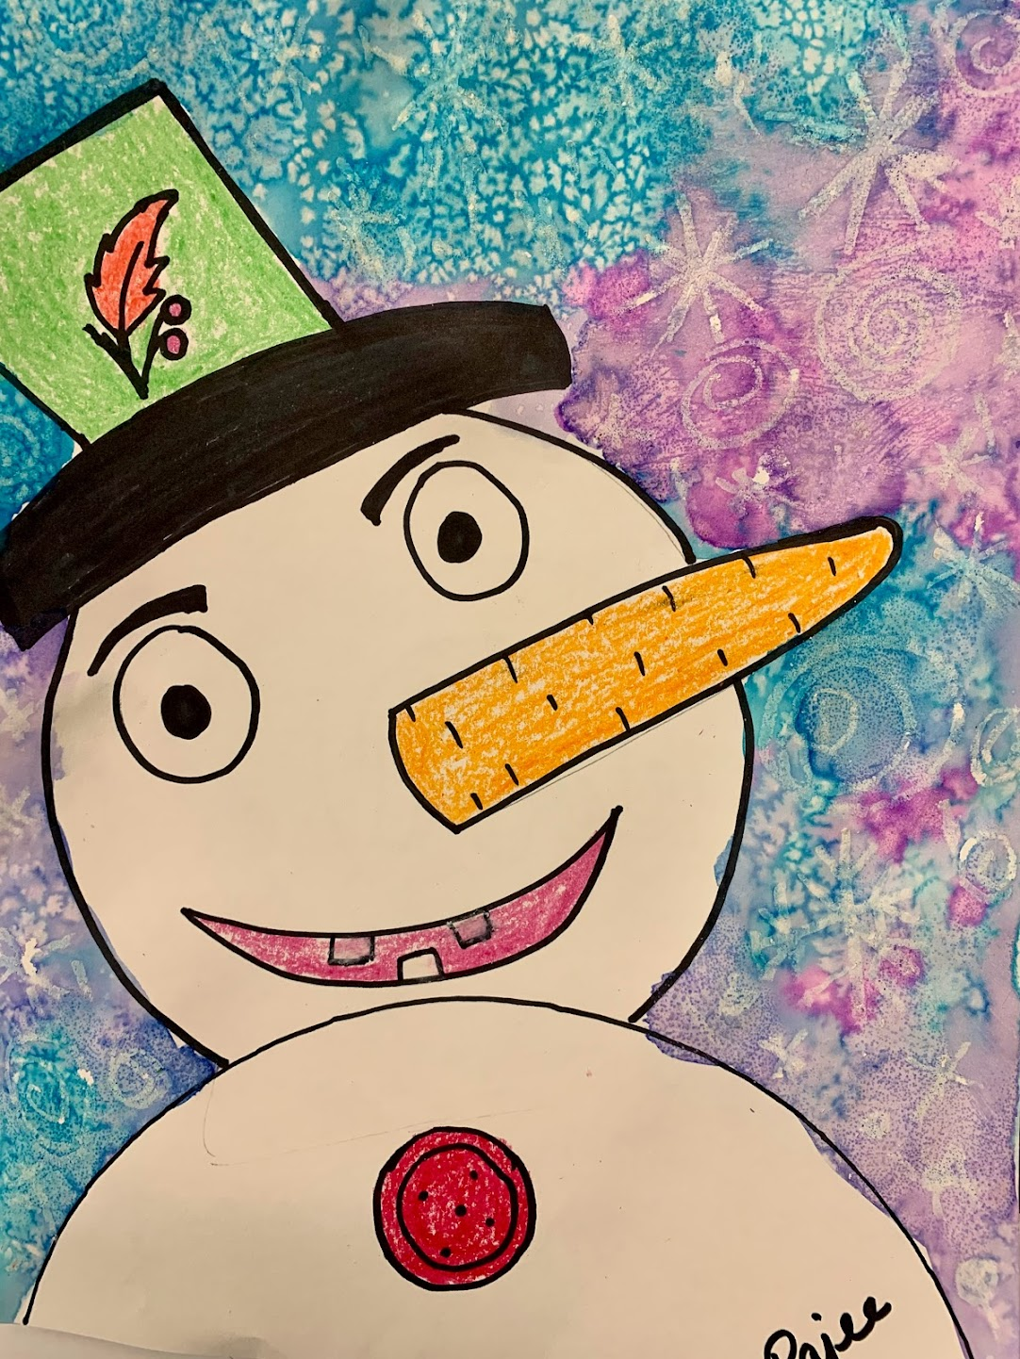
Winter Sky – Water Color Salt Technique Grade 2 & 3
December 2022

Slide 2
Materials
White multimedia paper 9x12
Water colors ( Tablet ones or the liquid concentrate) If you are using the liquid concentrate use only 5 drops for every ounce of water premix in the deep paint palette
Thick brush
Water cup to wash in between colors
Crayons from classroom
Sharpie from classroom
Salt in a small cups
Pencil and eraser from classroom

Slide 3
Salt over the Water color - Technique
Sprinkling salt on top of watercolor creates cool watercolor textures!
Sprinkling it over darker colors brings out more contrast
Fine salt makes finer texture
Coarse salt makes larger texture

Slide 4
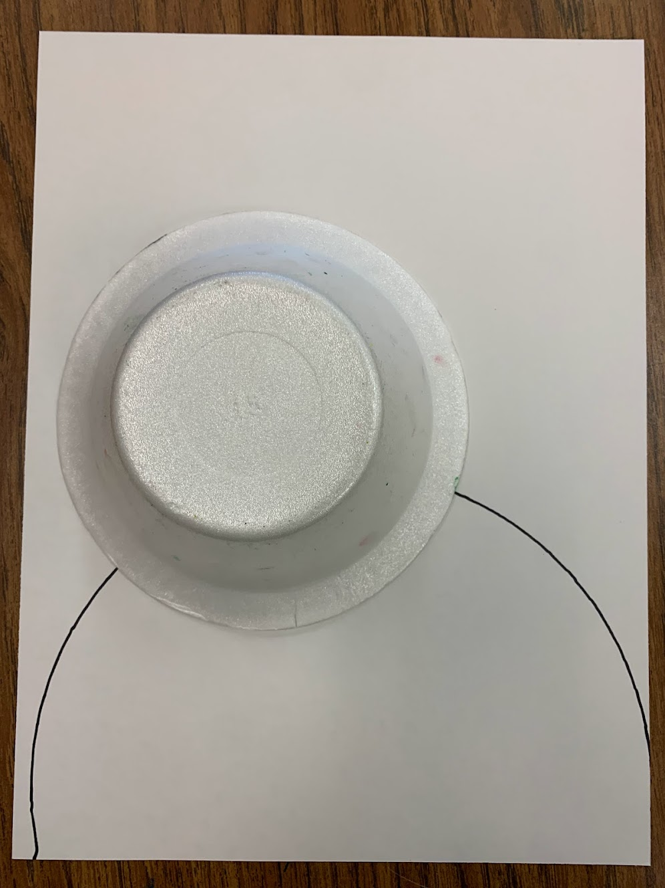
Place the paper plate on the lower end of the paper , only covering less than 1/4 of the paper
Overlap the semicircle with a inverted foam bowl.
Make sure to place the bowl closer to the left or right edge of the paper.
The snowman is looking up into the sky so please place the head of the snowman to the left or right edge of the paper
Use the paper as a template and draw the semicircle
Use the bowl as a template and draw 3/4 of the bowl starting from the bigger circle and end on the other side of the bigger circle.

Slide 5
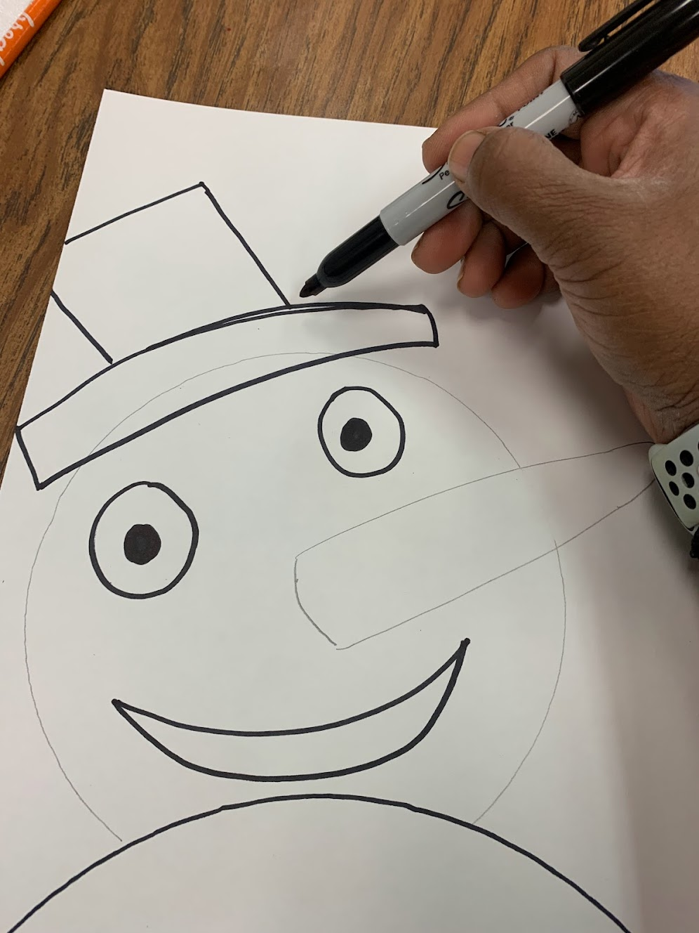
Draw the carrot nose pointing upwards into the sky
Erase the conflicting line on the face so the carrot is whole piece
Draw the 2 eyes a bit slanting as the snowman is looking gup into the sky.
Draw the tilted top hat for the snowman
Add the eye ball
Draw the smiley face

Slide 6
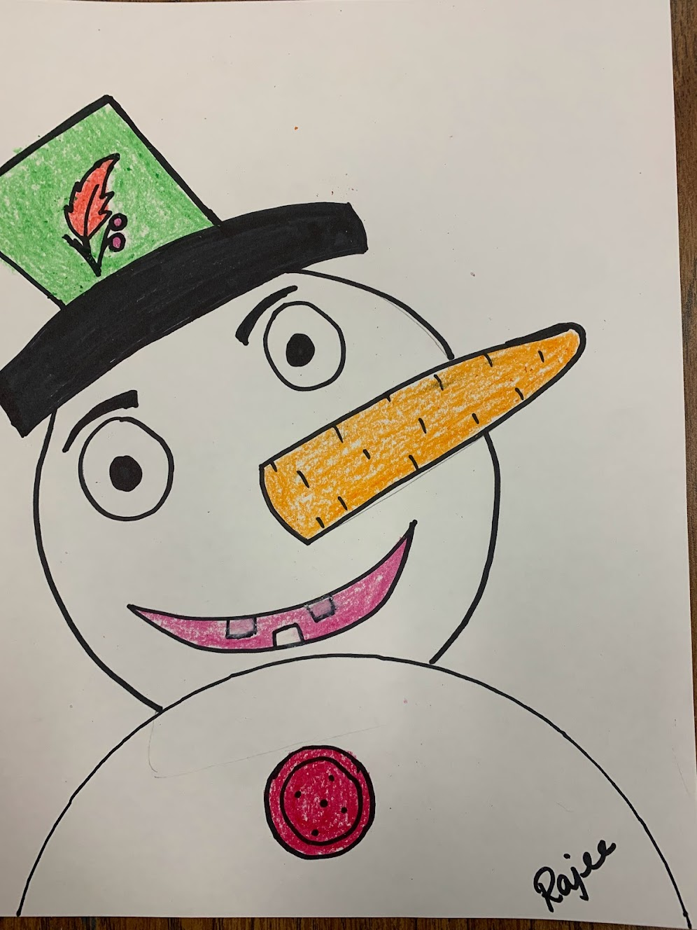
Trace with sharpie and color the rim of with sharpie
Color the rest of the hat, nose, mouth and button with crayon
Draw the eyebrows, teeth and button with sharpie
Write your name with sharpie

Slide 7
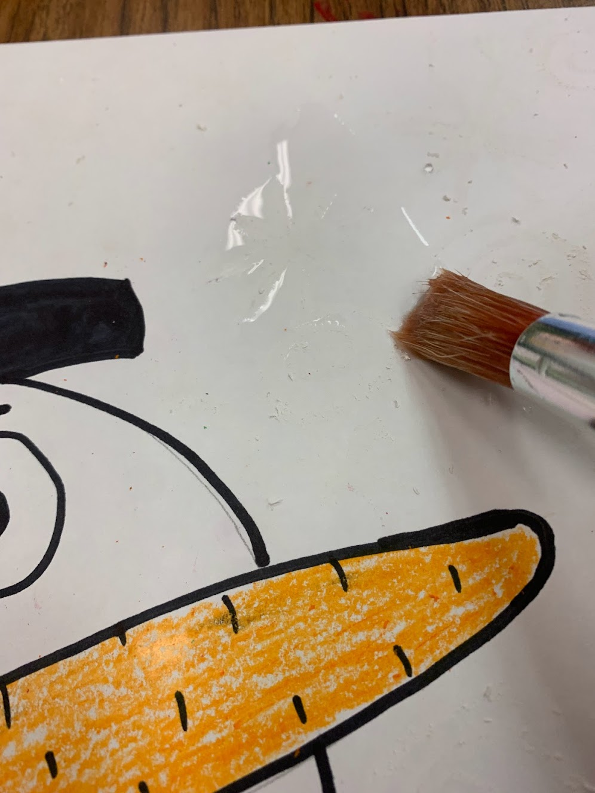
Draw stars and swirls on the background with white crayon
Using a thick brush, apply water, all over the area around the snowman. Saturate it heavily with water.
Load the water color on the THICK BRUSH and apply on the the water ed area. It should be very wet through out.

Slide 8
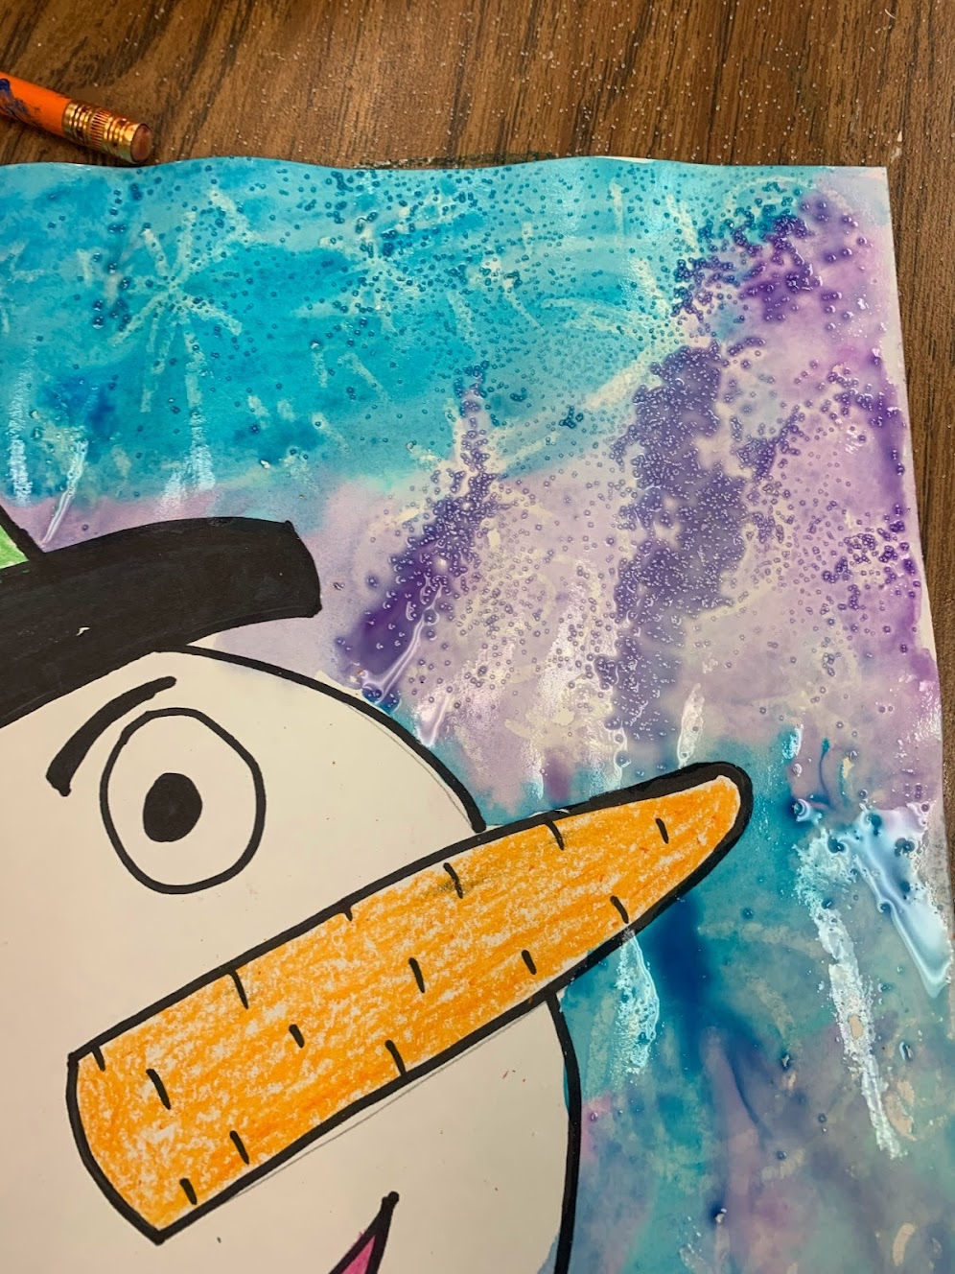
Try to slightly merge different color water colors but not mix it
Sprinkle a few pinches of salt over the watered area and leave it undisturbed.
The salt will absorb the ware color and once it dries it will create implied textures, that almost looks like snow.
Please wash between colors.
Once the art work dries you can gently scratch off the salt from the art.

