Slide 1
Winter Sky & TREE – Water Color Salt Technique
Grade 4&5
Rajee Subramanian
December 2022
Quail Run Elementary

Slide 2
Materials
White multimedia paper 9x12
Water colors ( Tablet ones or the liquid concentrate) If you are using the liquid concentrate use only 5 drops for every ounce of water premix in the deep paint palette
Thick brush
Water cup to wash in between colors
Crayons from classroom
Sharpie from classroom
Salt in a small cups
Pencil and eraser from classroom

Slide 3
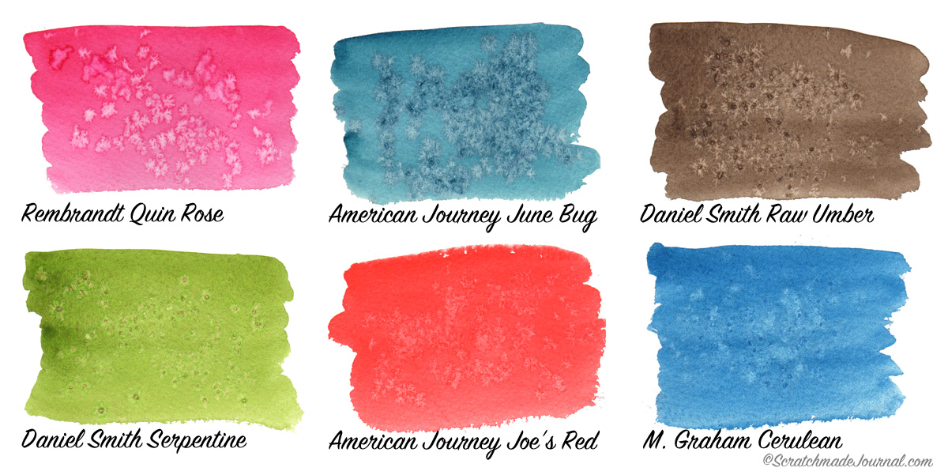
Salt over the Water color – Technique
Implied Texture
Sprinkling salt on top of watercolor creates cool watercolor textures!
Sprinkling it over darker colors brings out more contrast
Fine salt makes finer texture
Coarse salt makes larger texture

Slide 4
Draw the overlapping mountains 3
Mountains are optional
Draw the tree trunk and branches with pencil.
Remind the students that the trunk is thicker and the branches gradually becomes thin.
Trace the tree with sharpie and color the tree with sharpie
Write your name with sharpie
Add a moon with crayon
Add the swirls, snowflakes with crayon (Optional)

Slide 5
Using a thick brush, apply water, all over the area around the snowman. Saturate it heavily with water.
Load the water color on the THICK BRUSH and apply on the the water ed area. It should be very wet through out.

Slide 6
Try to slightly merge different color water colors but not mix it
Sprinkle a few pinches of salt over the watered area and leave it undisturbed.
The salt will absorb the ware color and once it dries it will create implied textures, that almost looks like snow.
Please wash your brush between colors.
Once the art work dries you can gently scratch off the excess salt from the art.

