Slide 1
Winter Sky
Water Color Salt Technique
TK, Kinder & Grade 1
Rajee Subramanian
December 2022
Quail Run Elementary

Slide 2
Materials
White multimedia paper 9x12
Water colors ( Tablet ones or the liquid concentrate) If you are using the liquid concentrate use only 5 drops for every ounce of water premix in the deep paint palette
Thick brush
Water cup to wash in between colors
Crayons from classroom
Sharpie from classroom
Salt in a small cups
Pencil and eraser from classroom

Slide 3
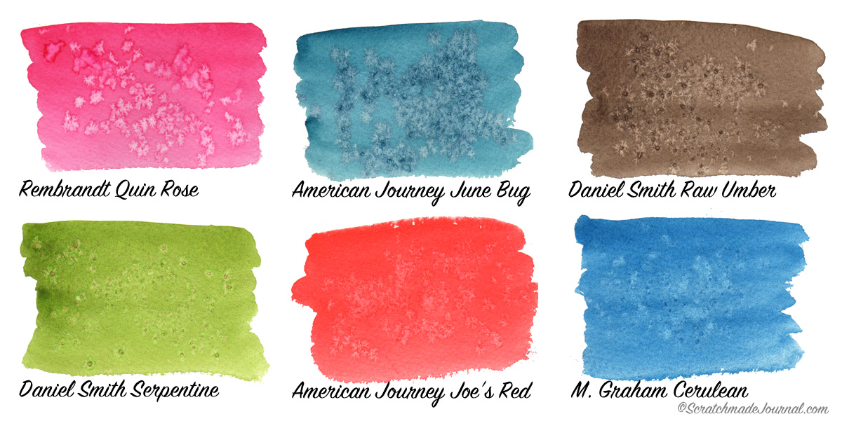
Salt over the Water color – Technique
Implied Texture
Sprinkling salt on top of watercolor creates cool watercolor textures!
Sprinkling it over darker colors brings out more contrast
Fine salt makes finer texture
Coarse salt makes larger texture

Slide 4
Draw AT Least one big stars and one big swirls on the background with any color crayon
Draw a crescent moon
Write your name with Sharpie
Using a thick brush, apply water, all over the paper. Saturate it heavily with water.
Fill the paper with little dashed lines going across and around the paper. Remind them of the last months yarn painting lines

Slide 5
Load the water color on the THICK BRUSH and apply on the the watered area. It should be very wet through out. So the water color will just spread automatically in the medium

Slide 6
Try to slightly merge different color water colors but not mix it
Sprinkle a few pinches of salt over the watered area and leave it undisturbed.
The salt will absorb the ware color and once it dries it will create implied textures, that almost looks like snow.
Please wash between colors.
Once the art work dries you can gently scratch off the salt from the art.

