Slide 1
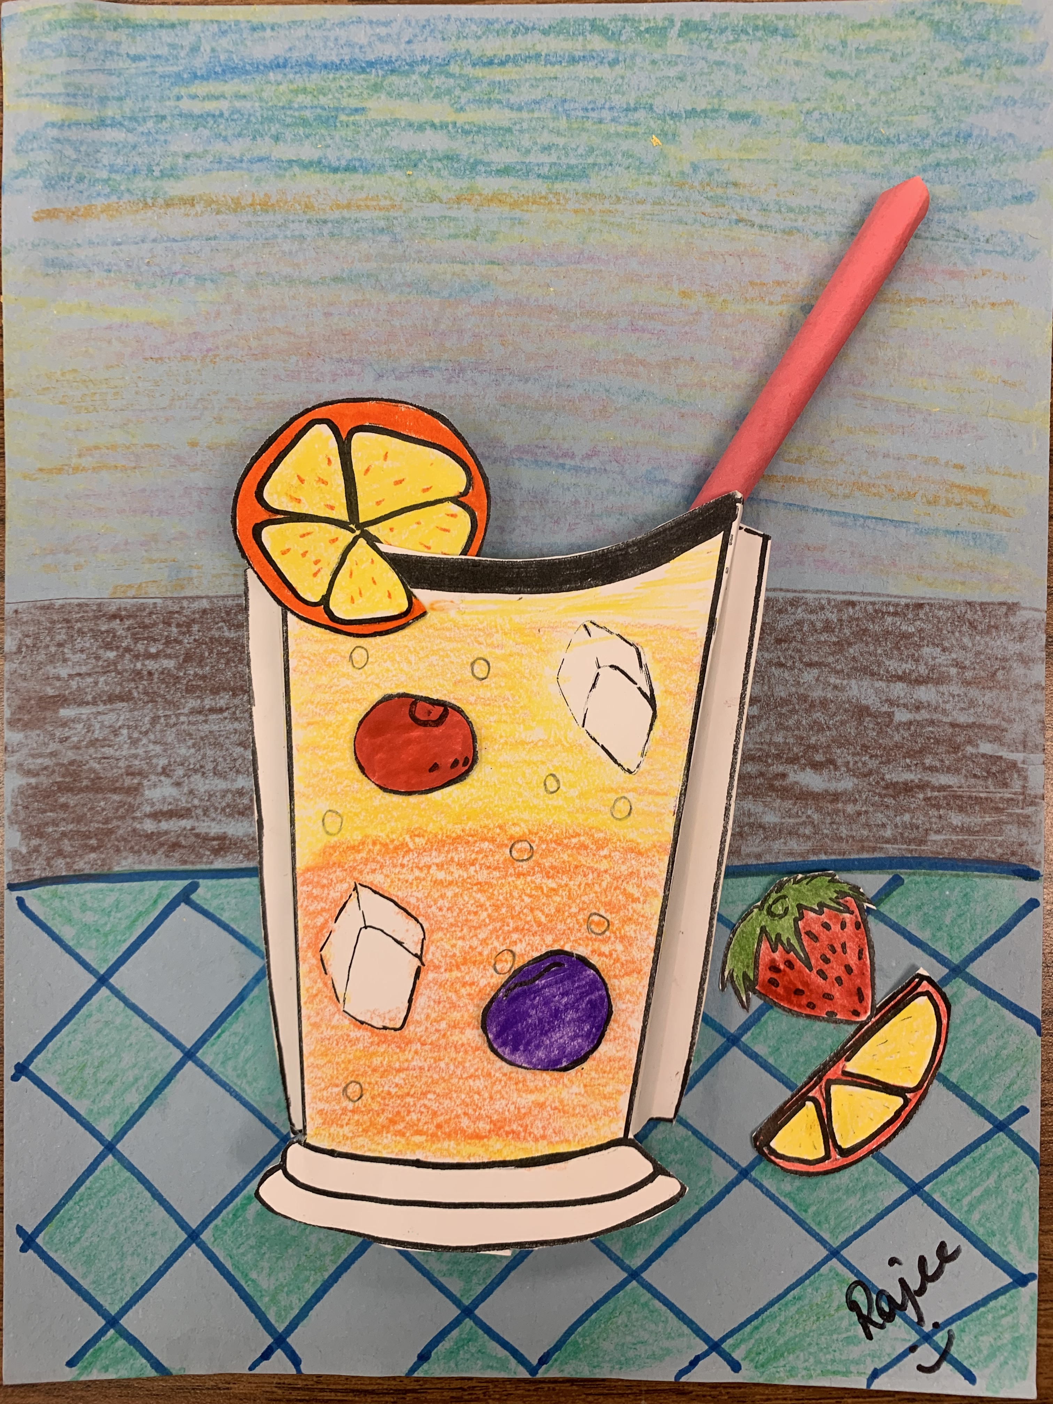
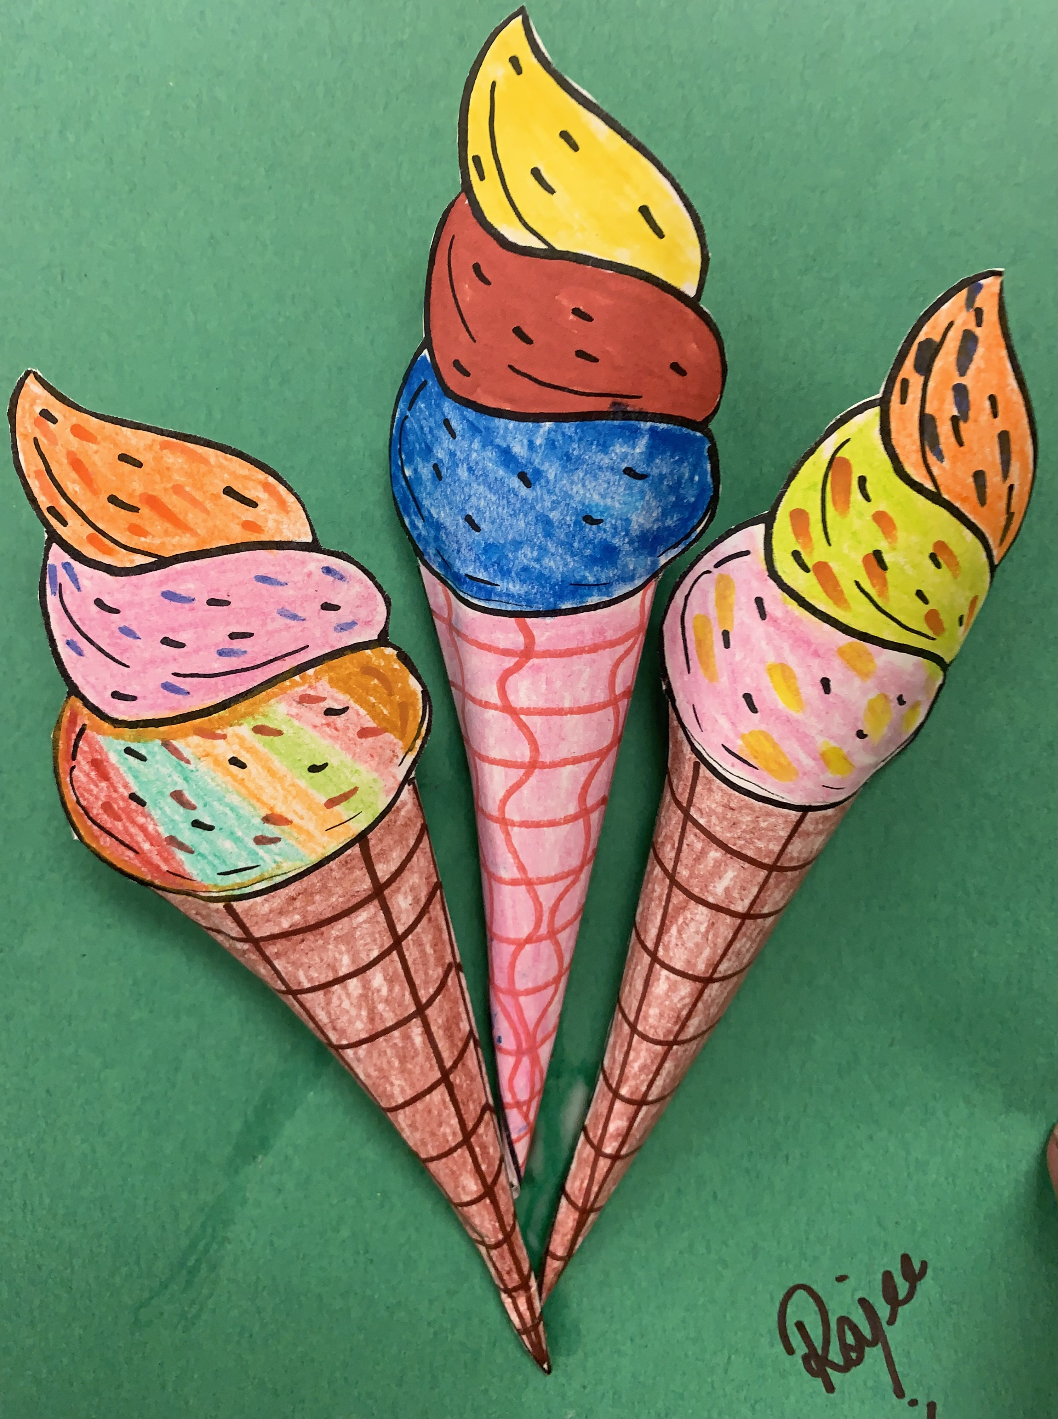
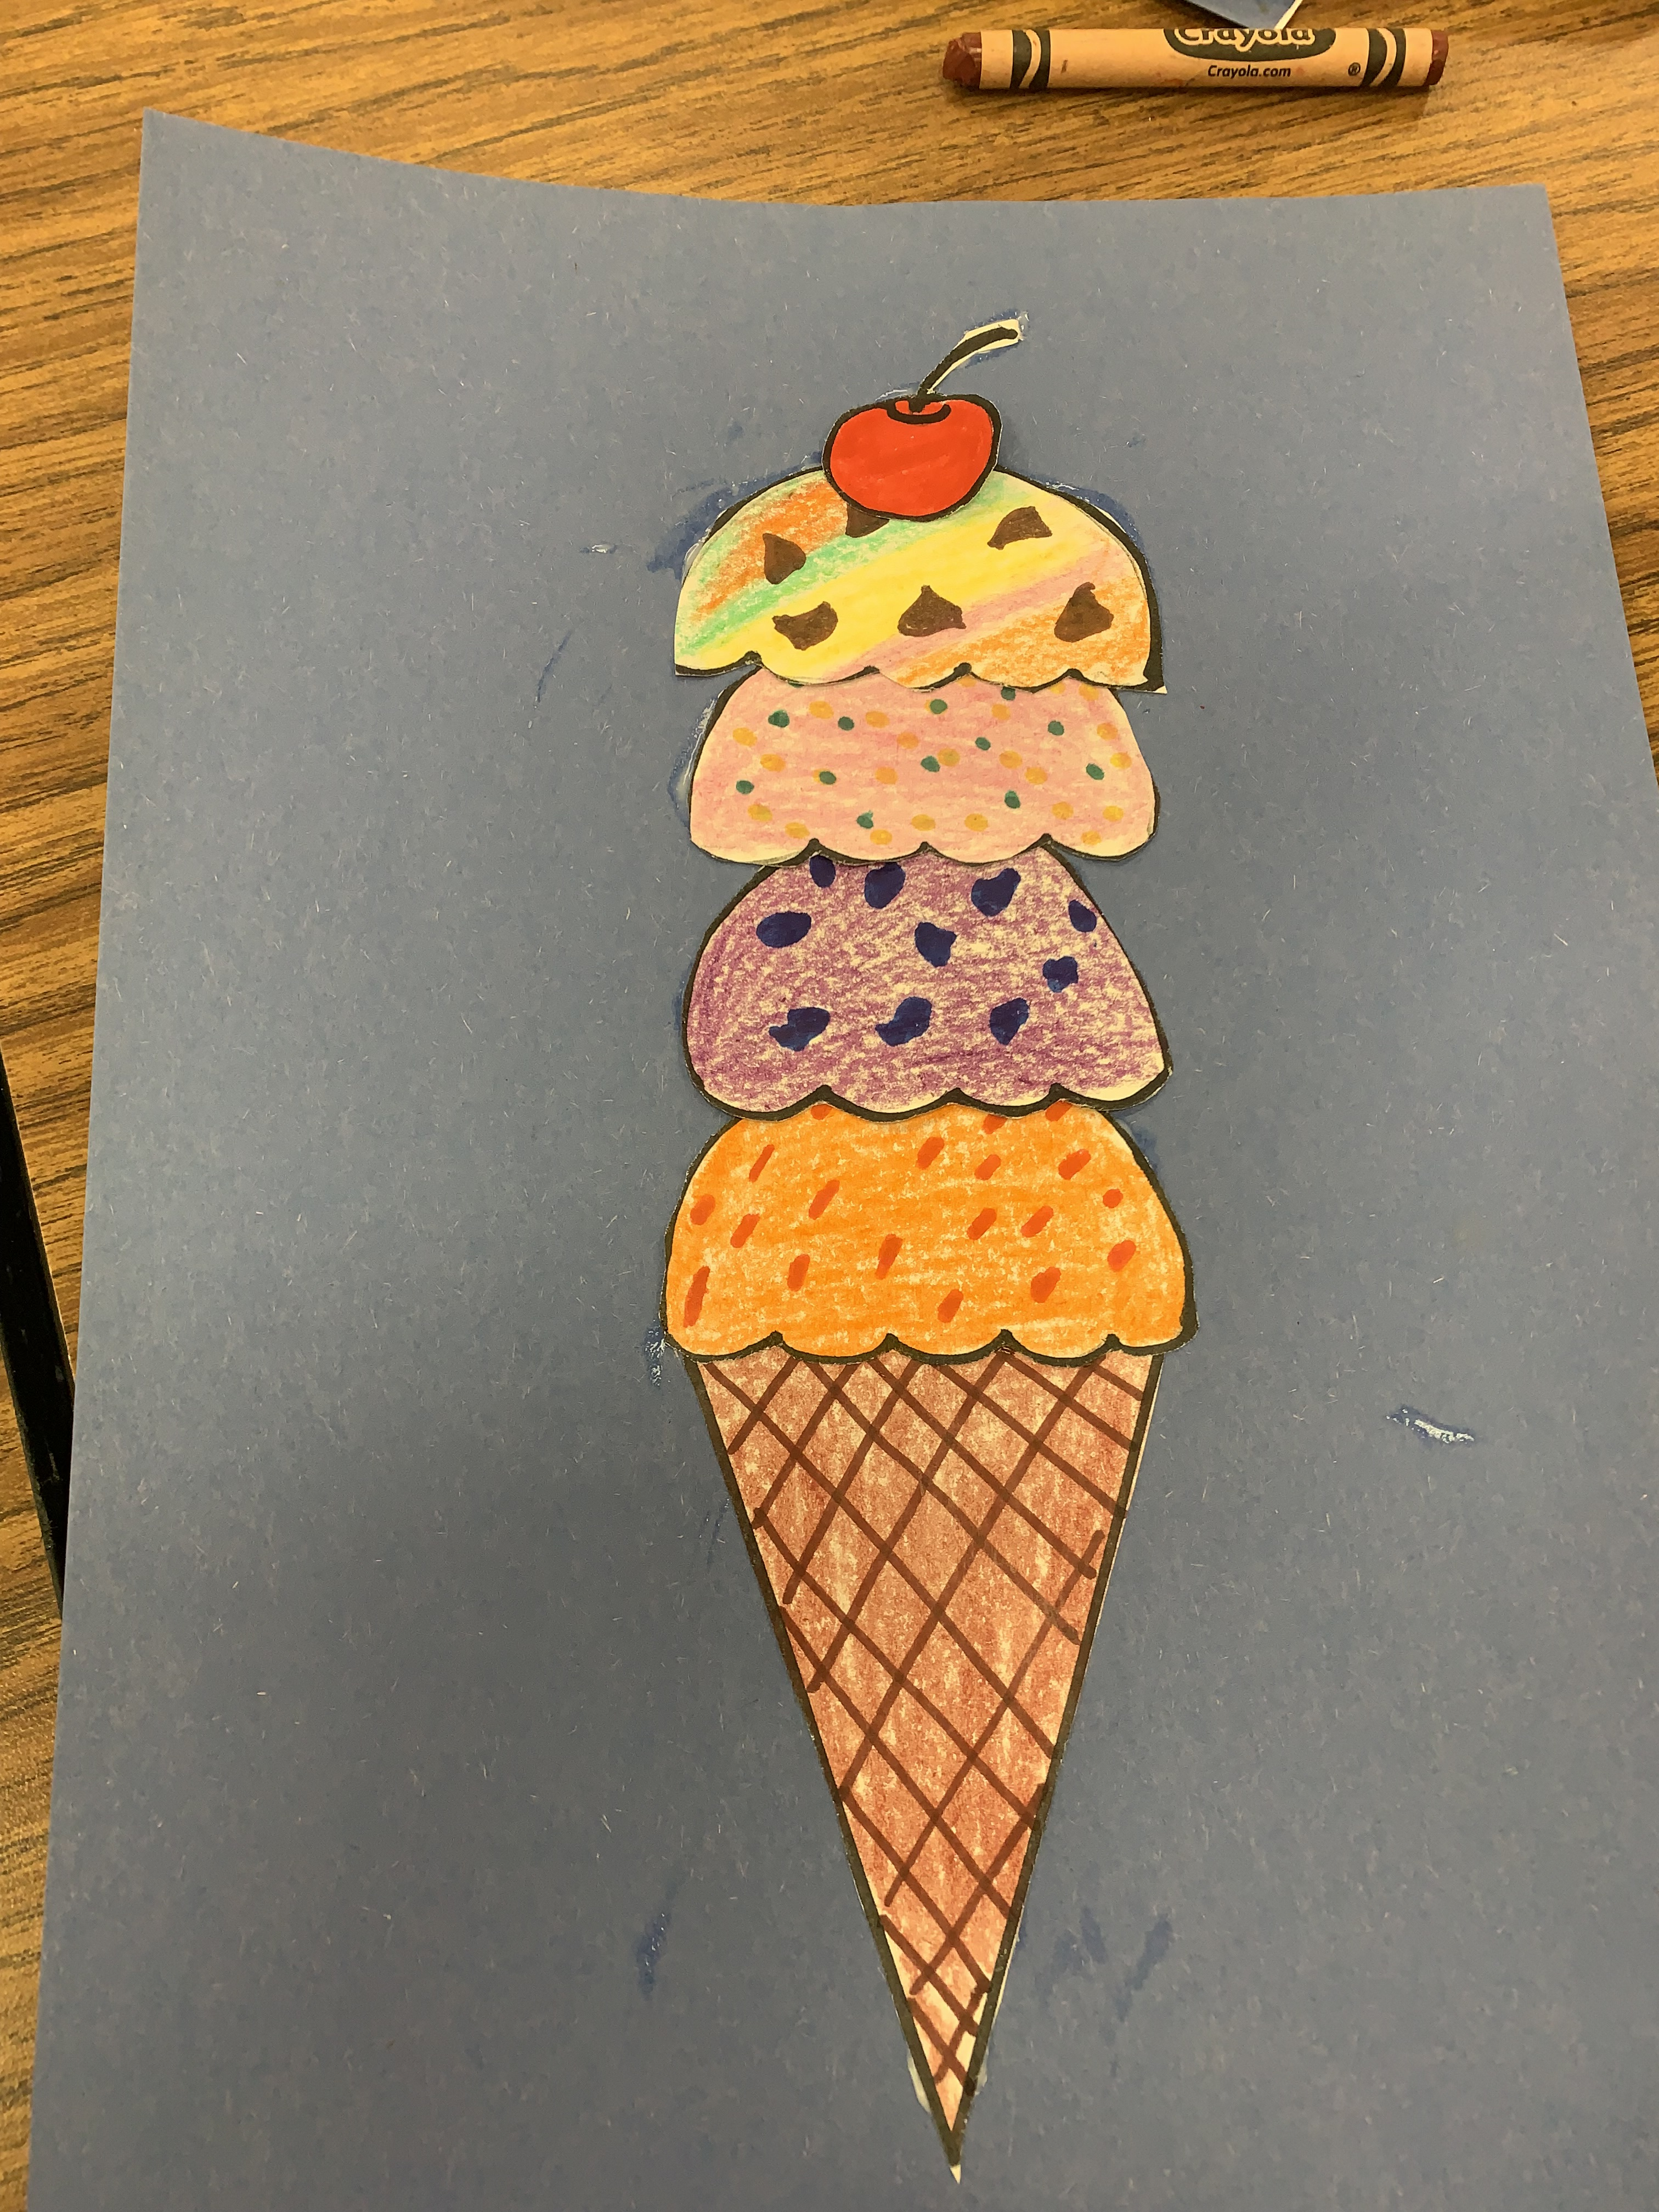
2023 Summer Art project – “I scream Ice Cream” - “Make Me a Cocktail”
May 2023
Rajee Subramanian

Slide 2
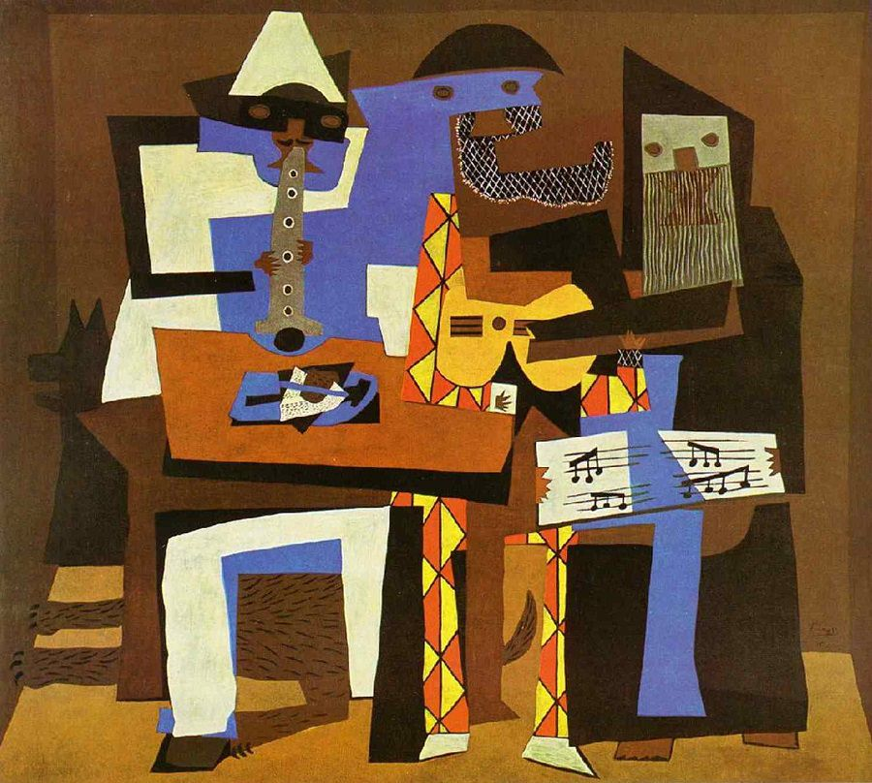
What is a Collage?
Collage comes from the French word “collér,” which means “to glue,”
A collage is a form of visual arts in which visual elements are combined to create a new image - Cubism movementt
It is an art form that originated in 20th century when Pablo Picasso was cutting an gluing pieces to conveys a
In the mid-twentieth century, collage art was a major influence on the Pop art movement message or idea.”

Slide 3
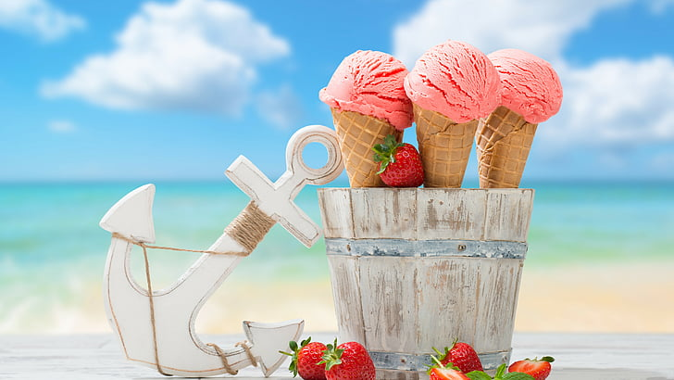
Summer and ice cream
Sunny summer days have us in mood for one thing
It’s ICE CREAM
Instant boost of energy in hot days to cool us all off

Slide 4
America’s top 10 ice cream flavors
1.Chocolate
2. Cookies & Cream
3. Vanilla
4. Strawberry
5. Chocolate chip
6. Cookie Dough
7. Butter Pecan
8. French Vanilla
9. Chocolate chip Cookie Dough
10. Salted Caramel

Slide 5
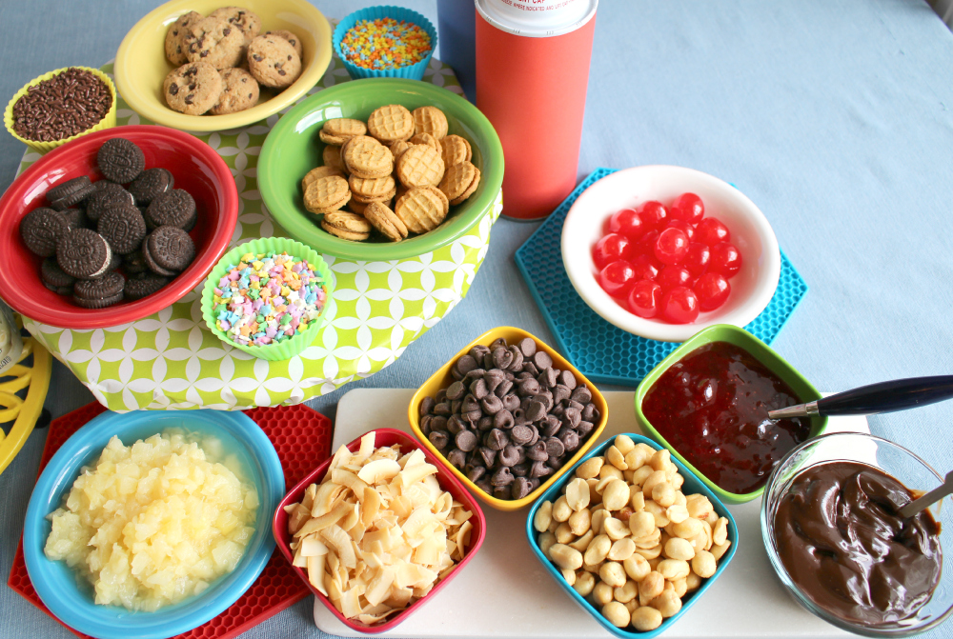
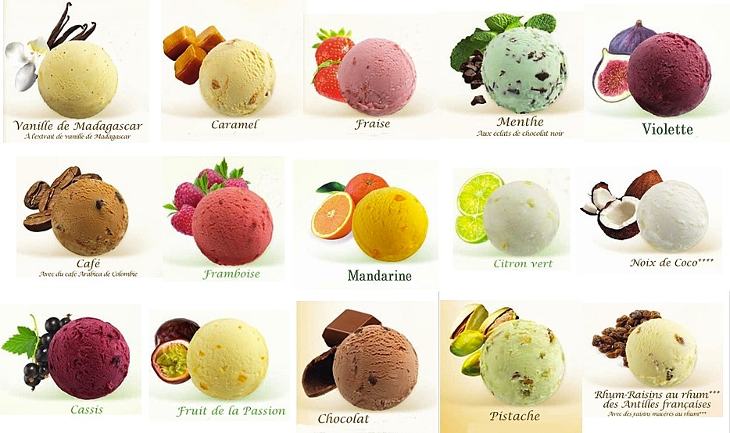
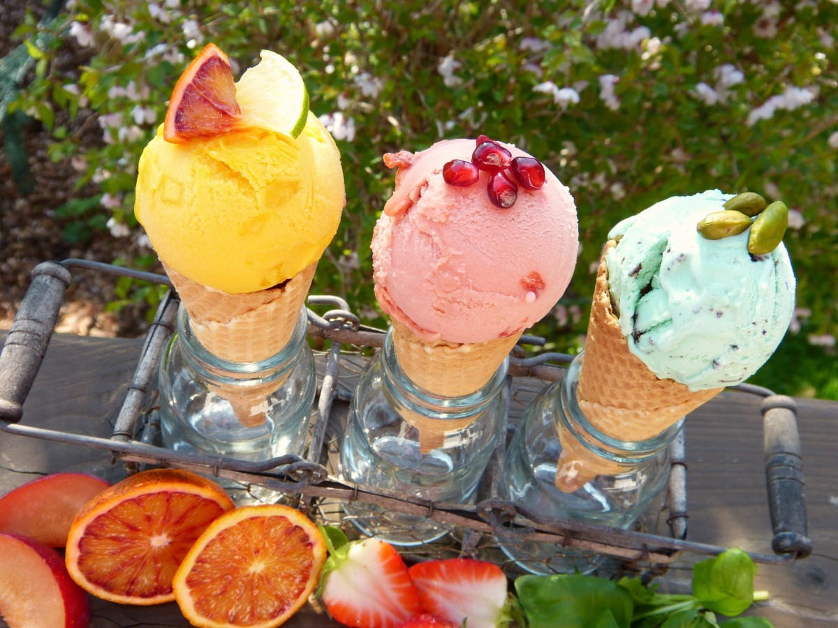
Flavors and Colors
This Photo by Unknown Author is licensed under CC BY-NC-ND

Slide 6
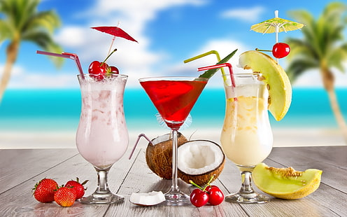
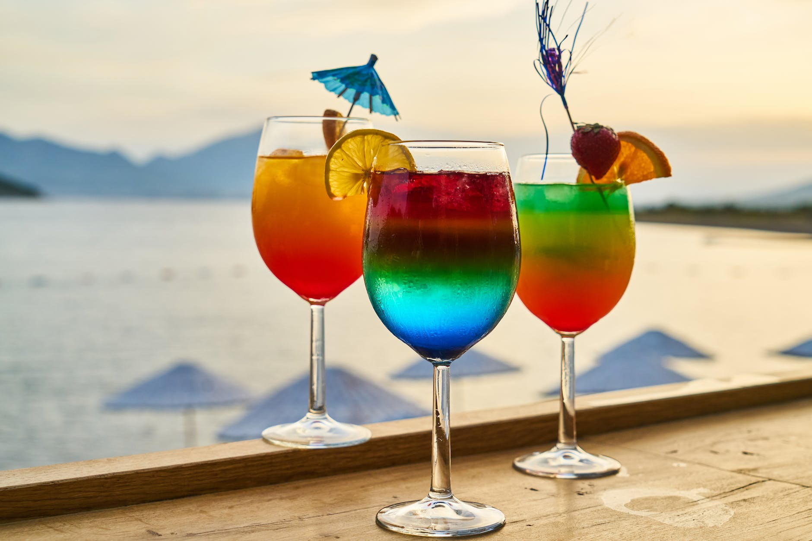
Cocktail – Mix of 3 or more juice – Favorite drink in summer

Slide 7
Materials
TK, K, Grade 1, 2 & 3
Grade 4 & 5
Grade specific template
Colored construction paper
Elmer’s Glue
Color pencils
Markers – Classroom
Crayons – Classroom
Sharpie - Classroom
Grade specific template
Colored construction paper
Elmer’s Glue/Glue stick
Tape
Color pencils
Markers – Classroom
Crayons – Classroom
Sharpie - Classroom

Slide 8
Tk, K , Grade 1
Draw the mix ins, waffle cone ridges and toppings with markers
Color using Crayons
Cut al lof them out

Slide 9
Tk, K , Grade 1
Collage/start gluing the pieces – first the waffle cone – Before gluing arrange the pieces and see if you like the arrangement , it fits into the page and the color combination is good

Slide 10
Tk, K , Grade 1
Collage all the pieces overlap each scoops one on top.
Trace around the whole image with sharpie
Write your name
you are done.

Slide 11
Grade 2&3
Draw toppings/sprinkles, cone ridges with markers
Color using Crayons
Finish coloring and cut out the cone

Slide 12
Grade 2&3
Fold on each of the lines and scroll the cone, with out ripping the ice cream, glue the edges and hold for few seconds
Make 3 cones and arrange it on the background, glue and write your name

Slide 13
Grade 4 & 5
Color the grade specific cocktail template with color pencil and markers for the outline
Split the blue construction paper in ½ or ¼ to create the fore ground
Create your foreground and background with markers, color pencil, crayon
Cut out all the pieces

Slide 14
Grade 4 & 5
Bifold the sides of the cocktail cup
Scroll the construction paper on a pencil, create a paper straw, cur the excess paper and glue.
Hold the straw in place for few seconds and slide the pencil out
Position it and glue the folded side on the background

Slide 15
Grade 4 & 5
Glue the straw inside the cup
Make a small slit on the slice of fruit and glue it on the cup’s ridges
Arrange rest of the fruits inside and outside the cup and glue them all.

