Slide 1
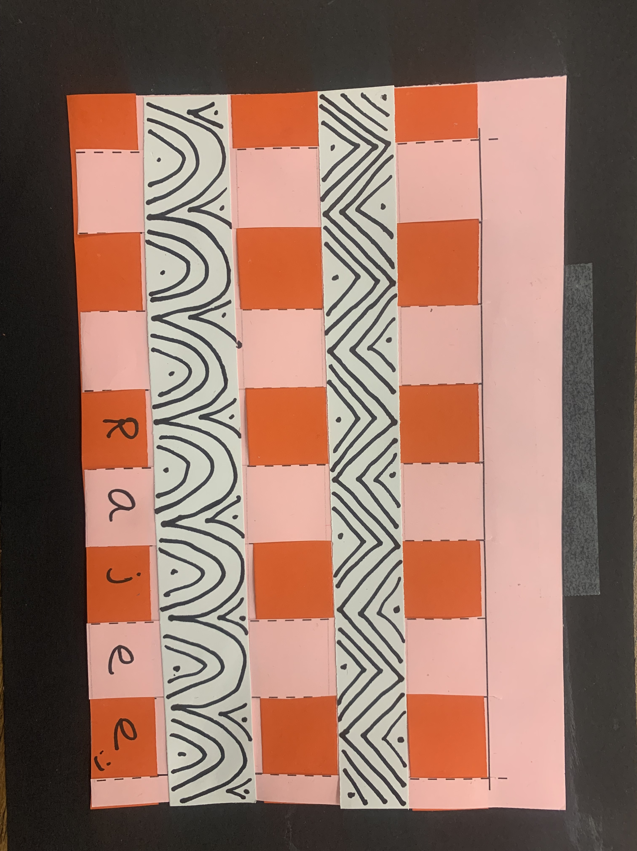
Kente paper weaving Tk & k - February 2023
Quail Run Elementary
Rajee Subramanian

Slide 2
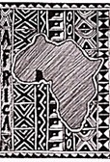
February – Black History Month
February is "Black History Month," a time to commemorate African-Americans who have changed the world.

Slide 3
Importance of art in africa
To understand about a community of people we look into their culture and art heritage.
Art is understood as cultural transmission.
Today we will learn about Ashanti tribal art from West Africa.

Slide 4
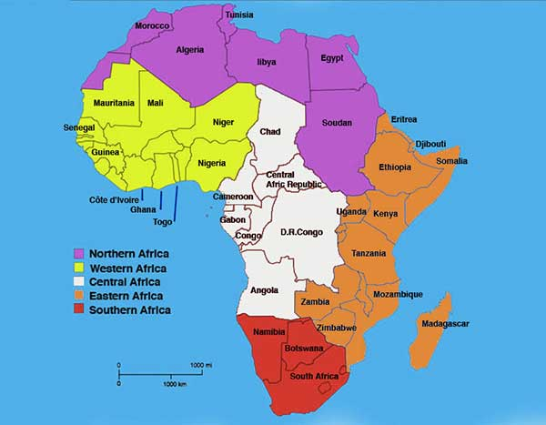
Did You Know???? Africa is the world’s second-largest continent.
It is more than three times the size of the United States.
Africa includes more than 50 countries.

Slide 5
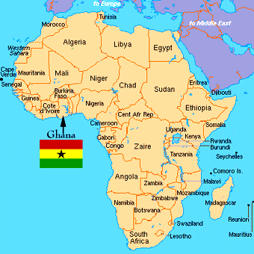
West African Region – Ghana – Ashanti People
Ashanti tribe, found in central Ghana, is the largest ethnic group of the Akan.

Slide 6
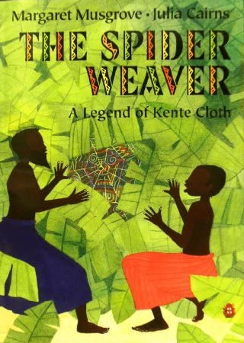
Literature Connection – The Spider weaver by
https://www.youtube.com/watch?v=91yapOM7BzI

Slide 7
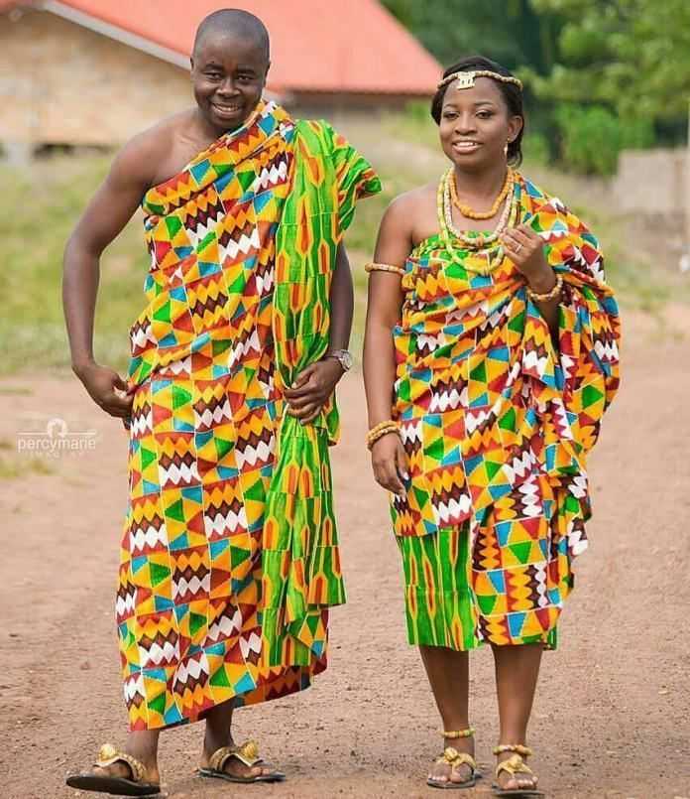
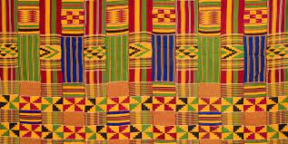
Kente Cloth Ghana – Ashanti People
Weaving done by men in West Africa
–Traditionally worn draped across the shoulders
Kente Cloth were originally made only for Kings & Queens
National dress of Ghana – Worn for holidays
Popular with tourists
Kente cloth is statement of pride in African heritage.

Slide 8
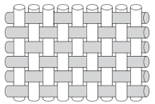
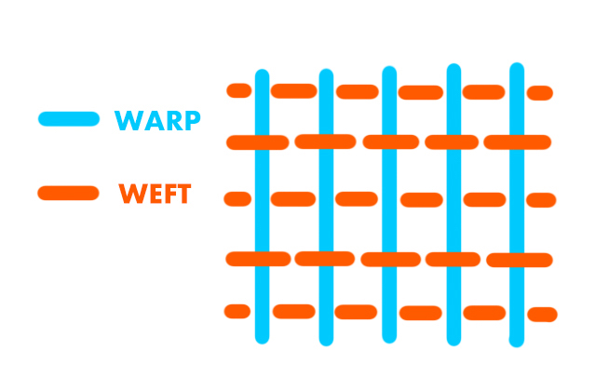
Kente Cloth Weaving
- Today we will use the simple pattern
- Under and over pattern
- Frist strip goes under then over
- Second strip goes over then under

Slide 9
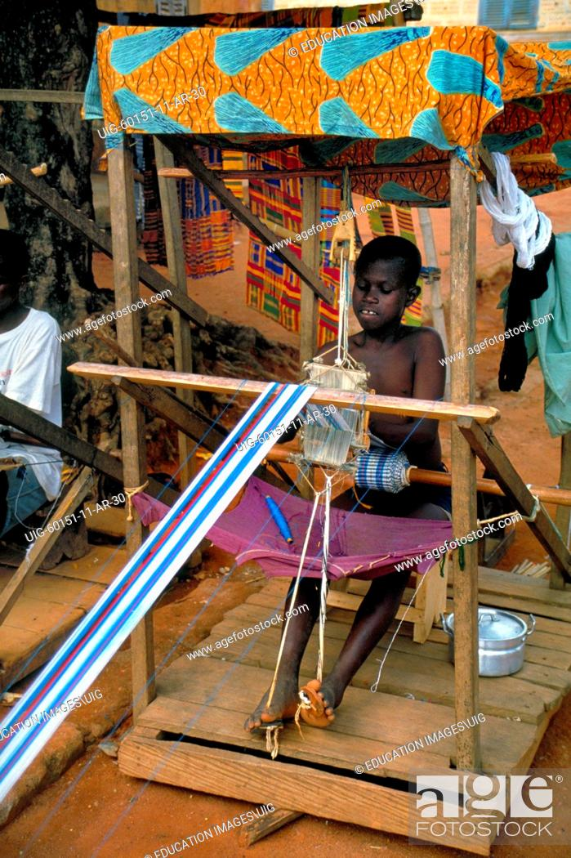
Kente Loom
Loom is a structure that holds the weaving together
Strip loom, upright loom, Standing loom, cardboard loom, Strip loom
Today we will use paper loom

Slide 10
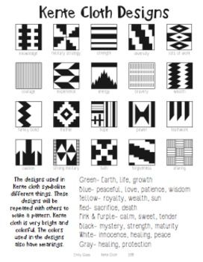
Art element & other learning
Patterns
Colors
Lines
Repetition
Geometry
Fine Motor Skills
Weaving techniques

Slide 11
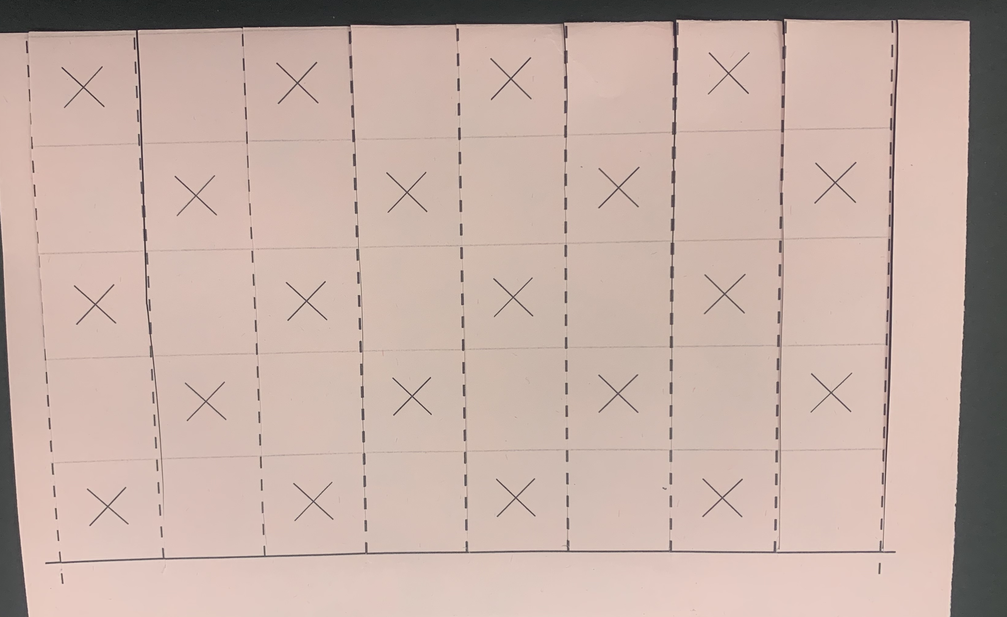
Materials
TK, Kinder
9x12 black construction paper
Half sheet paper loom
0ne inch colored stripes
Pair of scissors
Glue stick
Sharpie

Slide 12
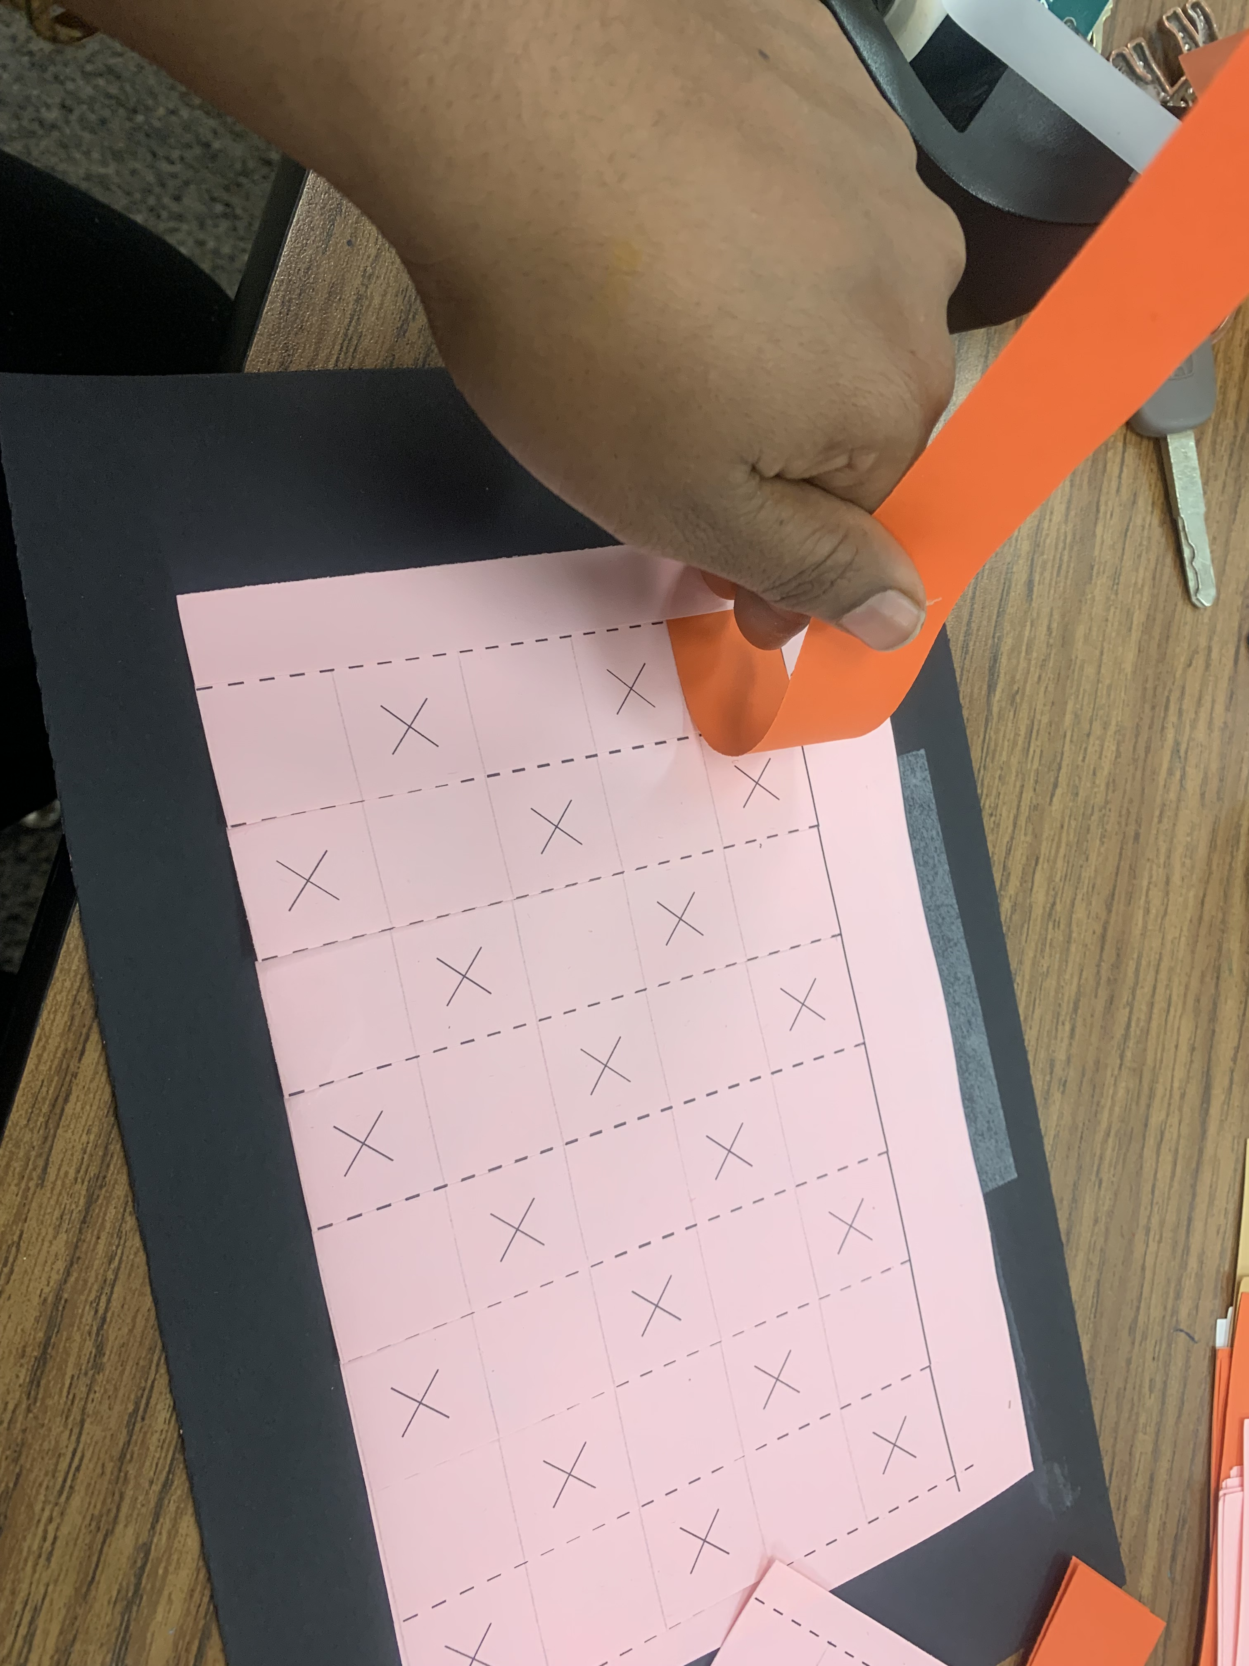
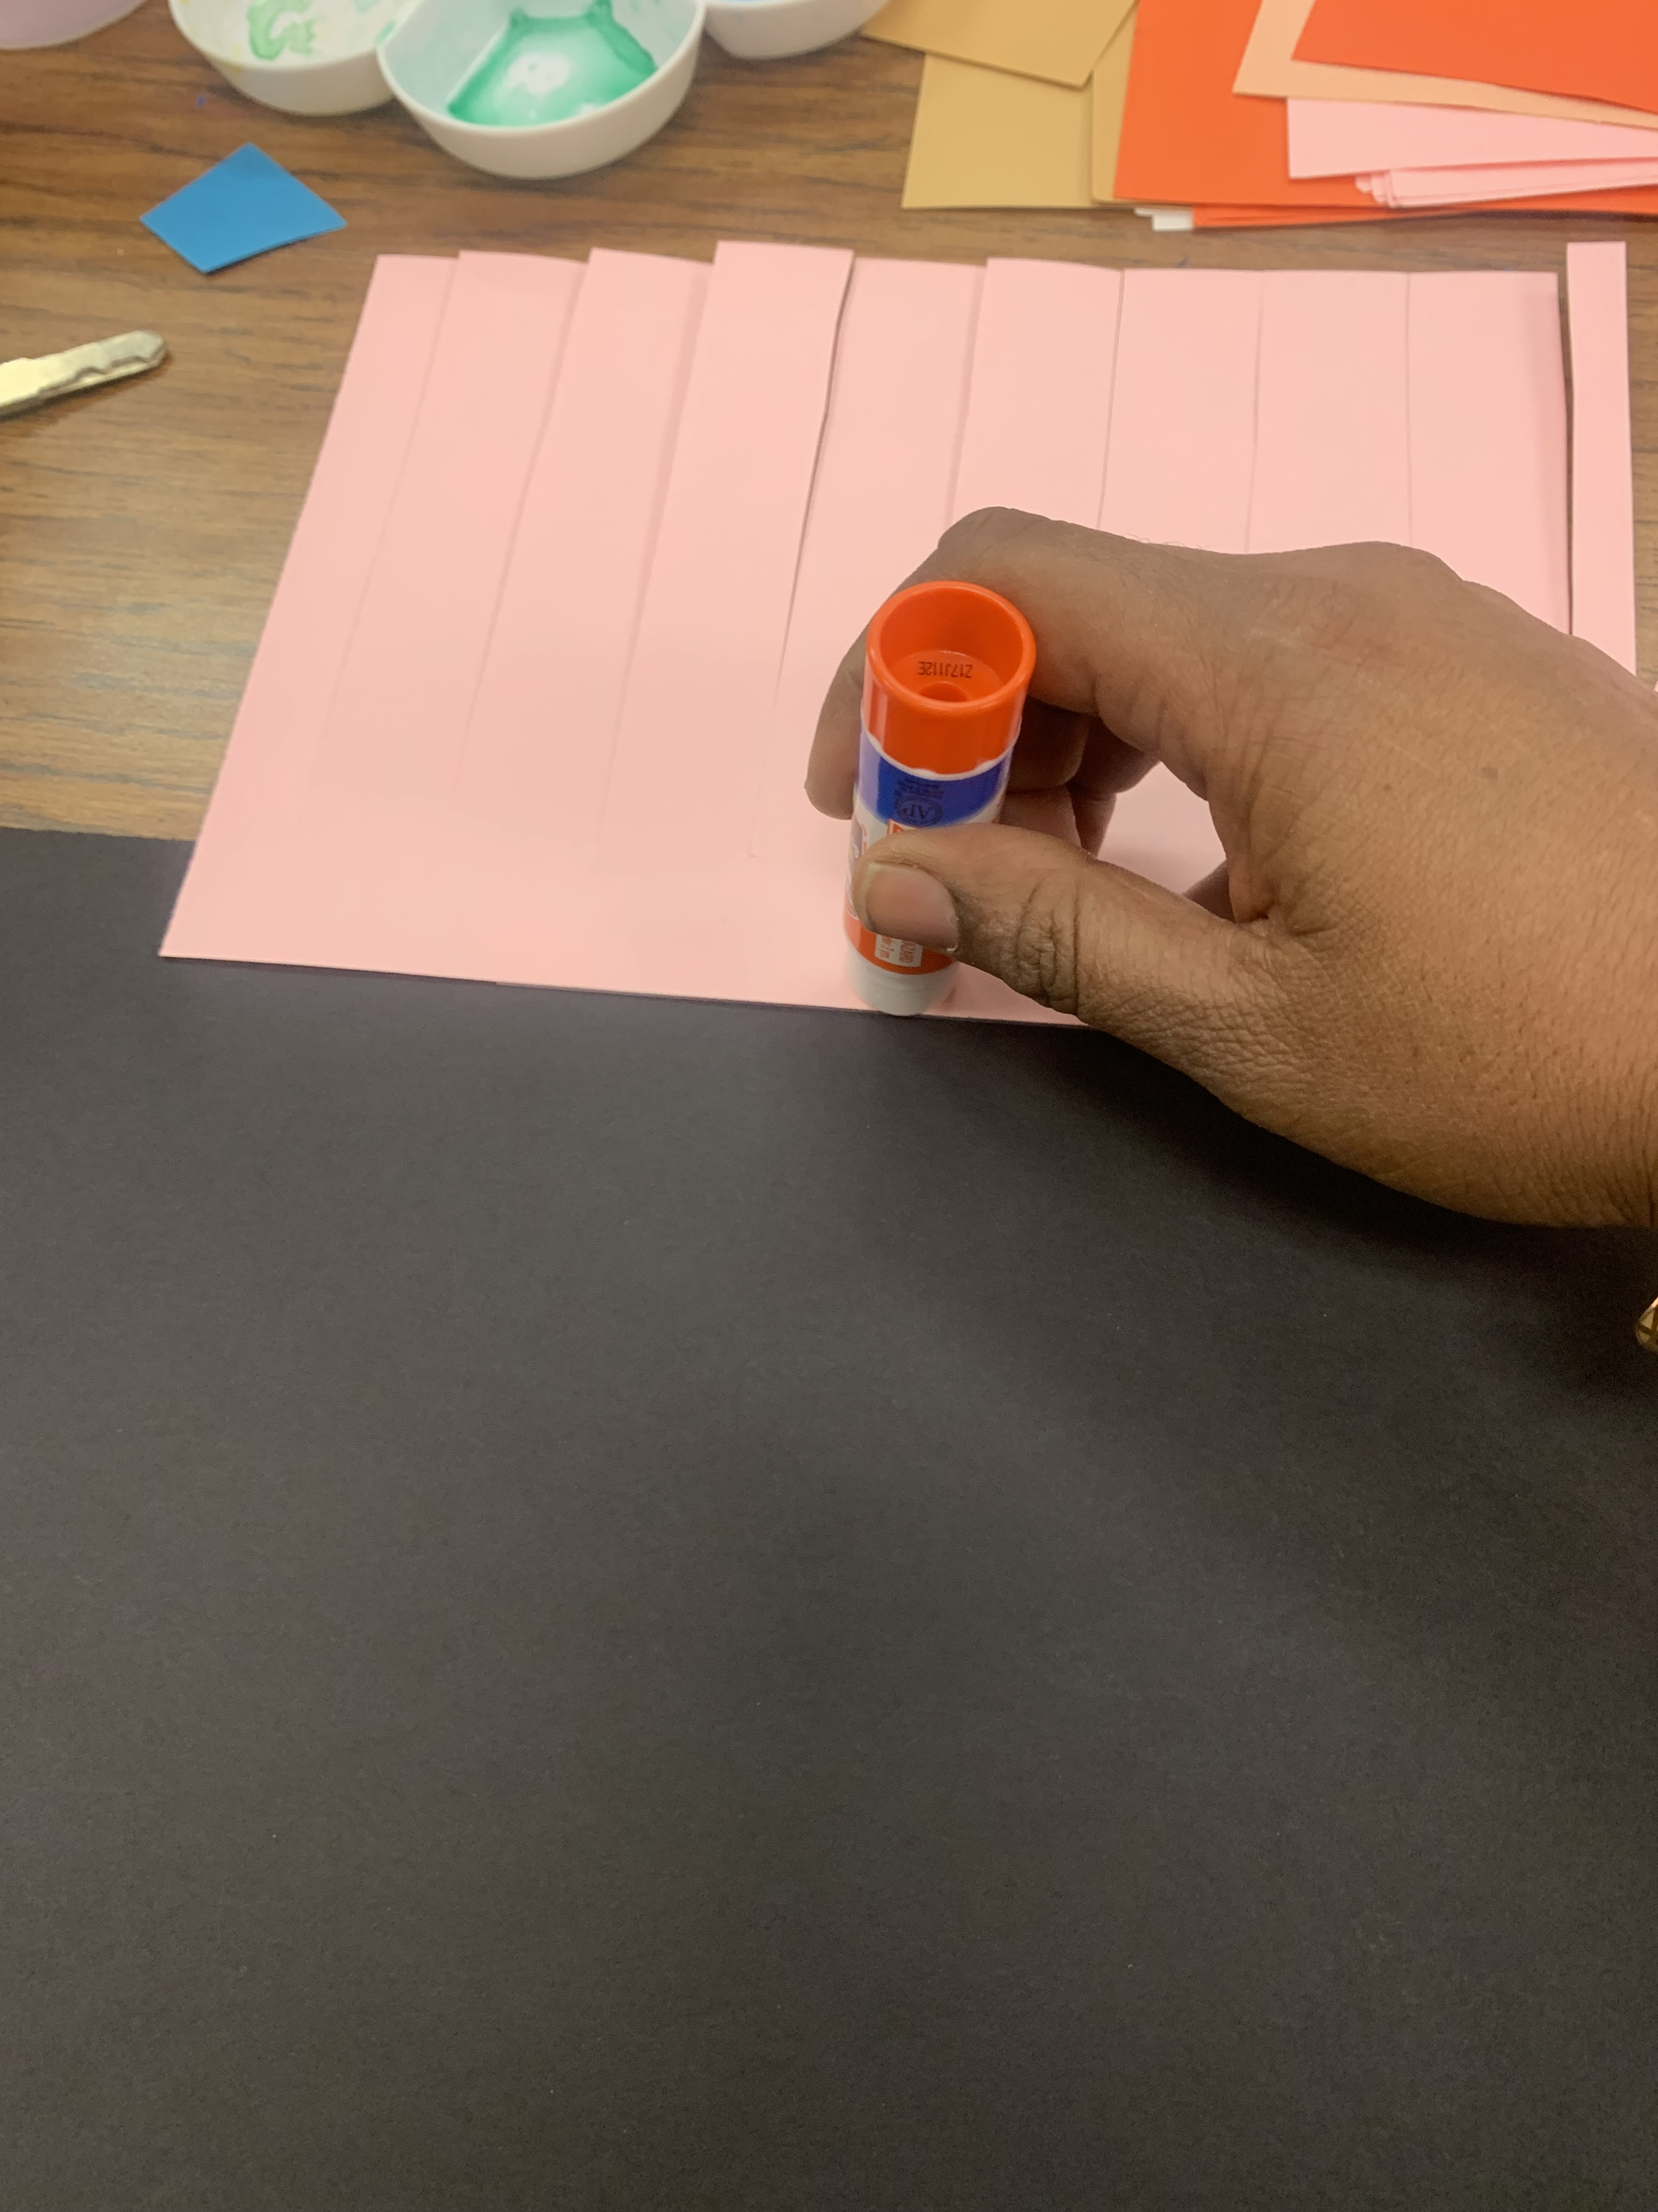
Procedure – TK, K
Tape the ½ sheet printed paper on the black construction sheet
Flip and glue on the back
Cut along the dotted lines all the way to the solid line
Take the one inch strip and start going under and over the strips covering the mark “X”

Slide 13
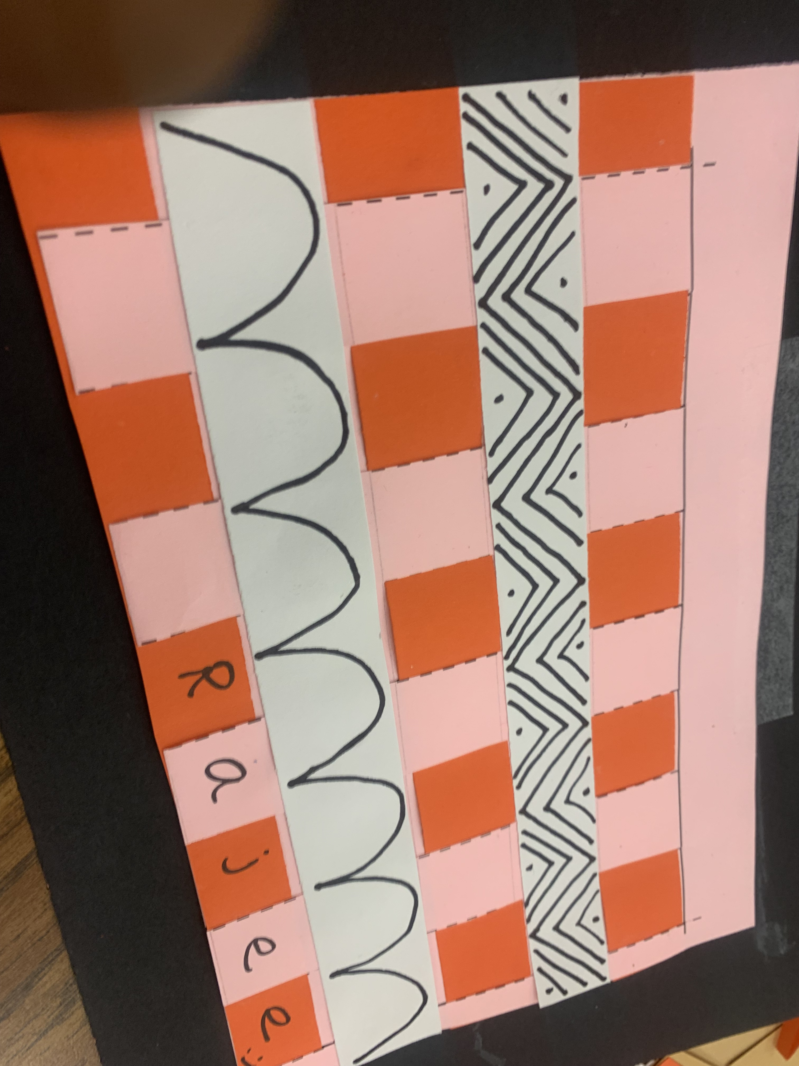
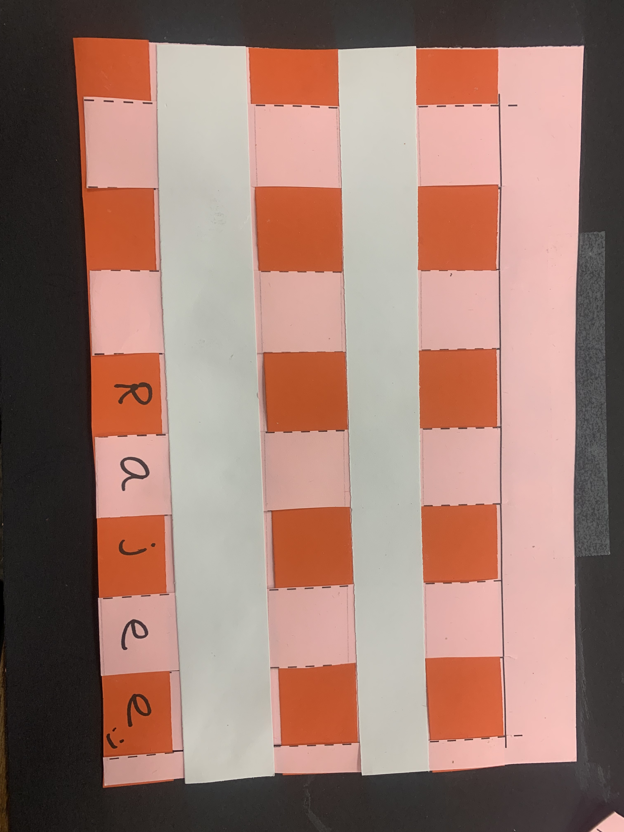
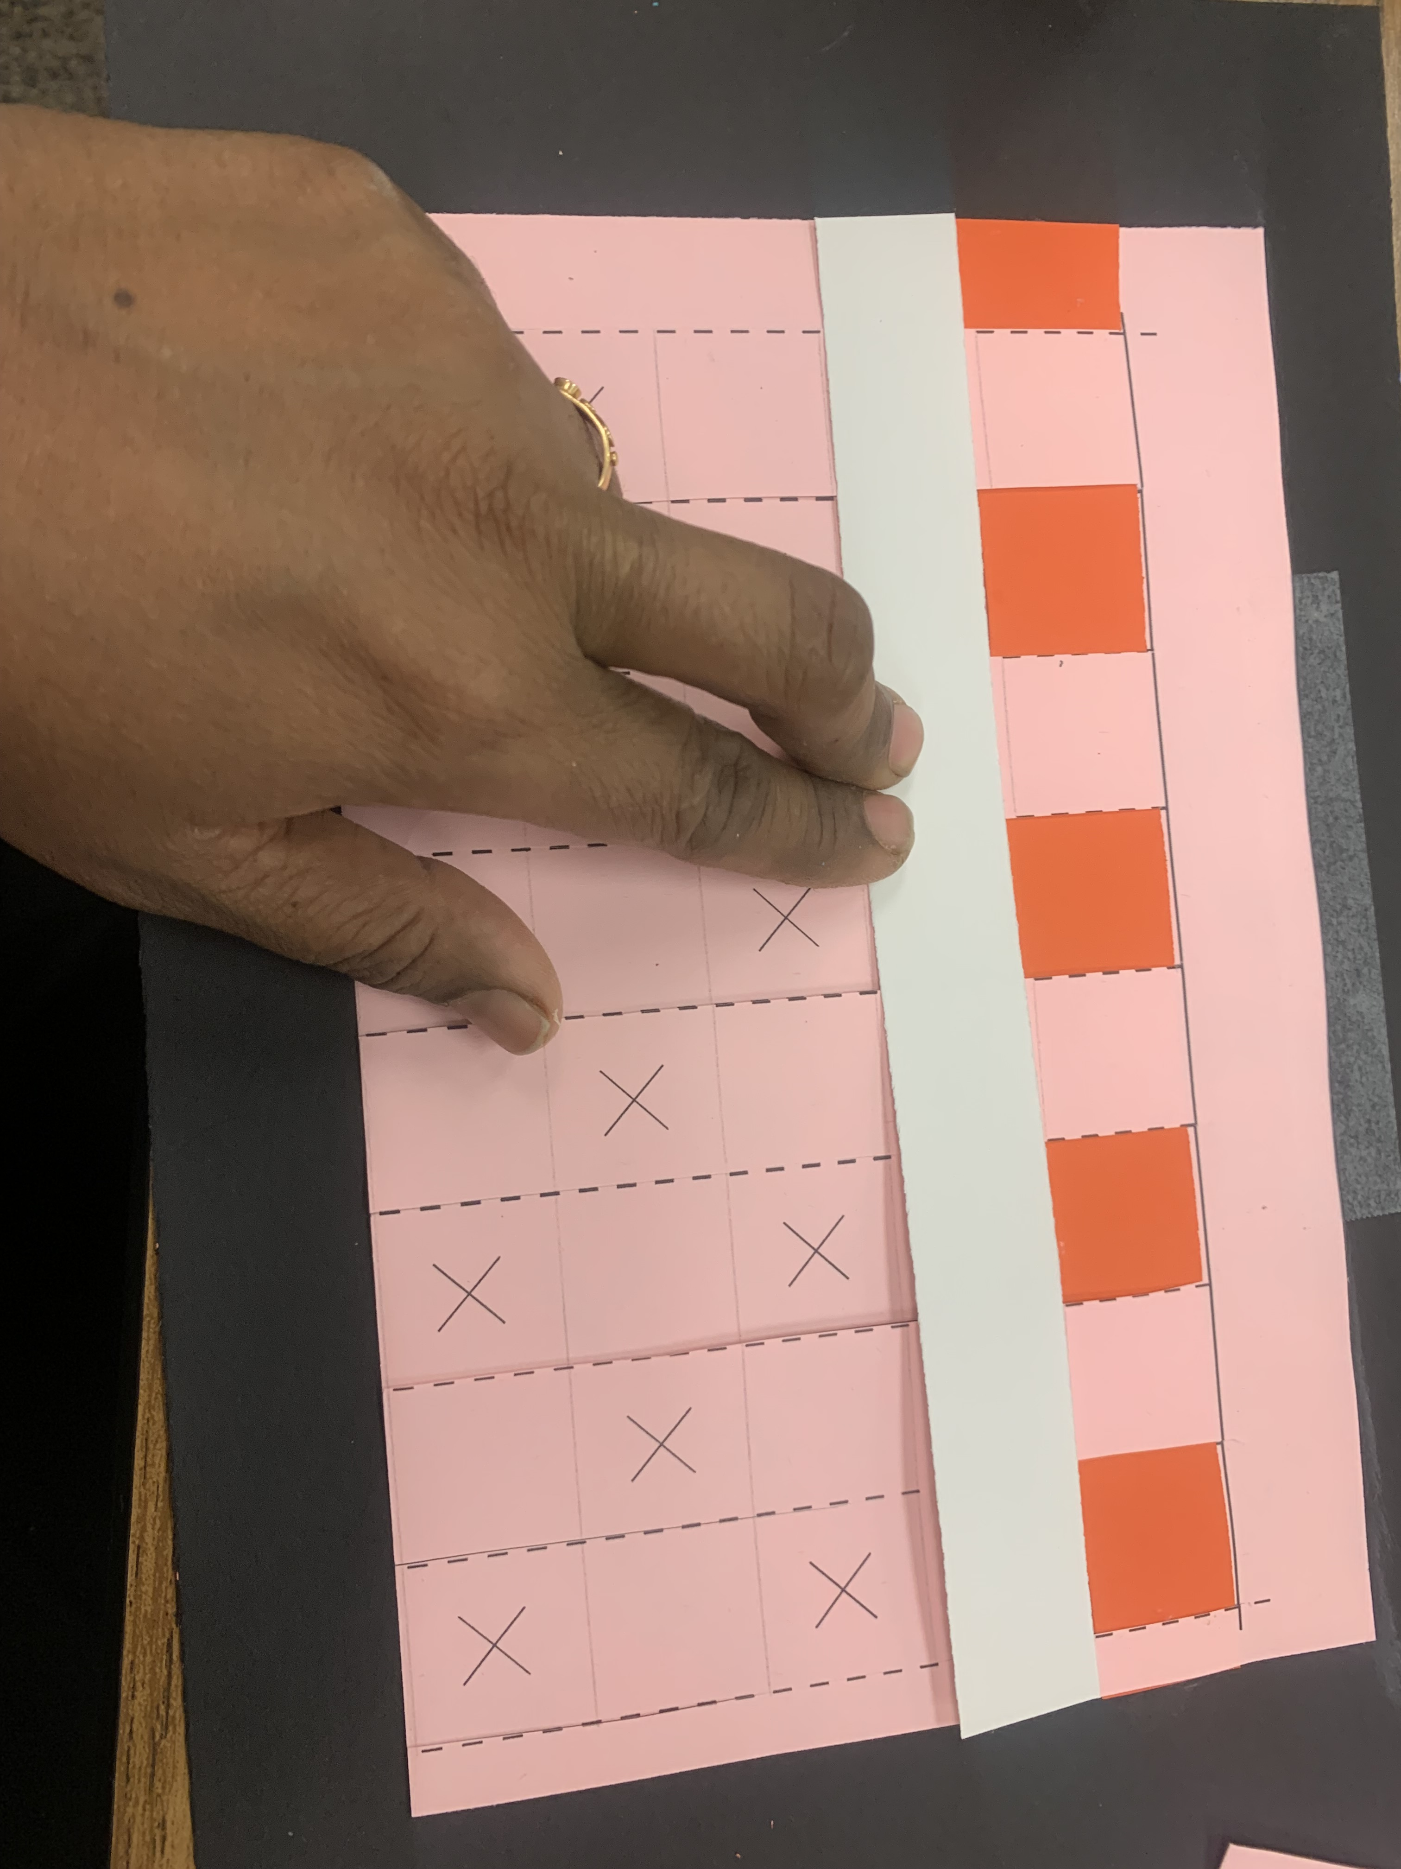
Procedure – TK, K
Weave all the way through and glue the edges
Glue down one white color strip over the printed paper to secure the first weave
Continue to do one more pattern and then write your name.
Add the pattens on the white strip.

