Slide 1
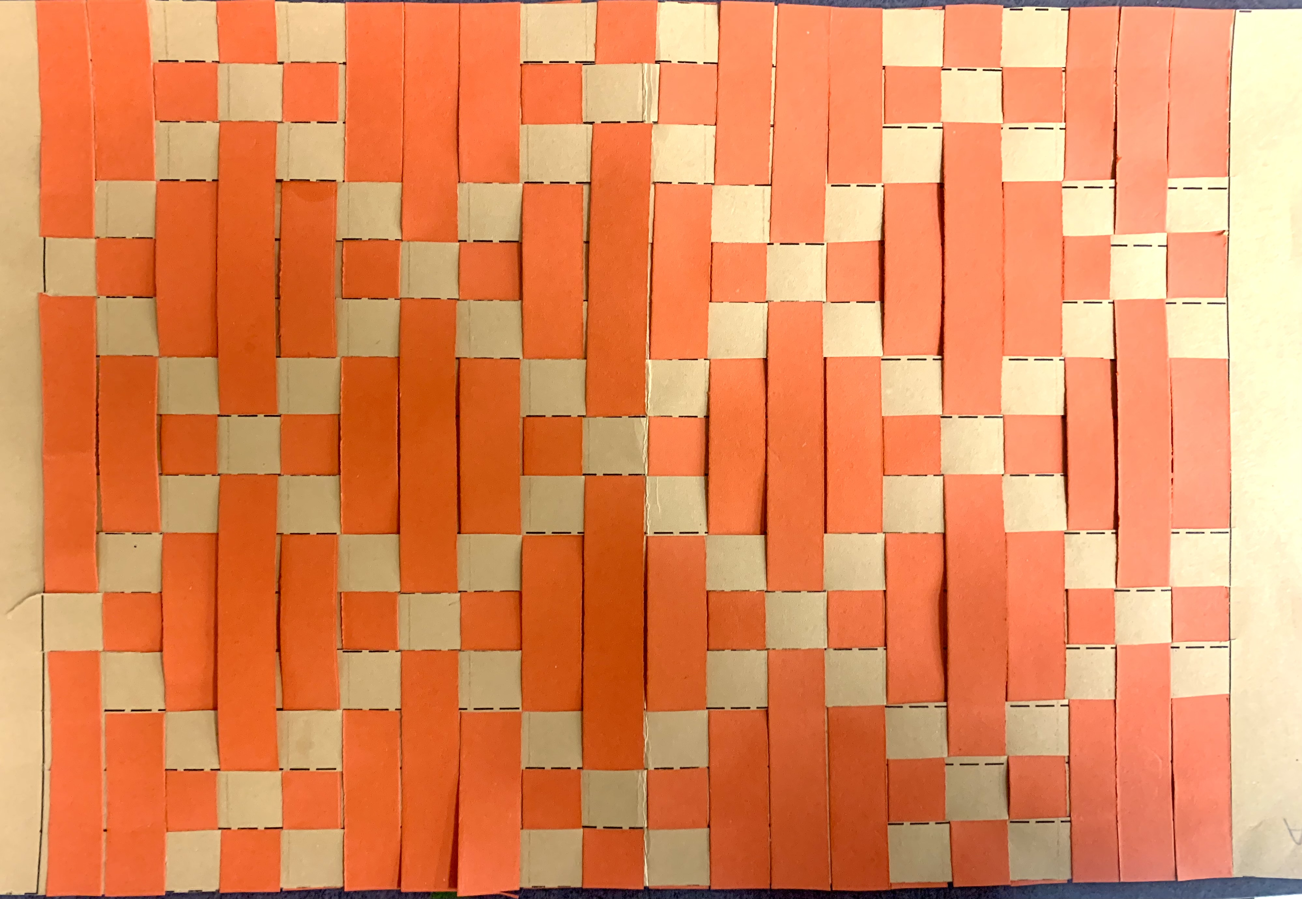
Kente paper weaving Grade 5
Quail Run Elementary
Rajee Subramanian

Slide 2
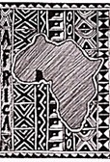
February – Black History Month
February is "Black History Month," a time to commemorate African-Americans who have changed the world.

Slide 3
February 2023 – Black History Month Theme ”Black Resistance”
The theme explores how "African Americans have resisted historic and ongoing oppression, in all forms, especially the racial terrorism of lynching, racial pogroms and police killings," since the nation's earliest days.

Slide 4
Importance of art in africa
To understand about a community of people we look into their culture and art heritage.
Art is understood as cultural transmission.
Among tribal communities, art is closely related to religious beliefs, and social interactions, and is an important part of the culture and daily life.
Tribal art is more expressive rather than representational.
Today we will learn about Ashanti tribal art from West Africa.

Slide 5
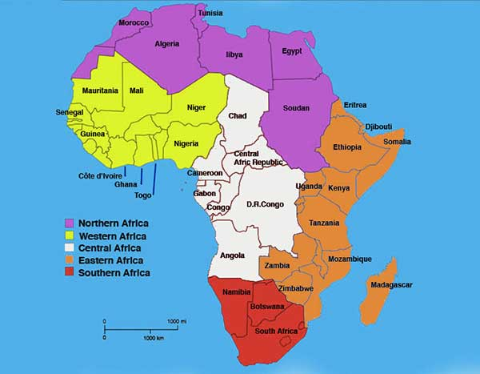
Did You Know???? Africa is the world’s second-largest continent.
It is more than three times the size of the United States.
Africa includes more than 50 countries.

Slide 6
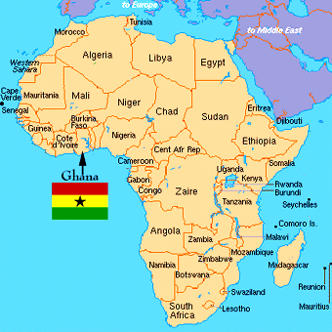
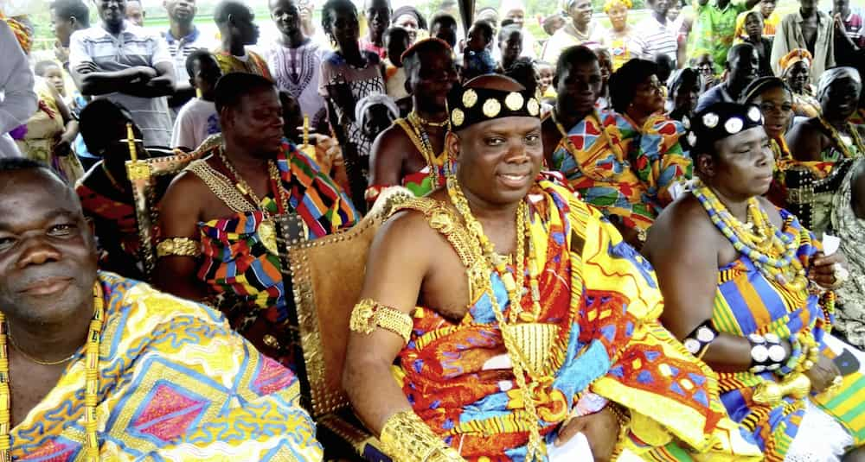
West African Region – Ghana – Ashanti People
Ashanti oral tradition and spiritual values build on the feelings of profound respect for the land, traditions, and culture.
Ashanti tribe, found in central Ghana, is the largest ethnic group of the Akan.

Slide 7
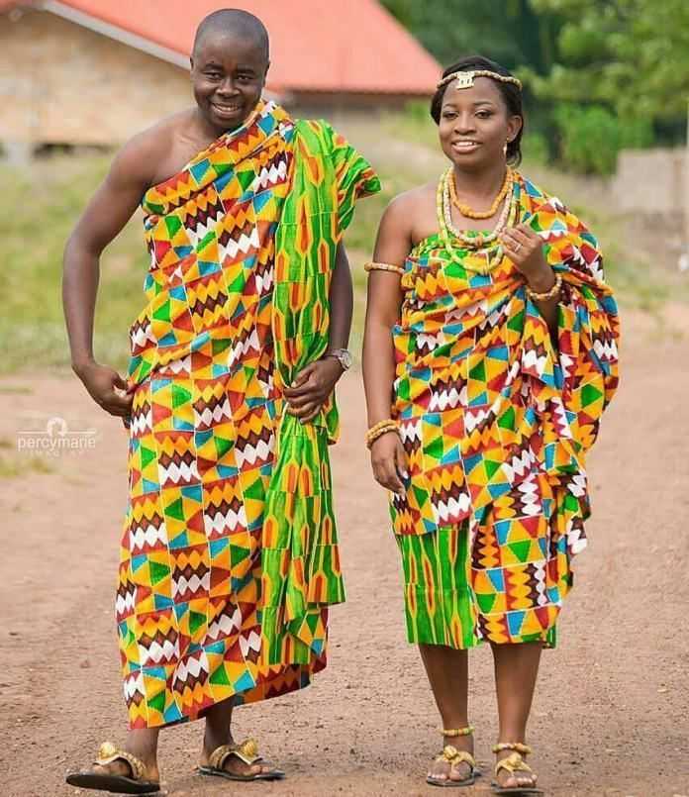
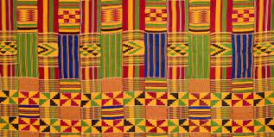
Kente Cloth Ghana – Ashanti People
- Weaving done by men in West Africa
–Woven in long narrow strips, then sewn together into large fabrics
–Traditionally worn draped across the shoulders
Kente Cloth were originally made only for Kings & Queens
National dress of Ghana – Worn for holidays
Popular with tourists
Kente cloth is statement of pride in African heritage.

Slide 8
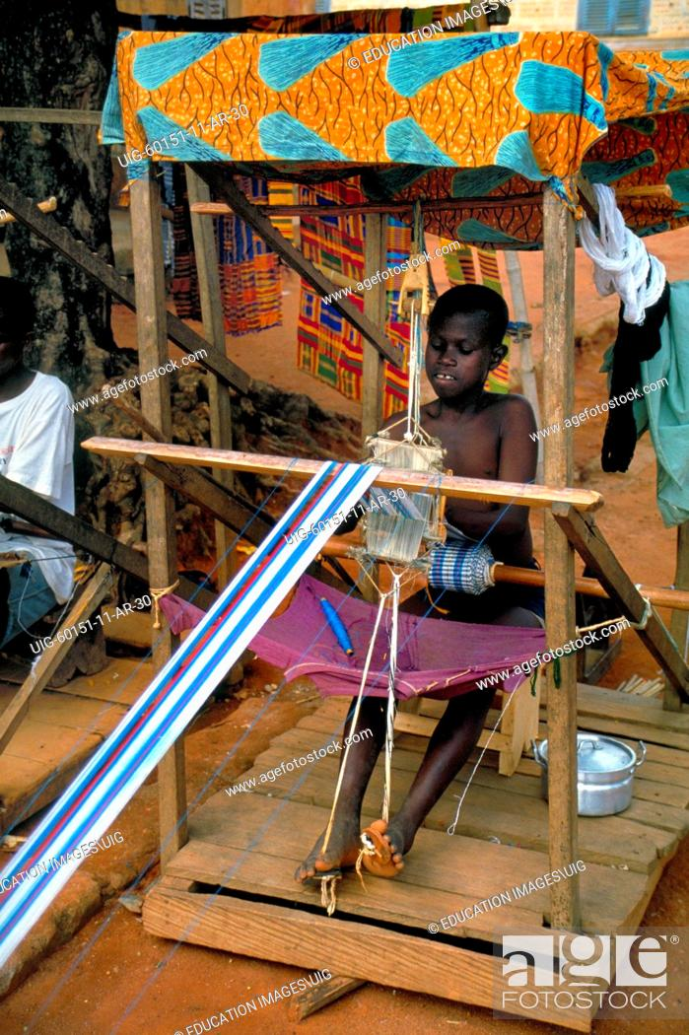
Kente Loom
Loom is a structure that holds the weaving together
Strip loom, upright loom, Standing loom, cardboard loom, Strip loom
Today we will use paper loom

Slide 9
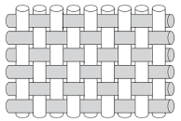
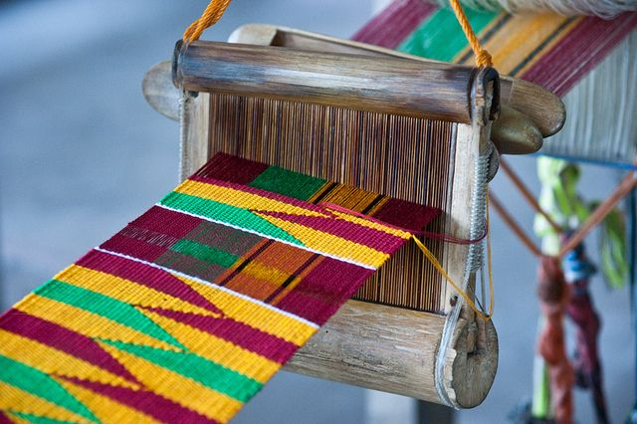
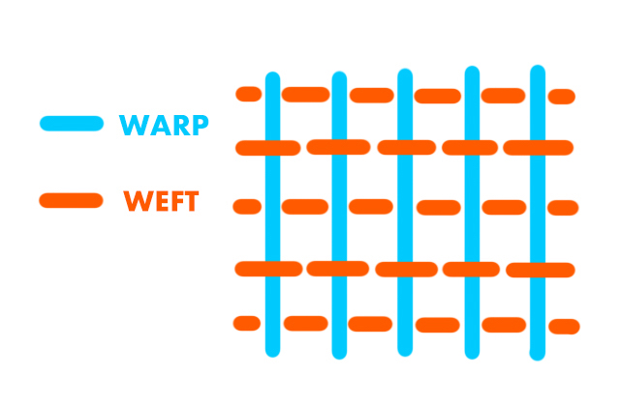
Kente Cloth Weaving
- Today we will use the simple pattern
- Under and over pattern
- Frist strip goes under then over
- Second strip goes over then under
Warp are the vertical long strips that is attached to the loom and will not move
Weft is the horizontal strips that moves under and over the long strips

Slide 10
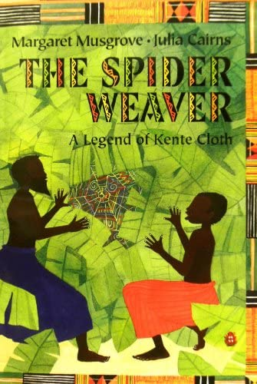
Literature Connection – The Spider weaver by Margaret Musgrove
https://www.youtube.com/watch?v=91yapOM7BzI

Slide 11
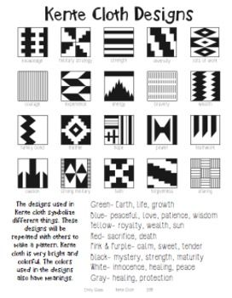
Art element & other learning
Patterns
Lines
Repetition
Geometry
Fine Motor Skills
Weaving techniques

Slide 12
Kente colors and patterns meaning
https://www.youtube.com/watch?v=w9CjQZ5DAto

Slide 13
Materials
Please do not mount it on the sheets, this project will be displayed on the in a protector sheet to expose the designs on both the sides.
Grade 5
9x12 colored printed template paper
1/2 inch different colored stripes 20 per student
Pencil
Pair of scissors
Glue stick 9x12 black paper
Sharpie

Slide 14
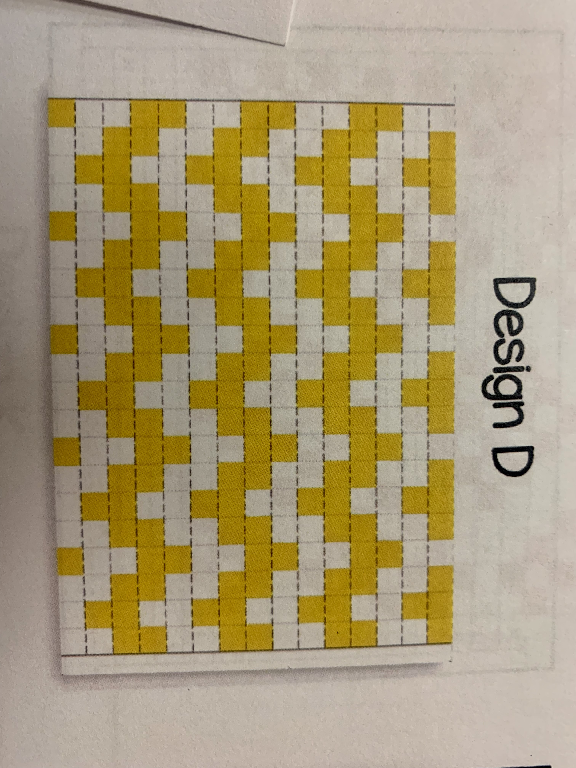
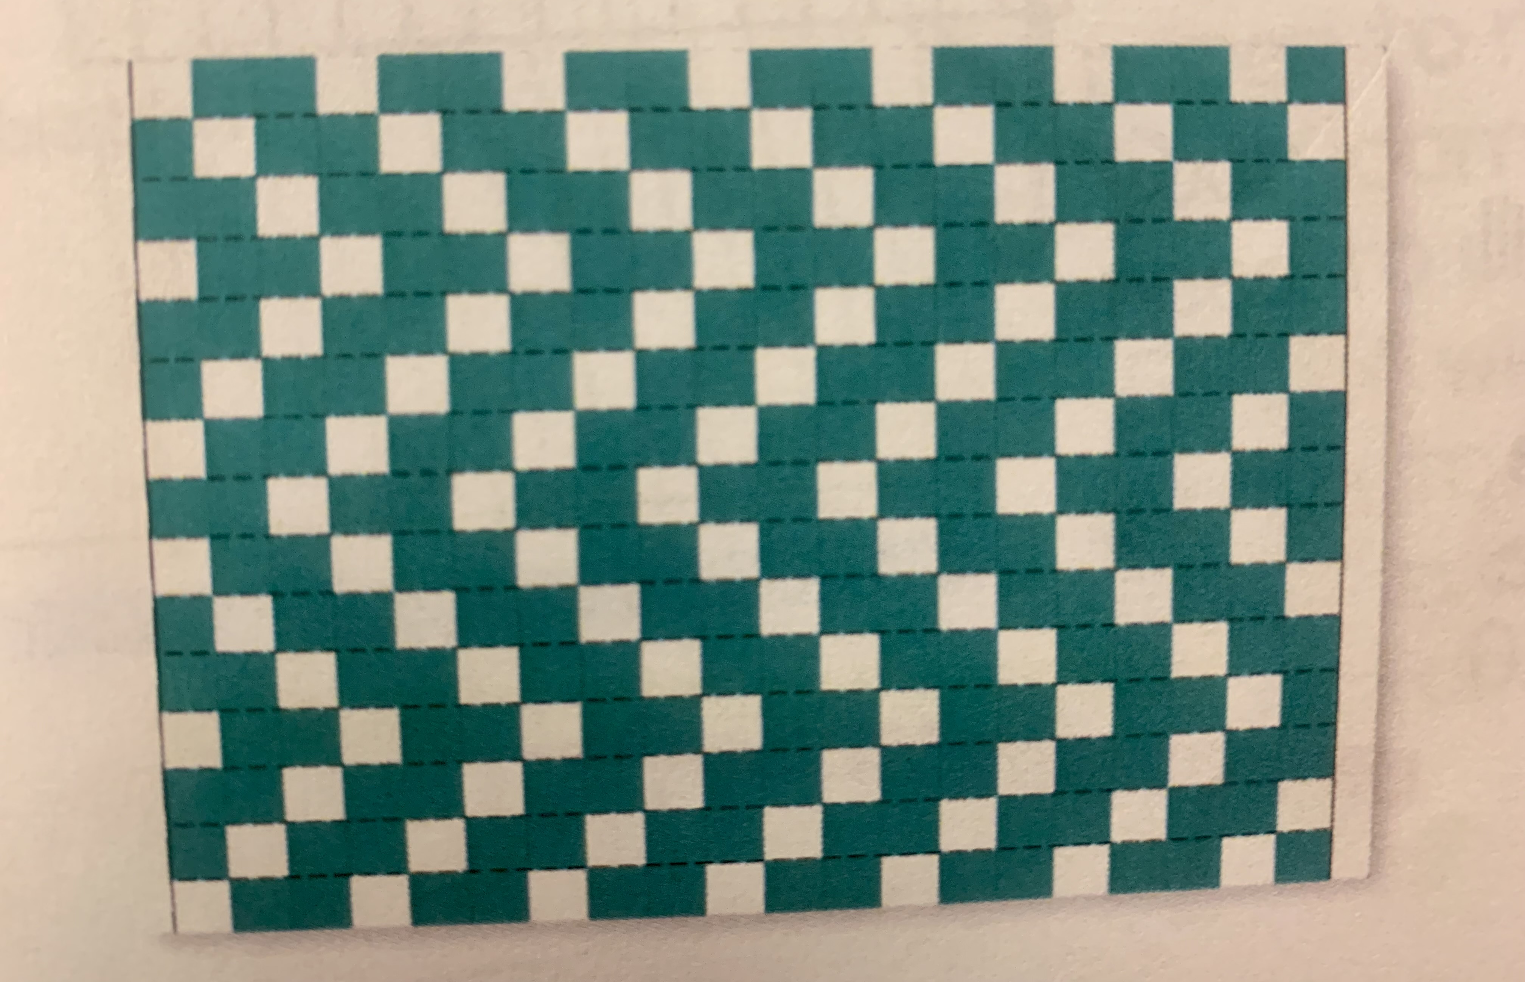
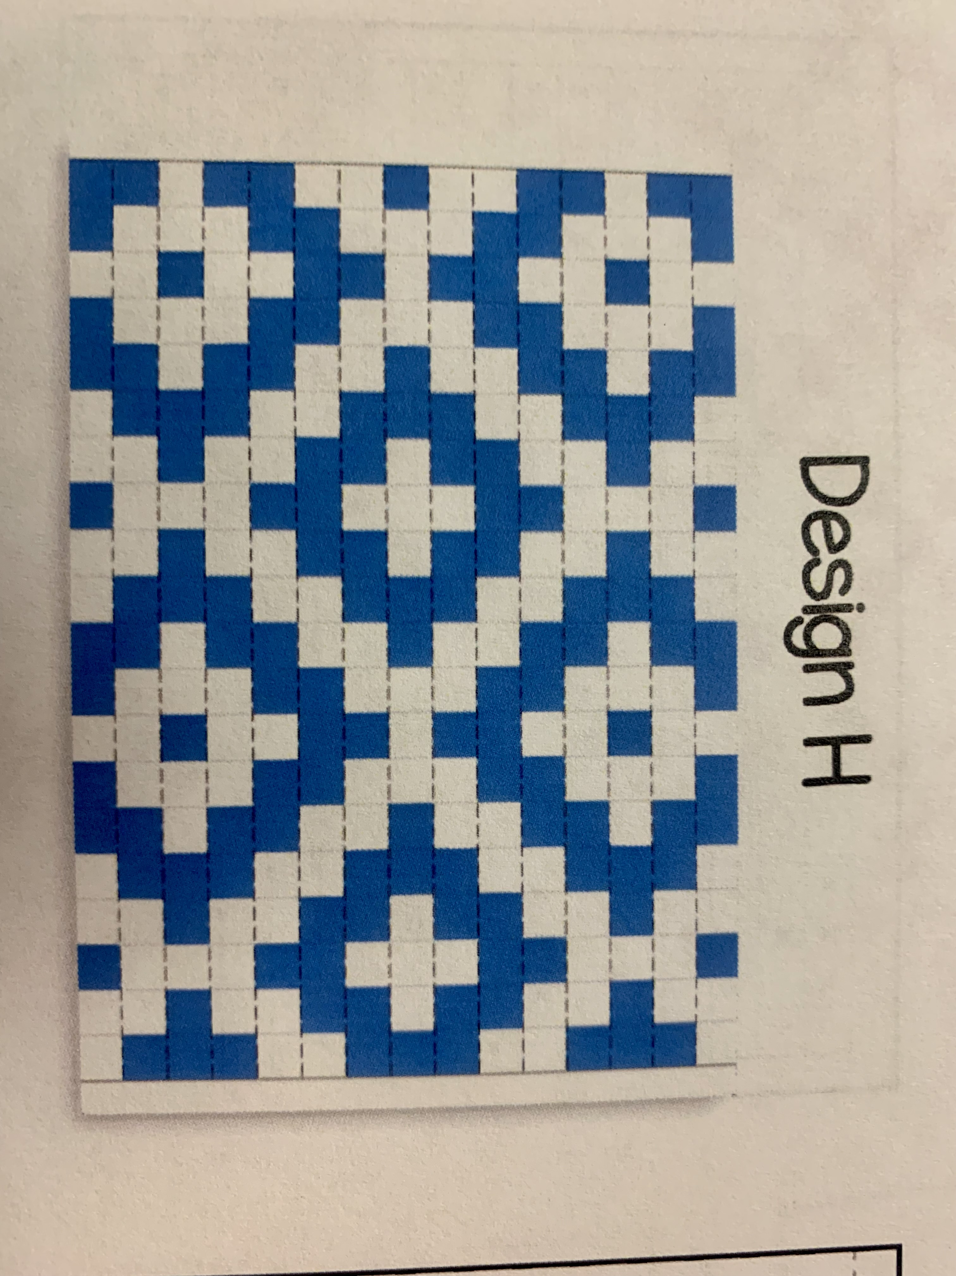
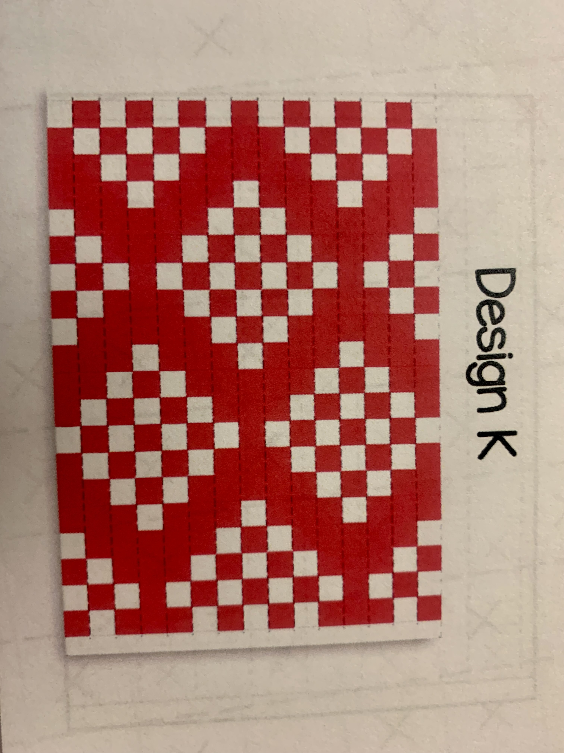
Grade 5
DESIGN D
DESIGN C
DESIGN A
DESIGN H
DESIGN K

Slide 15
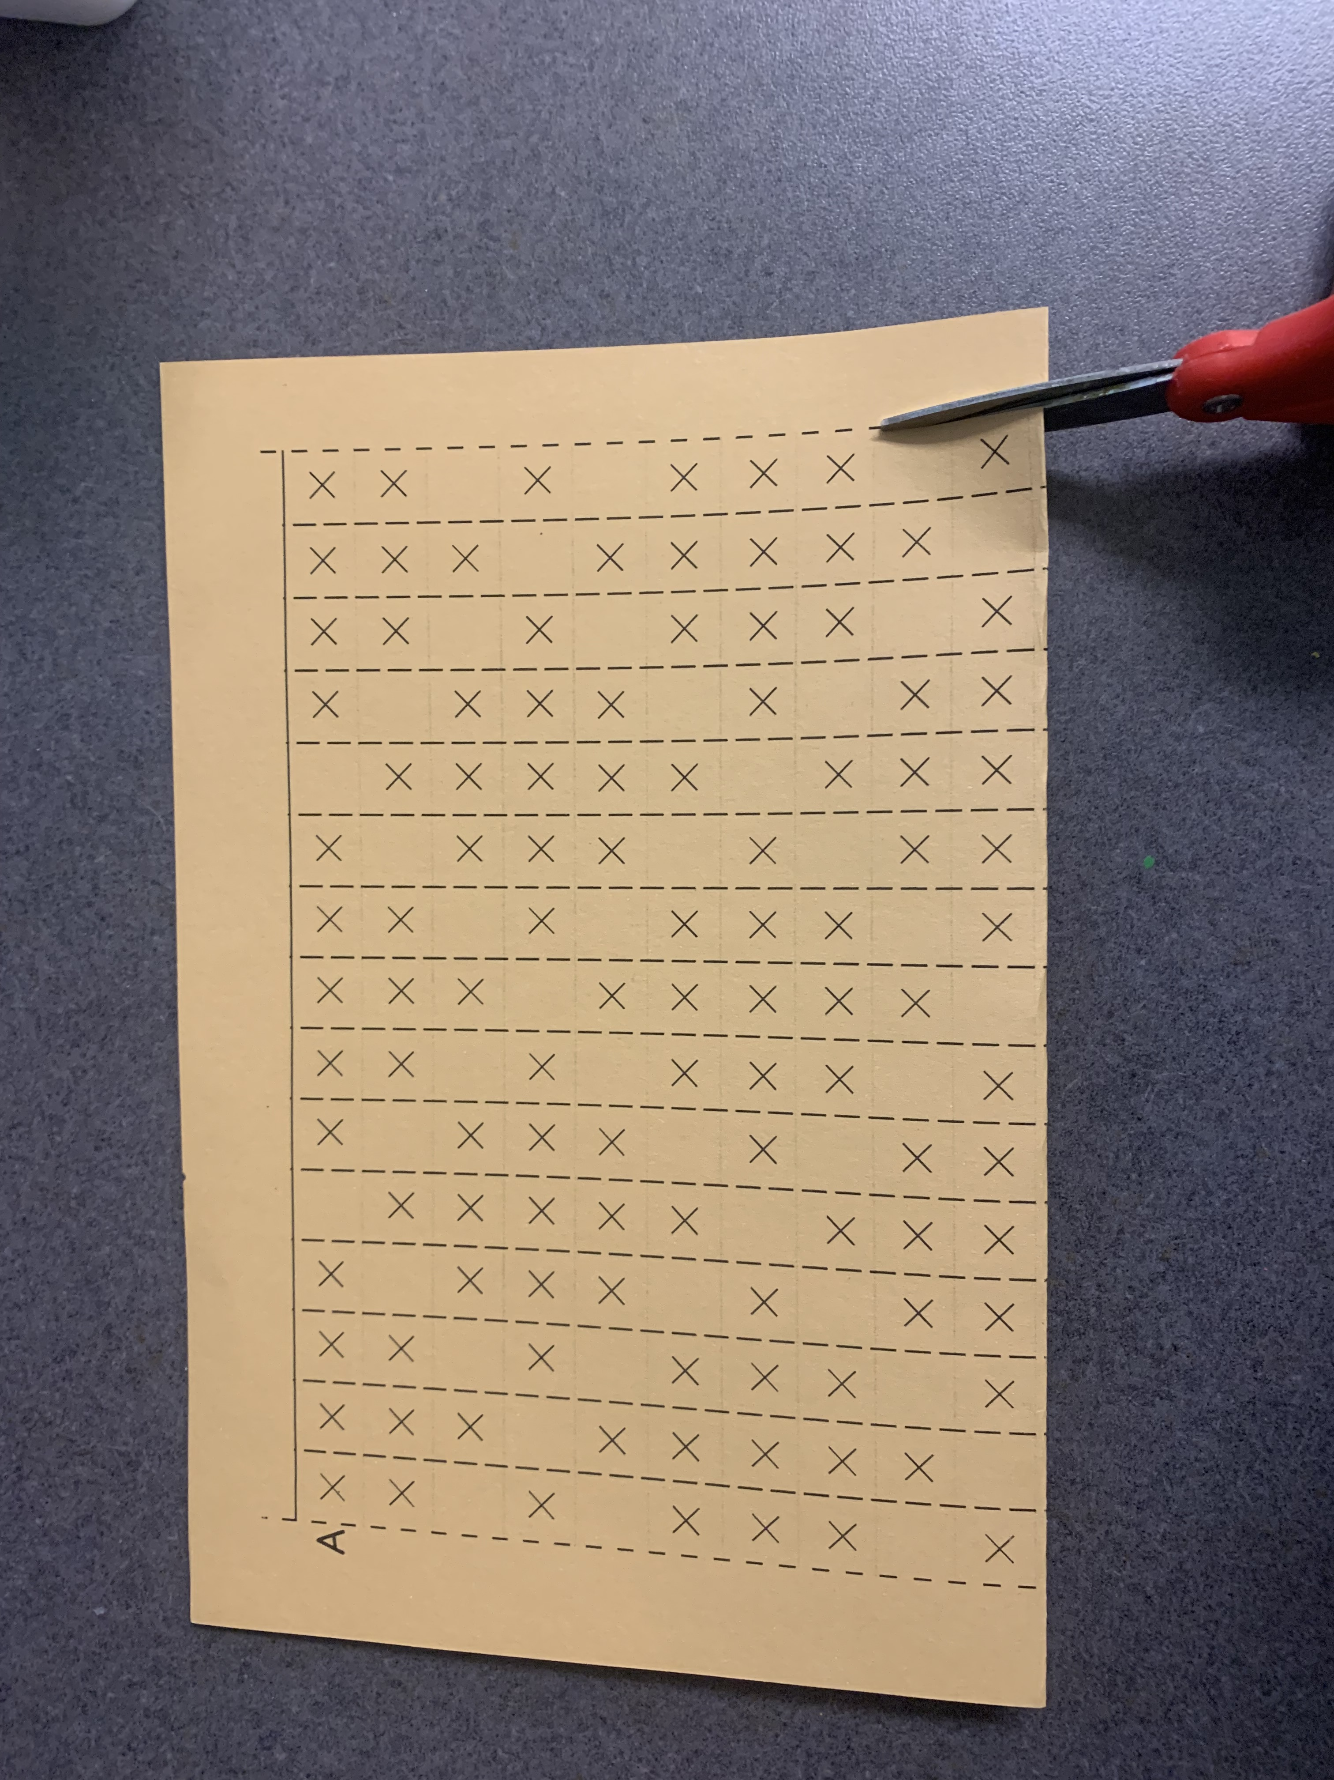
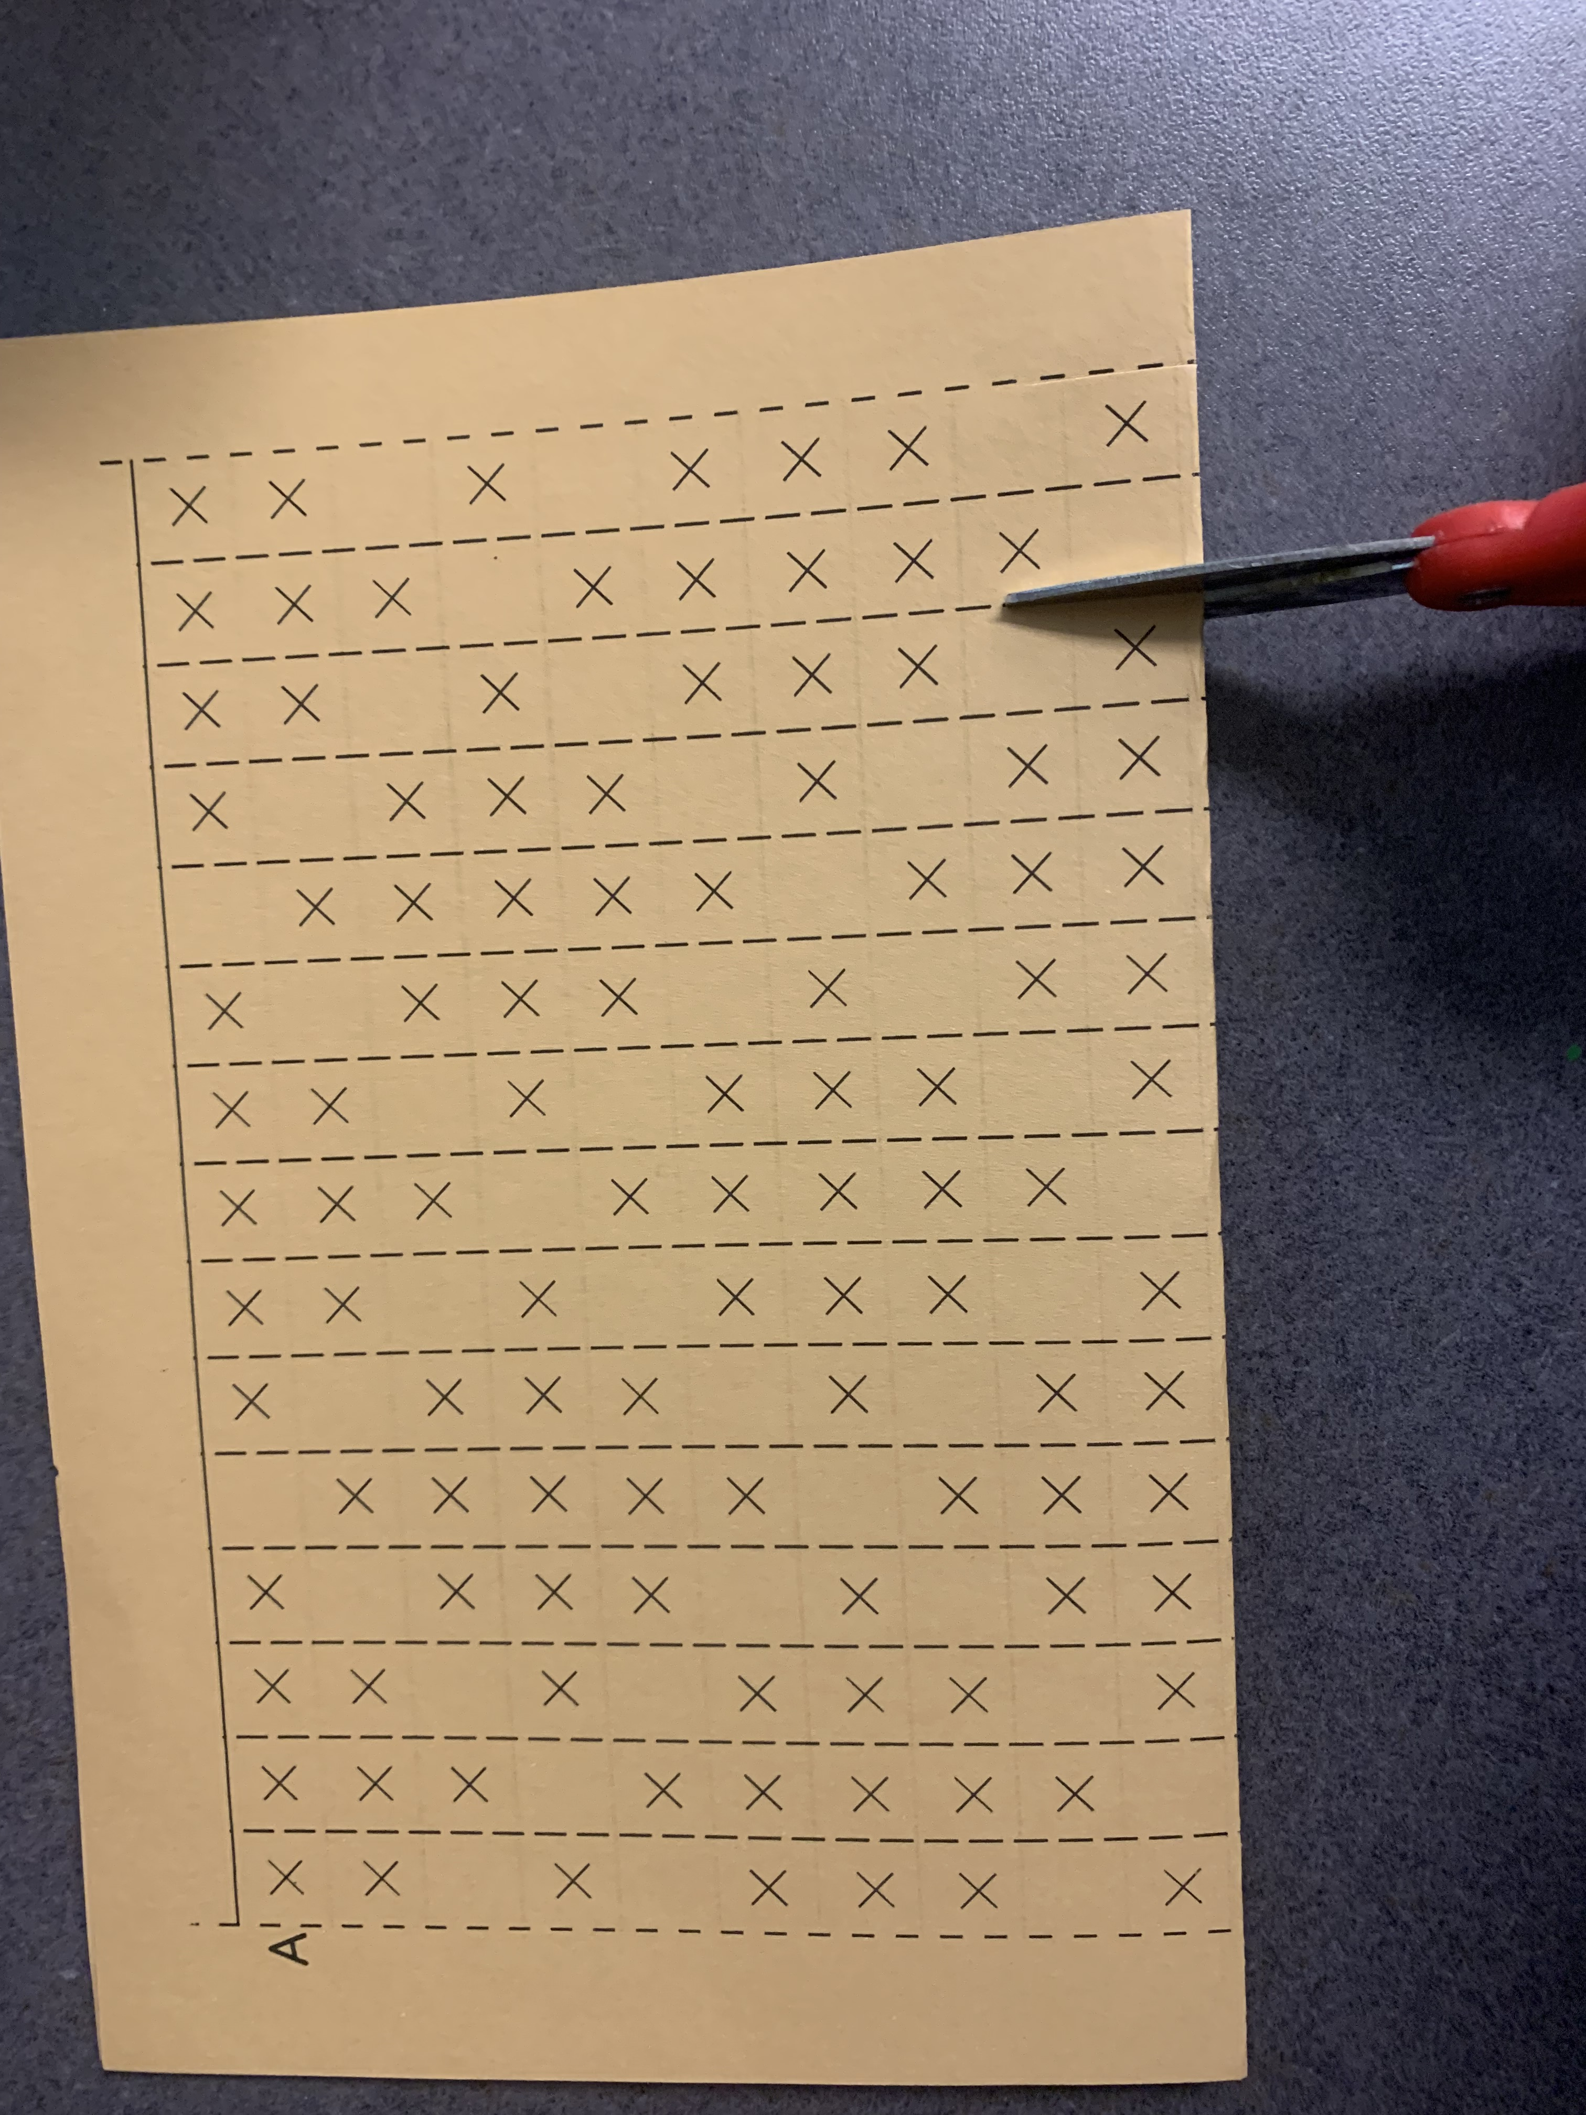
Grade 5
Cut from one side to the other
Fold color template in half - corner to corner
Starting from the folding side cut along the broken lines only until you reach the horizontal solid line on the top
IT IS VERY IMPORTANT THAT YOU CUT ALL THE WAY TO THE SOLID LINE, SO YOU HAVE ENOUGH SPACE AND YOU ARE ABLE TO WEAVE THE LAST STRIP WITHOUT ANY DIFFICUTY.

Slide 16
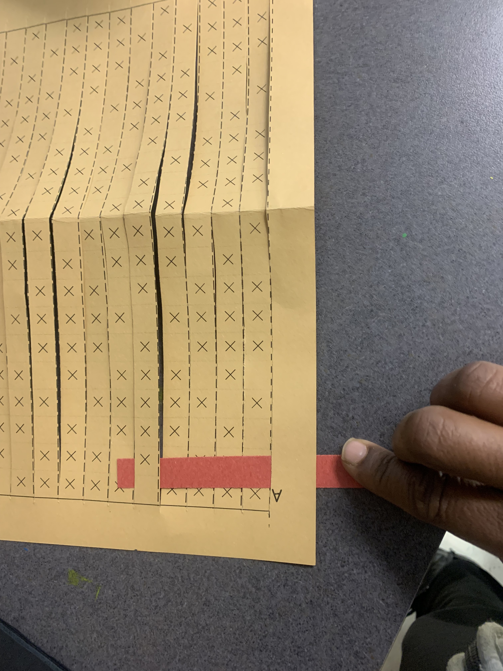
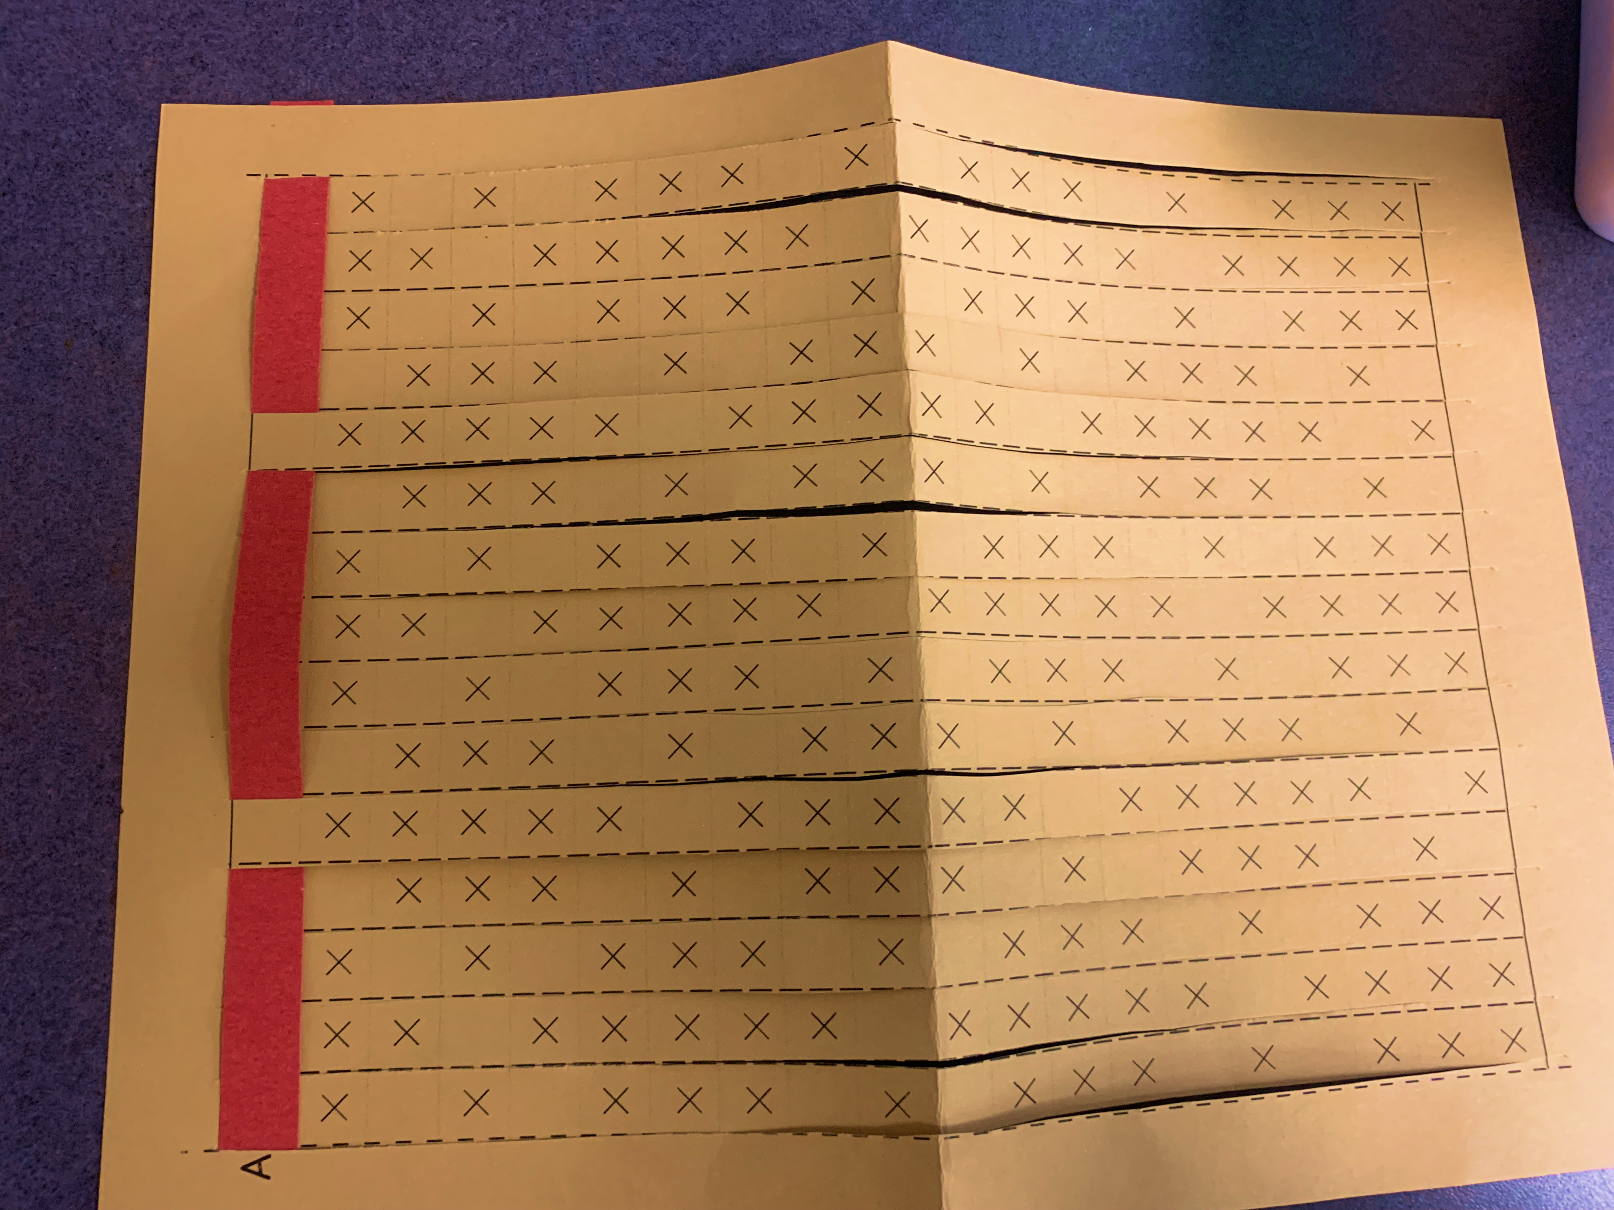
Grade 5
UNFOLD THE SHEET, Choose contrasting color WEFT strips. You can use different colors as you wish.
Weave your WEFT strip into your loom, you need to go under on the blank square and over on the squares that has “X” mark. (Basically you should hide the “X” space and display only the blank spaces)
As you weave make sure to push down on the strips to keep it with in the guided lines
Continue until you are done.
Glue the ends, write name – Flip the piece, glue on the other side ends too and analyze the changes. You can choose to have your name on both sides.
Draw kente patterns with sharpie as time permits on the colored space

