Slide 1
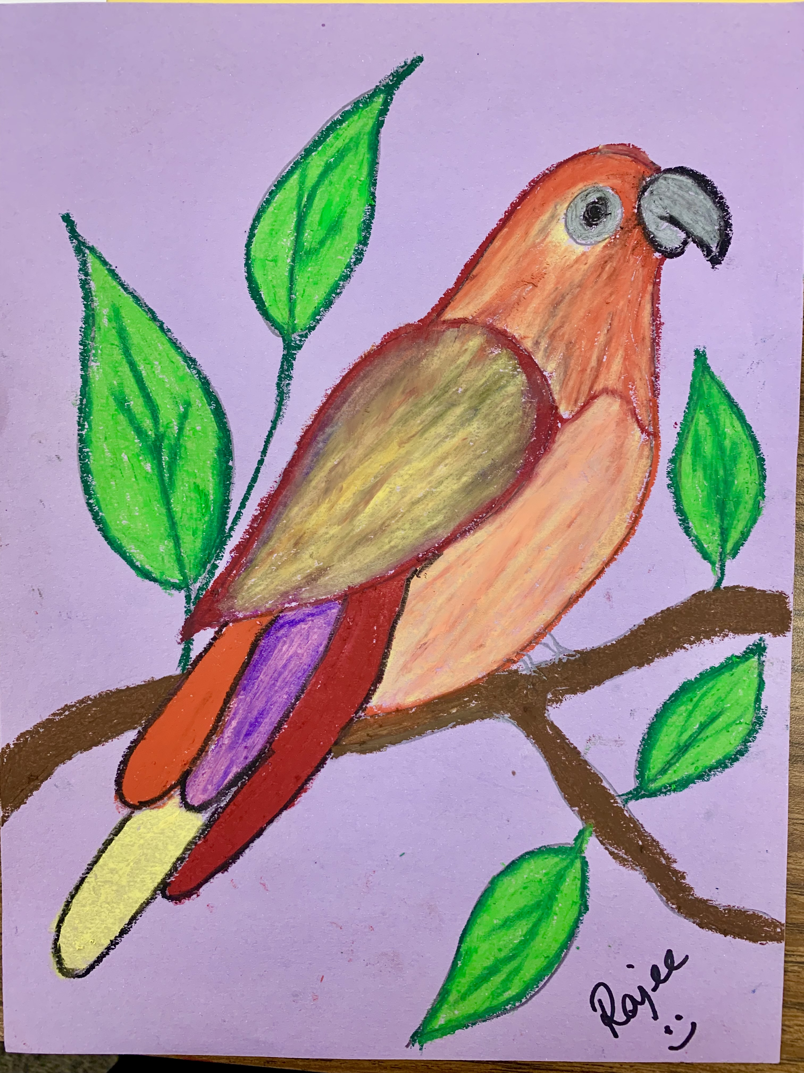
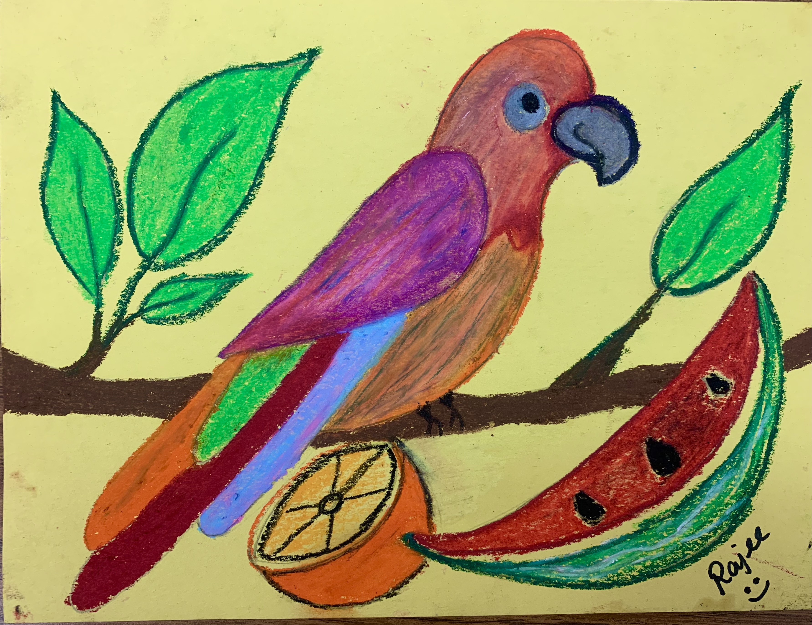
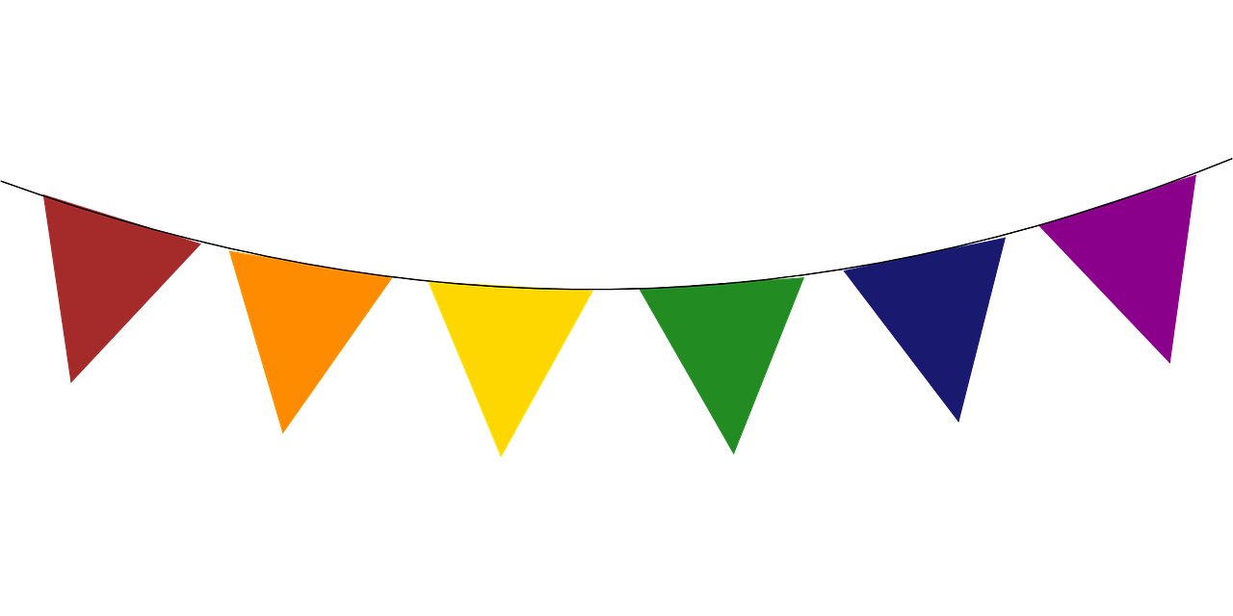
Frida’s still life
October 2022
Rajee Subramanian

Slide 2
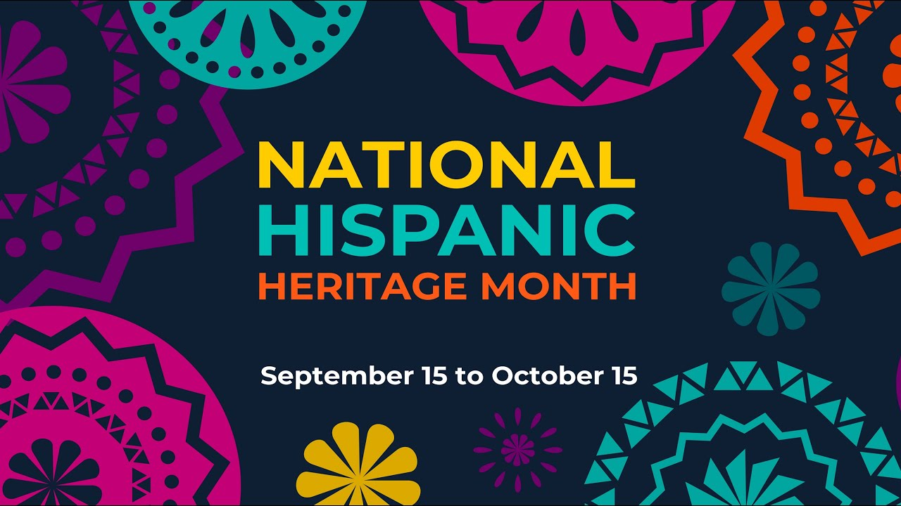
Inspiration: Hispanic heritage month
September 15 – October 15
Celebrate the history, heritage, culture and contribution of American citizen whose ancestors are from Spain, Mexico, Caribbean, Central and South America.
Celebration through Aztec - Mexican cultural art in QR
Frida is very proud to be a Hispanic descendant – loves her culture

Slide 3
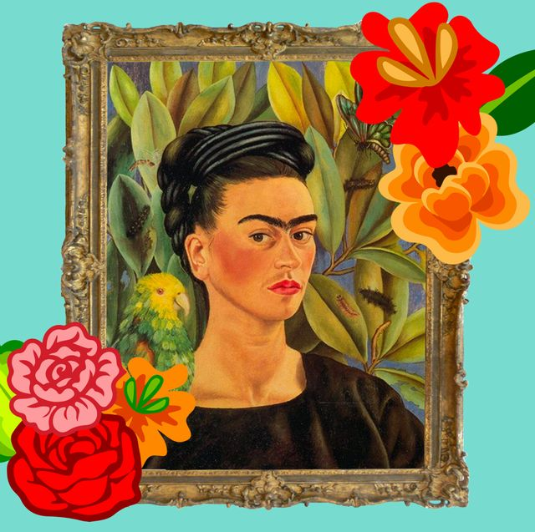
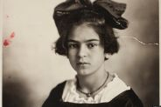
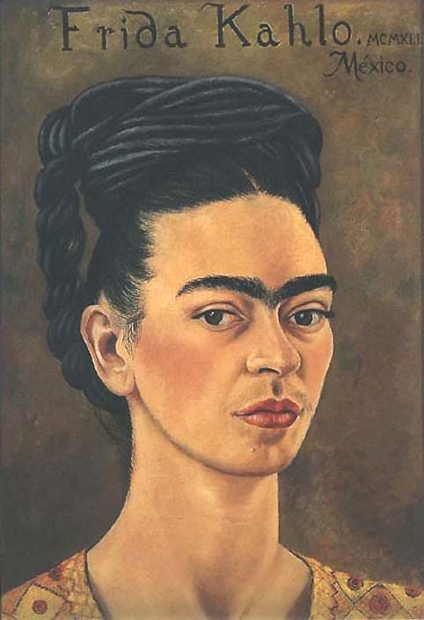
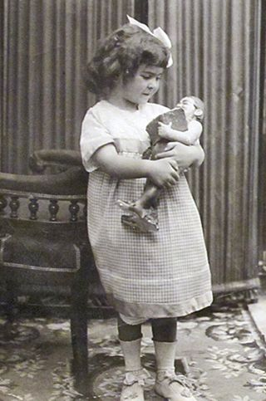
Frida Kahlo
Lived from 1907 – 1954 (47 years old)
Born in Coyoacan, México
Famous Artist

Slide 4
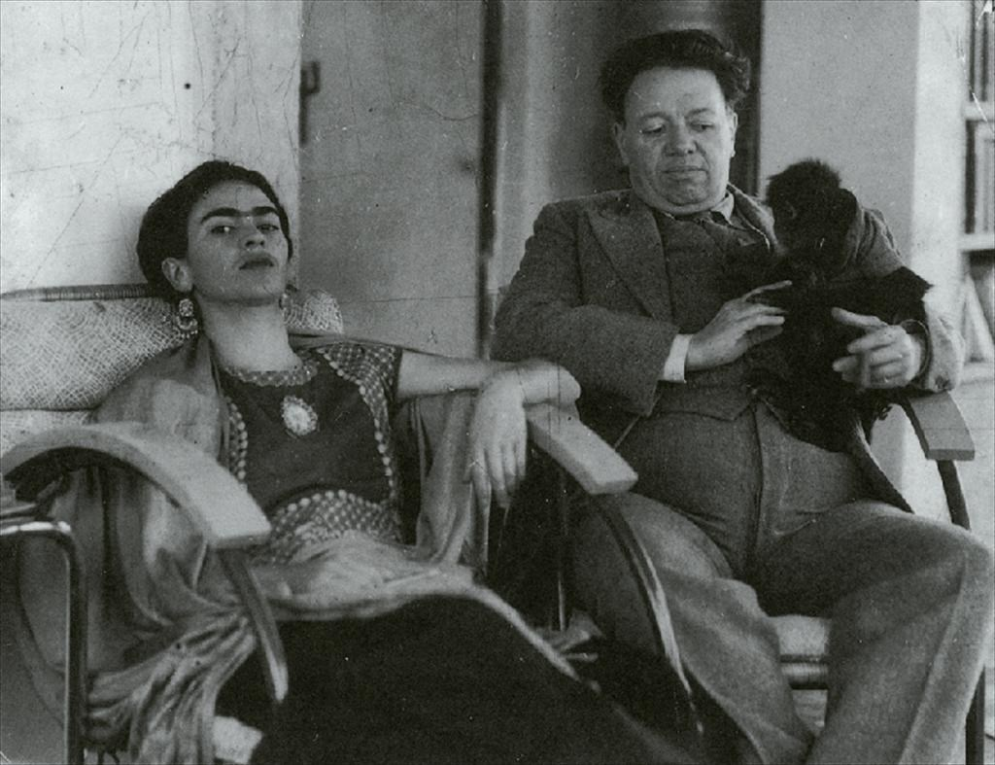
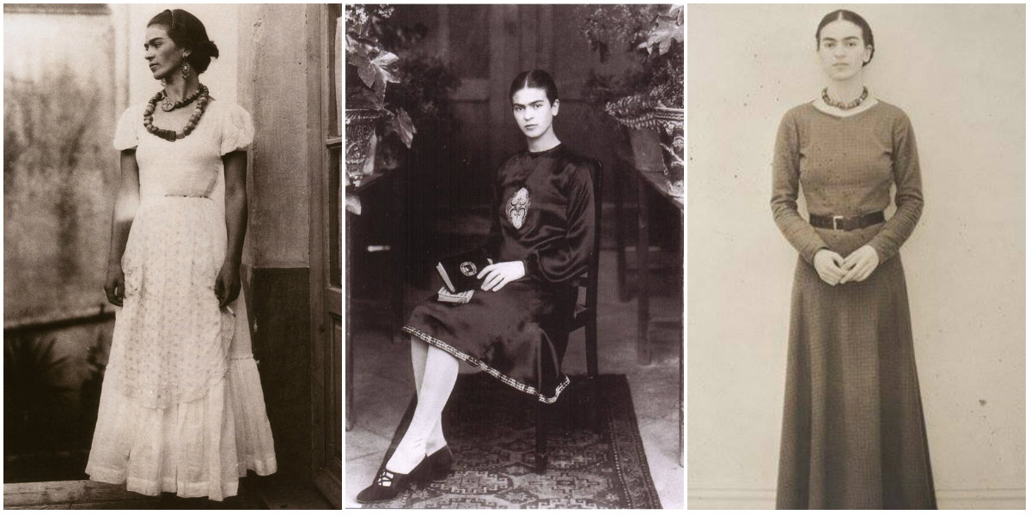
Life and Love
Attended a school with only 35 girls, noticed for being different/rebellious
Involved in sports like swimming, soccer & wrestling
Married Diego Rivera, famous Mexican painter
Painted 143 paintings, 55 being self-portraits
Often painted from bed due to physical injuries

Slide 5
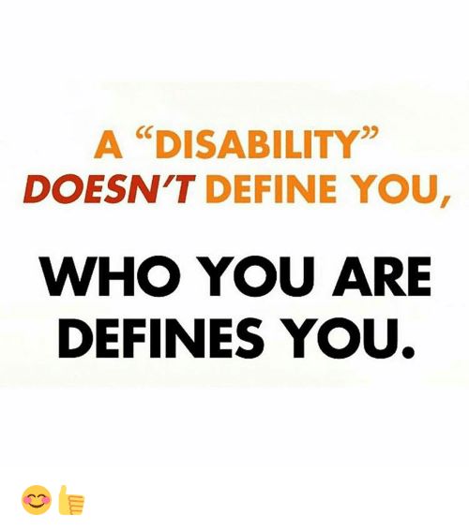
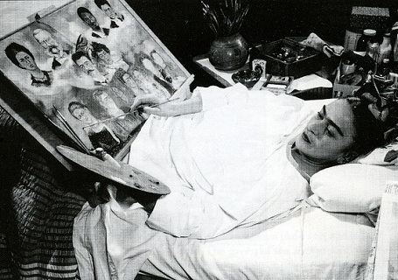
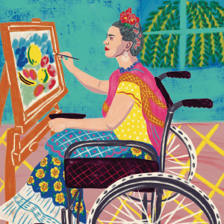
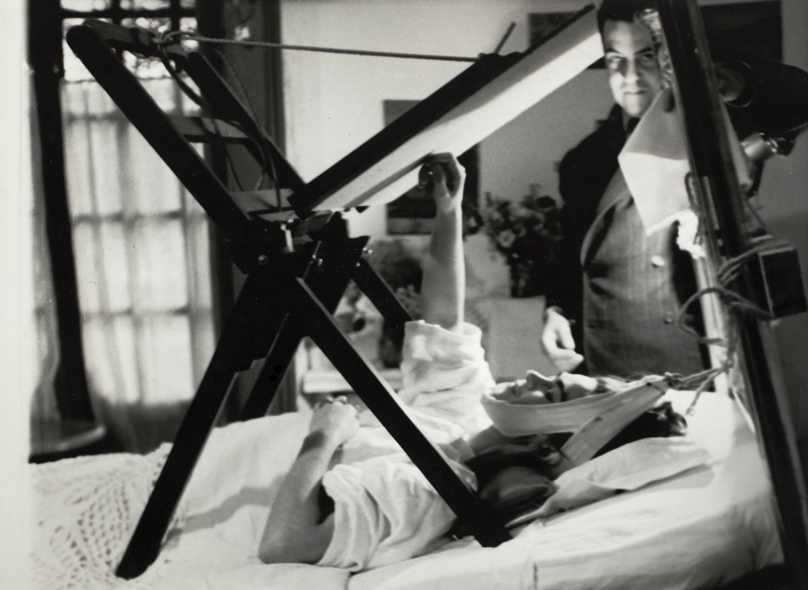
Disability Awareness
Disability is not a barrier!
Kahlo’s life challenges
Polio at age 6
Bus accident (spinal and pelvic damage)
Endured 32 surgeries

Slide 6
Literature
Frida Kahlo and her Animalitos
https://www.youtube.com/watch?v=aeGm_6HNh3k

Slide 7
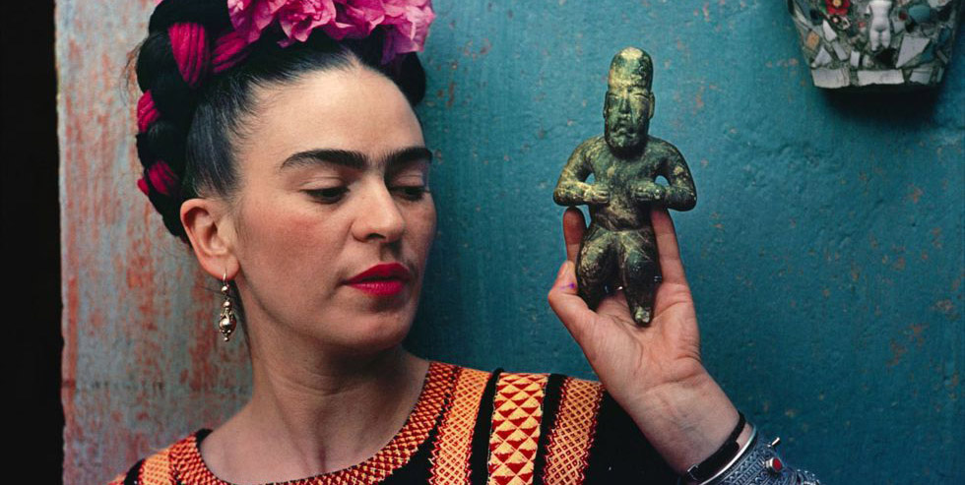
What can we learn from Kahlo’s life
Embrace what makes you different, even if the world sees it as odd. ... Her unibrow states self acceptance
Life is tough, but so are you. ... Her multiple physical challenges
Embrace and Love Your Roots. ... Her love for her culture
Live Colorfully. ... Her love for bold bright colors and nature
Feel Your Feelings (And Don't Apologize For It)… Express your true self

Slide 8
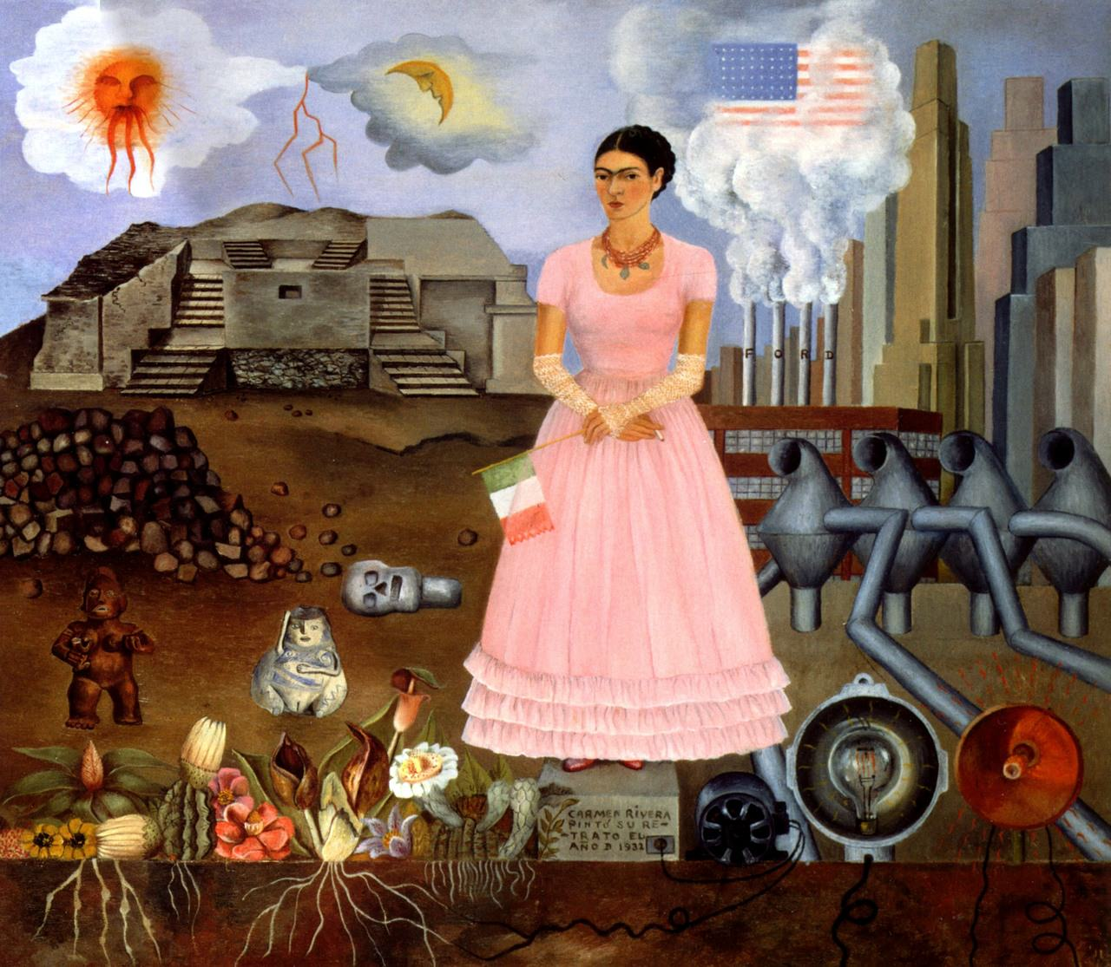
Her Artwork & Style
Often portrays both physical and emotional trauma
Mistaken for surrealism but she painted her worries Objectifies feelings (using physical objects to represent something bigger)
Usually uses a variety of colors
Self Portrait Along the Boarder Line Between Mexico and the United States

Slide 9
Self Portrait with Thorn Necklace and Hummingbird-1940
The thorn necklace describes pain and her worries

Slide 10
The Two Fridas- 1939
The reason behind this painting was said that it originated from her memory of an imaginary childhood friend.
Later she admitted it expressed her desperation and loneliness with the separation from Diego.

Slide 11
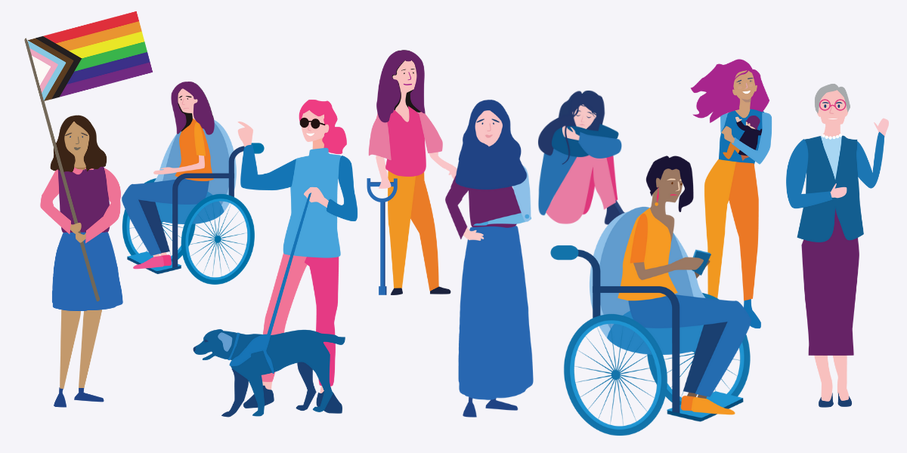
Frida Kahlo is an iconic symbol in today's world
Frida Kahlo stands today for much more than art
She is a symbol and an icon of feminism
Known as a heroine of the disability rights movement
Known for anti-racism movements
Supporter of LGBT communities

Slide 12
VIVA LA VIDA – Long live life

Slide 13
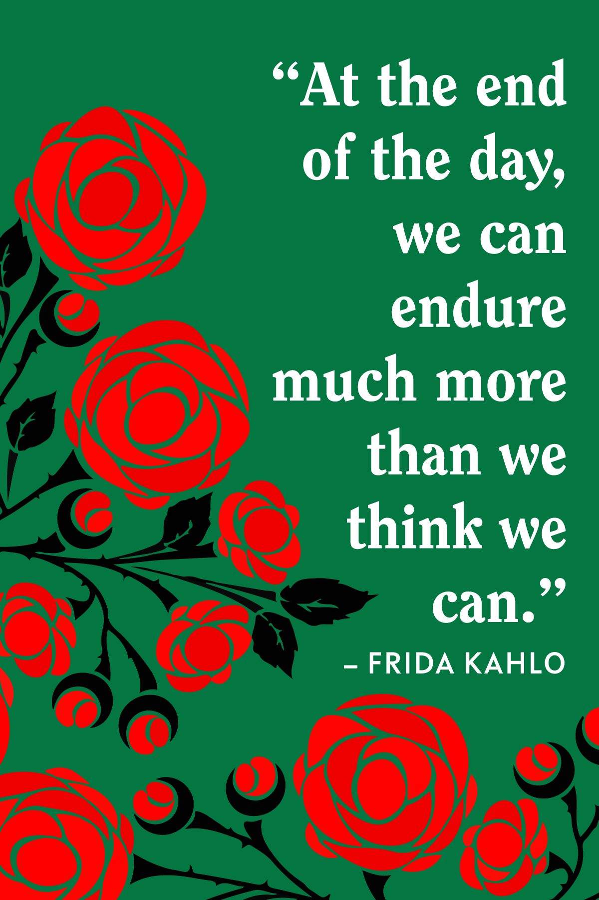
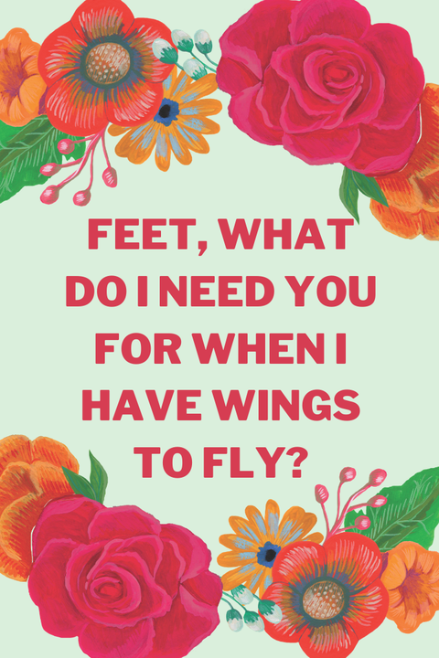
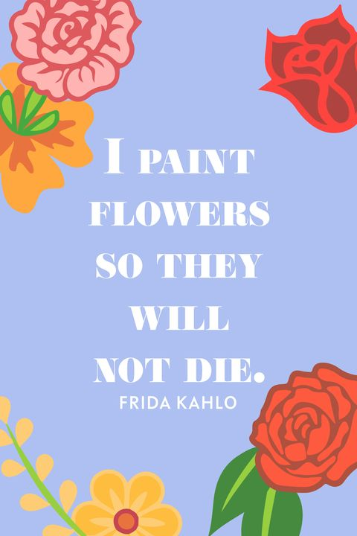
Frida’s Quotes
"I paint myself because I am often alone and I am the subject I know best.”

Slide 14
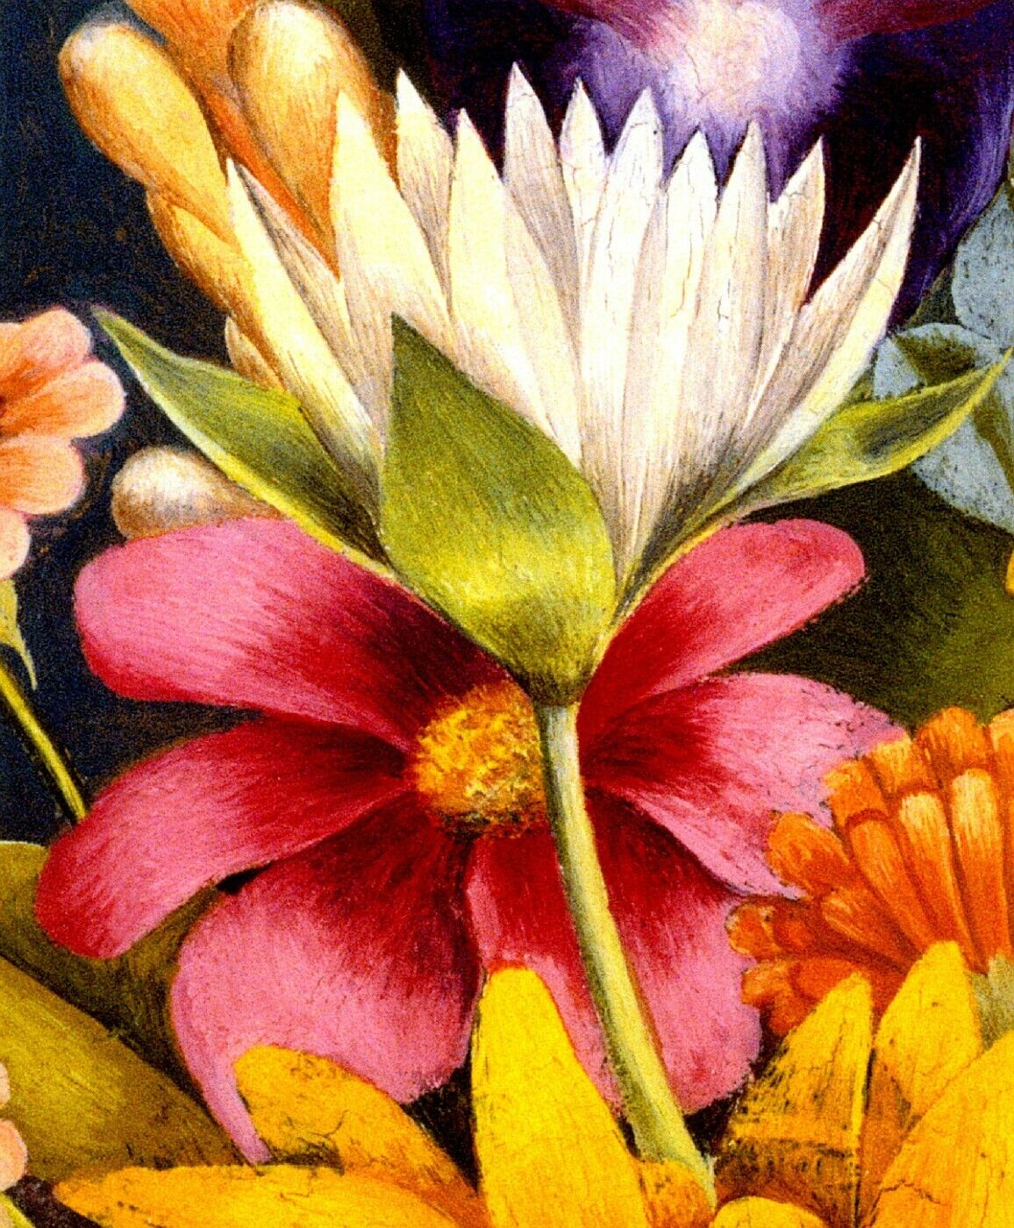
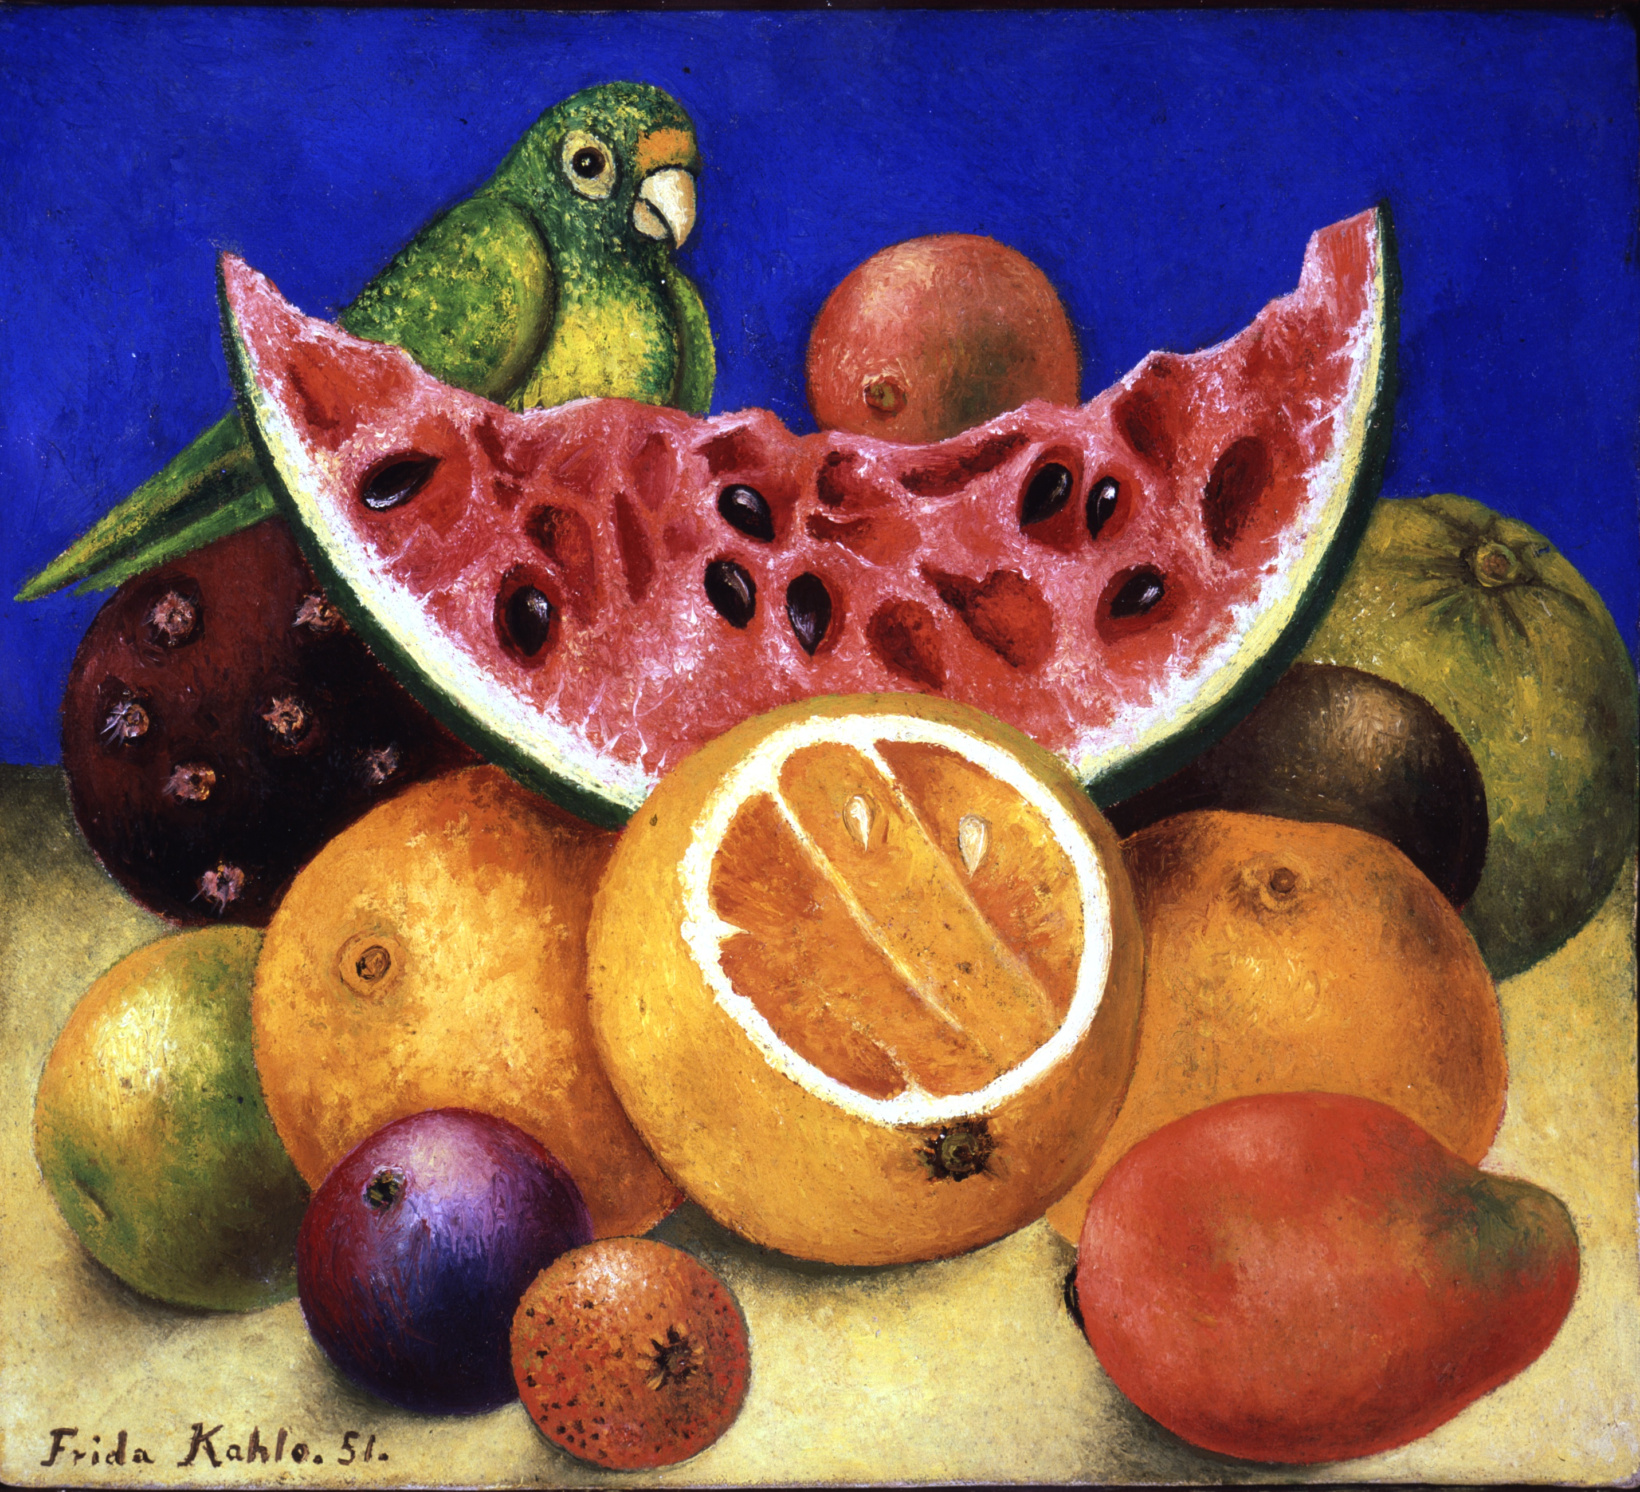
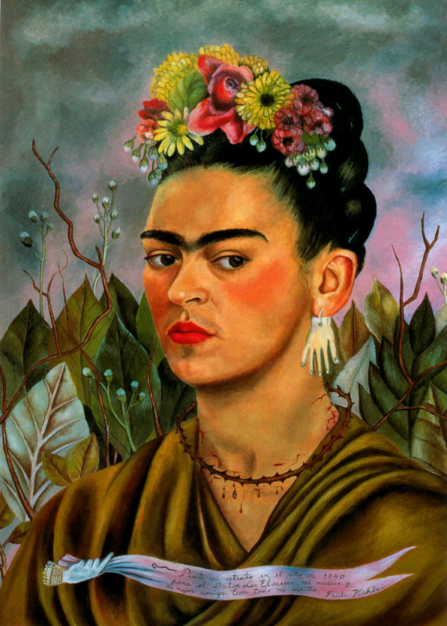
Subject – Fruits, Birds, Flowers
See how the fruits are overlapped in the fore ground.

Slide 15
Art Learning -
Lines drawing
Oil pastel
Background
Foreground
Middle ground
Blending oil pastel colors
Still life

Slide 16
Materials Grade 3 & Grade 4-5
Grade 3
Purple construction paper
Oil pastels
Sharpie (Classroom)
Glue
Q tip
Vaseline & Craft stick
line sheet steps
white practice sheet,
Pencil & eraser (Classroom)
Grade 4/5
Purple or blue construction
Oil pastels
Sharpie (classroom)
Glue
Q tip
Vaseline & Craft stick
lines sheet steps
white practice sheet
Pencil & eraser (Classroom)

Slide 17
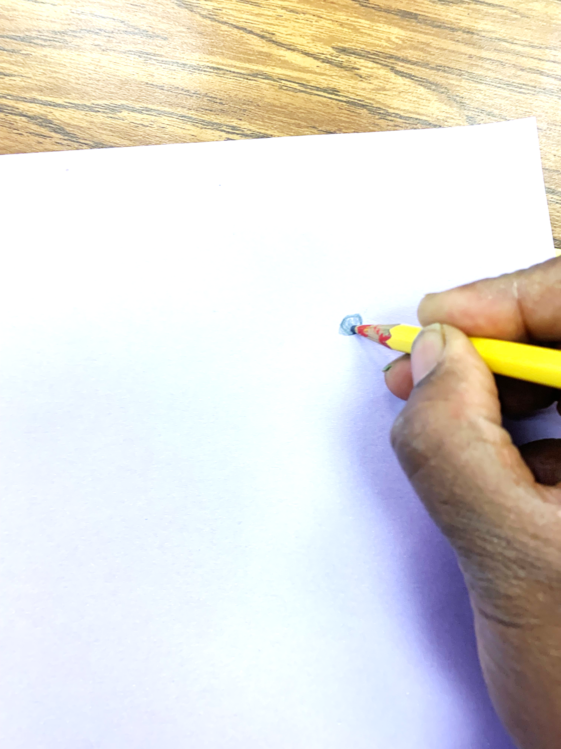
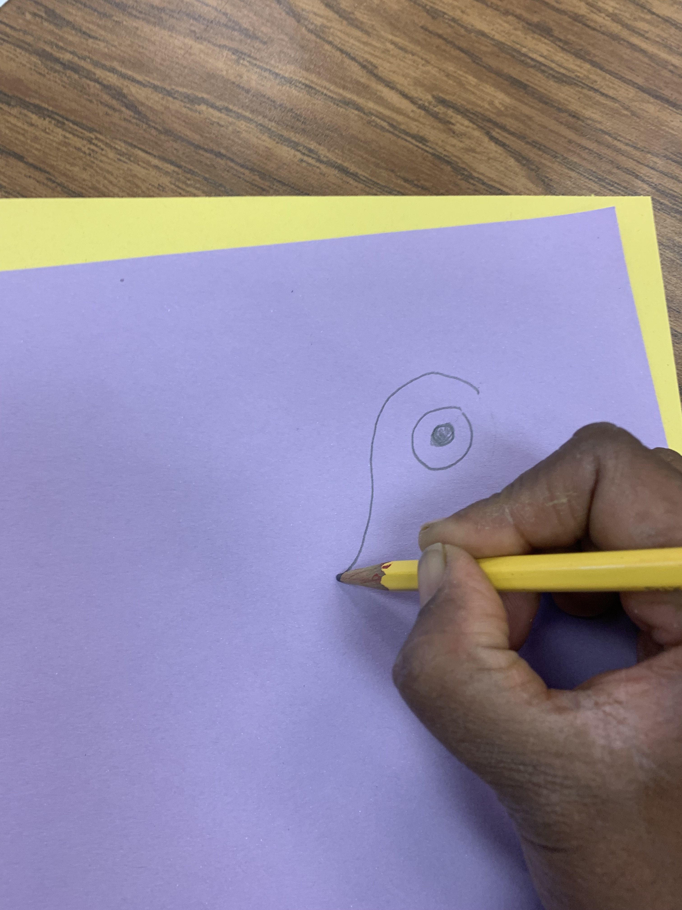
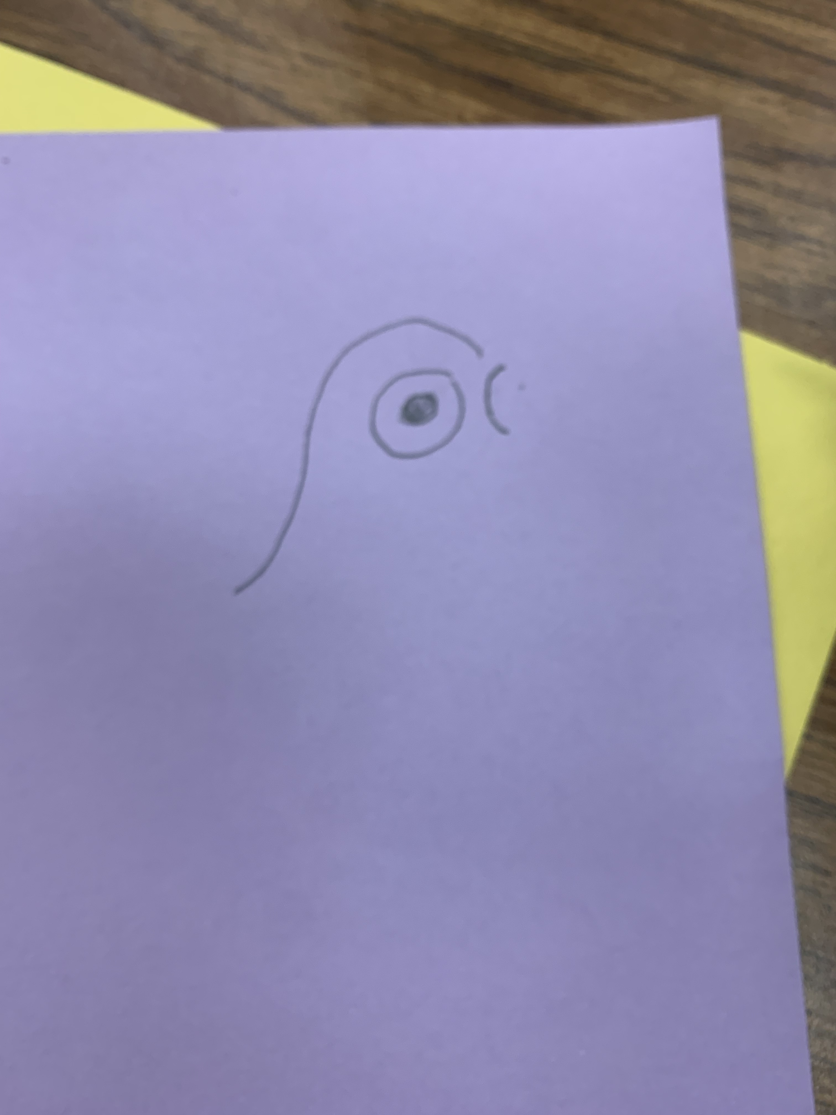
Grade 3 Procedure
Pencil
Portrait orientation
4 finger space
Make an mark/small circle for the inner eye
Draw the outer eye
Draw the top pf the head and extend it out
Draw the beak

Slide 18
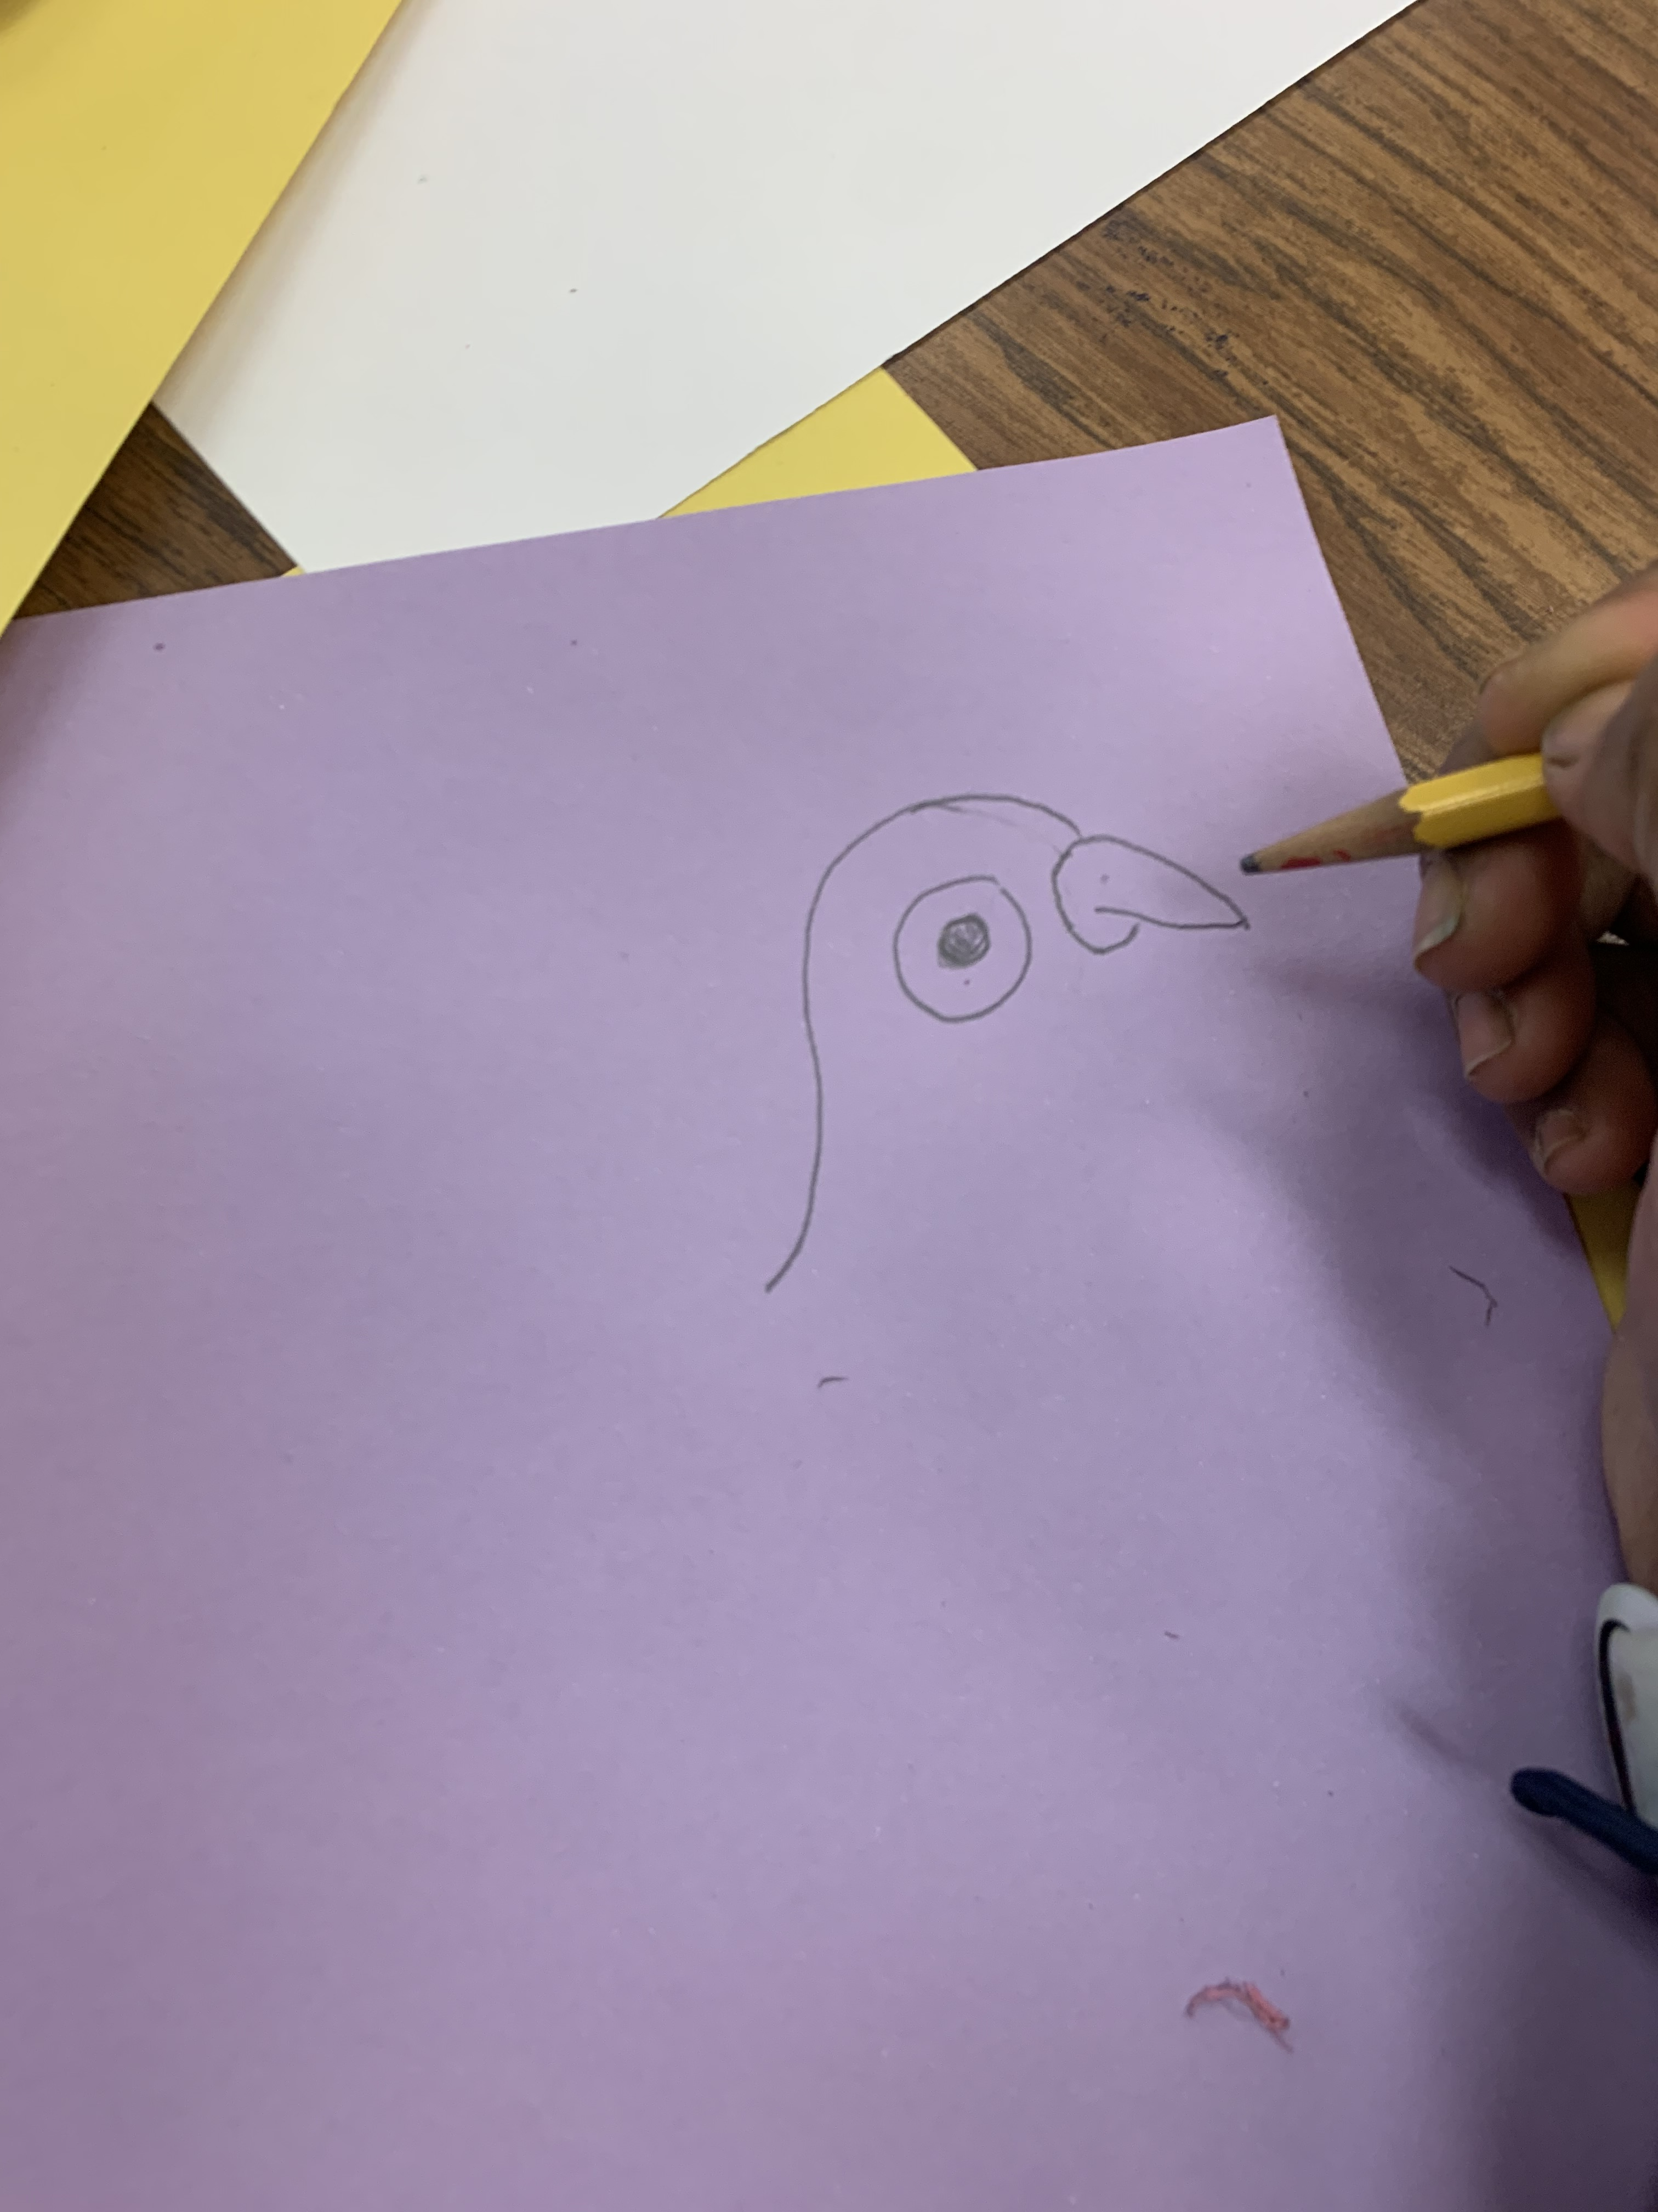
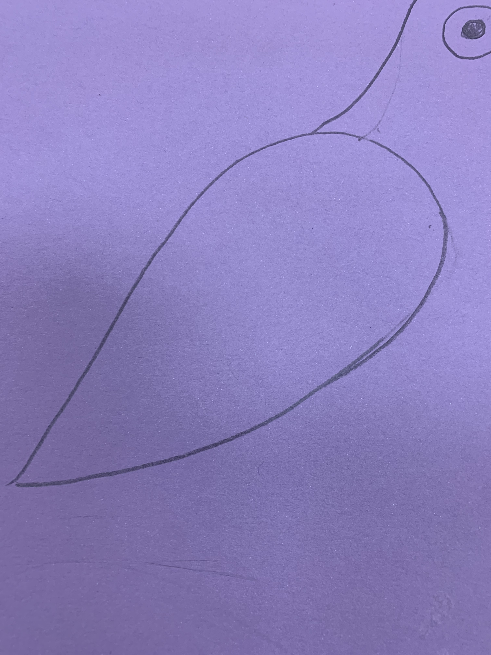
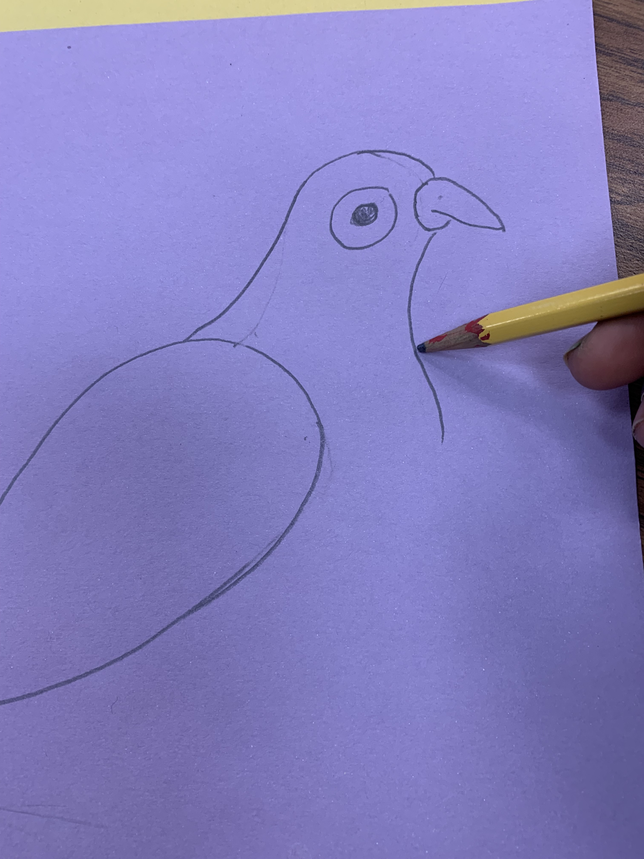
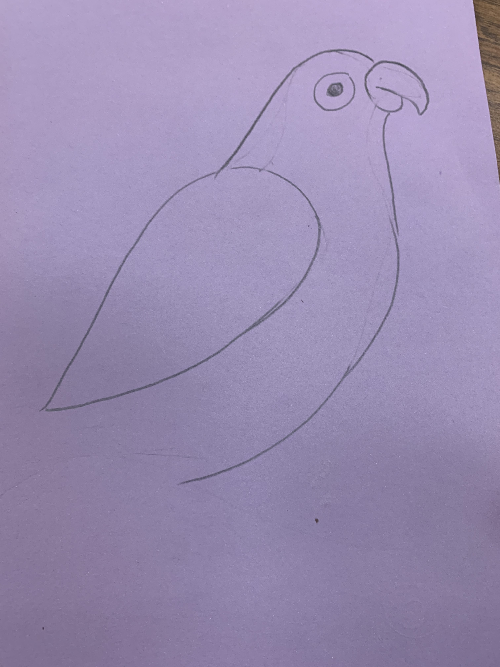
Grade 3 Procedure
Draw the beak
Big oblong shape for the back of the bird
Draw the neck
Draw the tummy

Slide 19
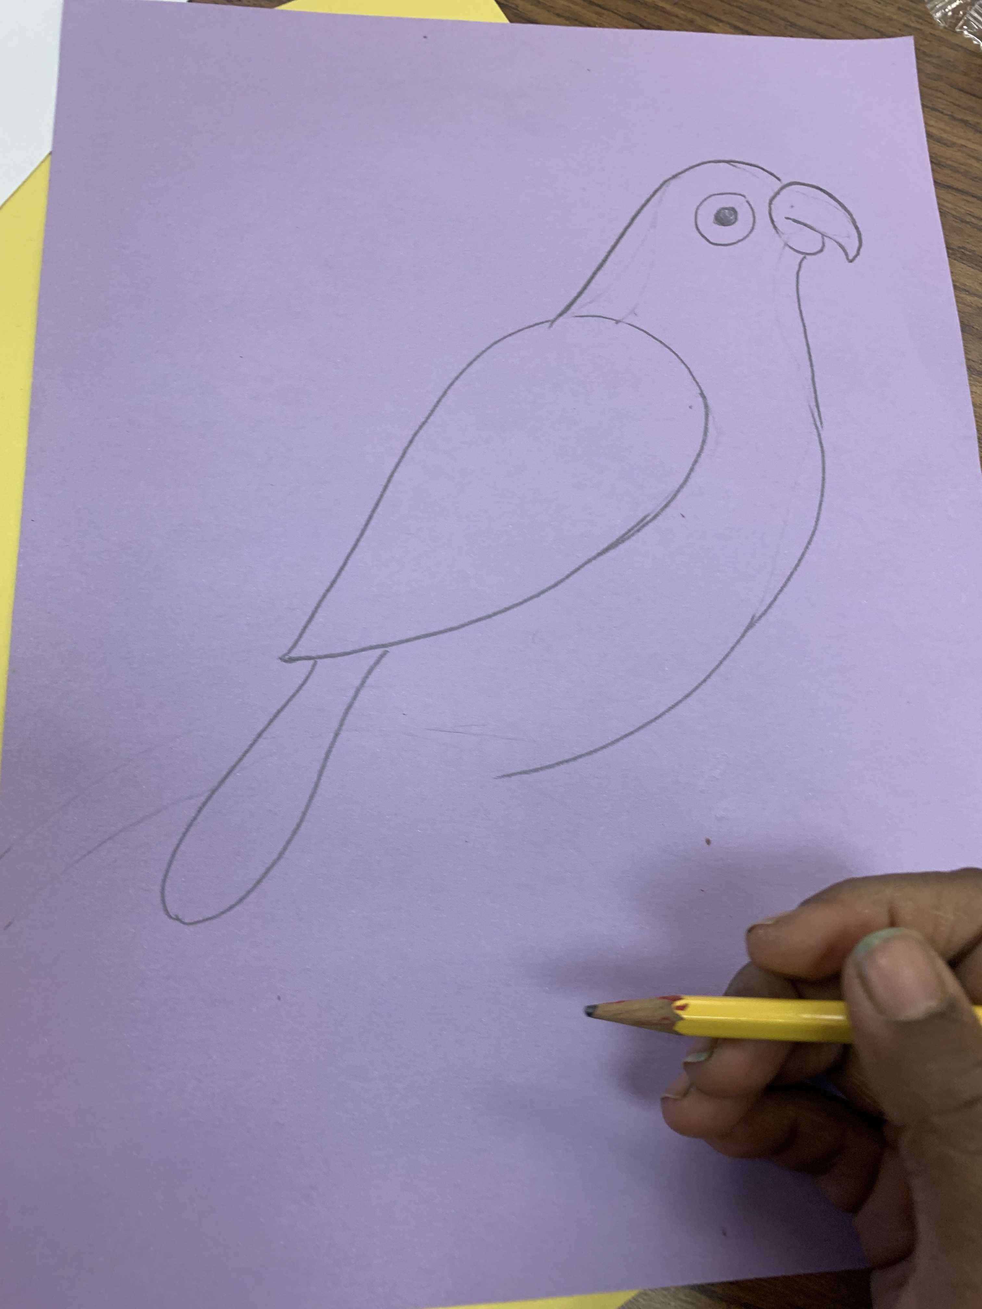
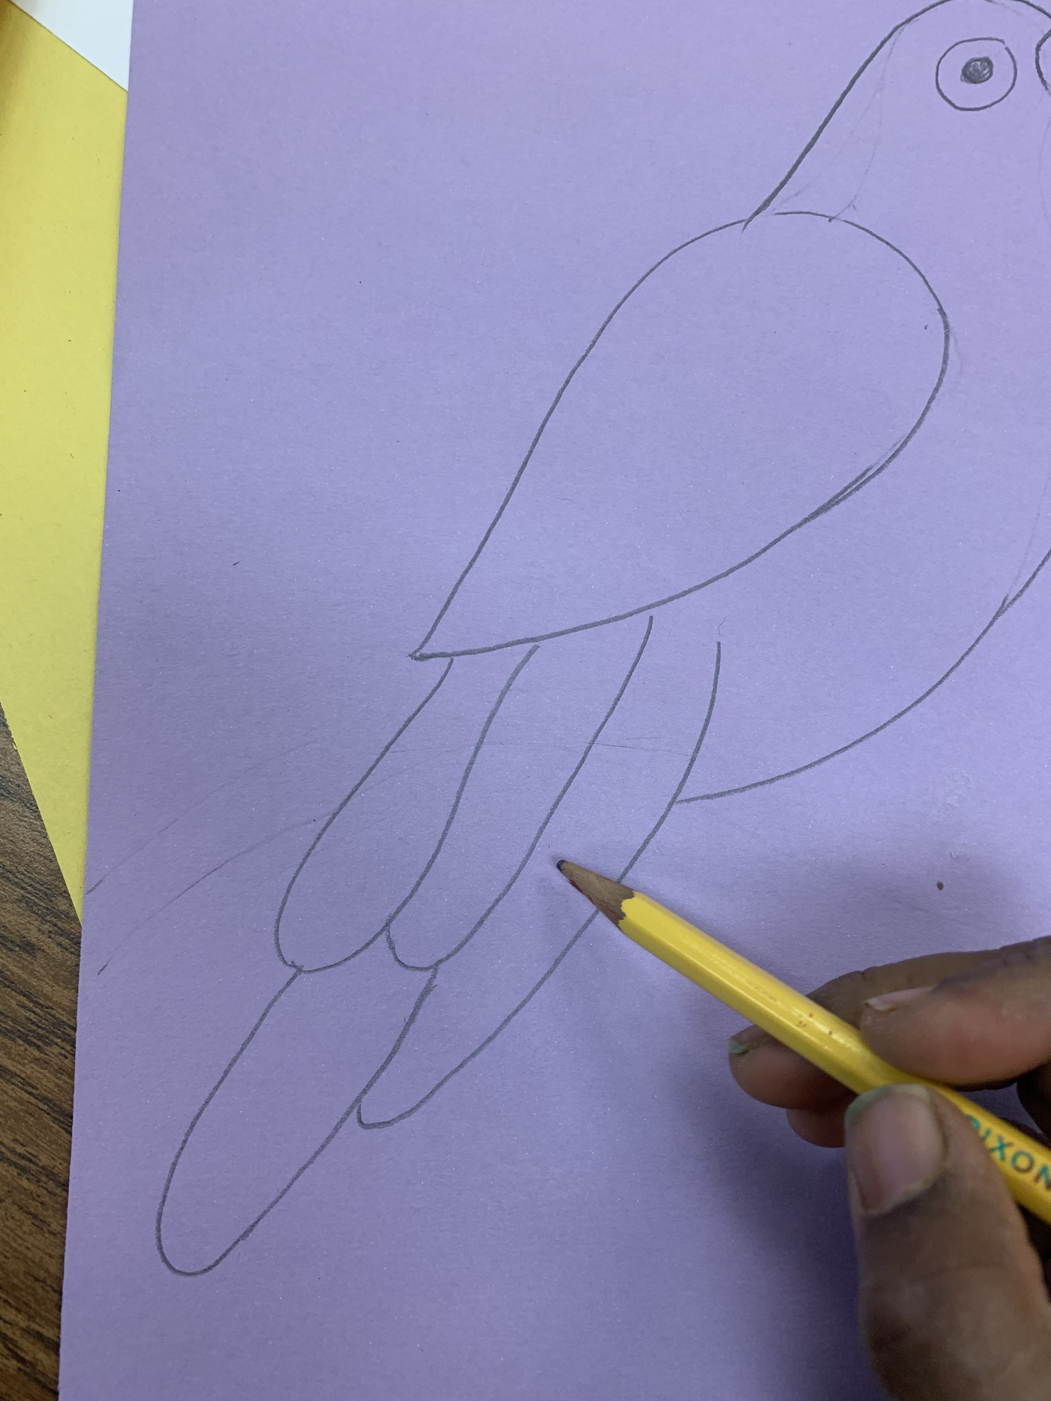
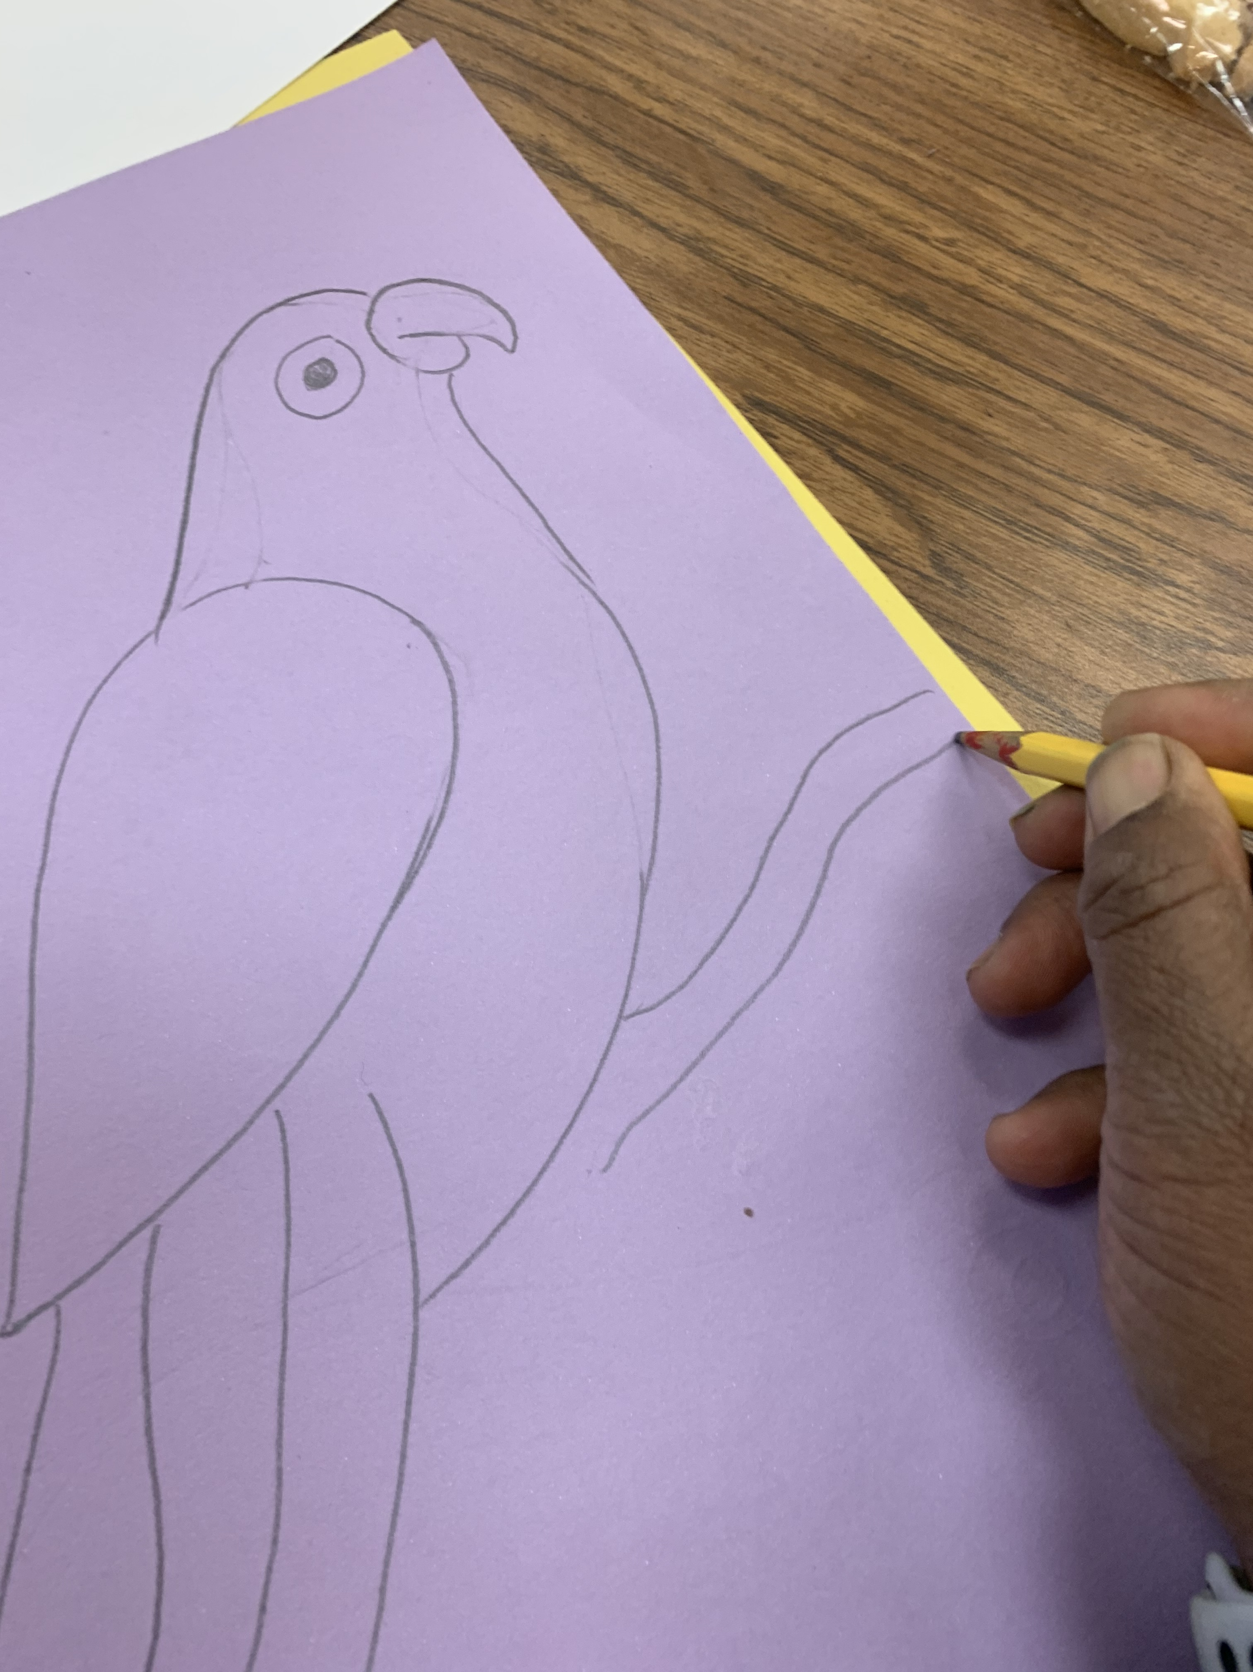
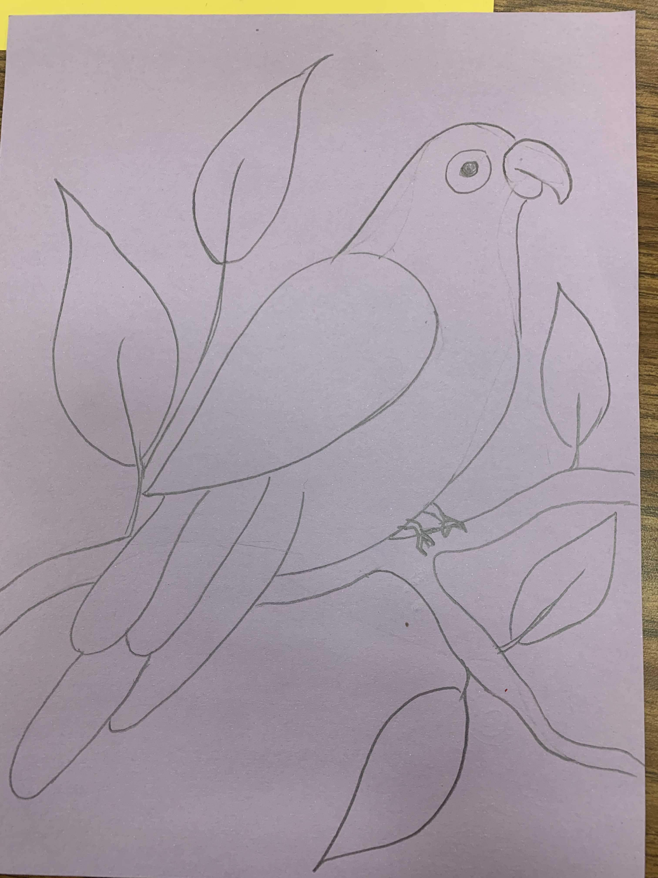
Grade 3 Procedure
Draw the feathers
More additional feathers
Draw the branch under the bird
Add leaves on the background

Slide 20
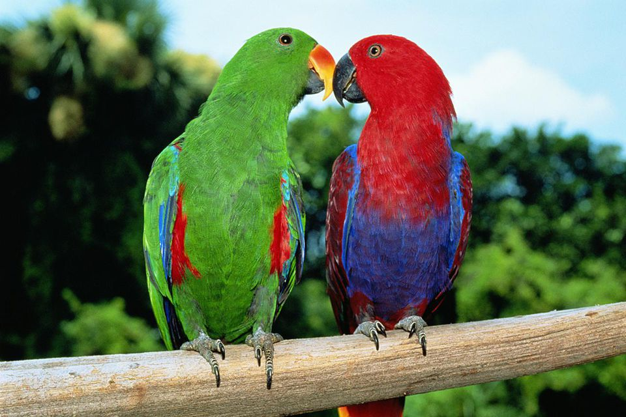
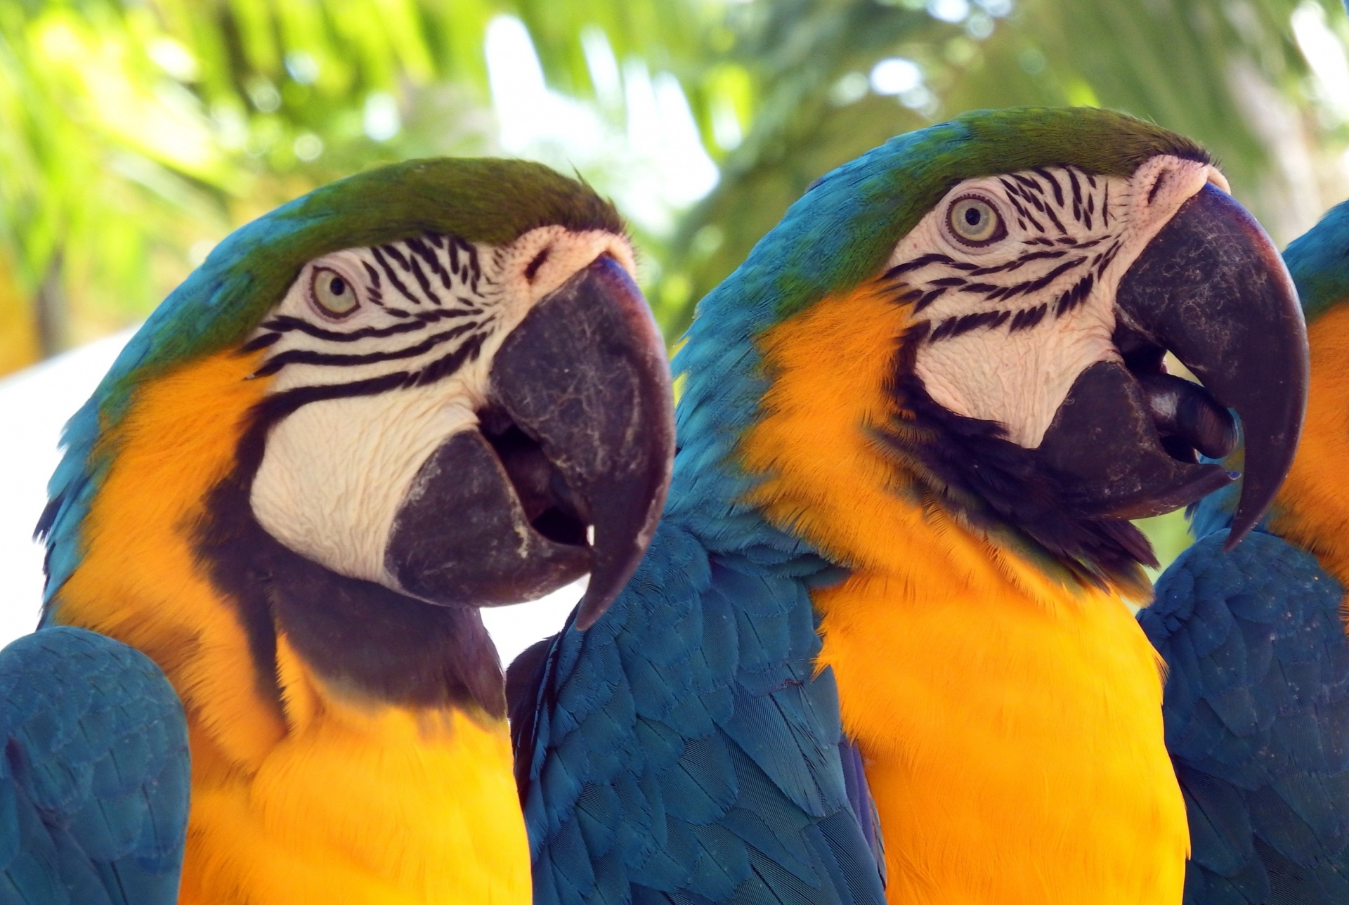
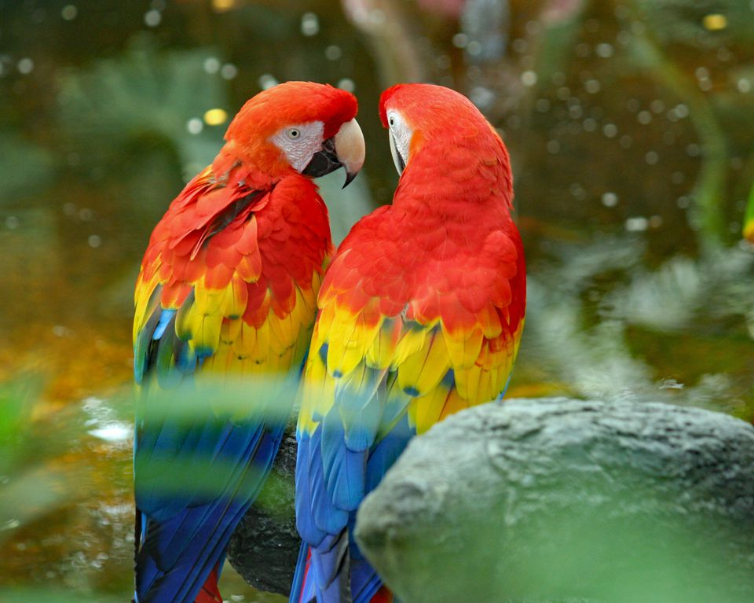
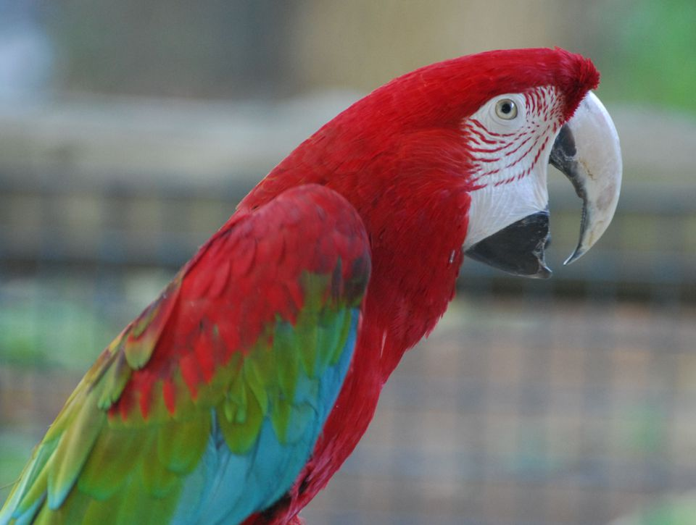
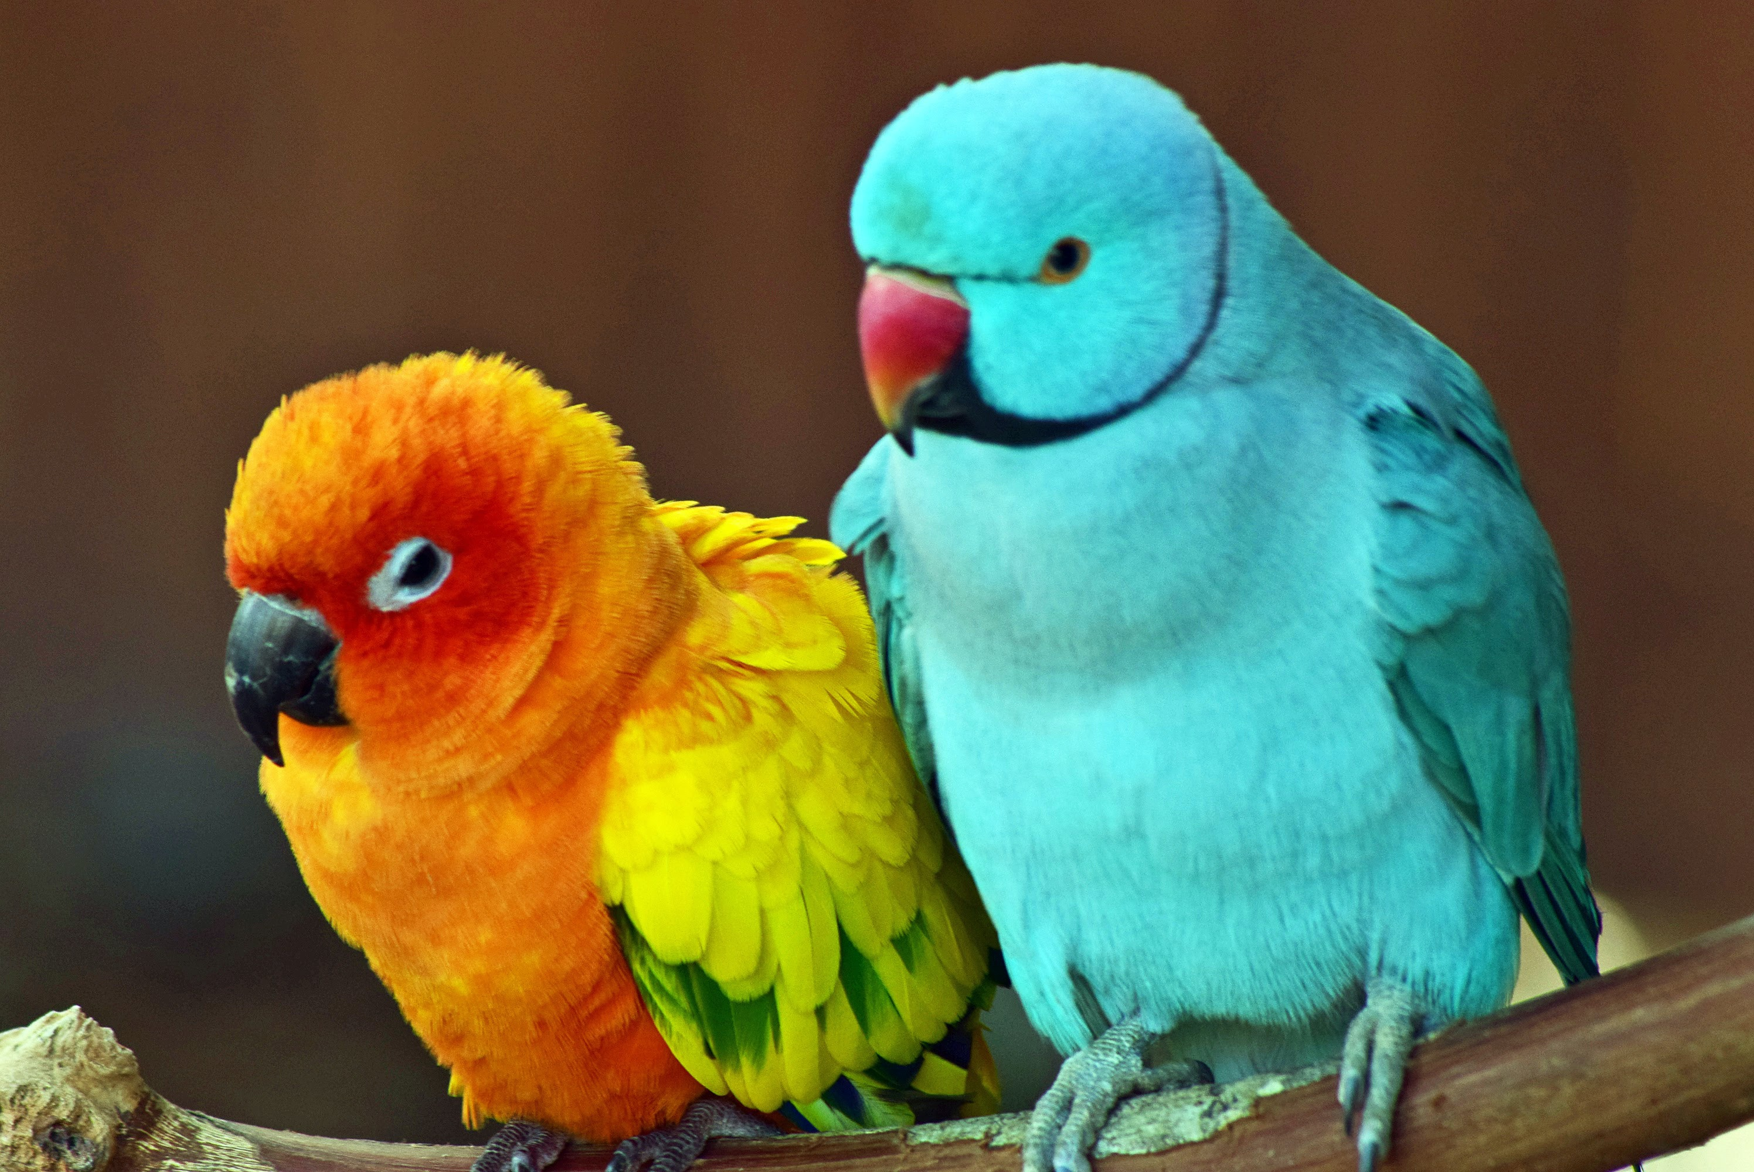

Slide 21
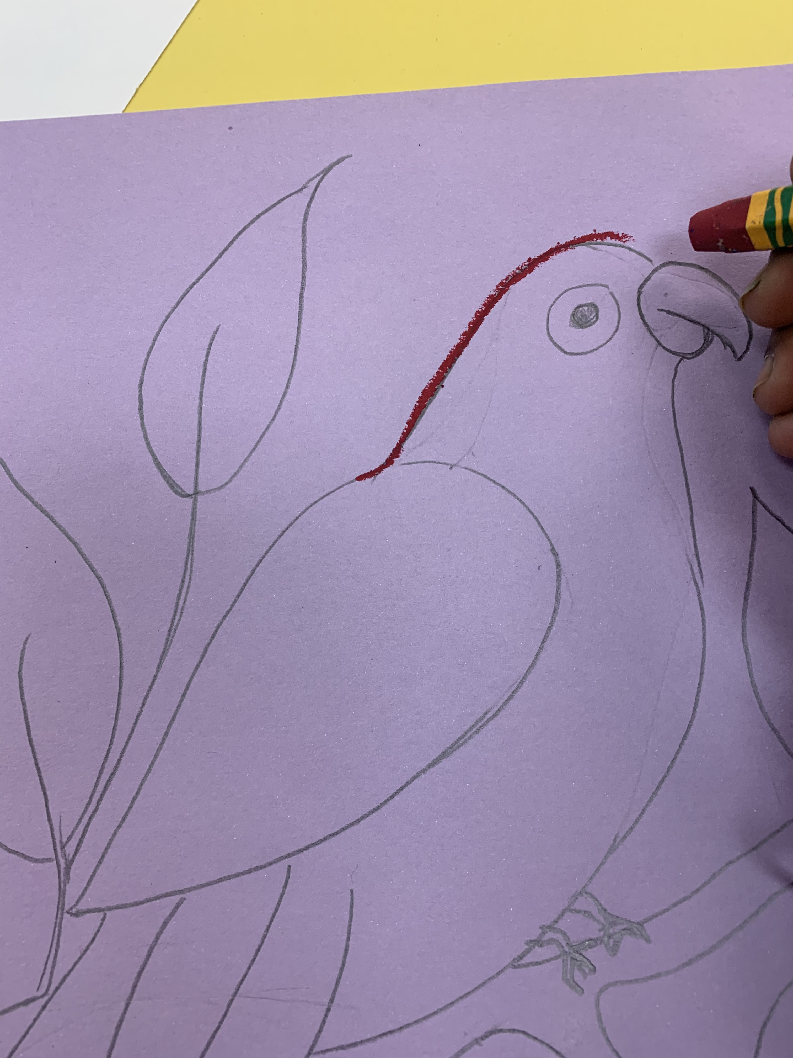
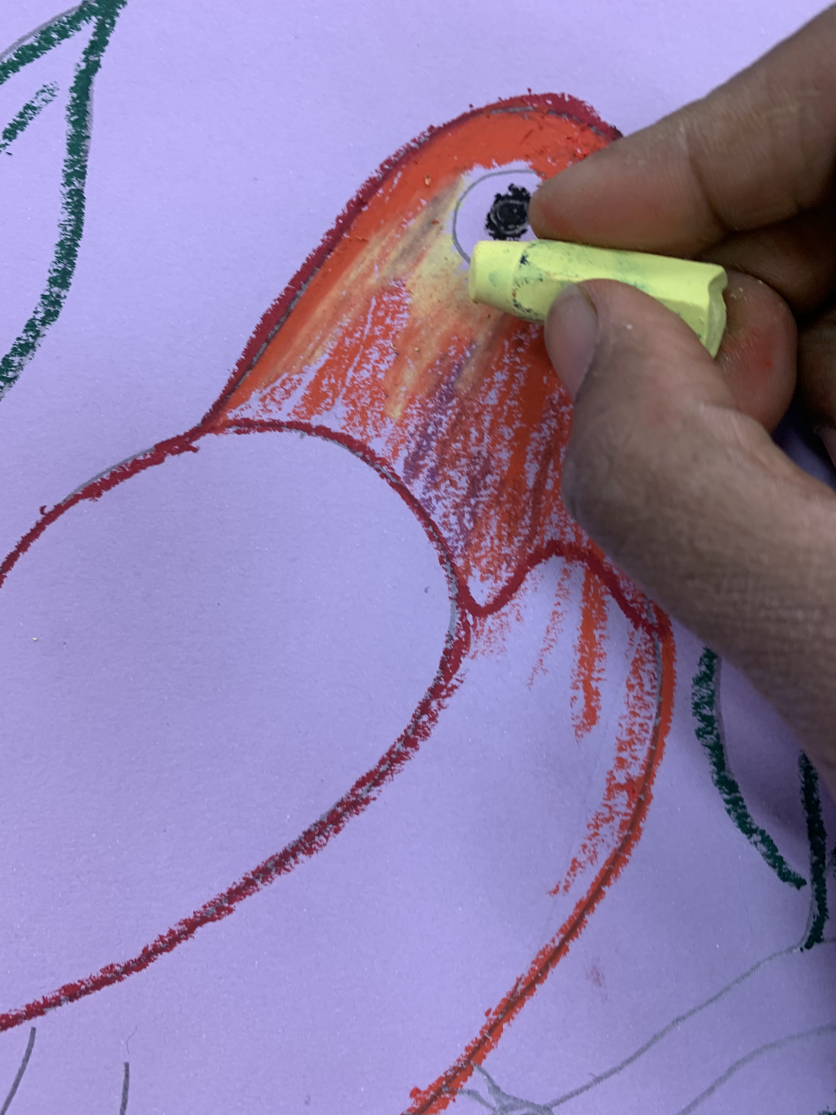
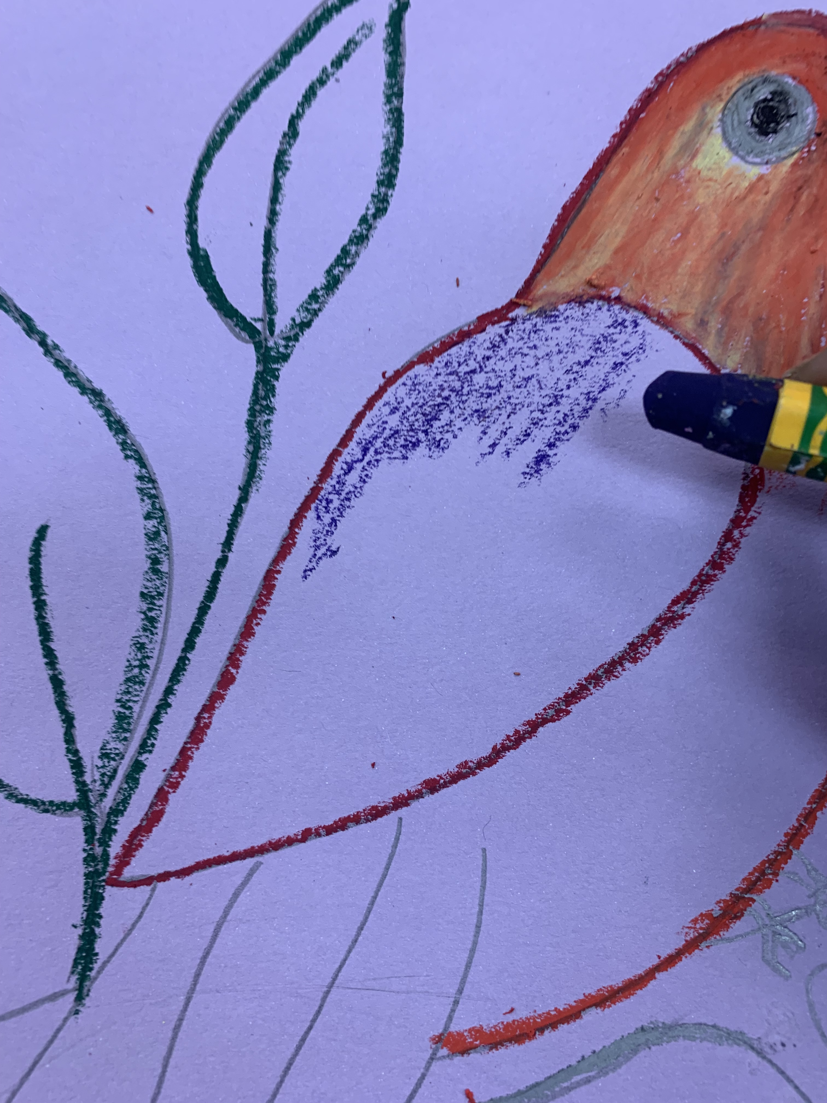
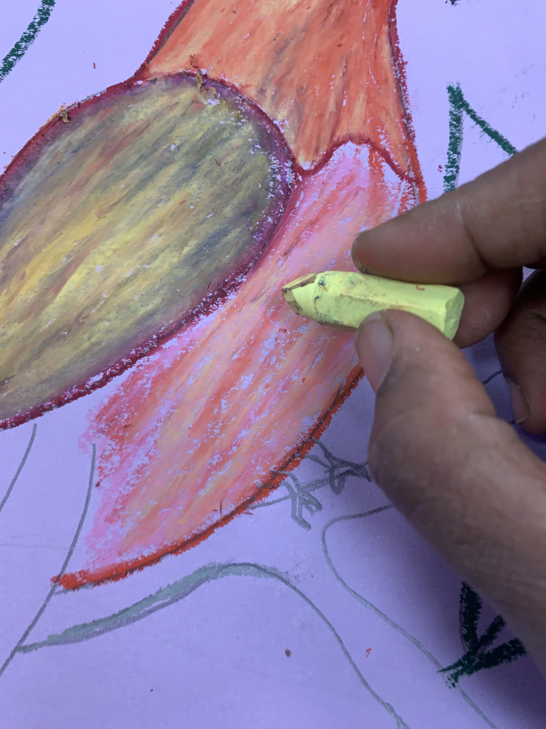
Grade 3 Procedure
Outline the bird the top half
Apply 2 or 3 oil pastels slightly in the inside
Use a Qtip and little Vaseline to blend the oil pastels
Then move to lover areas of the bird so it wont smudge.

Slide 22
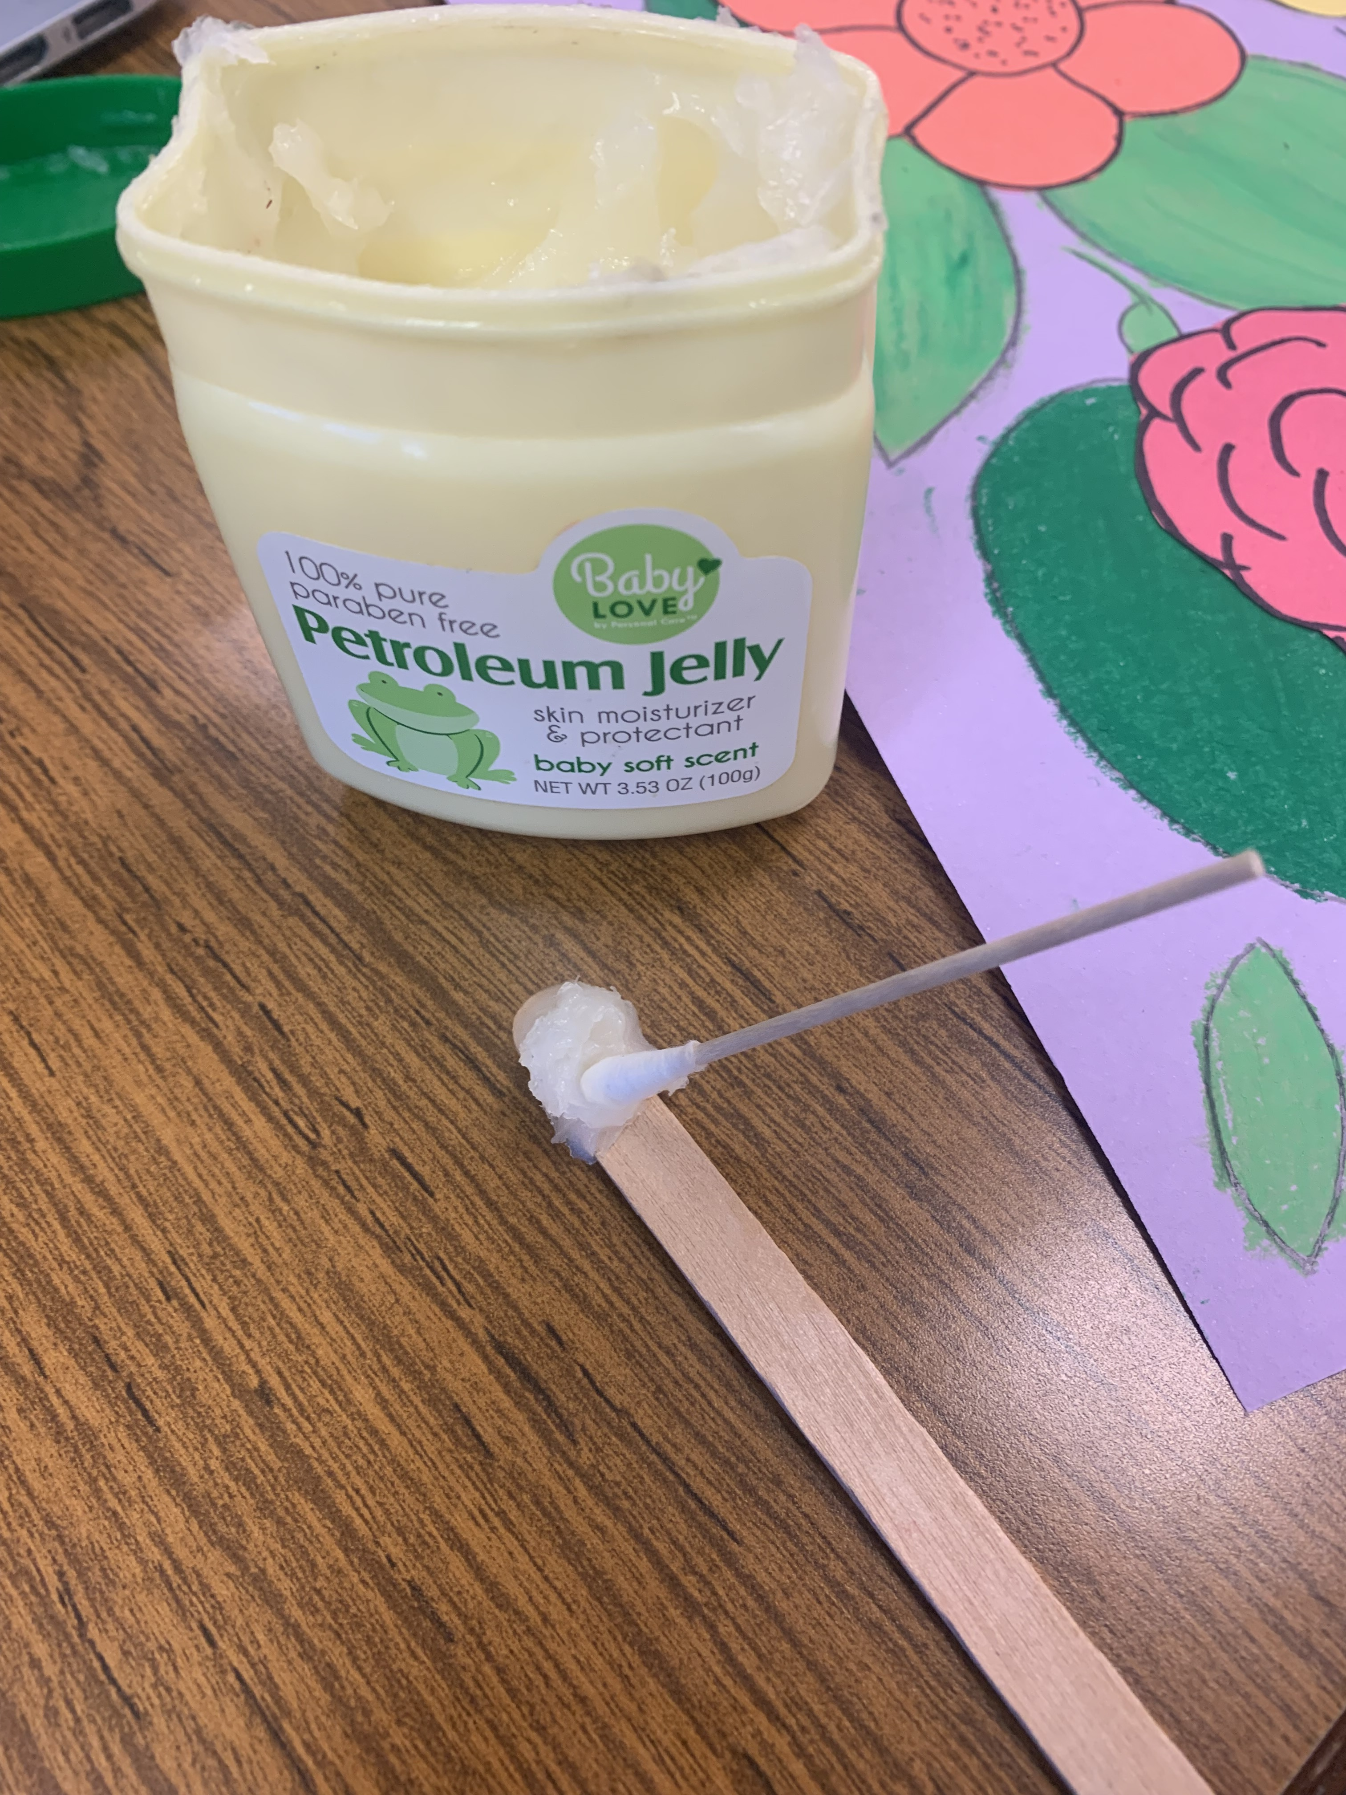
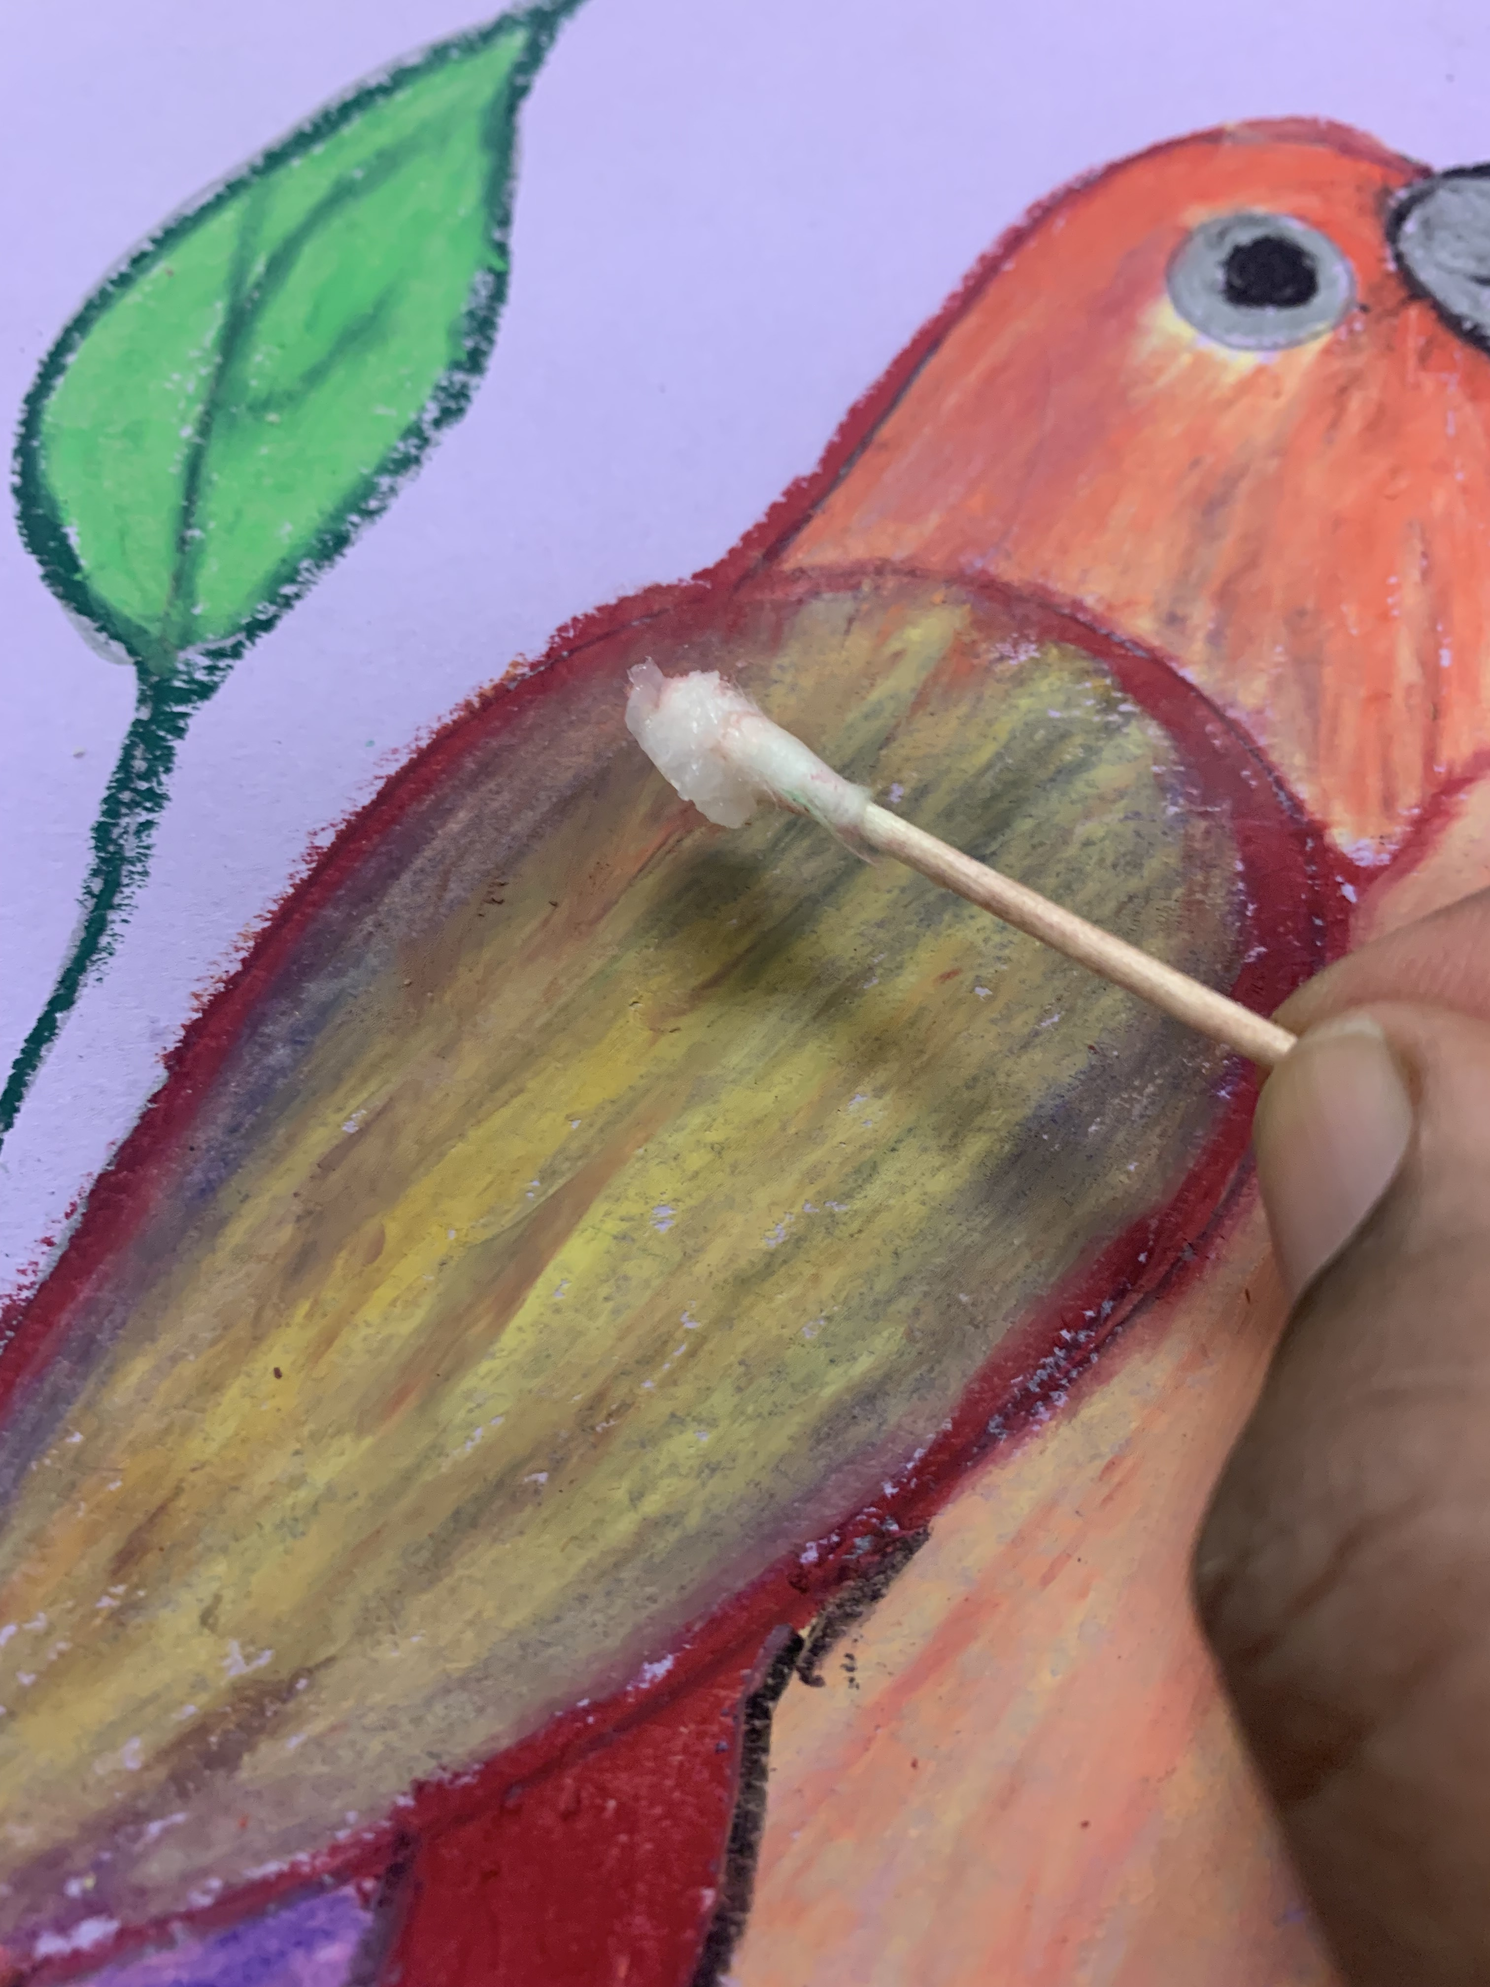
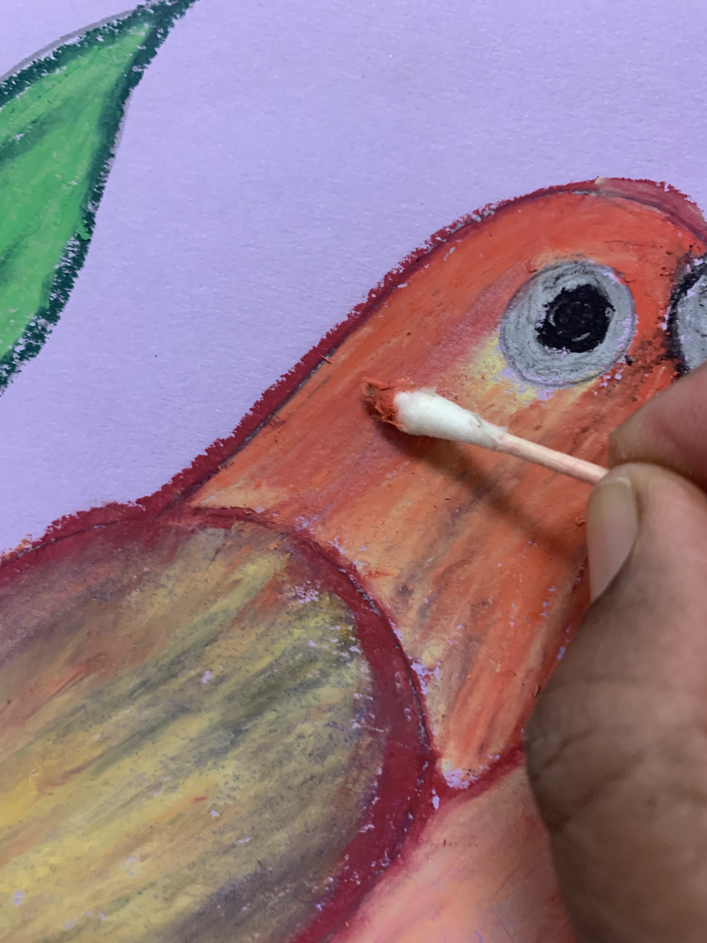
Grade 3-5 (Blending)
Scoop an little Vaseline on a craft stick
Take a little speck of Vaseline on a Qtip
Apply gently on the oil pastel to blend colors

Slide 23
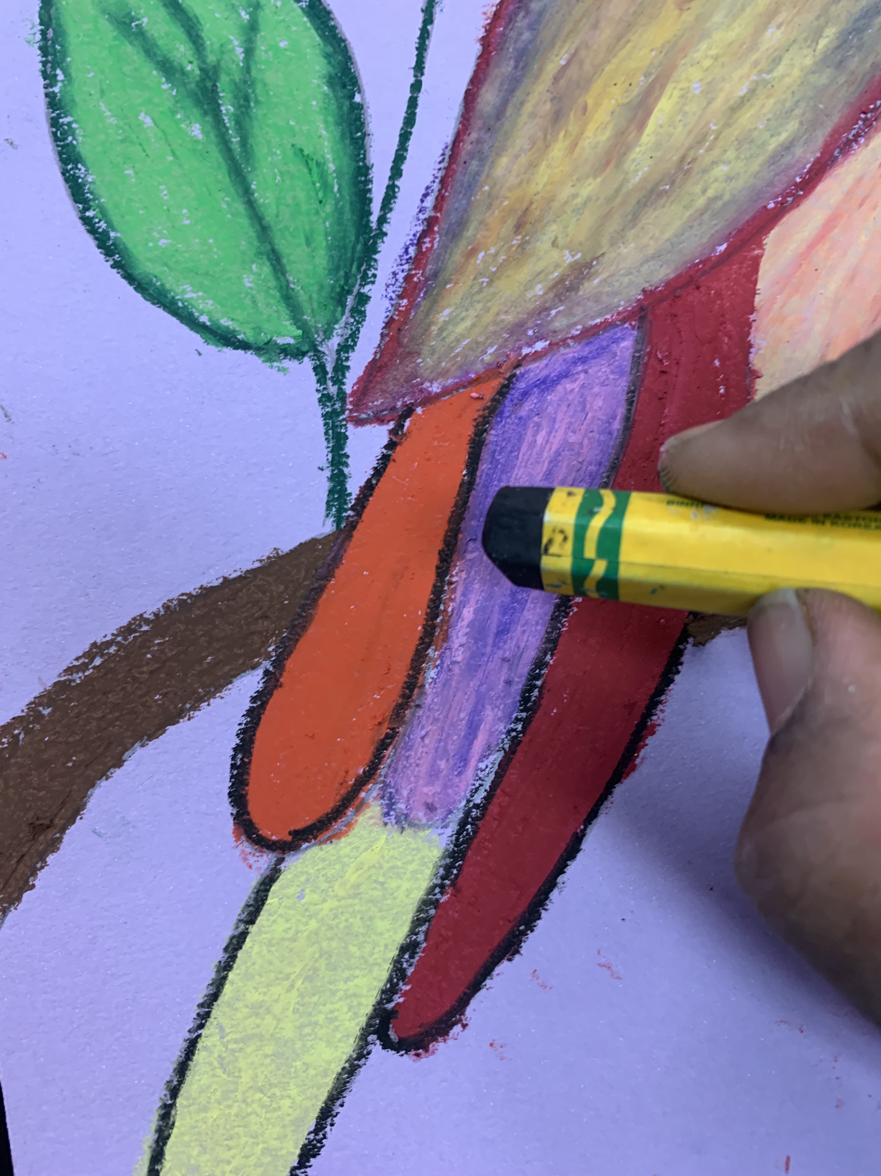
Grade 3 Procedure
Oil pastels to all the other areas.
Write your name with sharpie
Use a Qtip and little Vaseline to blend the oil pastels
Outline the bird with similar color in the area for sharpness.

Slide 24
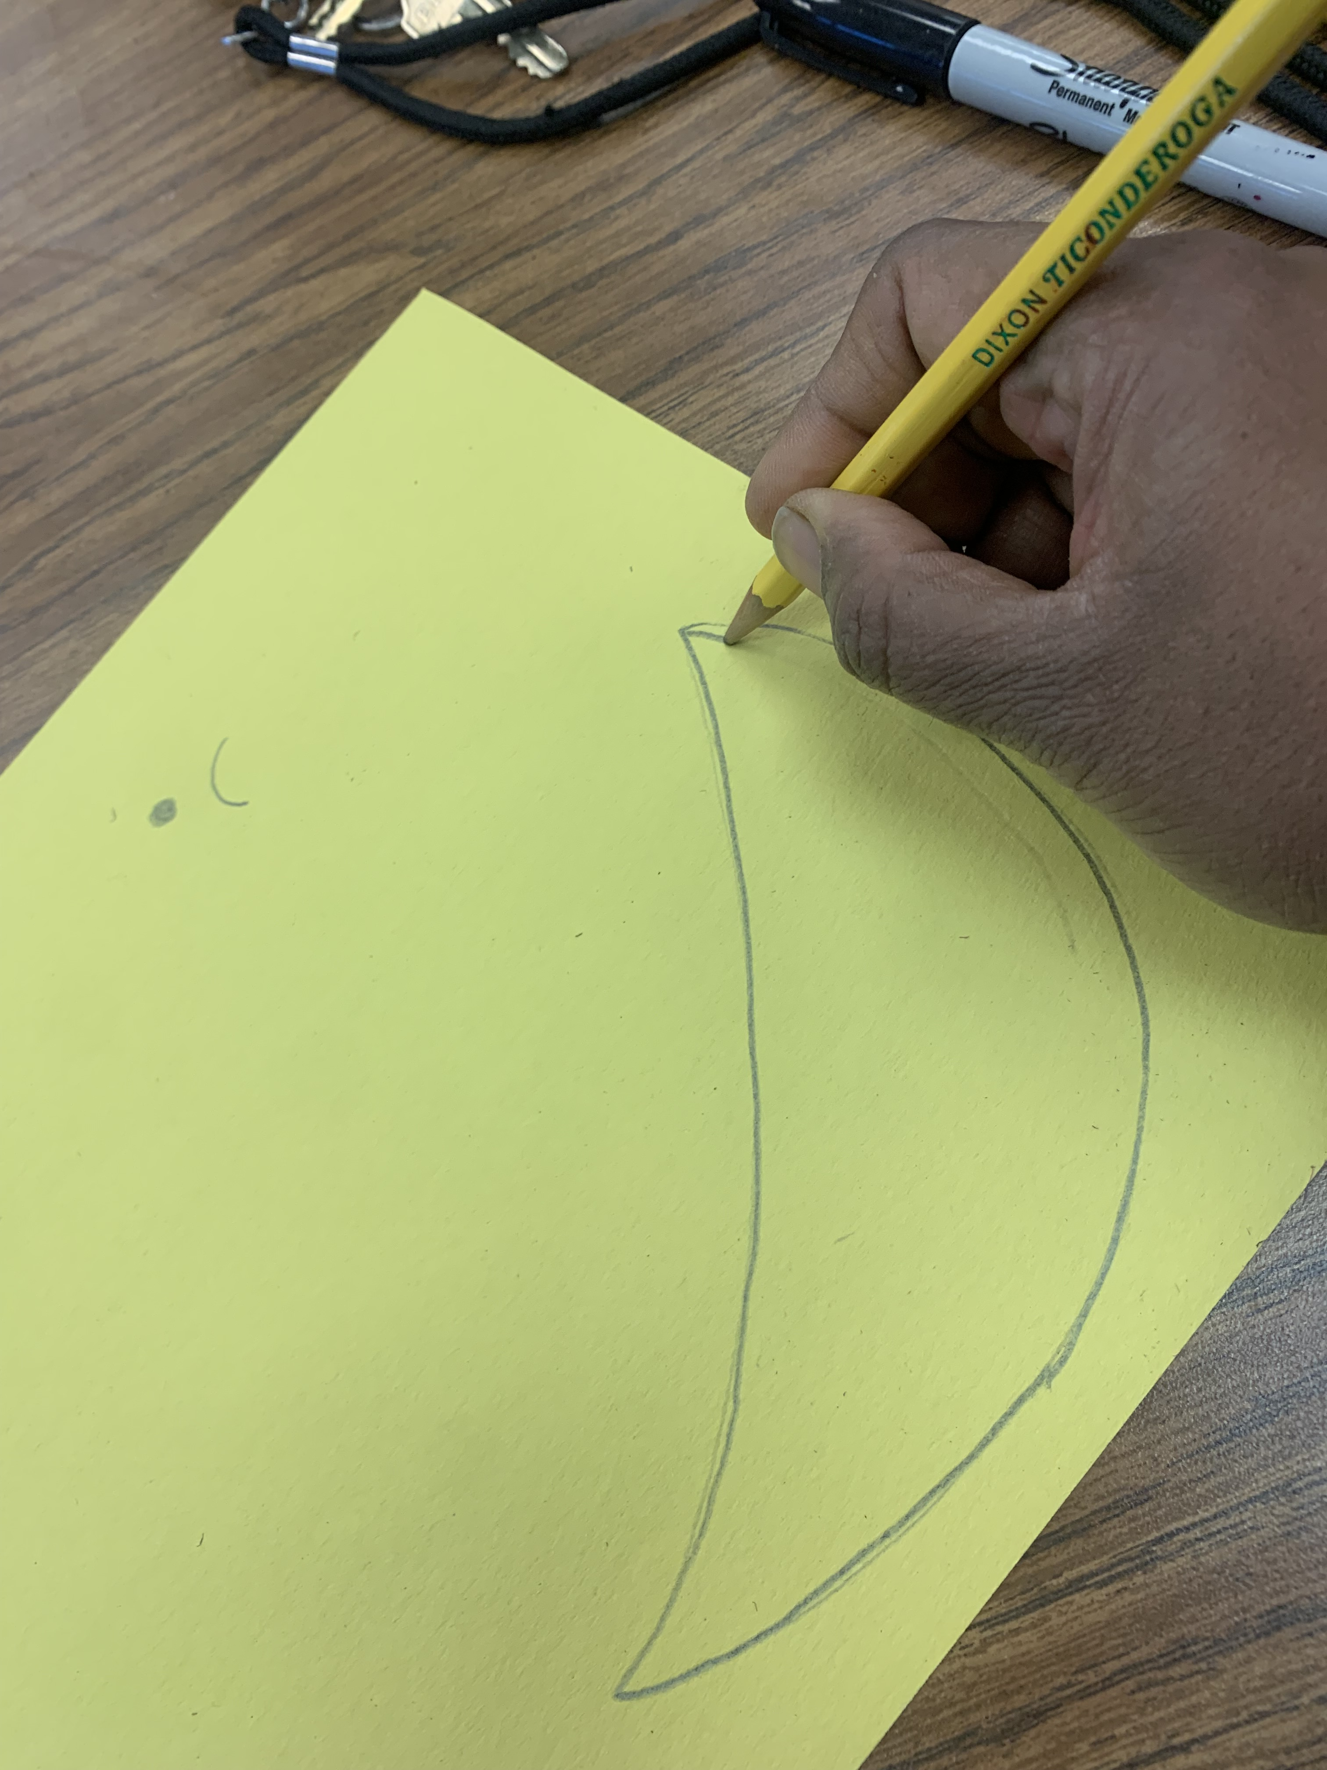
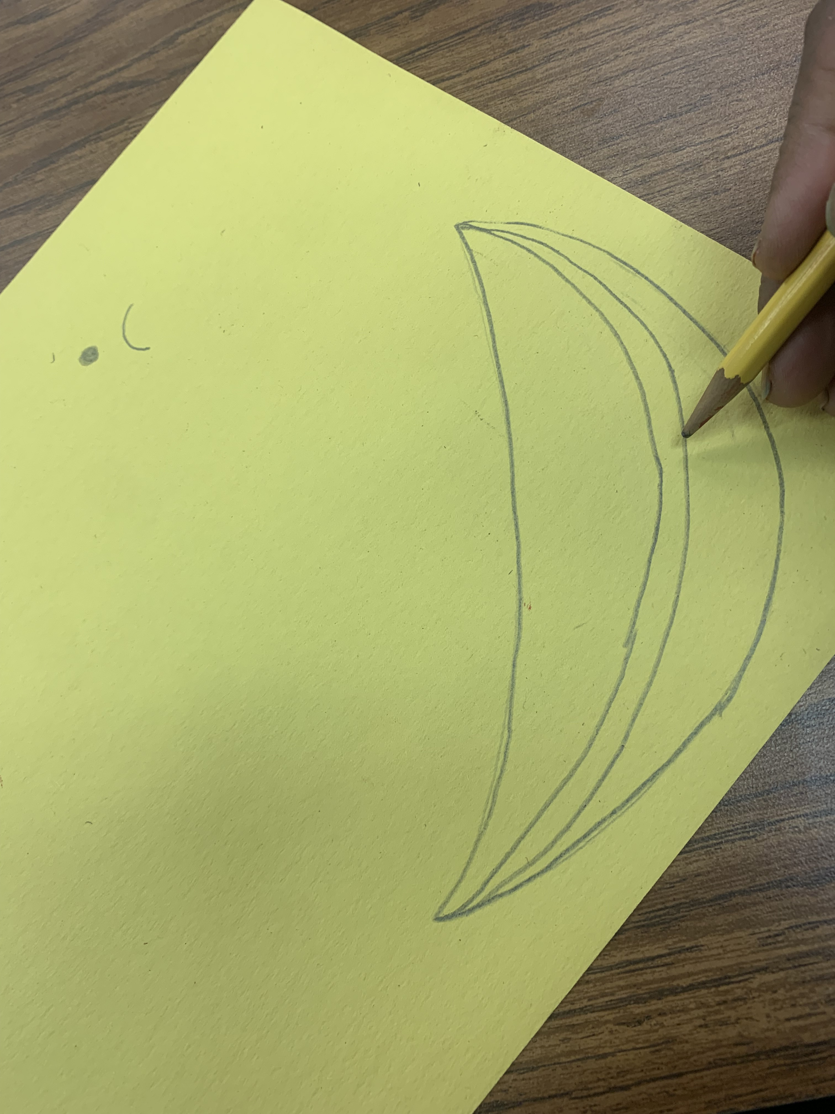
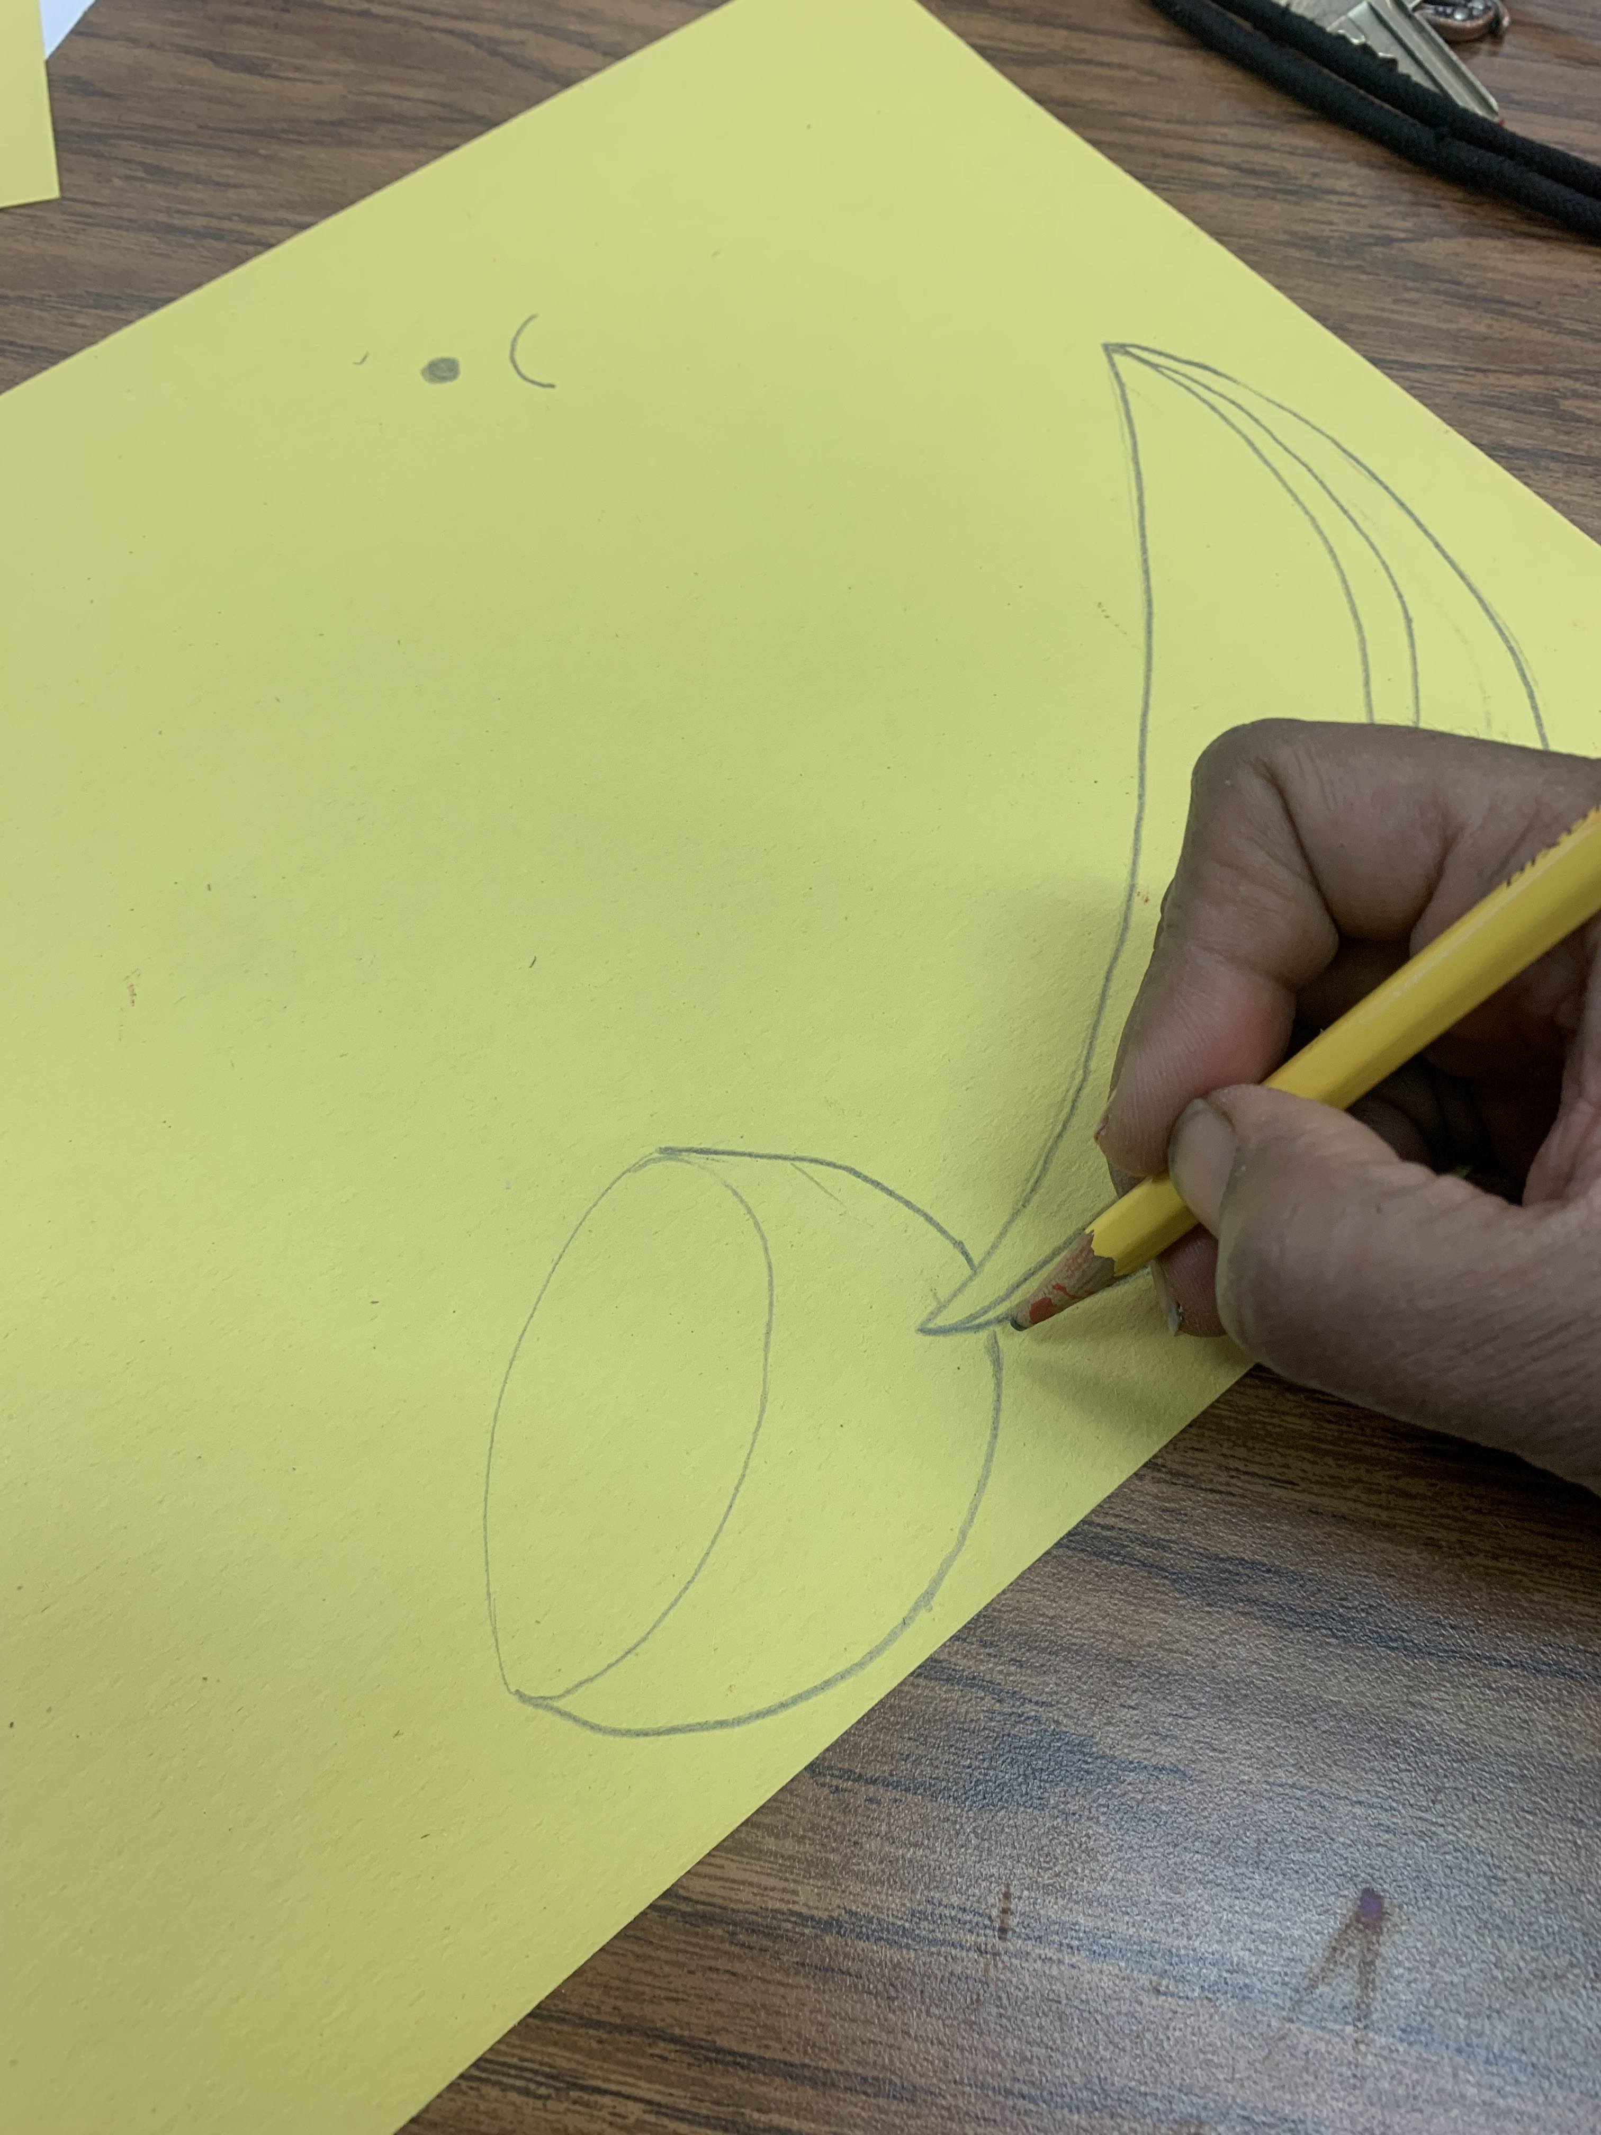
Grade 4/5 Procedure
Use Pencil - Landscape orientation
3 finger space on top right corner for the bird’s head
Mark the area for fruits in the foreground
Give 4 finger space from the bottom right corner for the watermelon
Start with the watermelon
Draw the fruits (watermelon & Orange)

Slide 25
Grade 4-5 Procedure
3 finger space on the top
Make an mark/small circle for the inner eye
Draw the outer eye
Draw the top pf the head and extend it out
Draw the beak

Slide 26
Grade 3 Procedure
Draw the beak
Big oblong shape for the back of the bird
Draw the neck
Draw the tummy

Slide 27
Grade 3 Procedure
Draw the feathers
More additional feathers

Slide 29
Grade 3 Procedure
Outline the bird the top half
Apply 2 or 3 oil pastels slightly in the inside
Use a Qtip and little Vaseline to blend the oil pastels
Then move to lover areas of the bird so it wont smudge.
Color the fruits at the last as the oil pastels will not smudge all over

Slide 30
Grade 4/5 Procedure
Write your name with sharpie
Follow the instructions oil pastel blending technique

