Slide 1
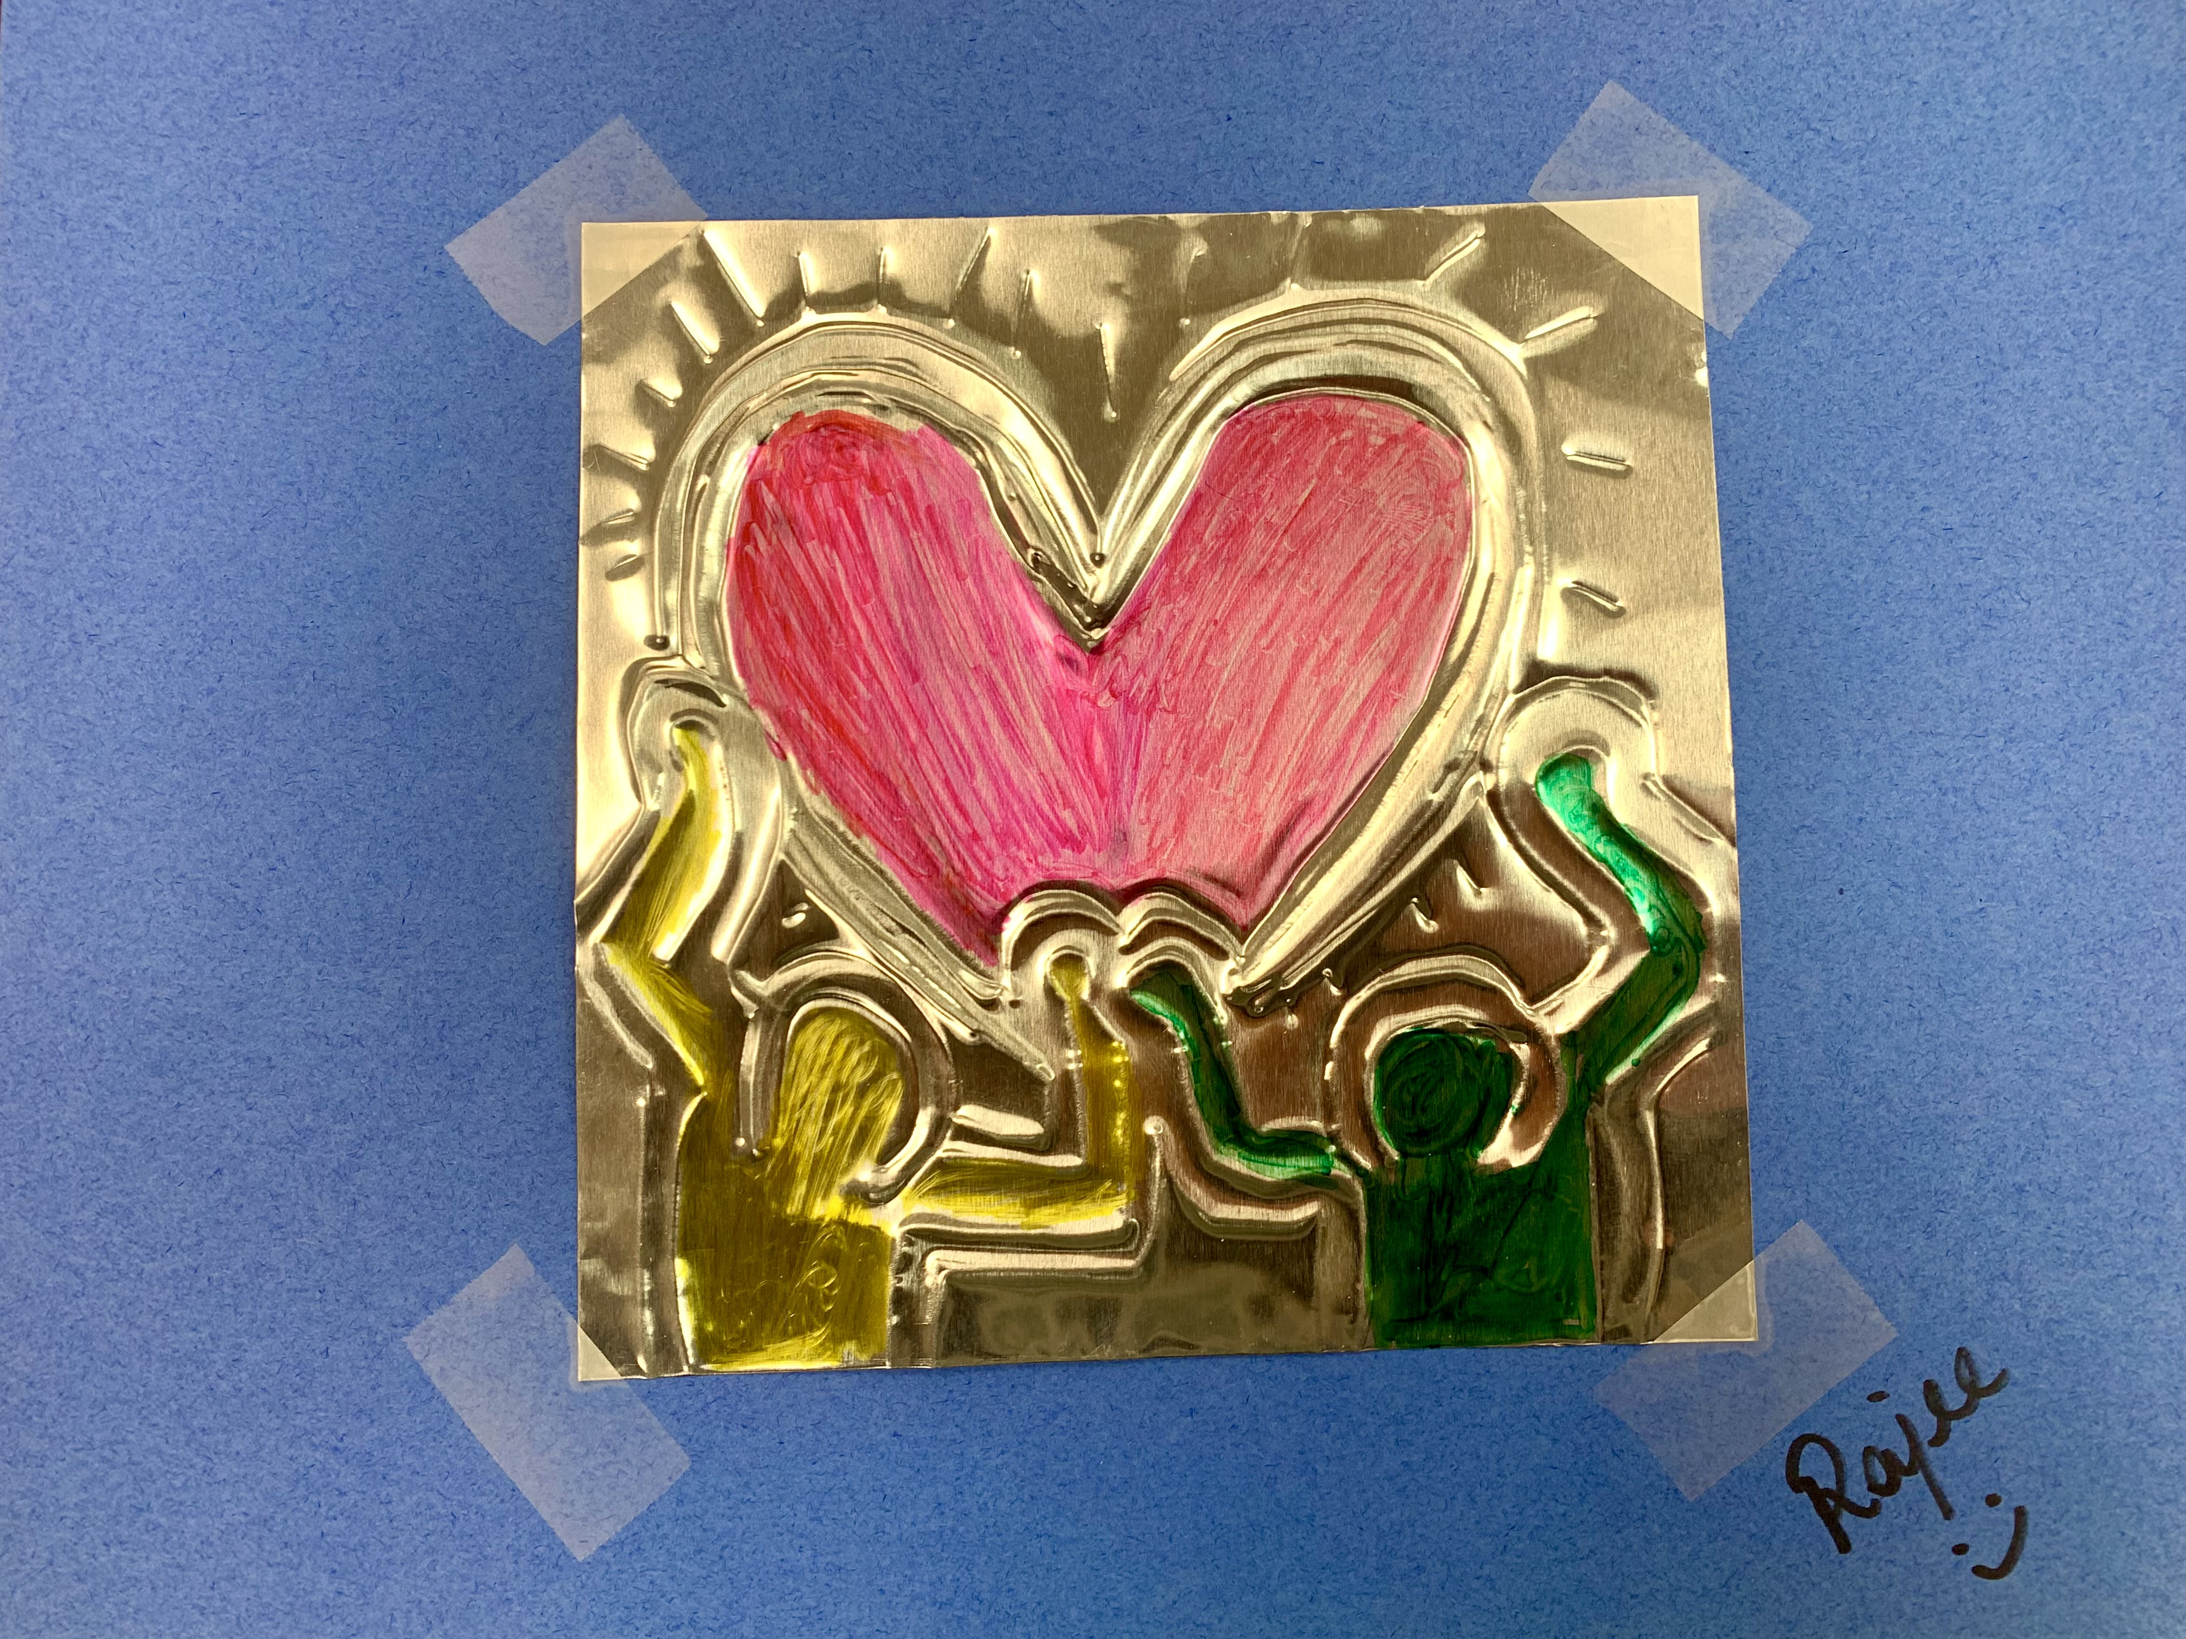
Embossed figures in motion – Keith Haring March 2023 Rajee Subramanian
Grade 2/3

Slide 2
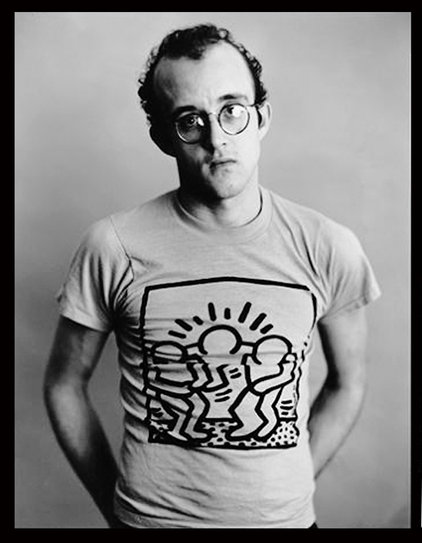
Keith Haring
Born on May 4, 1958, in Reading, Pennsylvania.
Famous for his bold drawings/color, cartoon, pop art, graffiti art
Fascinated by the popular cartoon art of Walt Disney and Charles Schultz.
Studied art in New York visual arts university
He created his own store to sell his art on objects and everyday items.
He did numerous workshops for children
He left the world on Feb 16, 1990
His work is exhibited in famous museums around the world

Slide 3
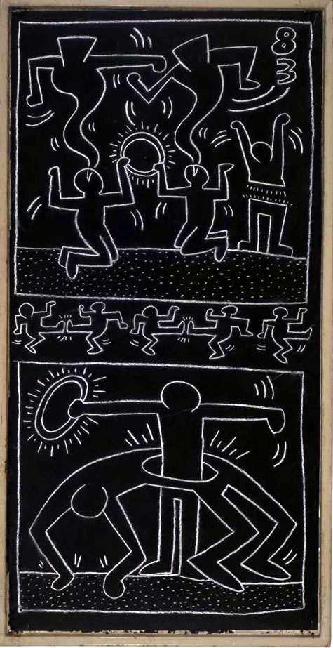
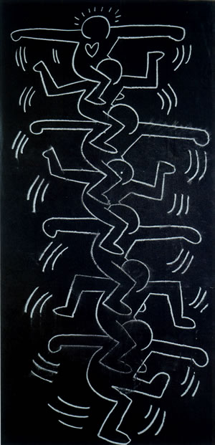
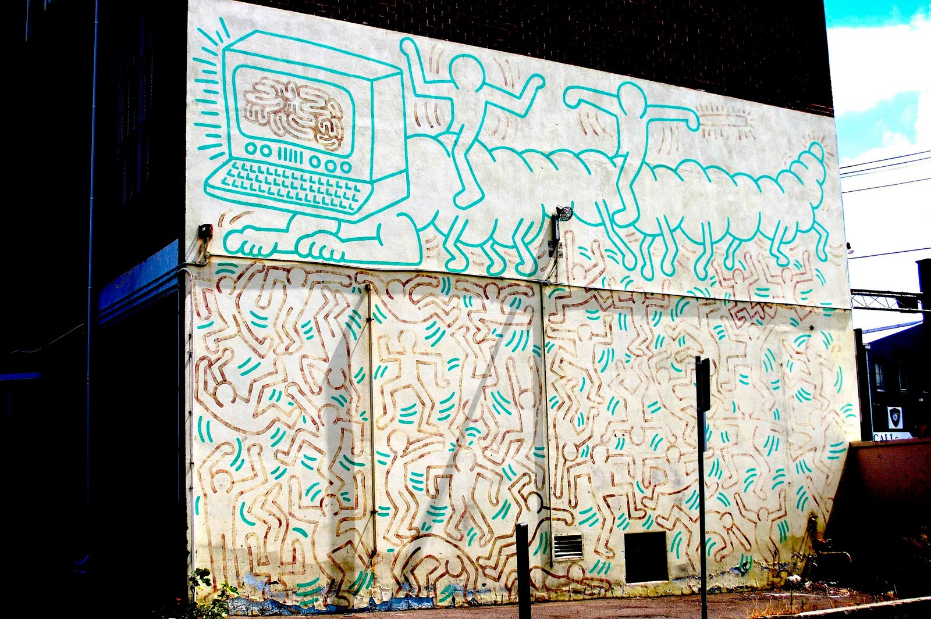
Photos of some of his Subway Drawings:

Slide 4
He transferred stick figures into work of art

Slide 5
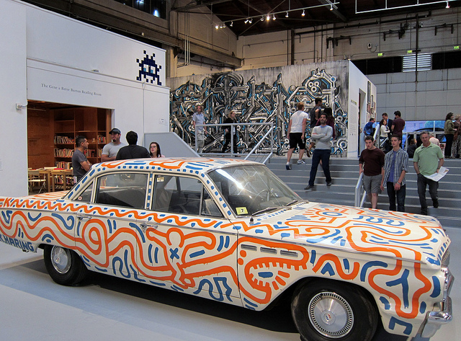
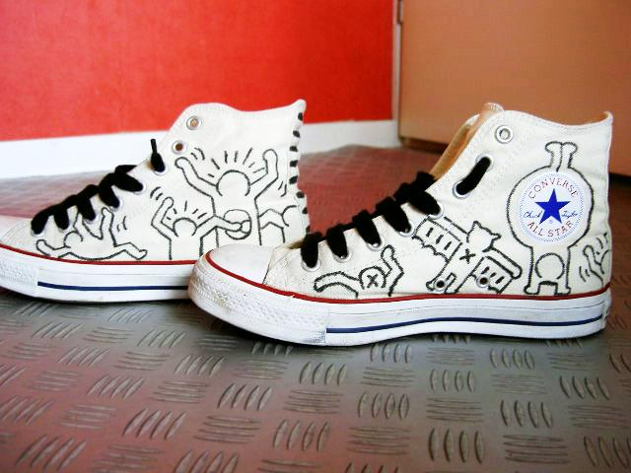
He would draw and paint on almost anything and everything

Slide 6
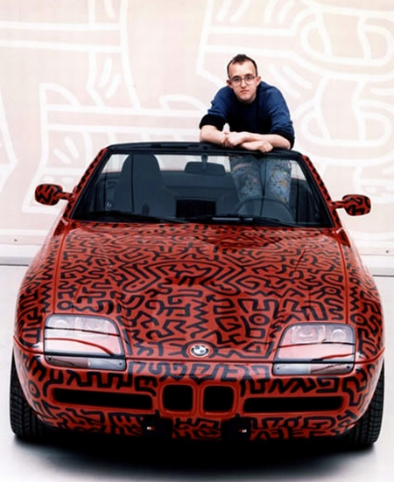
He painted
his
own
car,
and…

Slide 7
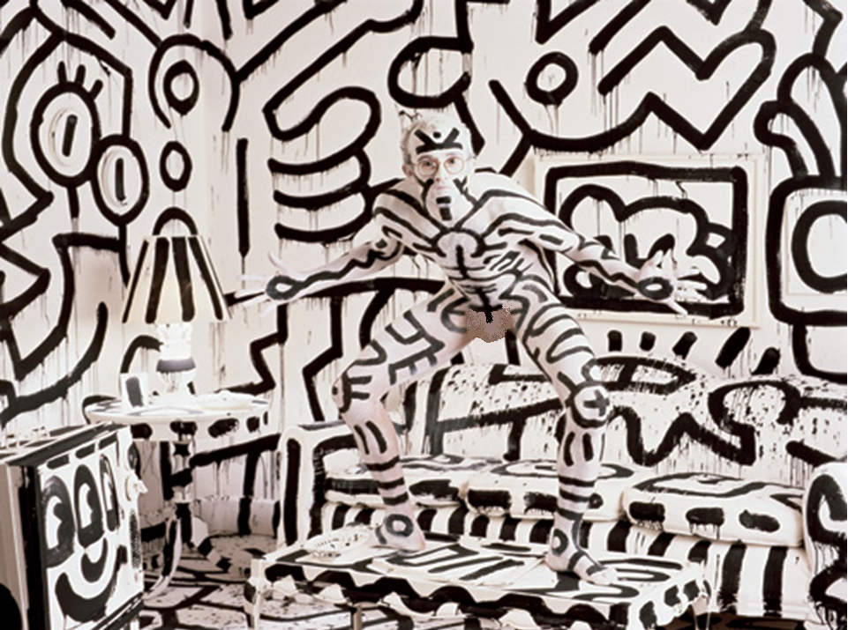
…EVEN HIMSELF!

Slide 8
He opened a store in New York to sell his own artwork.

Slide 9
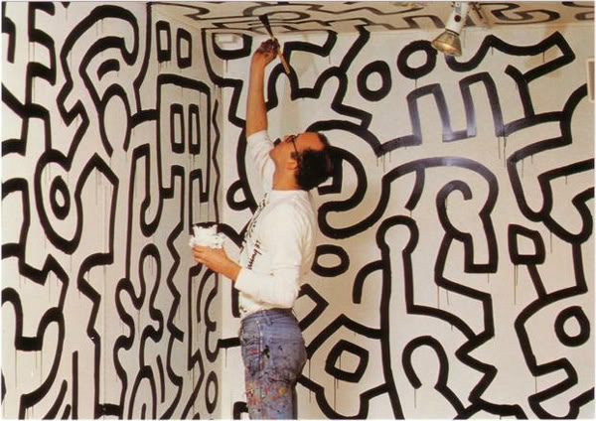
He painted the inside in his own signature style.

Slide 10
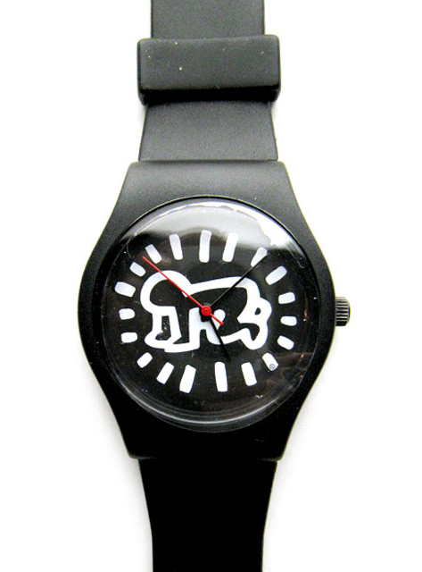
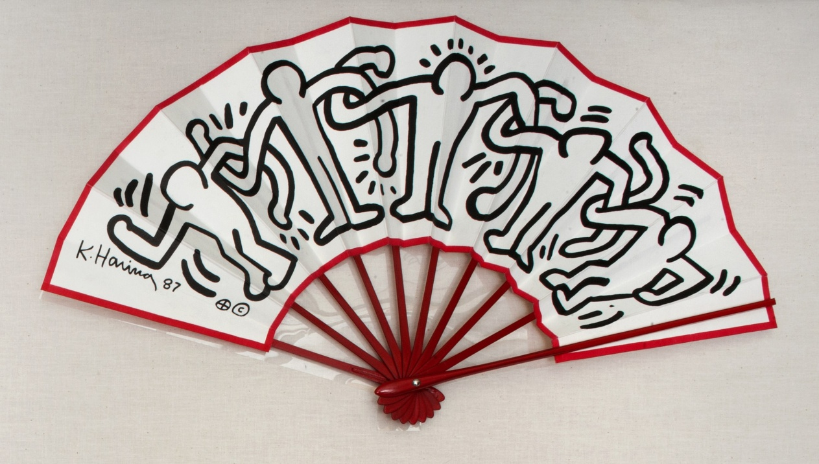
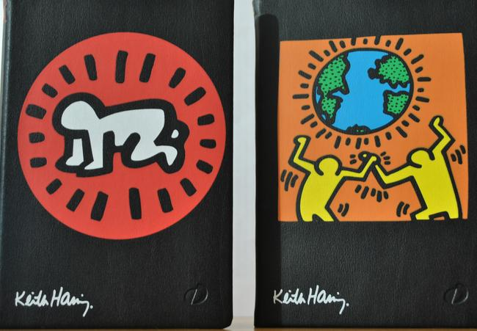
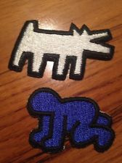
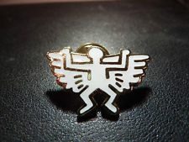
What kinds of things could you buy at the Pop Shop?

Slide 11
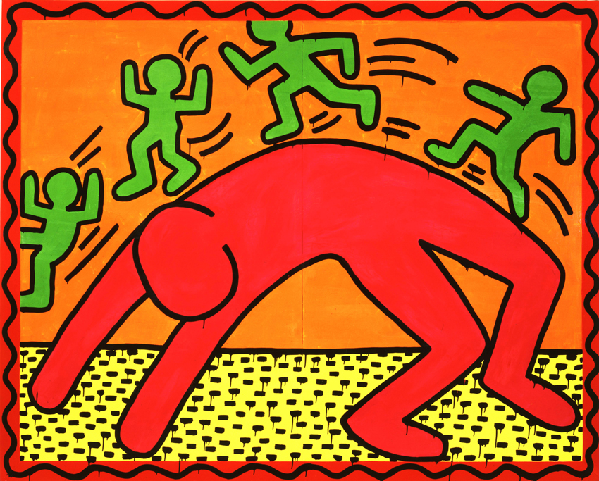
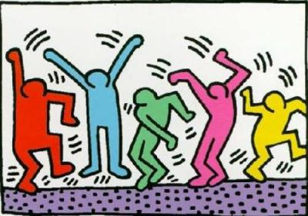
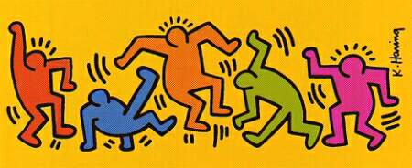
He used action marks to bring his figures to life:

Slide 12
Art Principles Movement & Rhythm
MOVEMENT is the path the viewer’s eye takes through a work of art.
Movement is used to create the look and feeling of action in artwork.
Movement can be directed along lines, edges, shapes and color

Slide 13
Art technique - Metal Tooling
Metal tooling is a centuries-old art
Metal tooling is a soft metal is worked with a rounded tool on the back side in order to create a raised design on the front.
Mexican and South American artists call this art form repajado

Slide 14
Art technique - Embossing
An embossed pattern is raised ridges against the material
A debossed pattern is sunken into the surface of the material
So you tool on one side that is debossed and the other side is embossed
Color on the embossed side

Slide 15
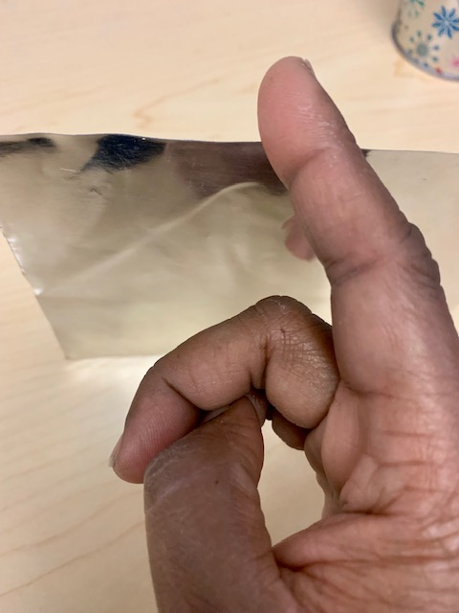
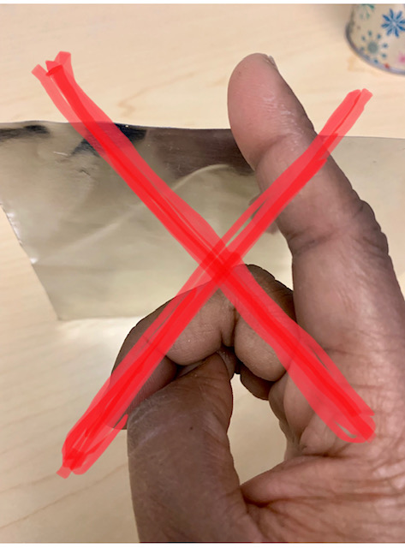
Safety guidelines - working with metal foil
Metal foil can be sharp at the edges
It may be tempting to touch and feel the metal foil
Be gentle. Do not grasp/snatch the metal.
Never run your fingers along the edges of the metal foil
Just like paper cut it can cut your self

Slide 16
Materials
GRADE 2&3
6x6 tin foil (silver for grade 2 & 3)
Grade specific Template
Wooden skewers
Blunt pencil
Tape
Foam sheets
Colored sharpies
Colored construction sheet/any backing paper (All grades)

Slide 17
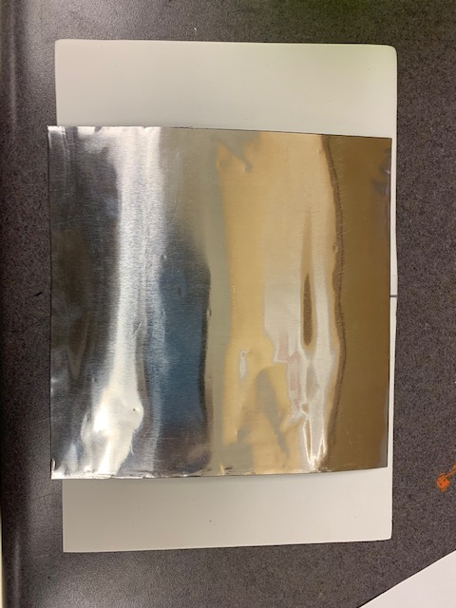
Procedure for Tooling (All grades)
Step 4: Tape the template and the foil on the both sides on the foam sheet
Step 1:Place the foam sheet
Step 2: Then place the tin foil on the foam sheet and tape it
Step 3: Place the template on the foam sheet

Slide 18
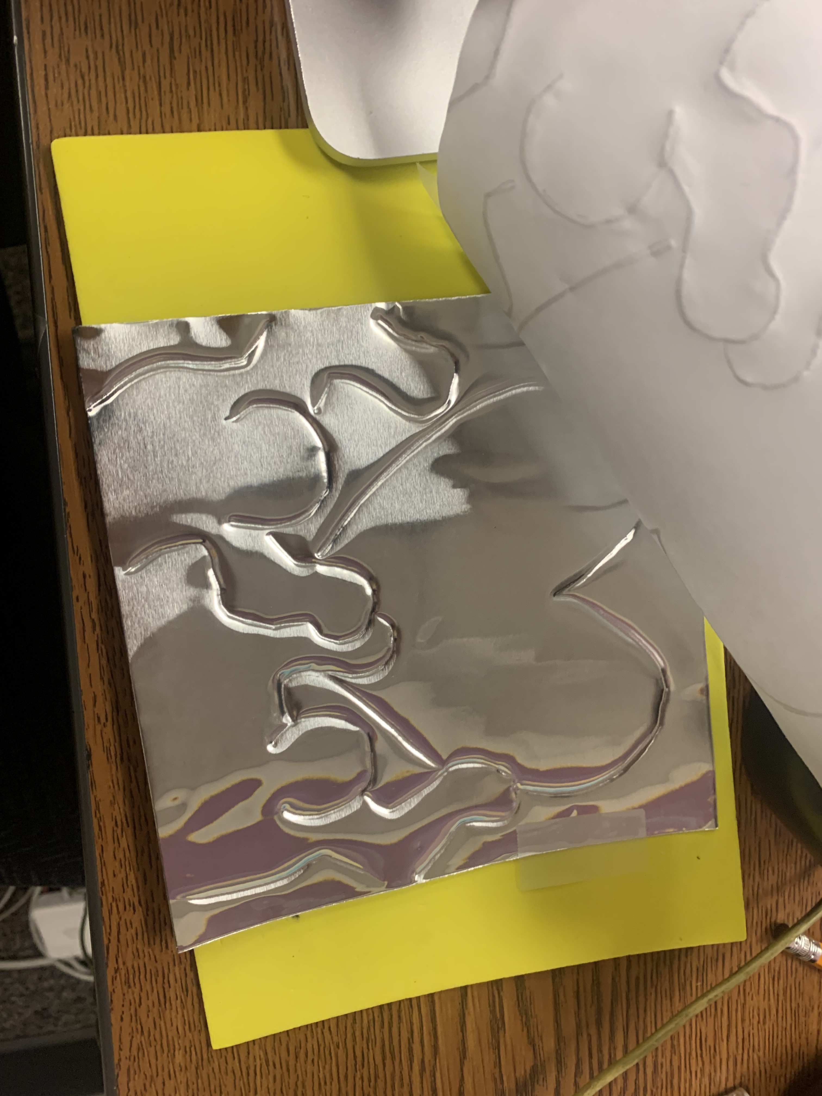
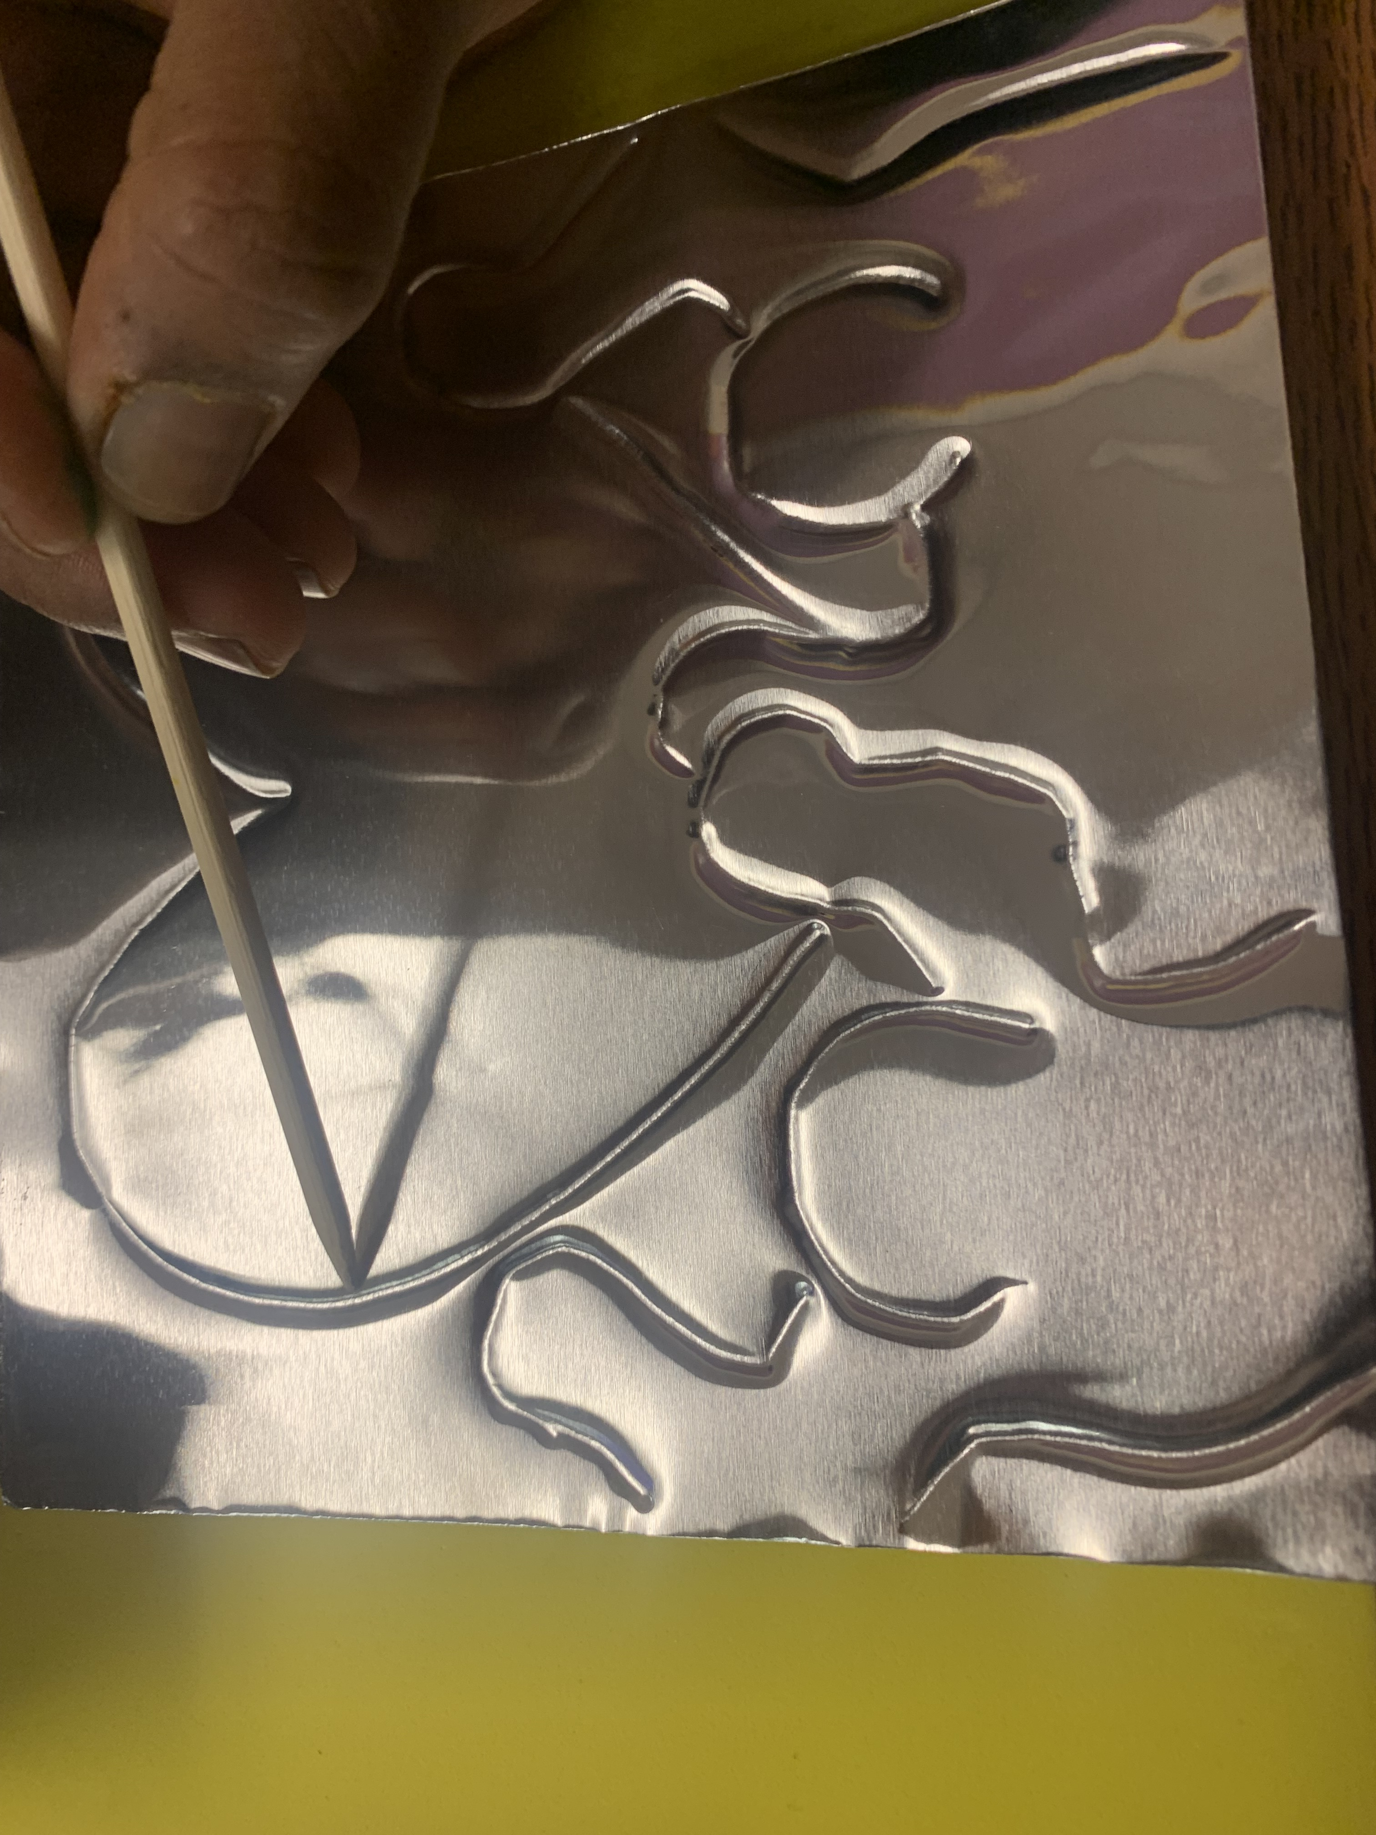
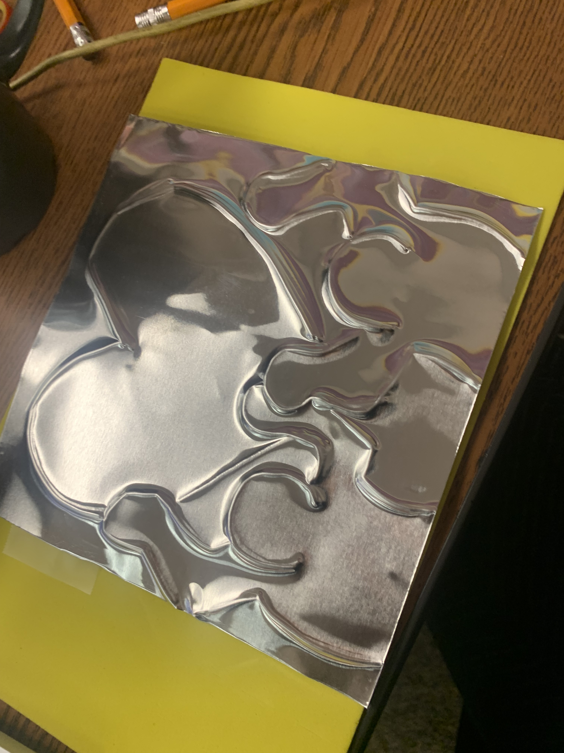
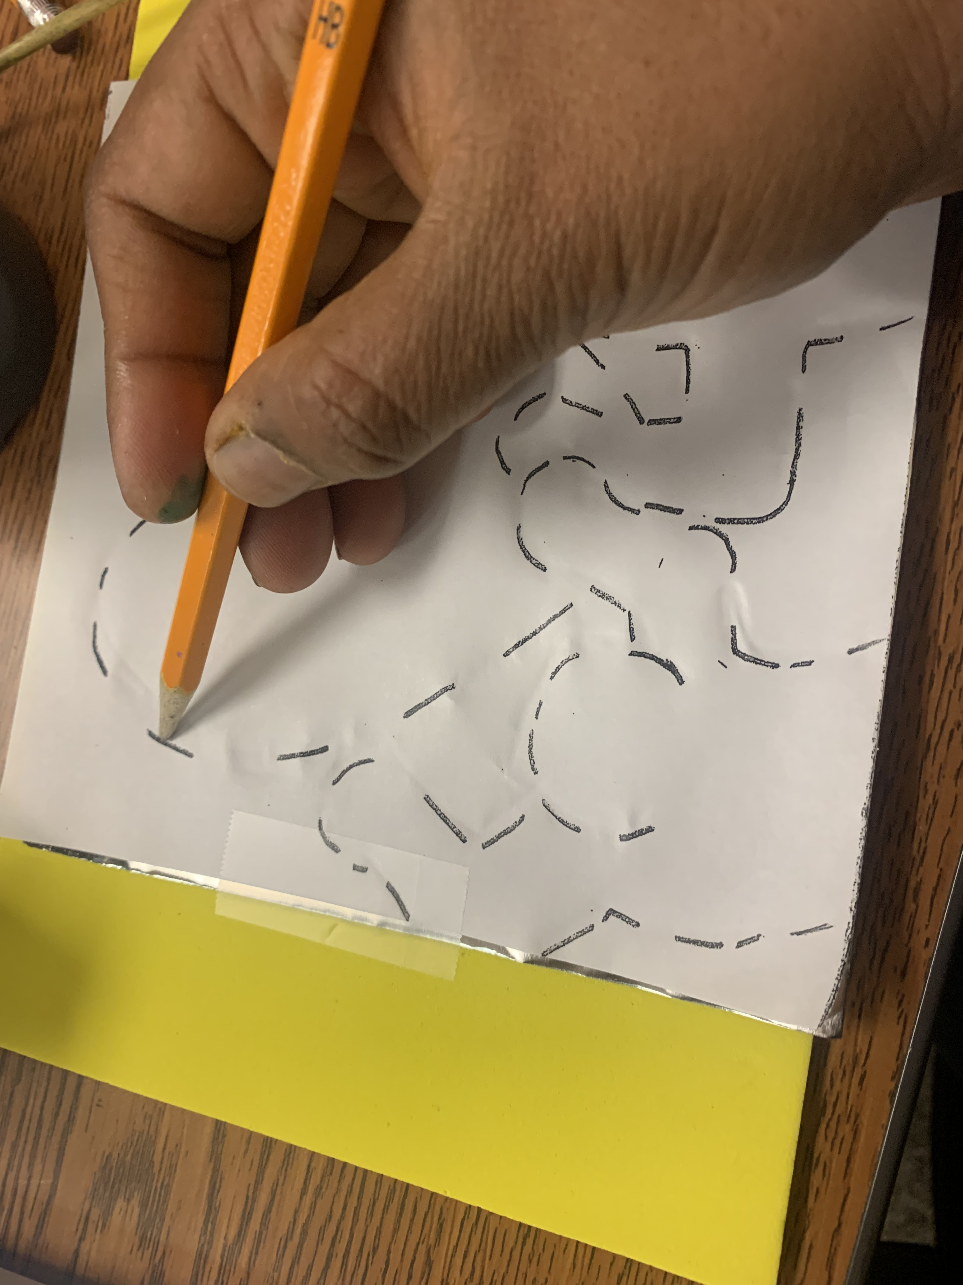
Procedure for Tooling & Embossing (All grades)
Step 7: Retrace the lines using wooden skewers or pencil to make sure the tooling has depth
Step 8 : Flip the foil to see the embossed side
(The ridges are clear)
Step 6: Remove the tape and the template once completed
Step 5: trace the image hard and connect the dots using a blunt pencil

Slide 19
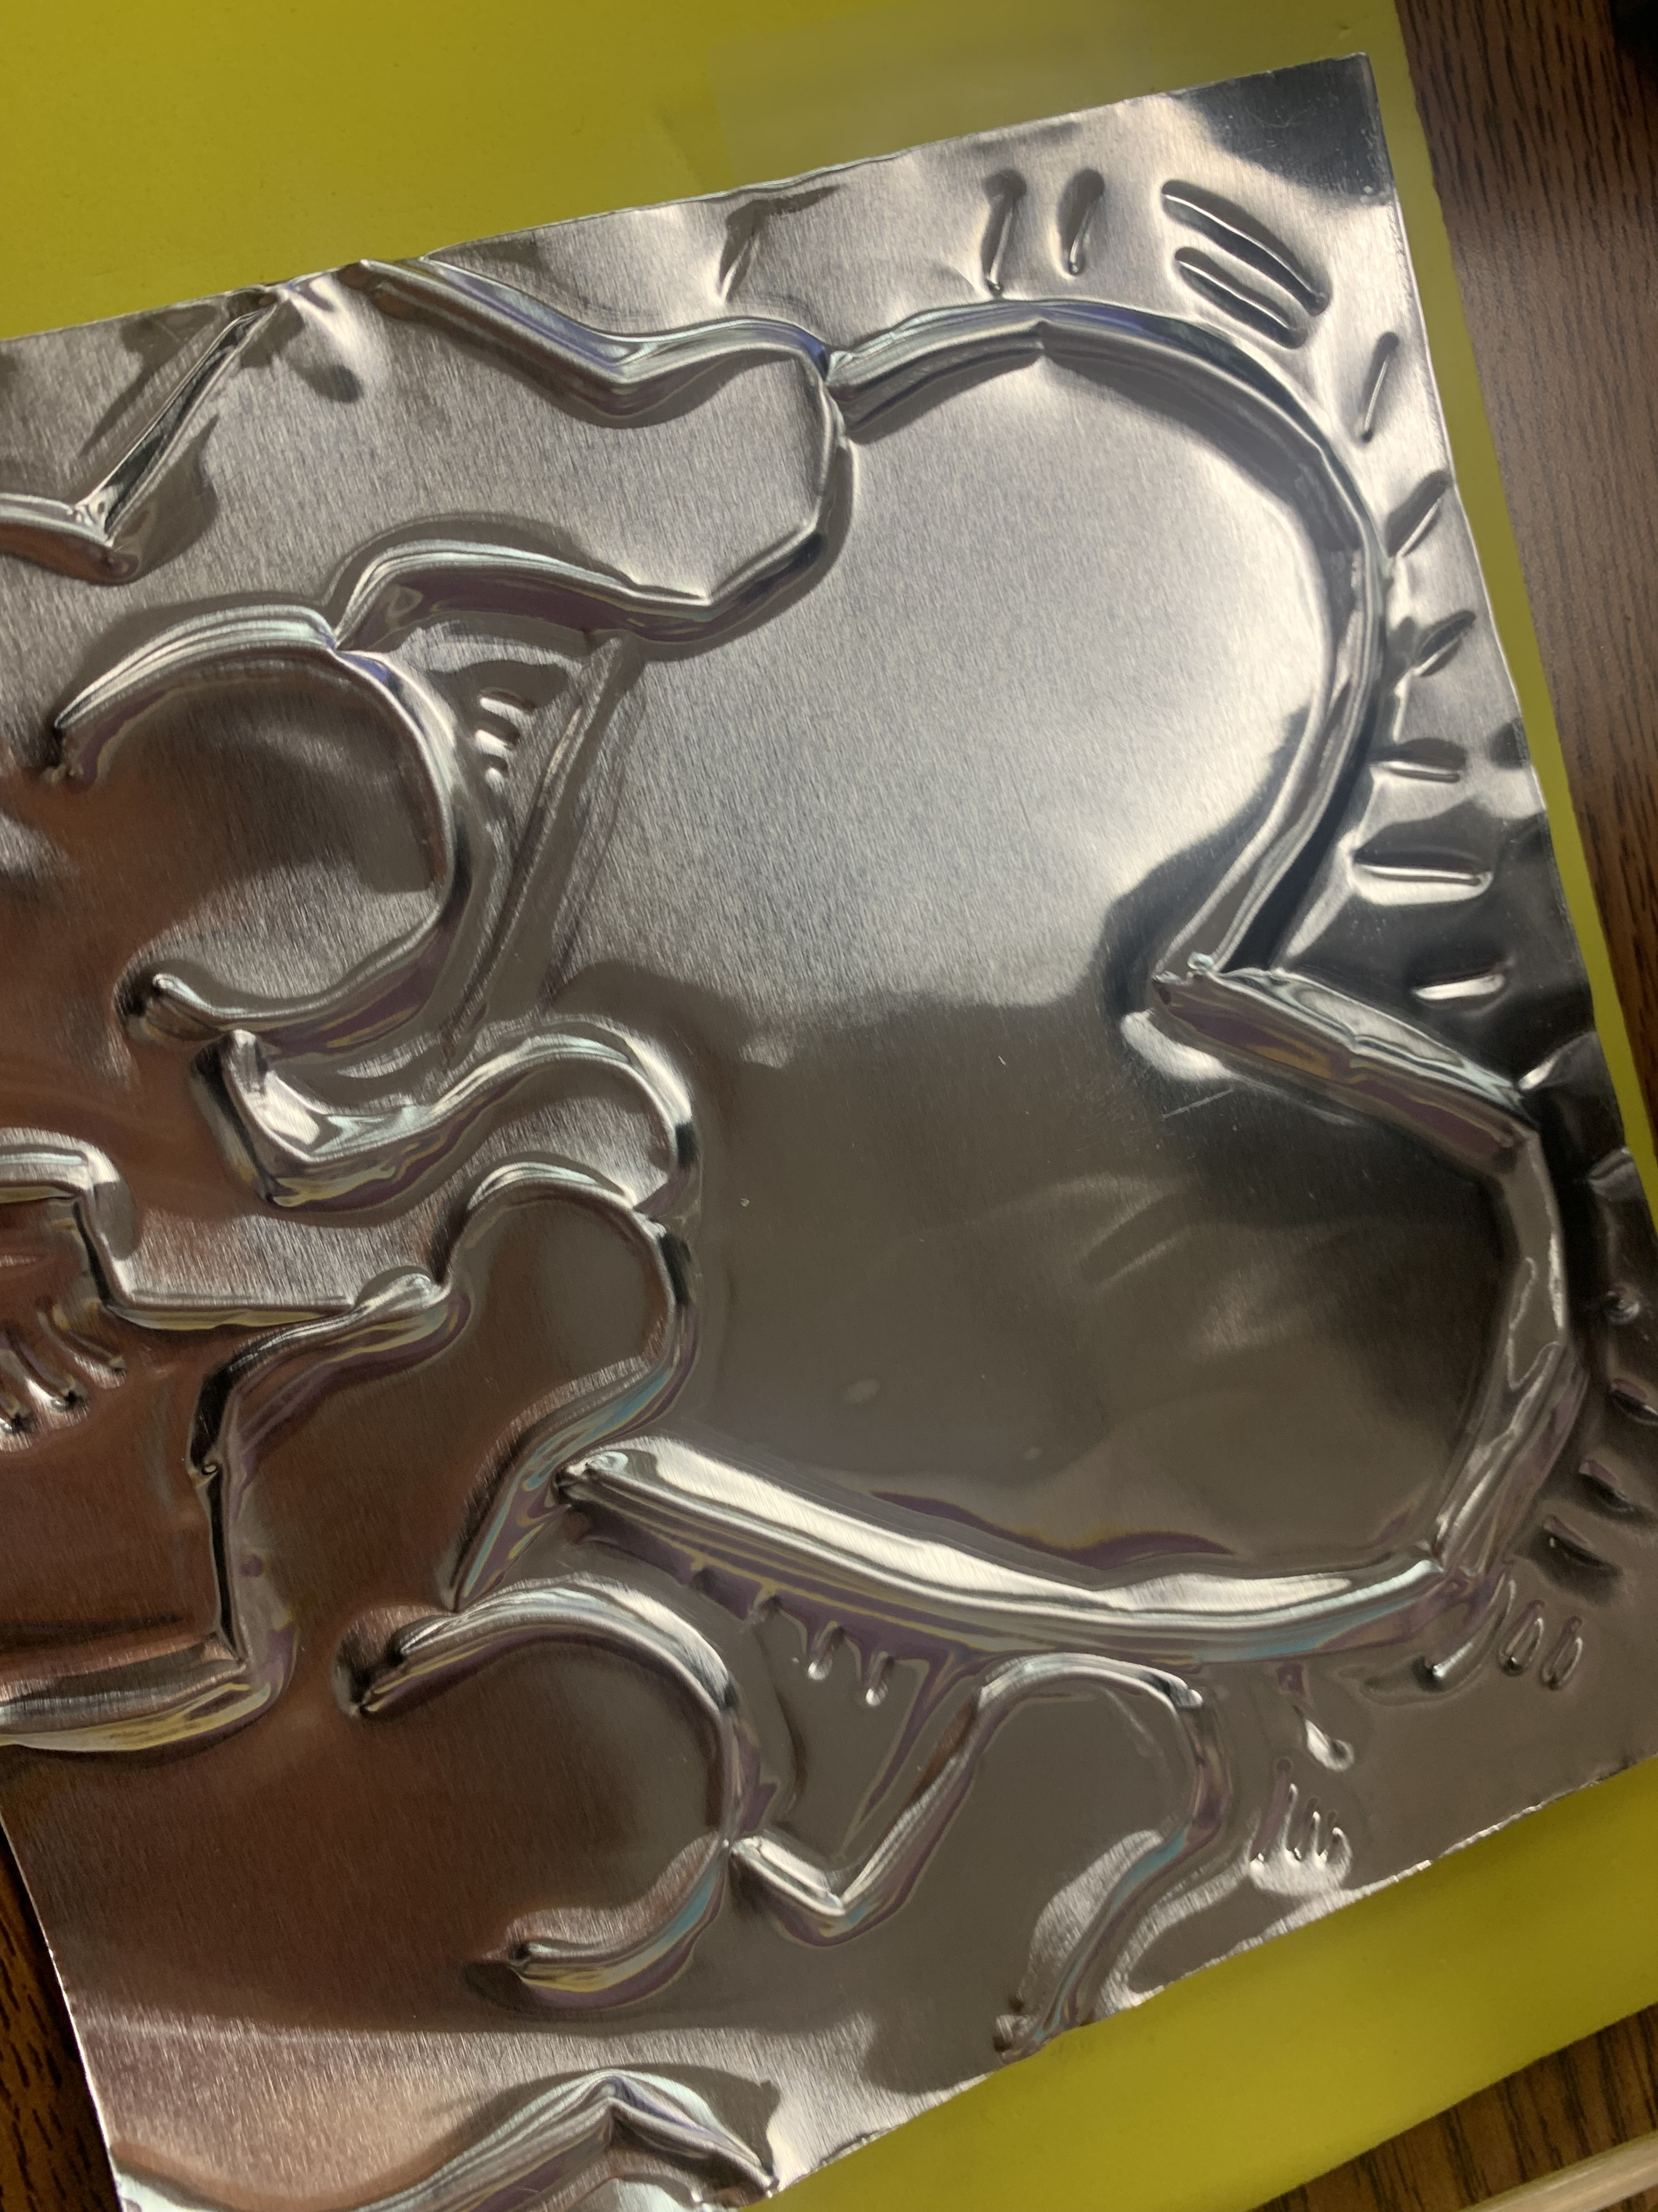
Procedure for Tooling & Embossing (All grades)
Step 10: The raised lines are the embossed part(protruding lines) – Color only the inside of the heart and person with sharpie
Step 9: Retrace both outside the shapes and inside the shapes with the back of wooden stick or back of the pencil that has eraser.
- Remember to add action marks
Step 11: Place foil on the backing paper. Tape the four corners and write your name.

Slide 20
Art show – May 10 – 5:00pm – 7:00pm
2022 Art Show -https://www.youtube.com/watch?v=qI19l1ugCA4
Interactive mural in the amphitheater
2 pieces of art per class - Choose here by April 15th
2 Labels will be created
Mounting instructions – given at the next meeting - Mounted art to be submitted by May 5th
Mounting materials (April 23 in the MPR) – other days following the April 23 in art room
Volunteers needed – Day of the event – Sign up genius will be sent – Please sign up

