Slide 1
Clay project
April 2023
Rajee Subramanian
Quail Run Elementary

Slide 2
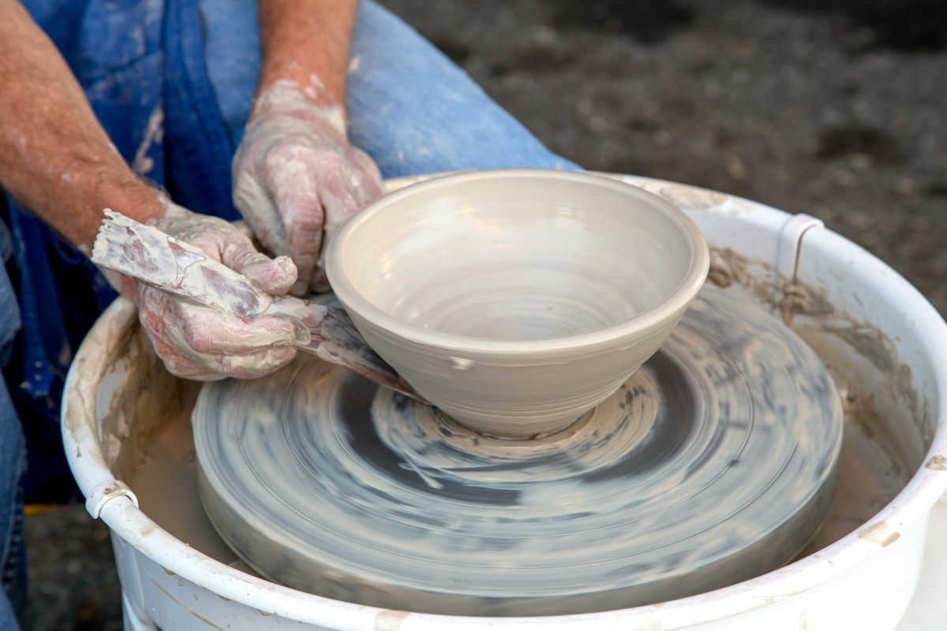
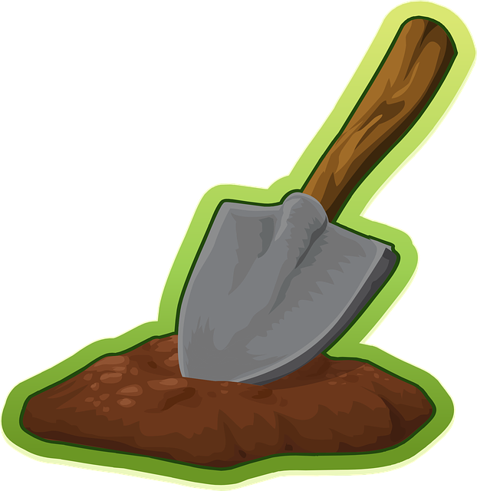
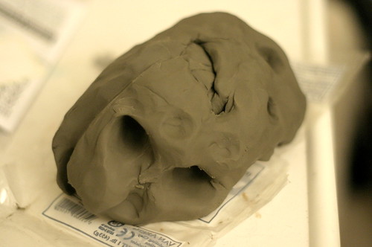
What is clay?
Anything that you can squish, mold and create is called clay.
What is clay made of?
Dirt and Water makes clay – All materials found in nature

Slide 3
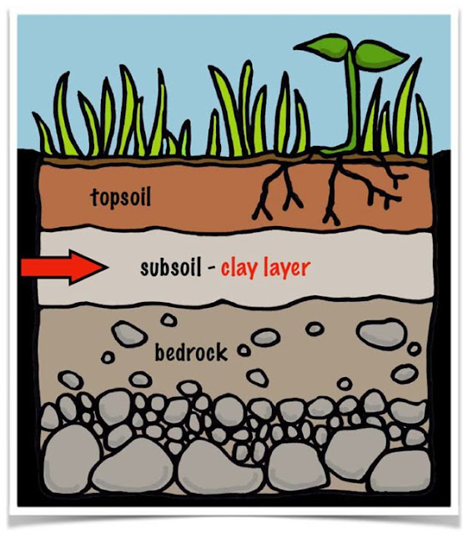
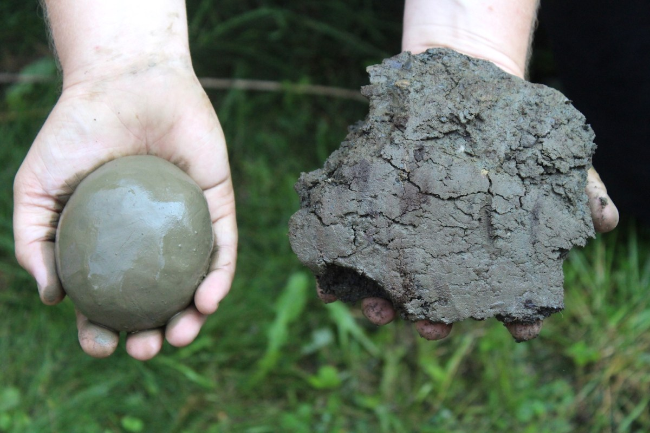
How is clay formed in Nature?
Clay is formed by decomposition of rocks through the weathering action
Over time bits of earth/broken rocks are carried by rain water traveling from one place to the other and settles in areas.
Top soil covers the clay layers.

Slide 4
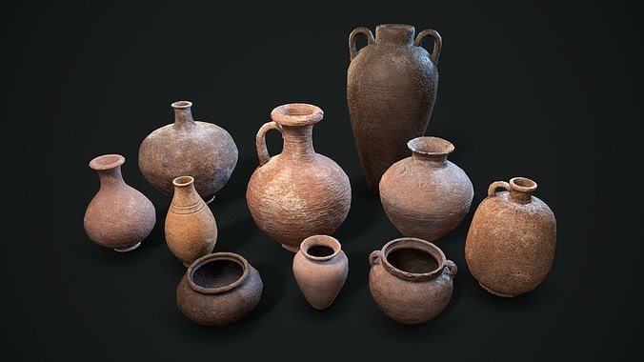
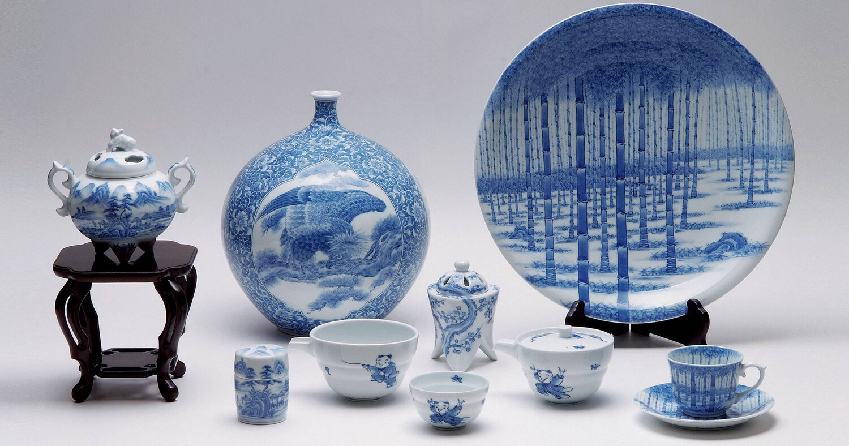
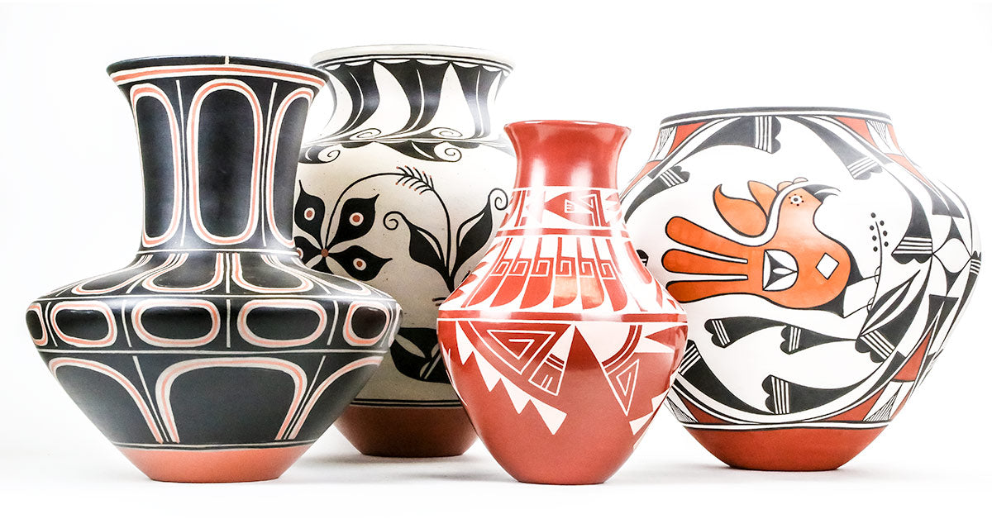
History of pottery
Ancient man found that the clay found in nature can be molded and made into pots to use for cooking and as decorative piece
Middle eastern countries – 7,000 BCE
Asian counties – 4,000 BCE
American Countries - 1,000 BCE
All about history of pottery
https://youtu.be/08mkqd7Skmw

Slide 5
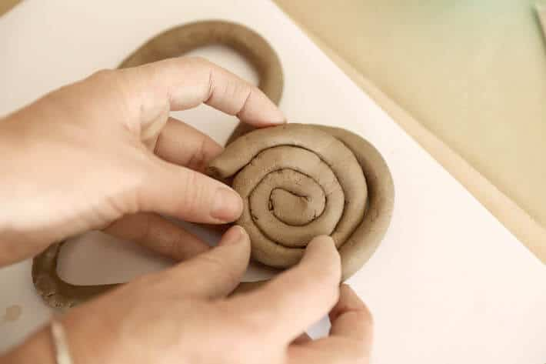
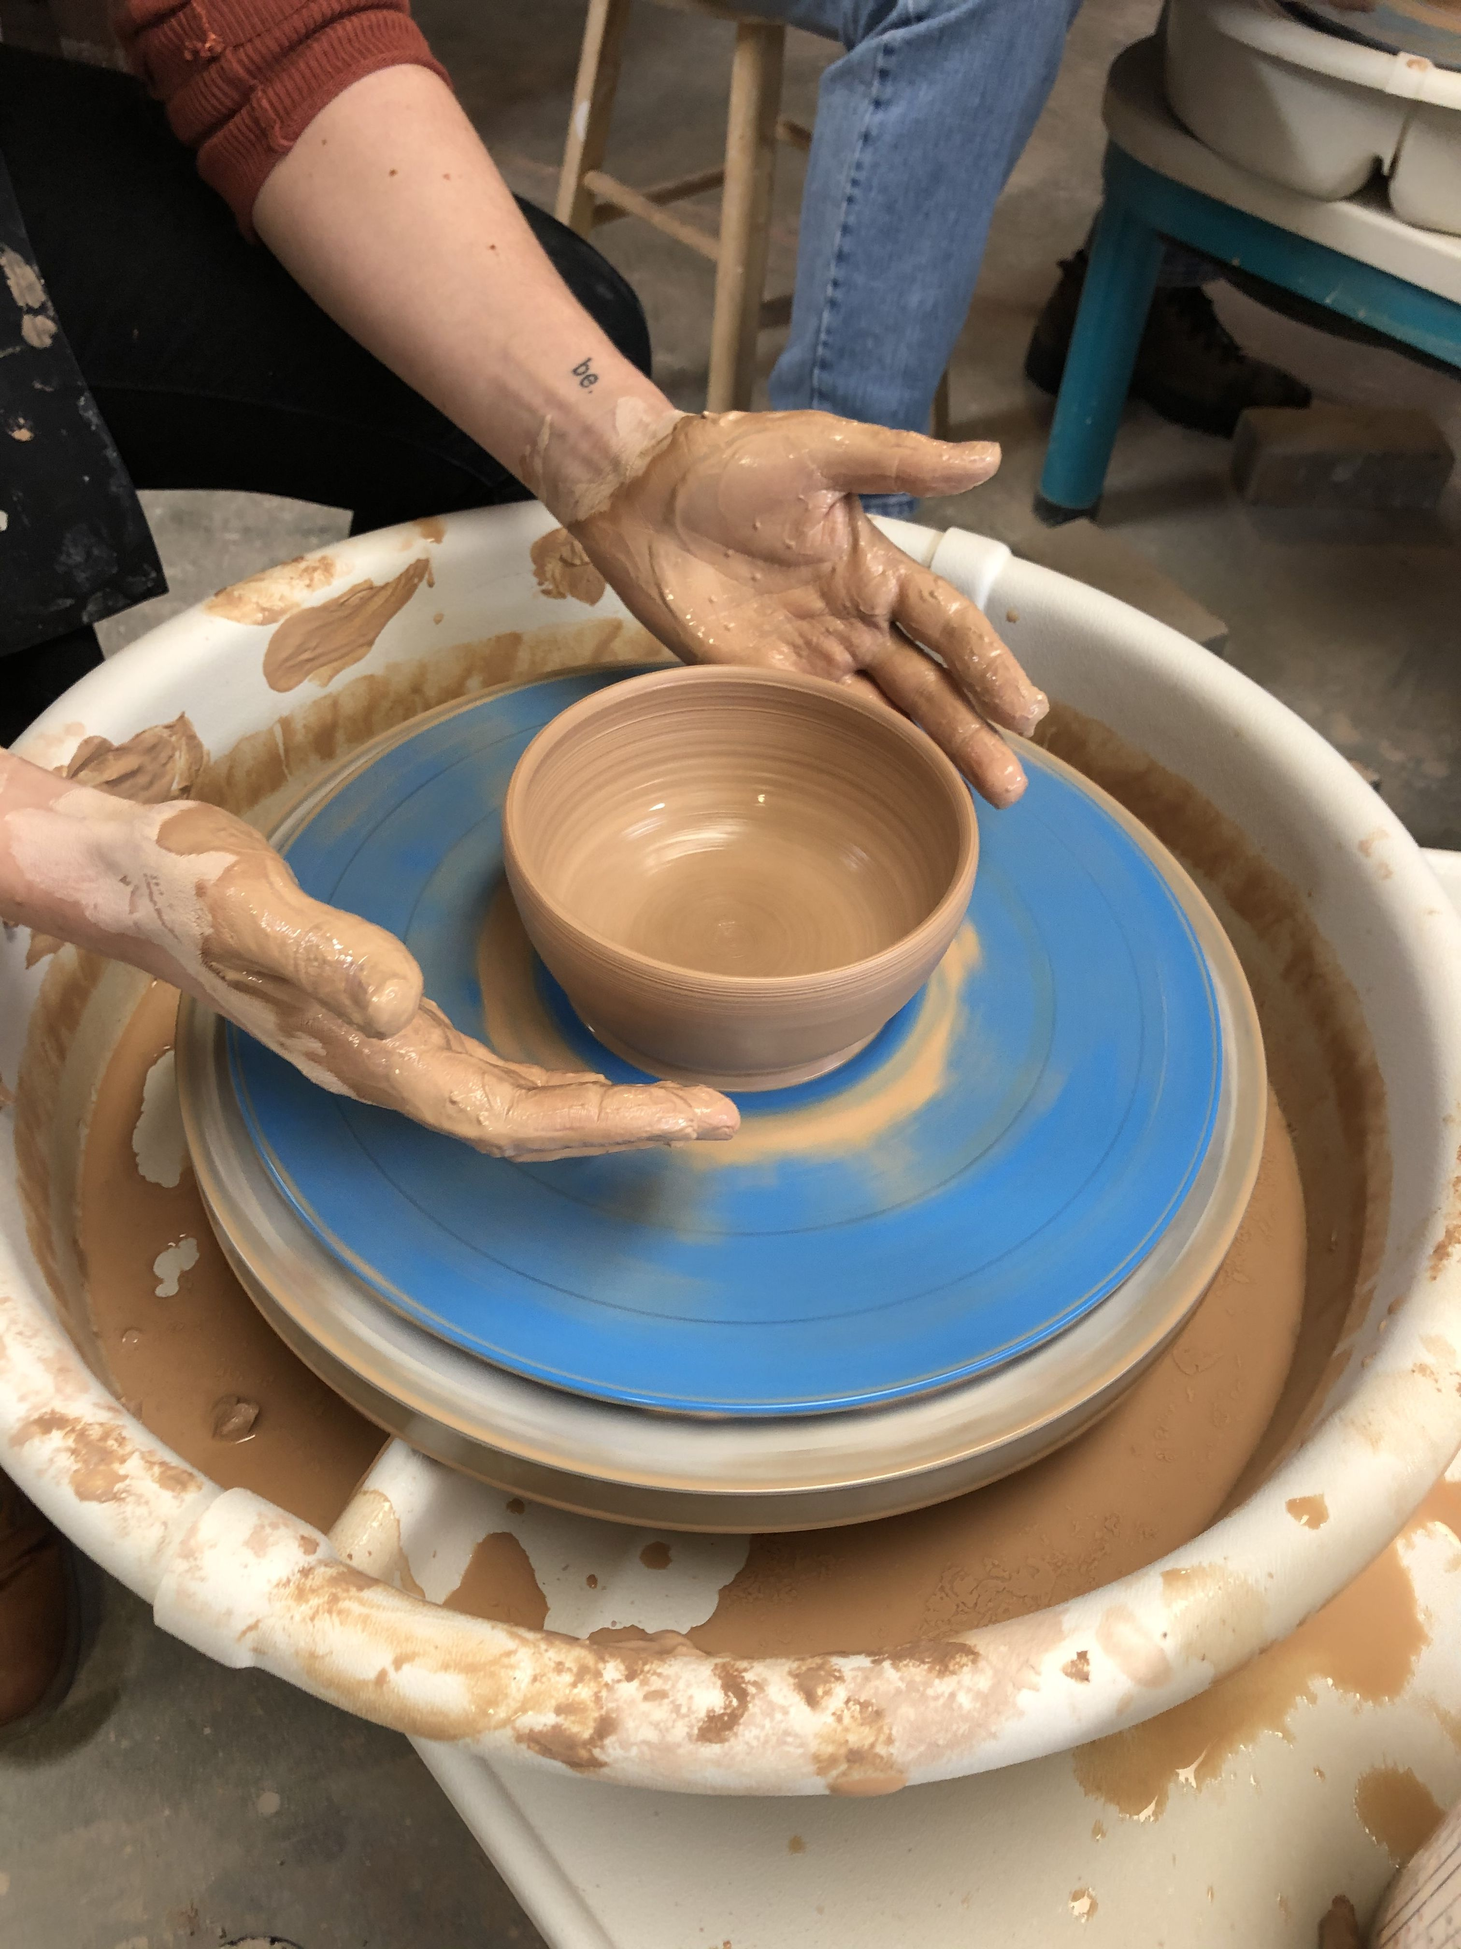
Different ways of working with clay
Roll – Slab roll and cut to assemble
Coil – Make long coil snakes and stack
Pinch – Use fingers to pinch and mold
Wheel
Today we will use our fingers and hand to make our model

Slide 6
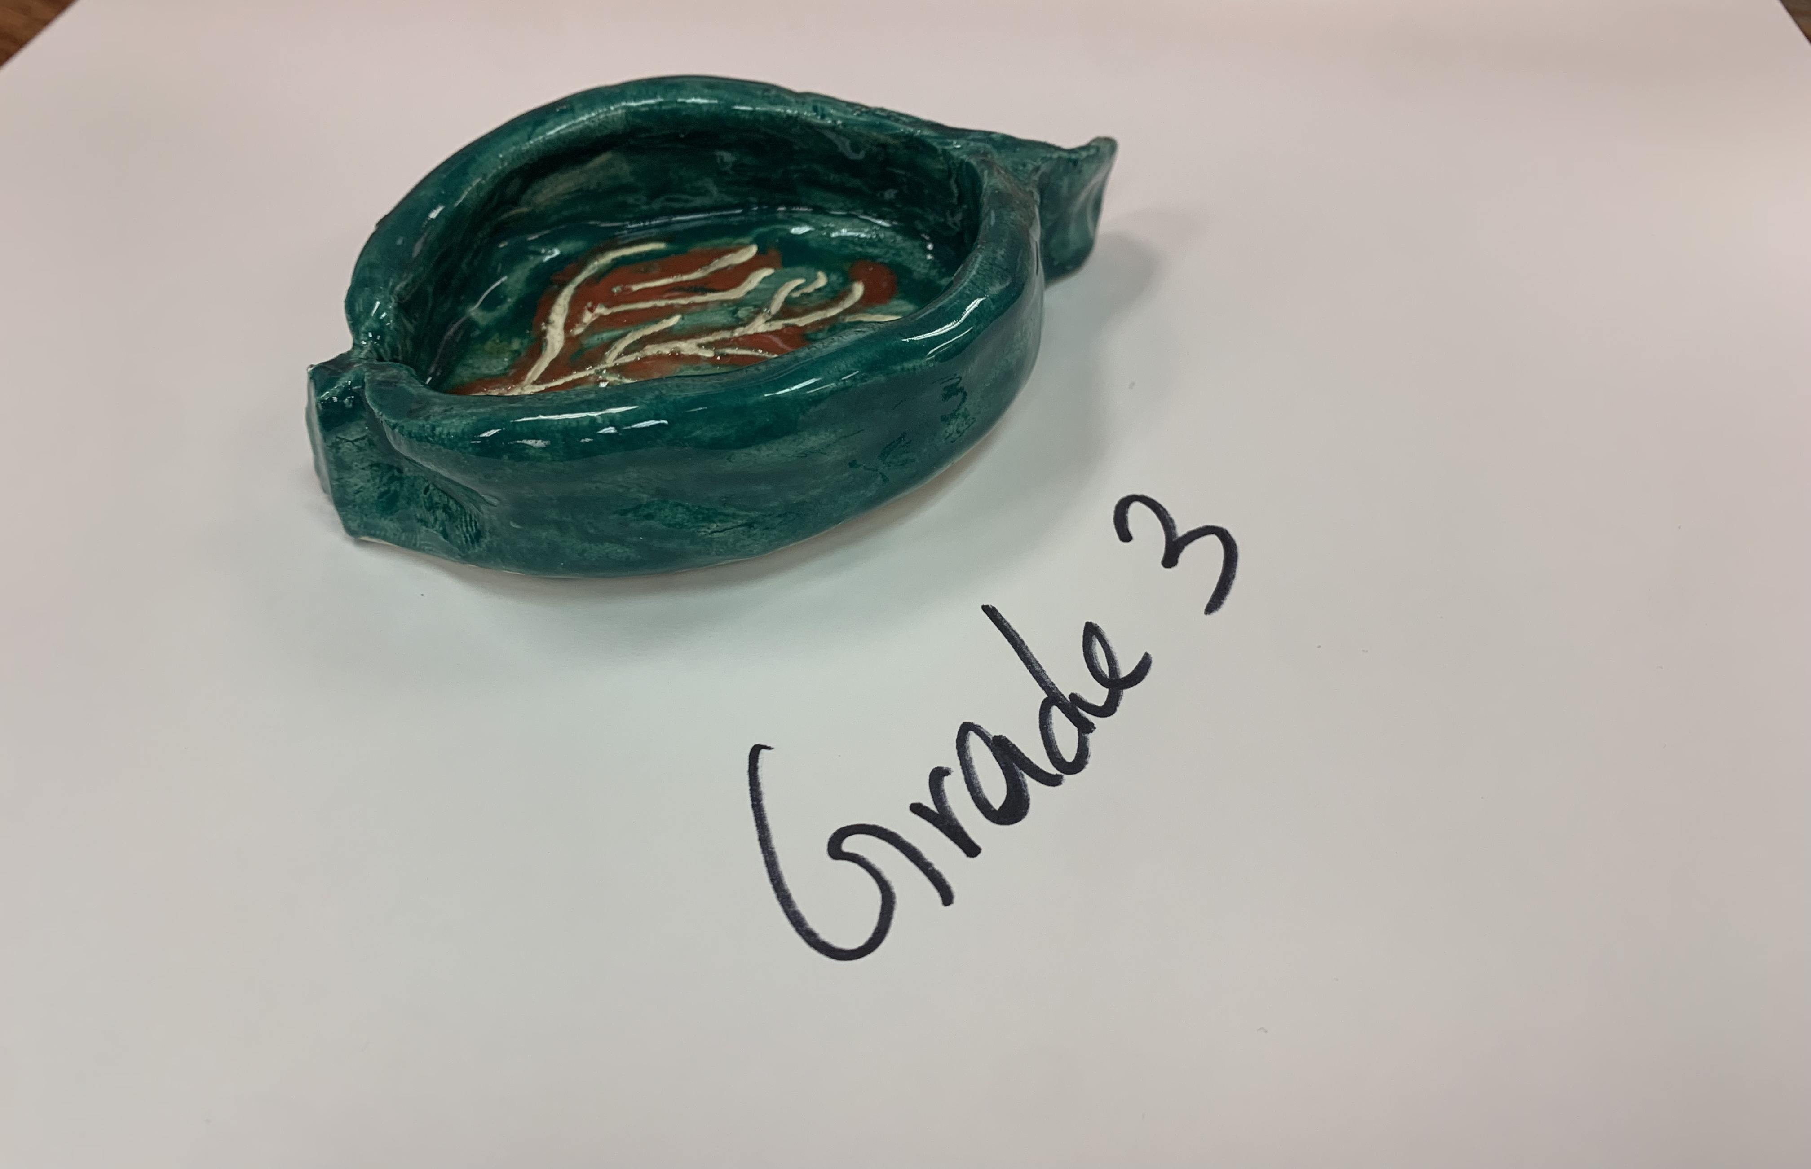
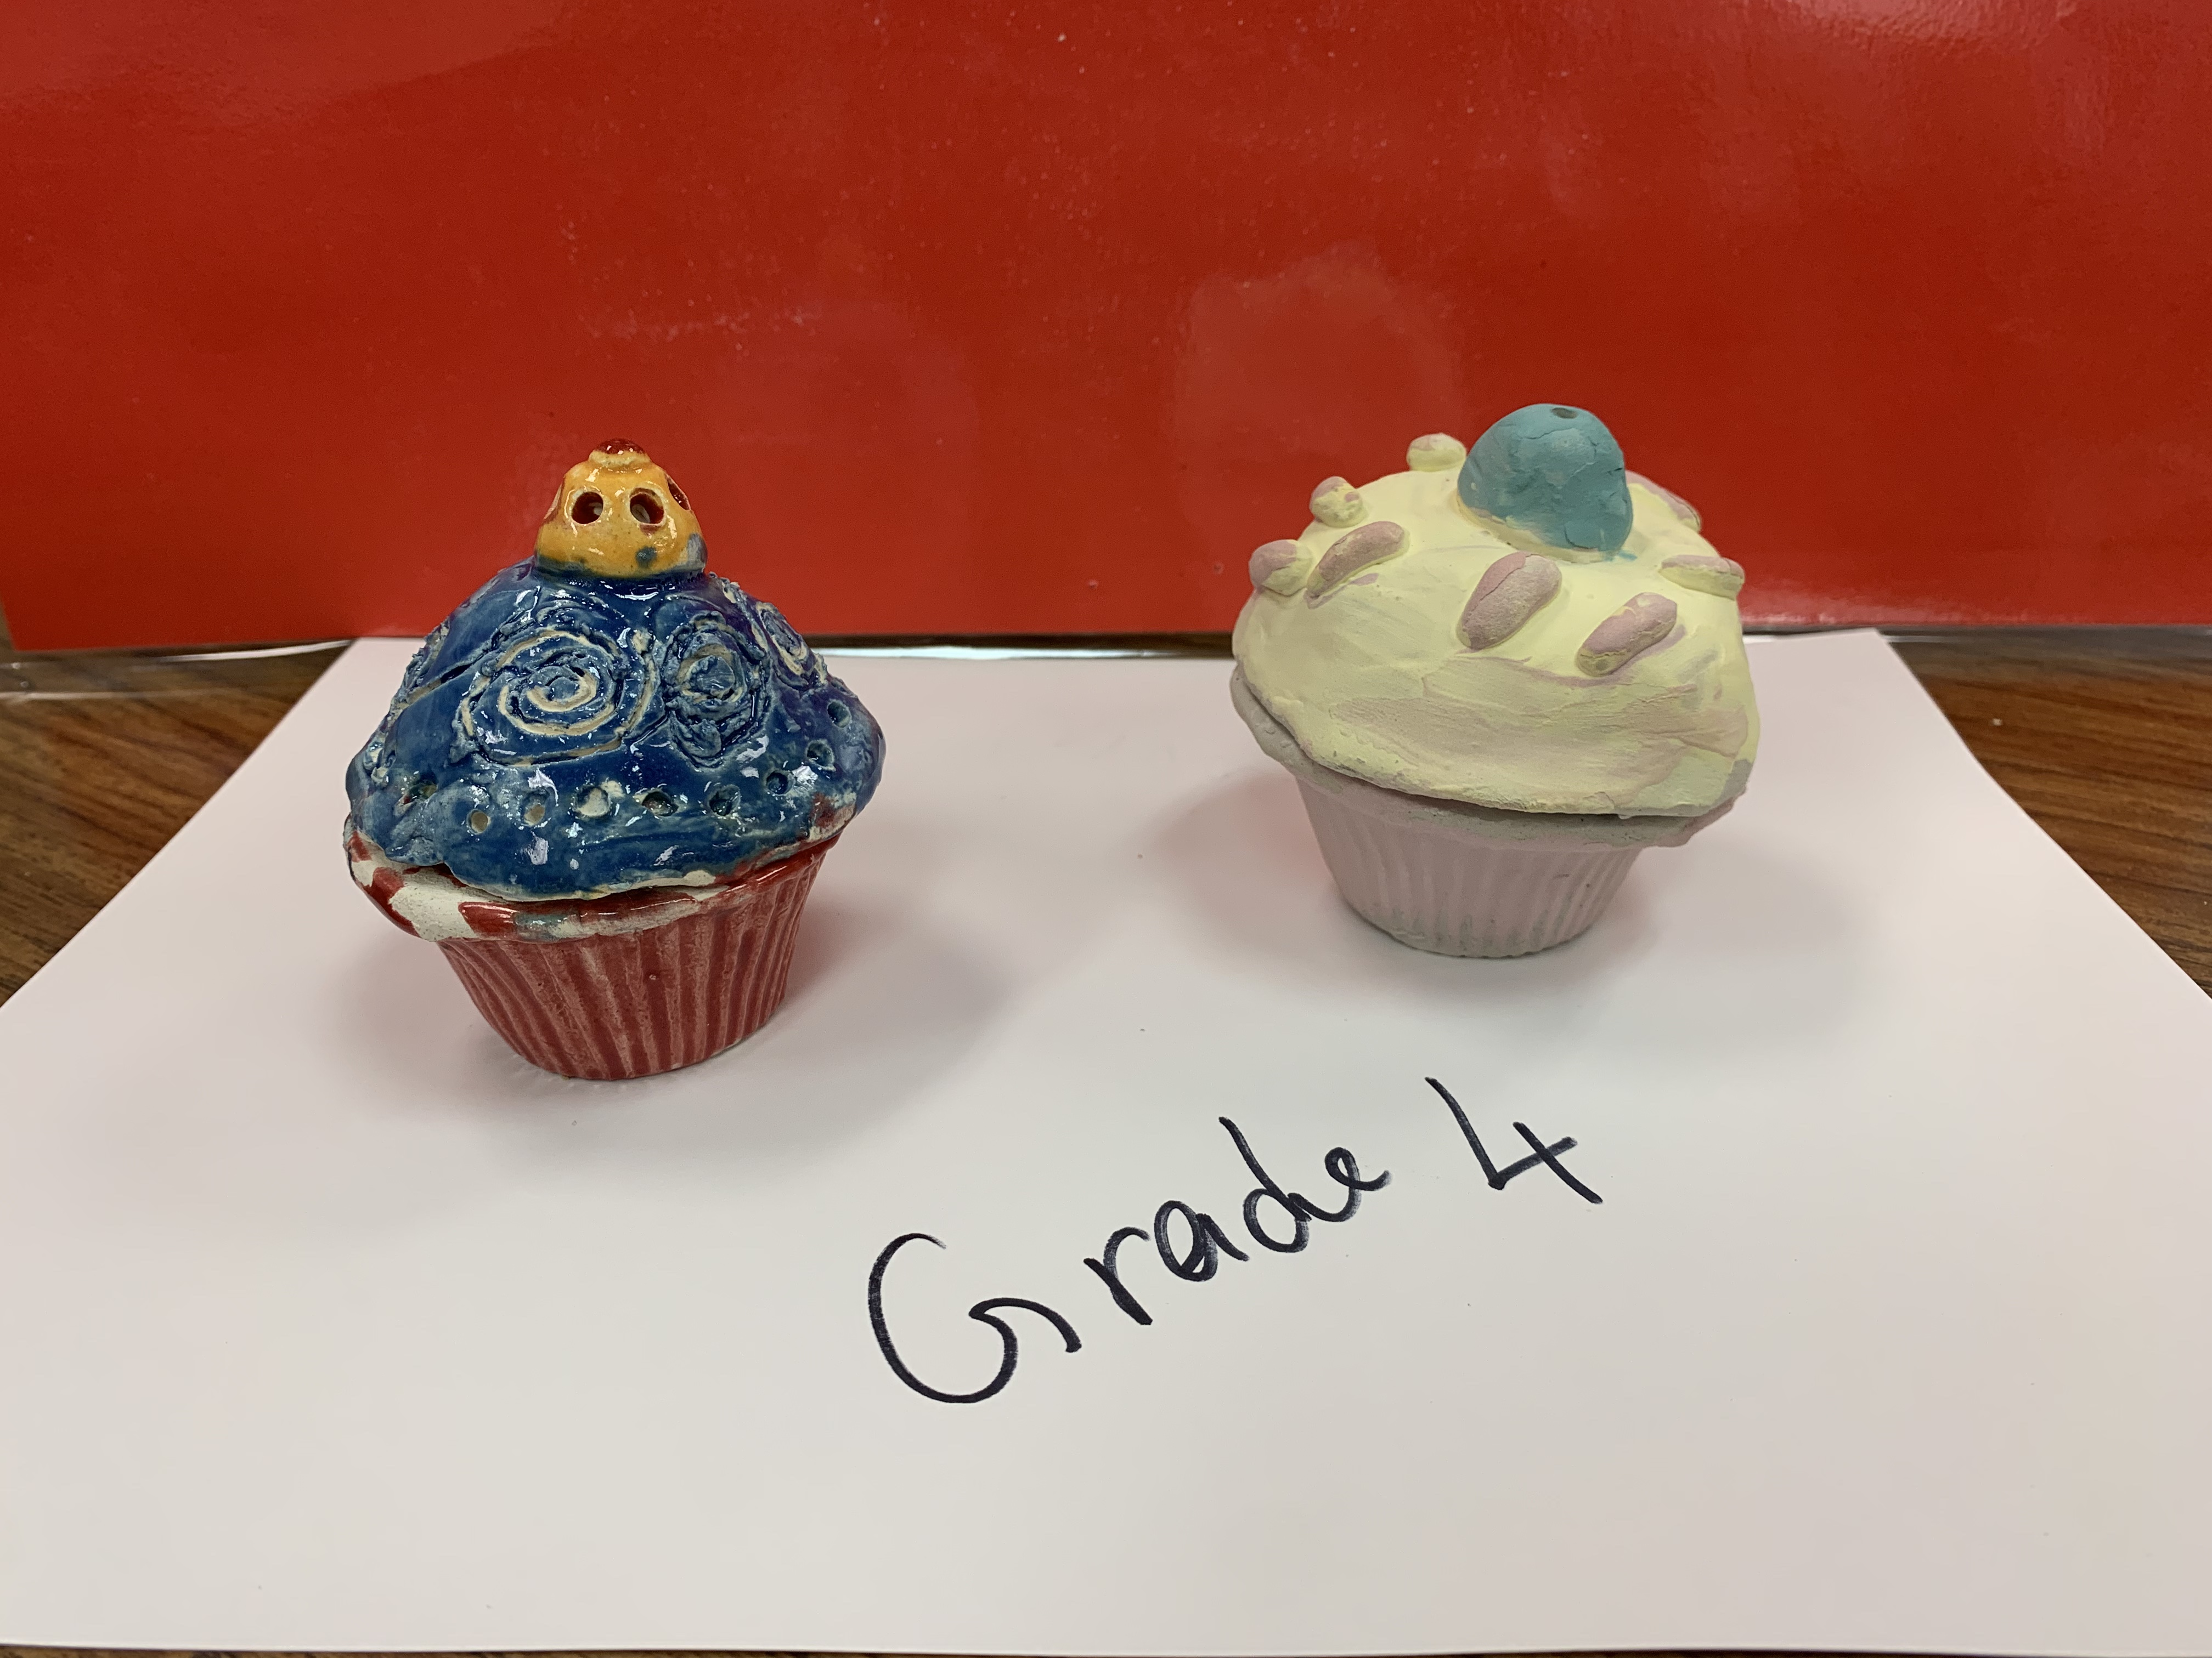
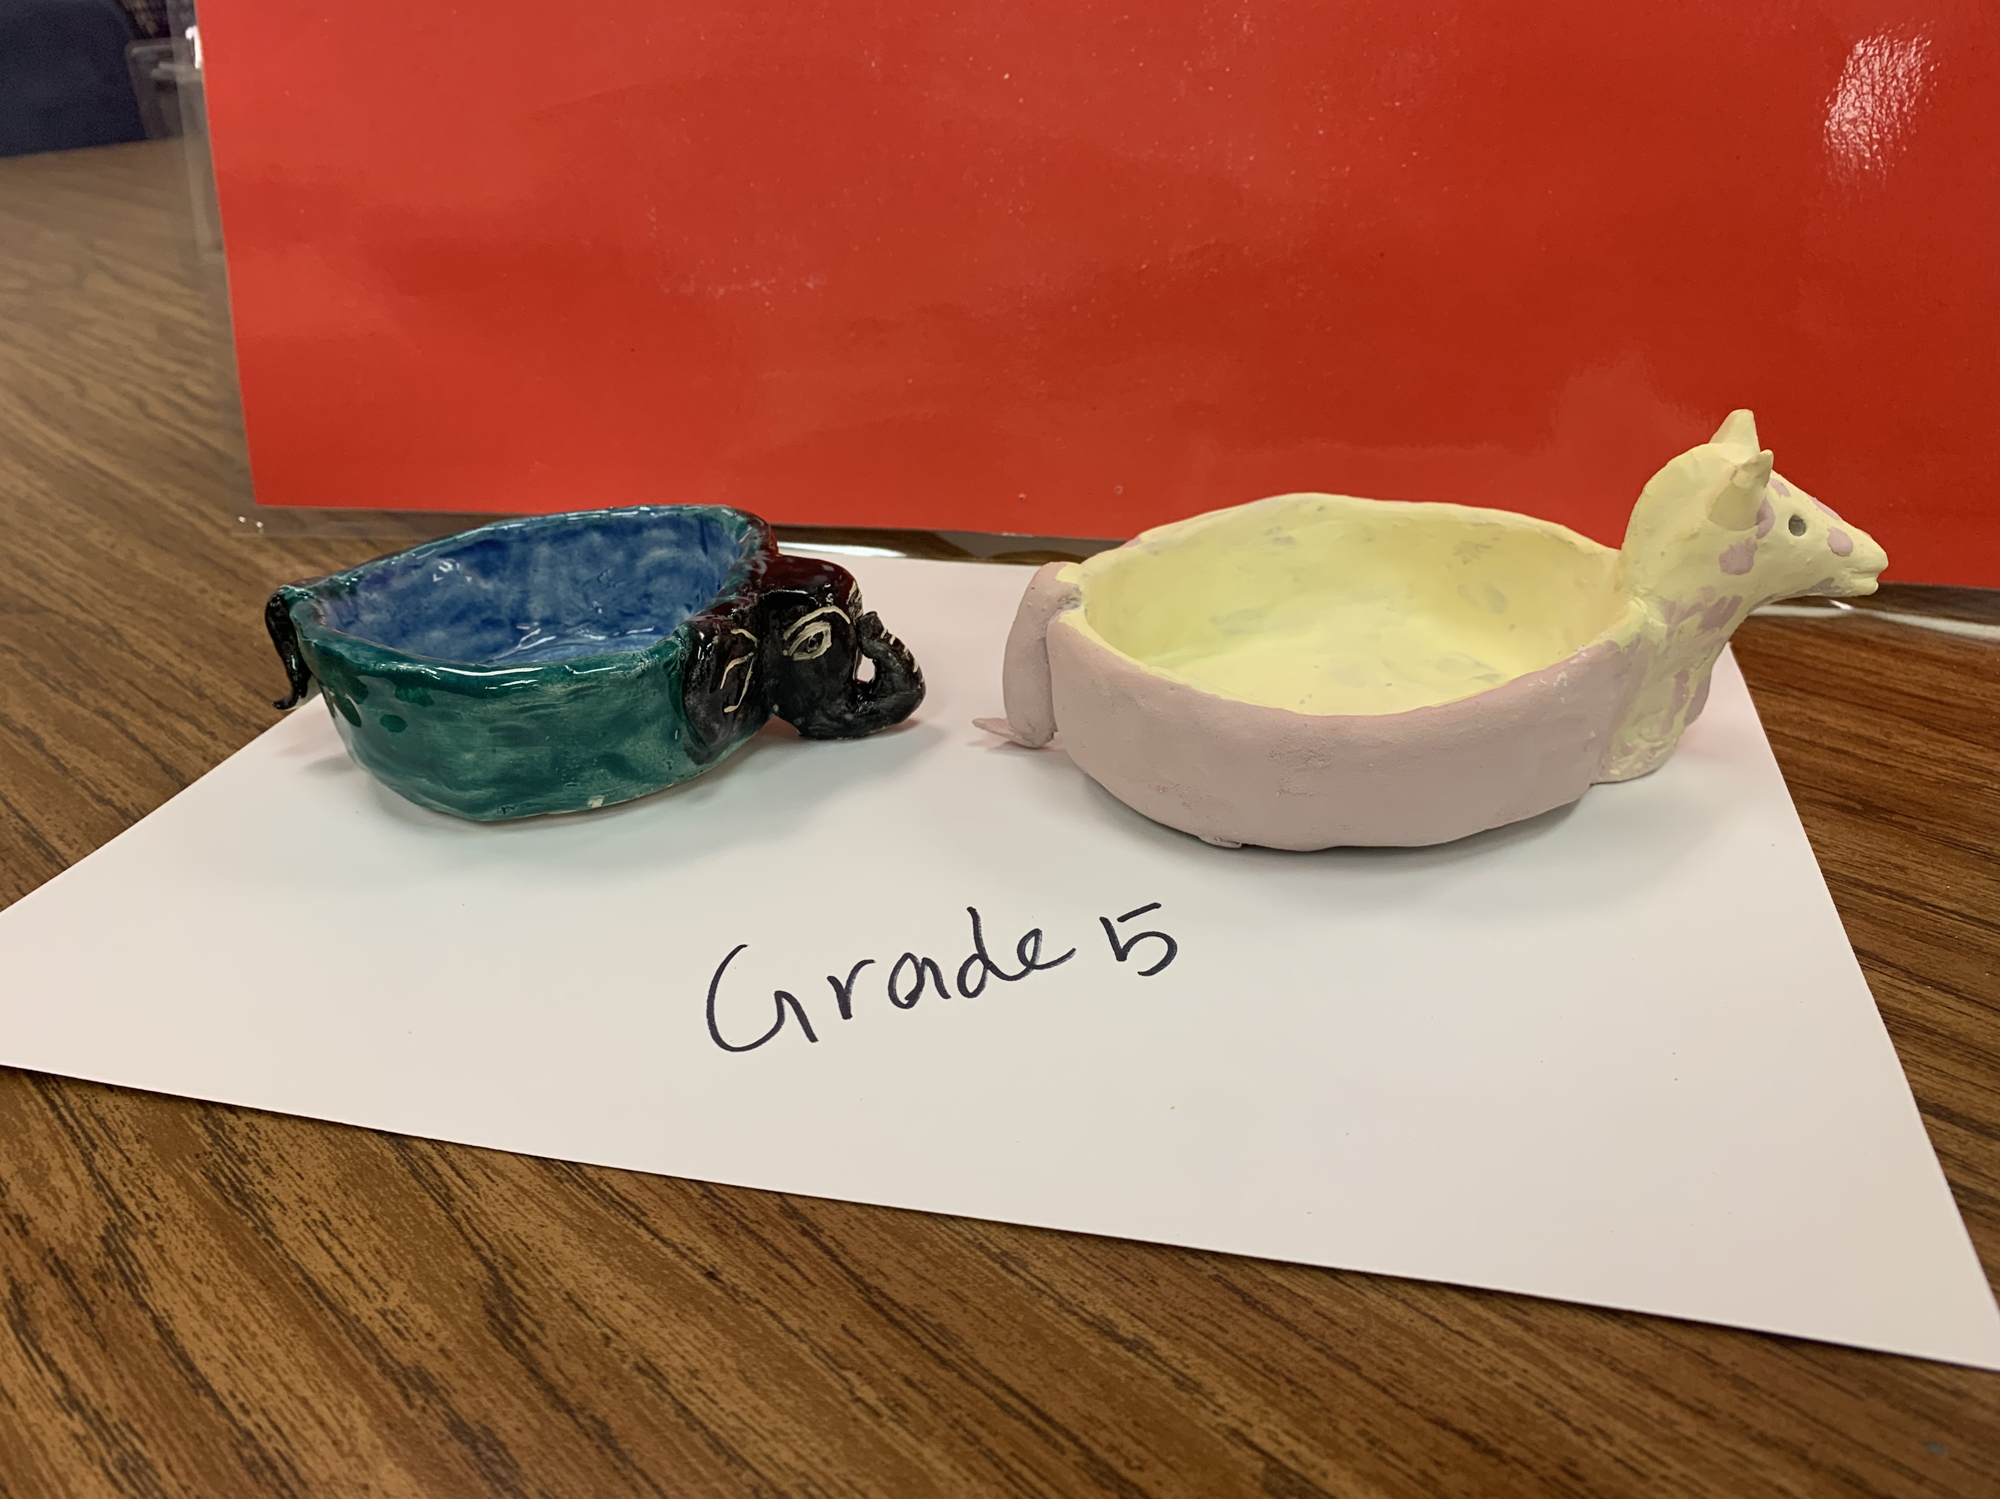
Grade specific clay project
Tk, Kinder, Grade 1
Grade 1 can also make Grade 2 project
TK – Grade 2 no need to fire in the kiln

Slide 7
Materials
TK, Kinder, Grade 1
Air dry clay – slightly bigger than a size of a cuties (orange)
Skewer sticks
Place mat
Clay shape stamps
Piece of white construction paper
One brush per student
Acrylic paint
Plastic water cups to drip the stamps
Paper napkin
Mod podge – Optional
Yarn

Slide 8
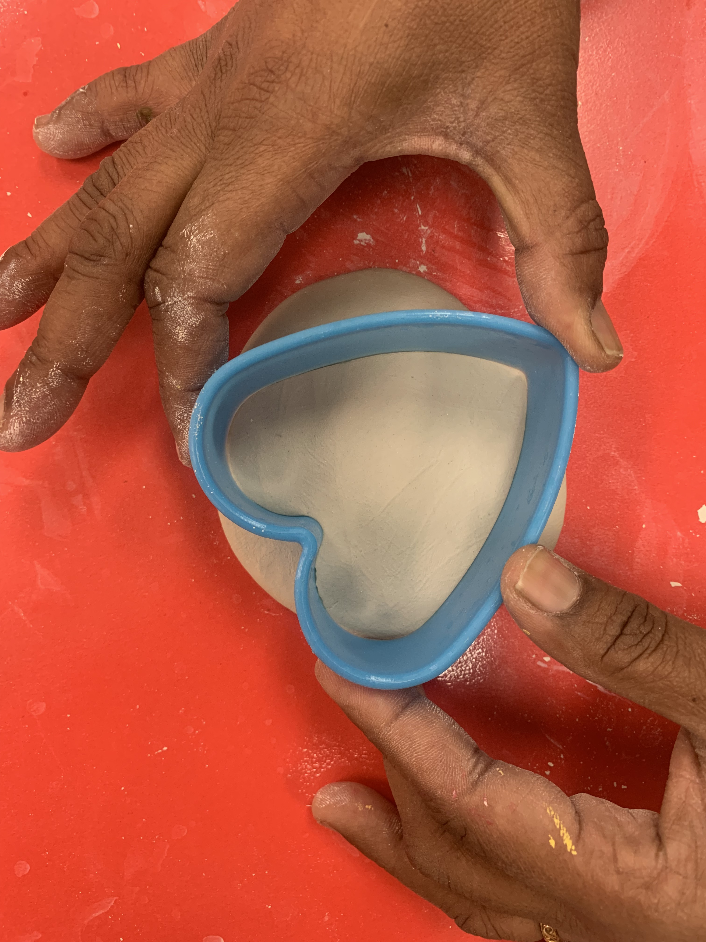
Tk, Kinder, grade 1 Procedure
After assuring the thickness of the clay, pick a cookie cutter to cut out the shape
Place it on the plastic sheet and use your palm to flatten the clay
the thickness of the clay should be an Oreo cookie size
Roll the clay into a smooth ball, use pressure
Peel of the excess clay on the sides of the cookie cutter

Slide 9
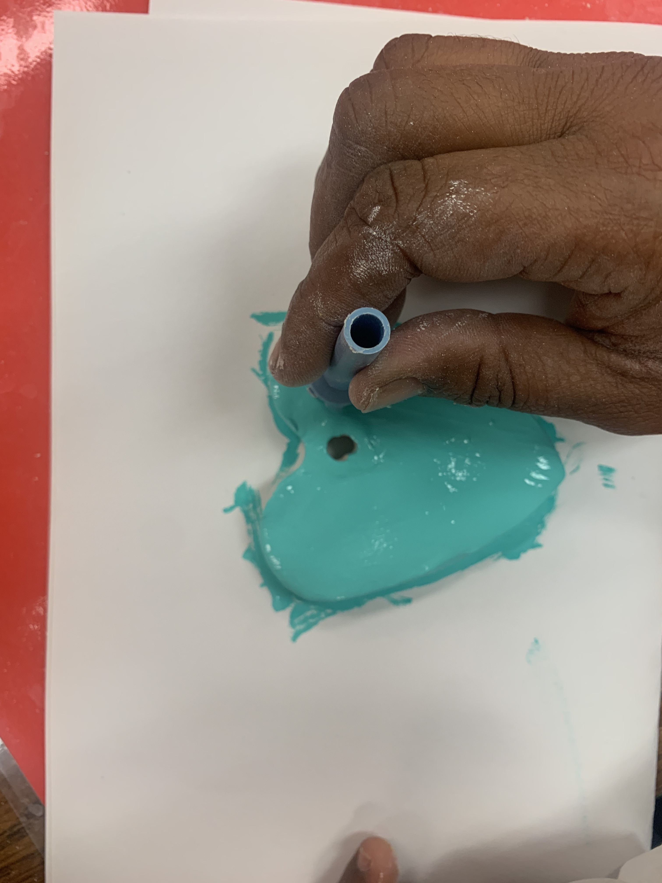
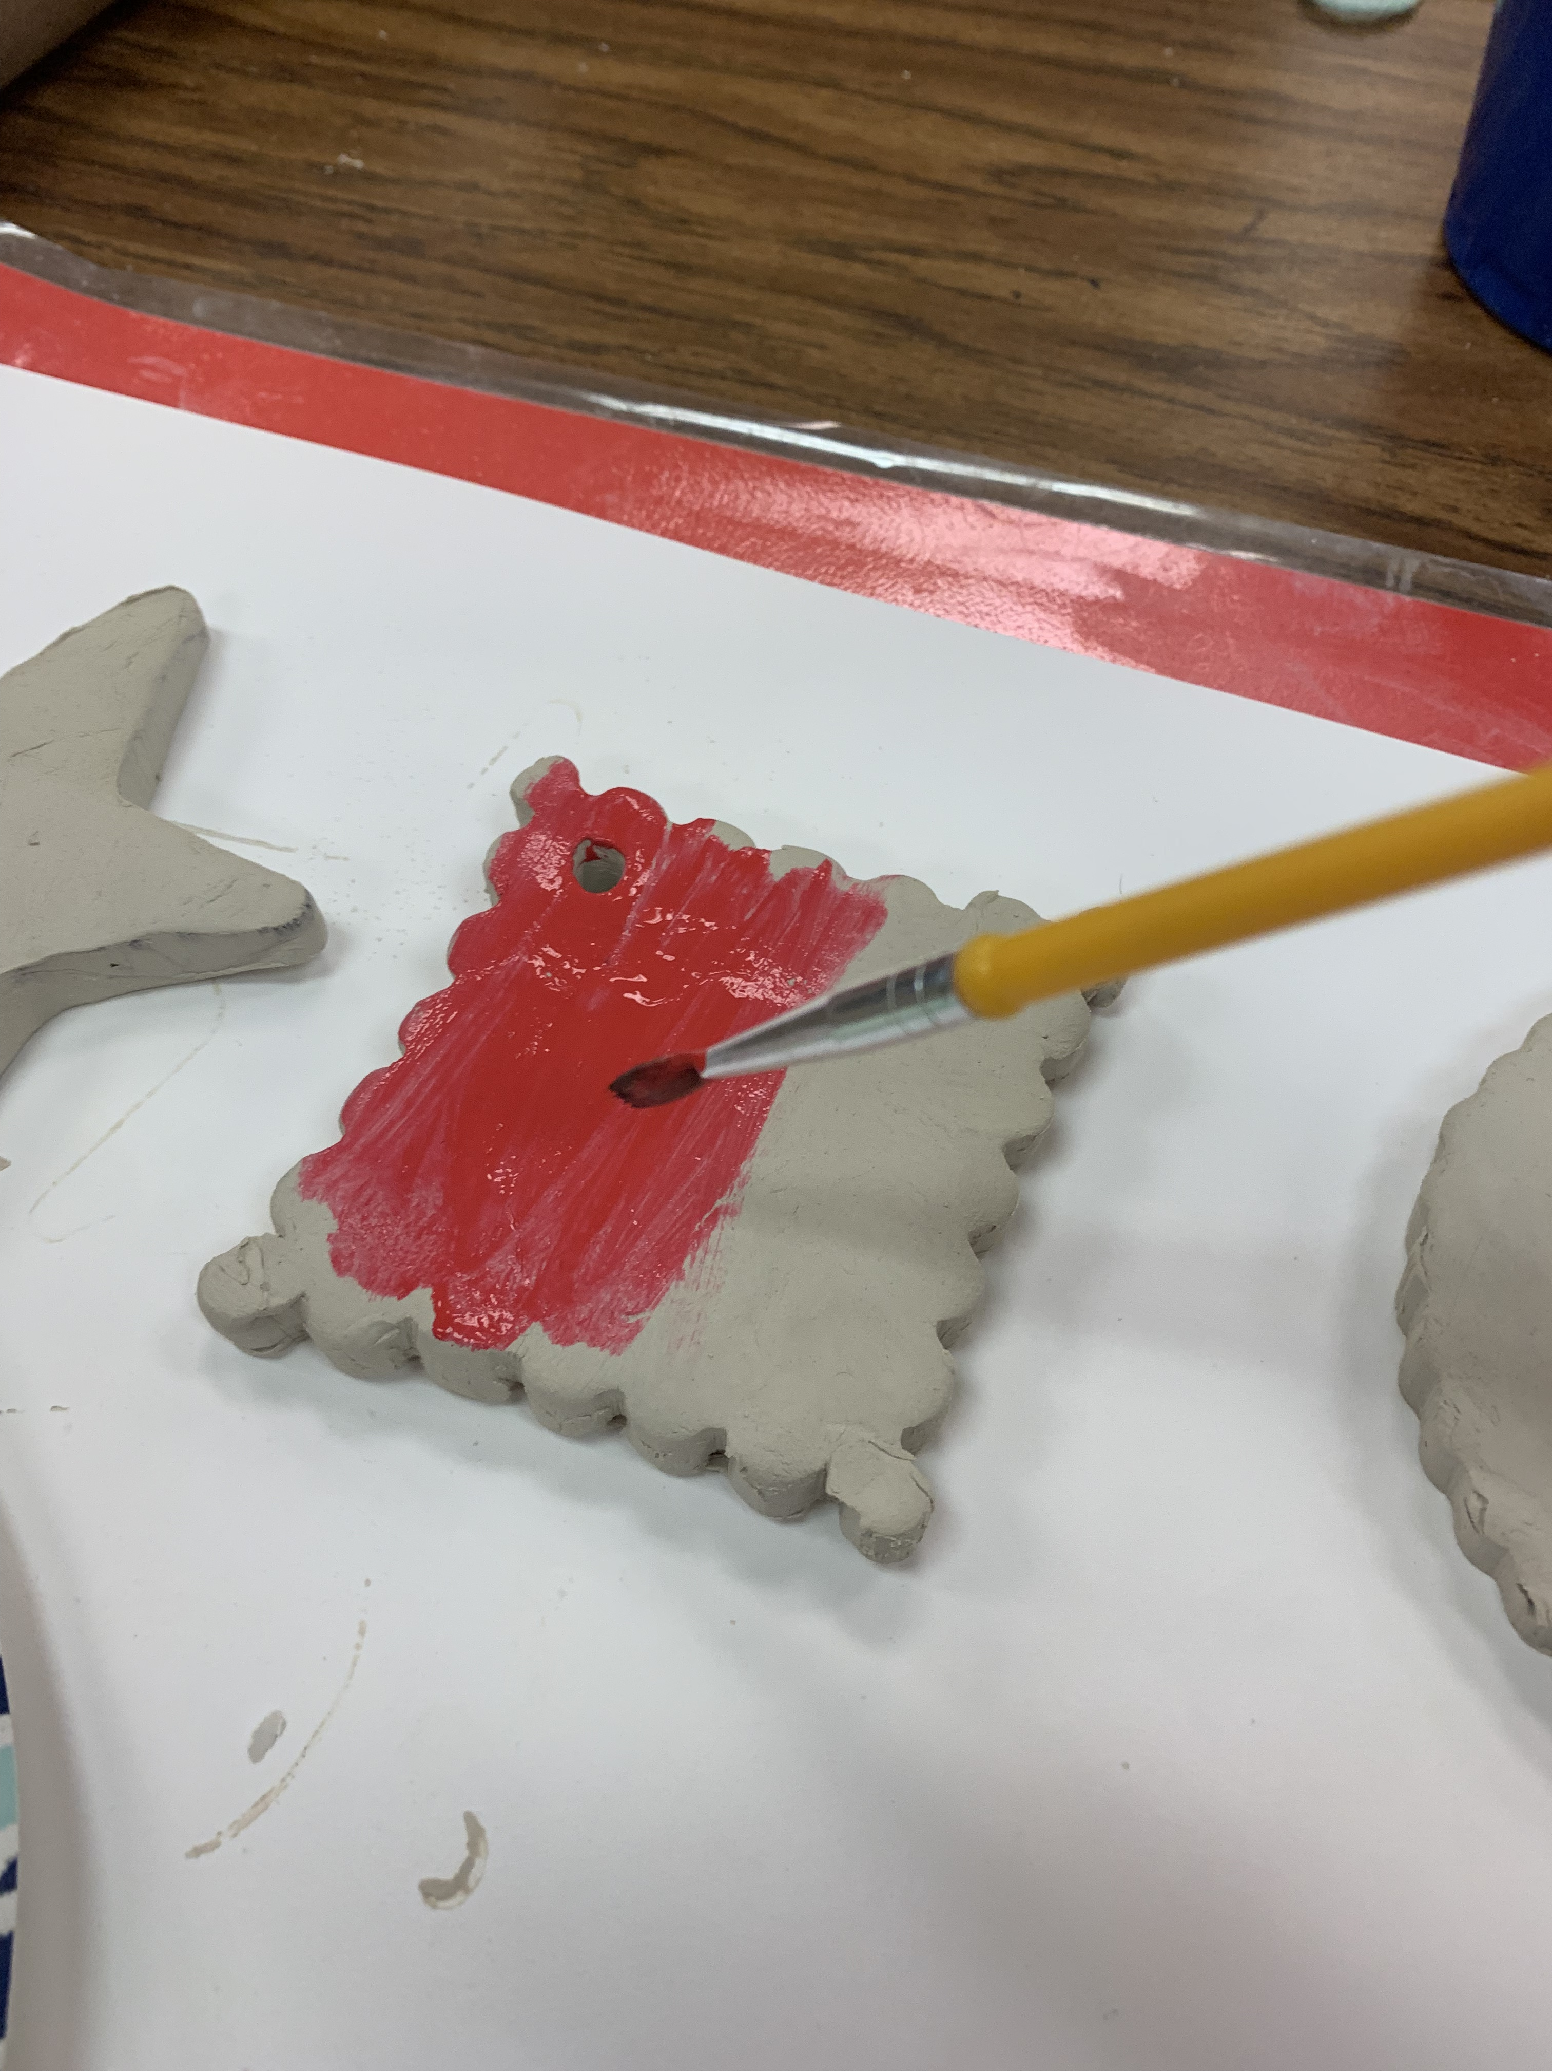
Tk, Kinder, grade 1 Procedure
Gently flip the art piece on the same construction paper and paint the whole piece
Gently unmold the cookie and place it on the construction paper.
Then using the back of the skewer sticks make a hole on the top of the clay so we can use the hole to hang the art piece
Using the skewer sticks simply score your initials (first and last name) and your class room number
Please watch this video click the above image to play the video

Slide 10
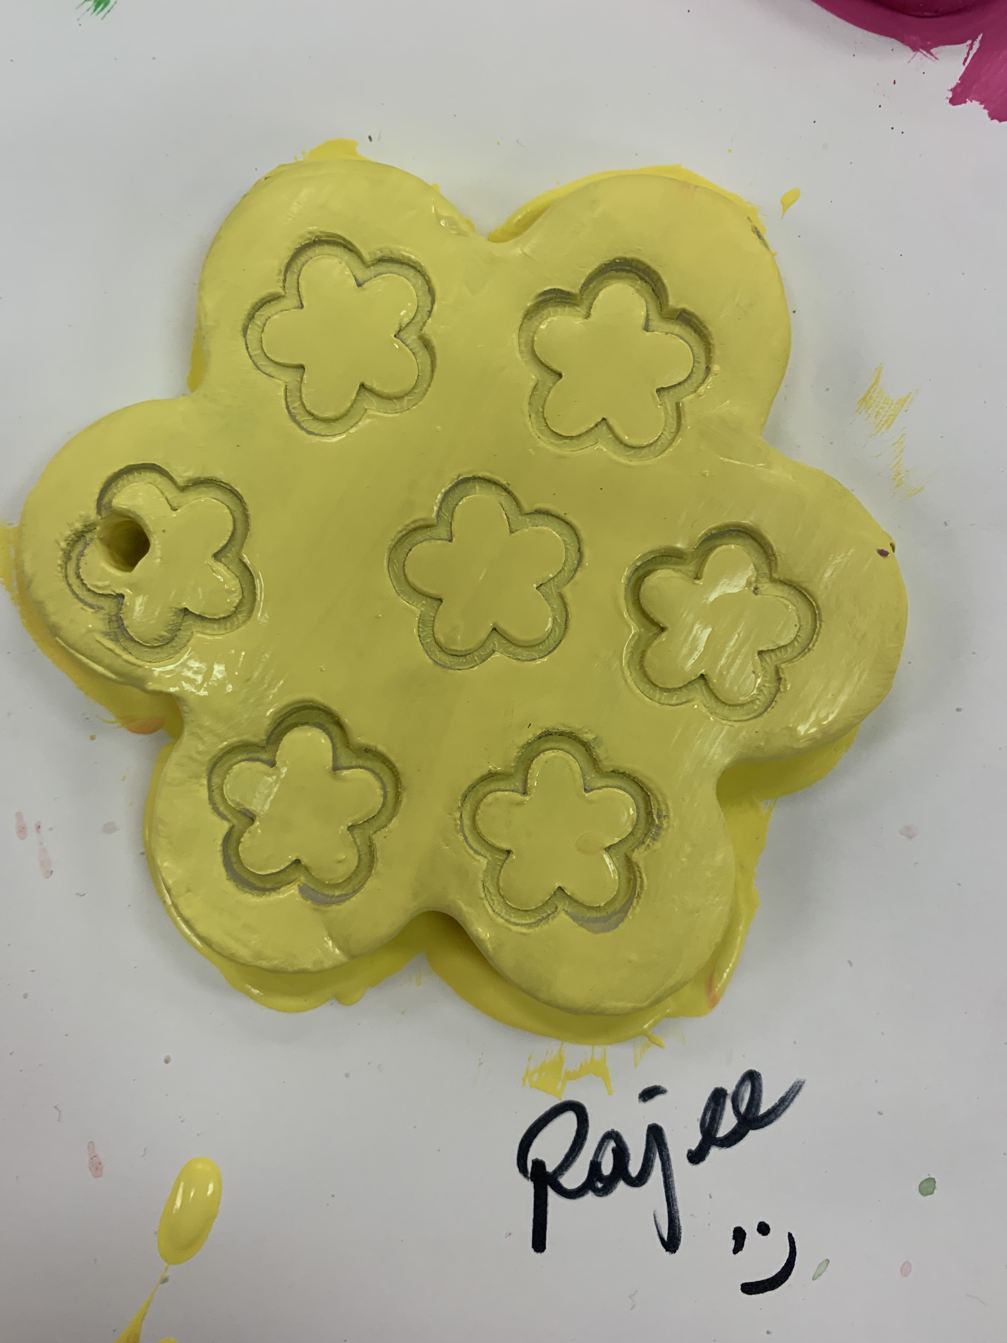
Tk, Kinder, grade 1 Procedure
Please ask the students to drop the stamps into the cup of water so the acrylic paint is easy to clean
The art piece needs to dry at least 2 days then you can add mod podge if you prefer. Not mandatory.
After the drying is complete, tie a piece of yarn so it can be use to display.
Please take time to wash the placemat, brush, cookie cutters and the brush thoroughly so the next class can have a clean set to work with

