Slide 1
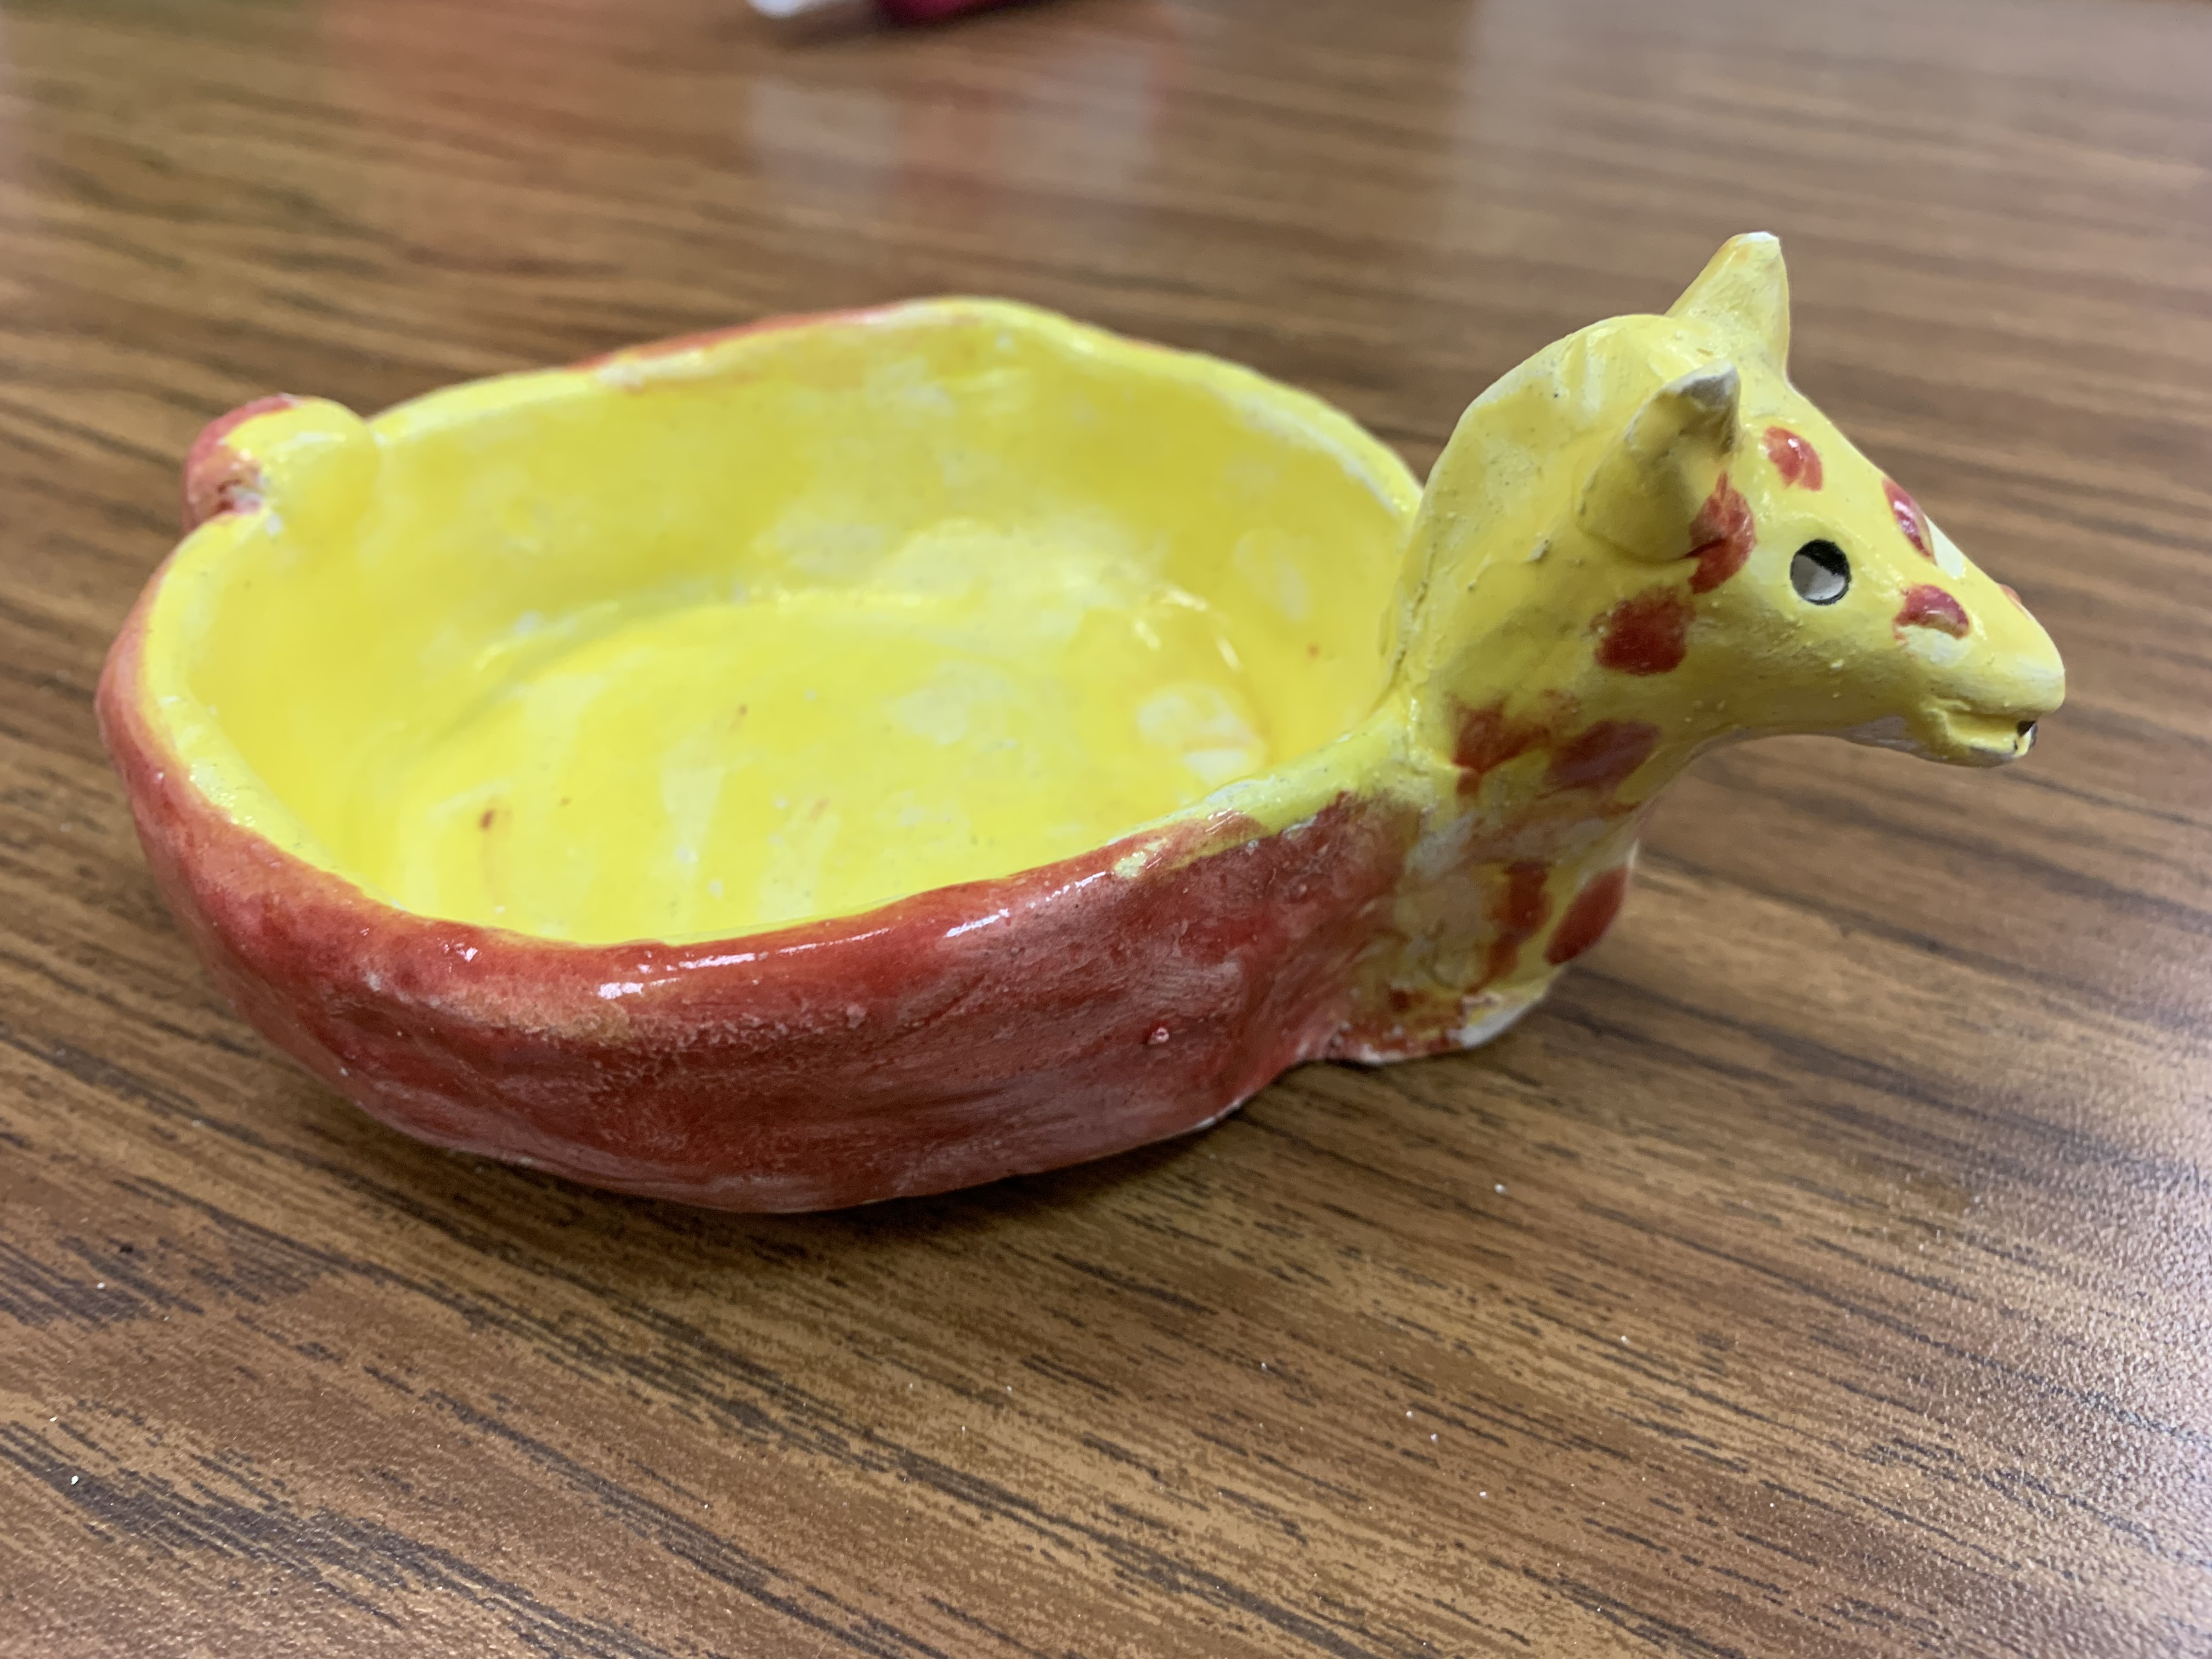
Clay project – Grade 5
April 2023
Rajee Subramanian
Quail Run Elementary

Slide 2
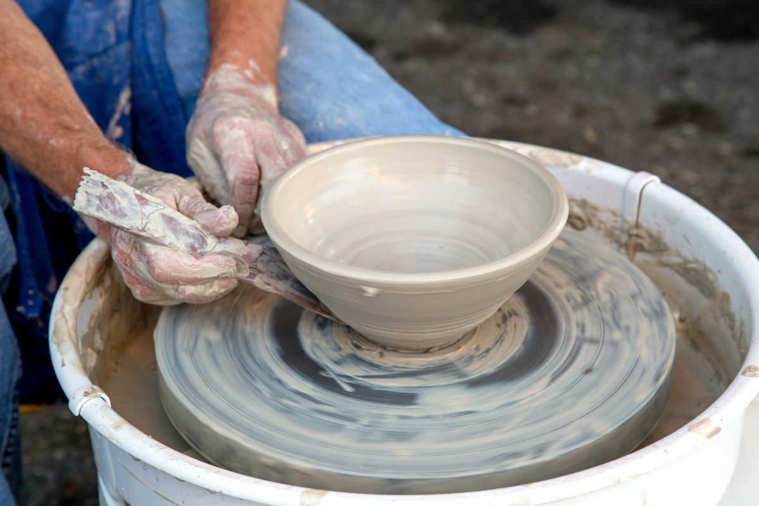
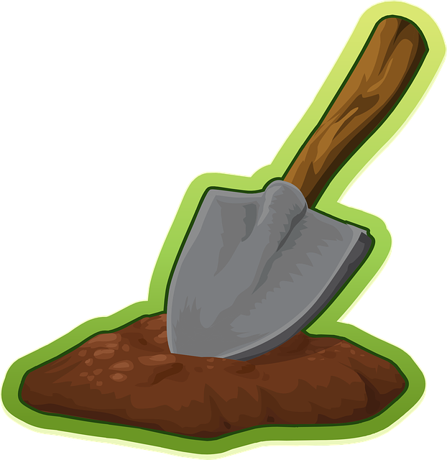
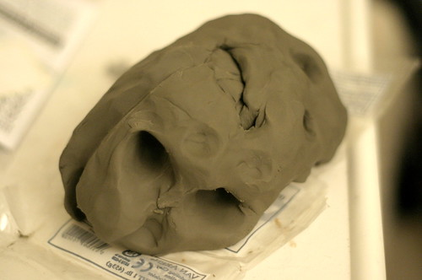
What is clay?
Anything that you can squish, mold and create is called clay.
What is clay made of?
Dirt and Water makes clay – All materials found in nature

Slide 3
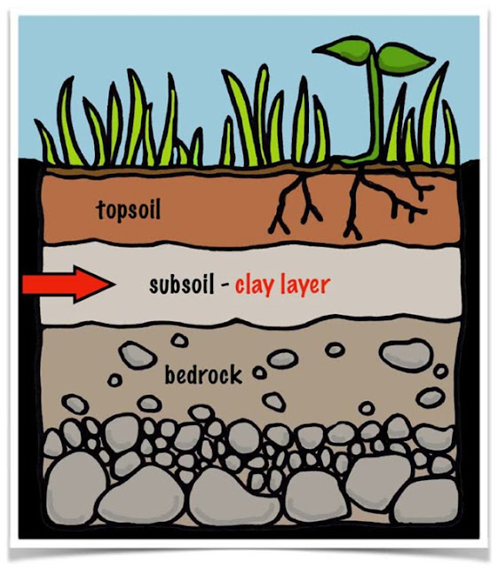
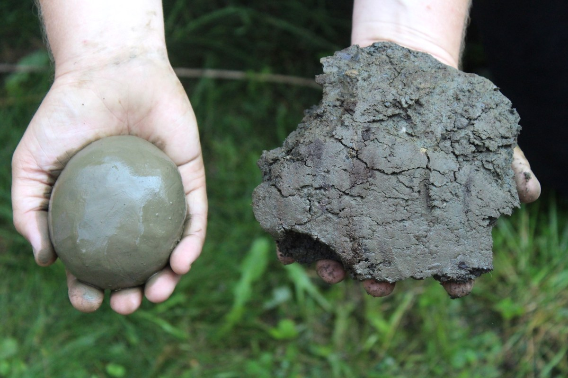
How is clay formed in Nature?
Clay is formed by decomposition of rocks through the weathering action
Over time bits of earth/broken rocks are carried by rain water traveling from one place to the other and settles in areas.
Top soil covers the clay layers.

Slide 4
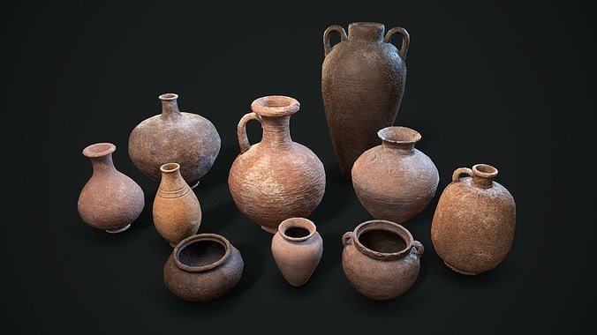
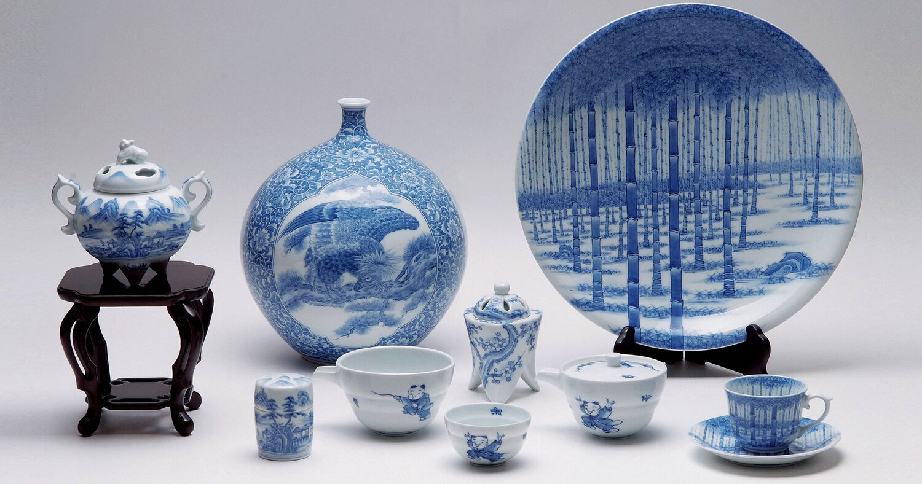
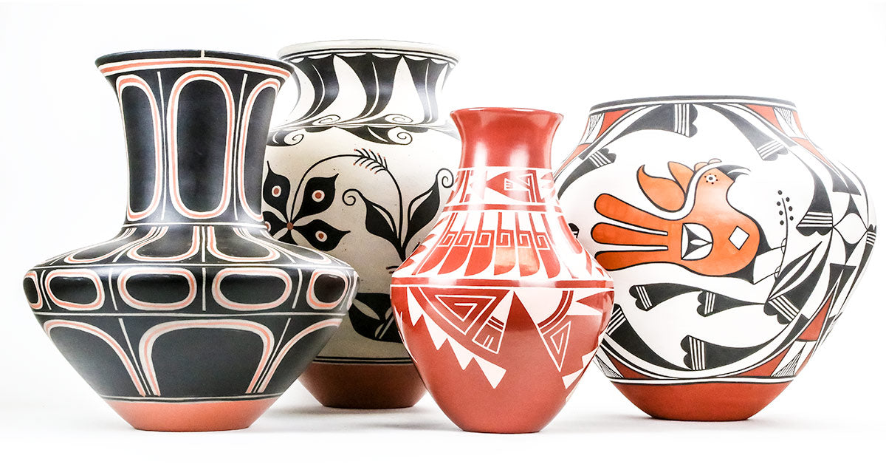
History of pottery
Ancient man found that the clay found in nature can be molded and made into pots to use for cooking and as decorative piece
Middle eastern countries – 7,000 BCE
Asian counties – 4,000 BCE
American Countries - 1,000 BCE
All about history of pottery
https://youtu.be/08mkqd7Skmw

Slide 5
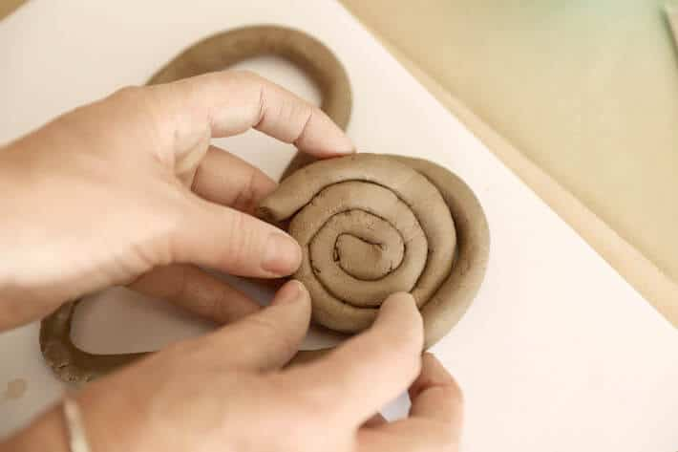
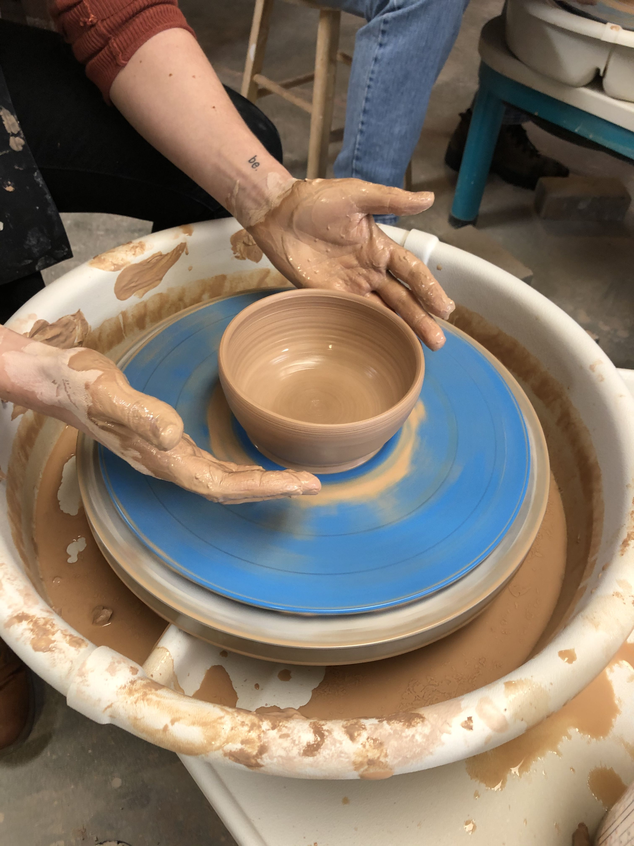
Different ways of working with clay
Roll – Slab roll and cut to assemble
Coil – Make long coil snakes and stack
Pinch – Use fingers to pinch and mold
Wheel
Today we will use our fingers and hand to make our model

Slide 6
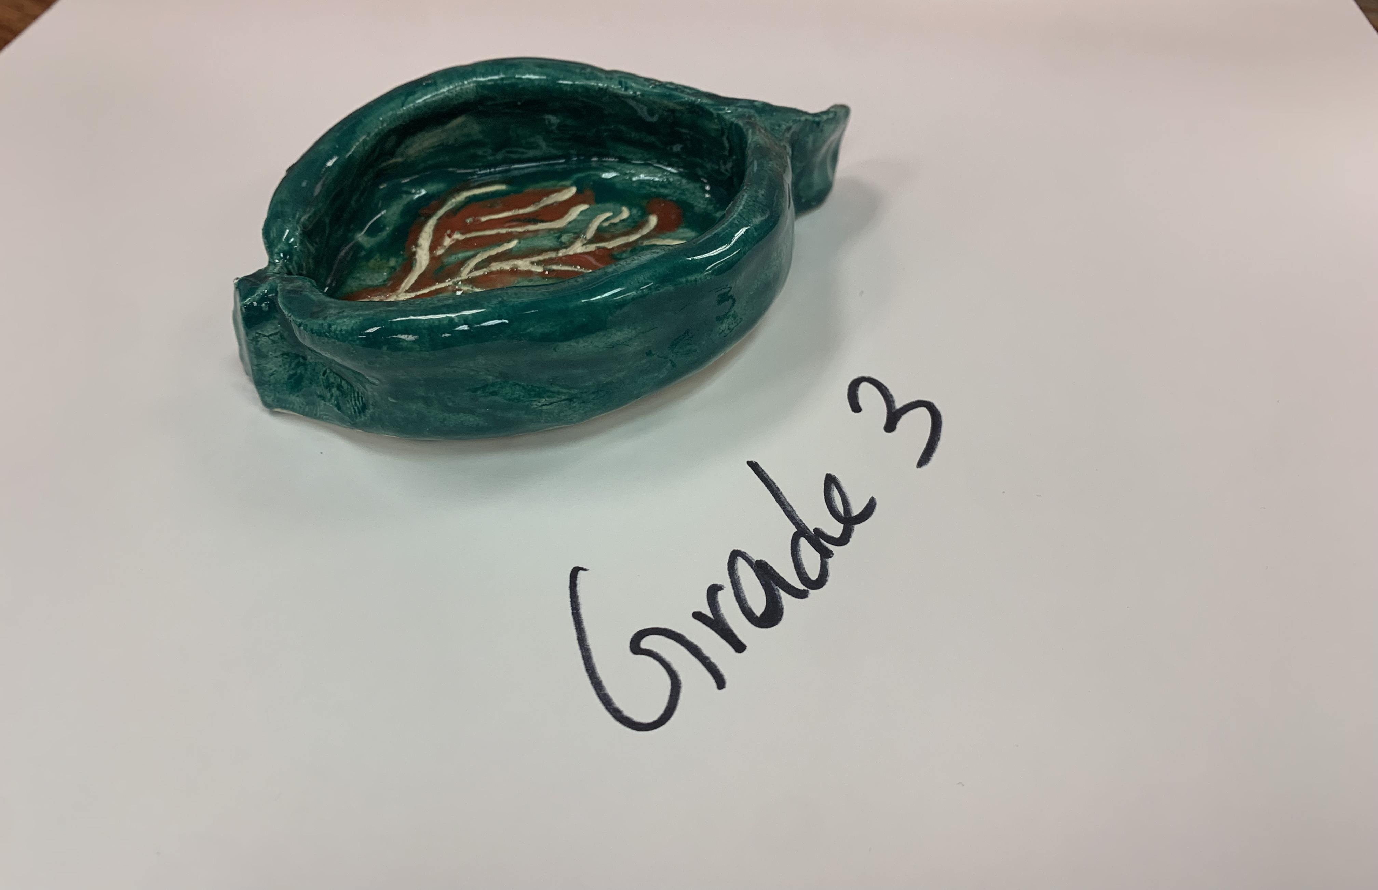
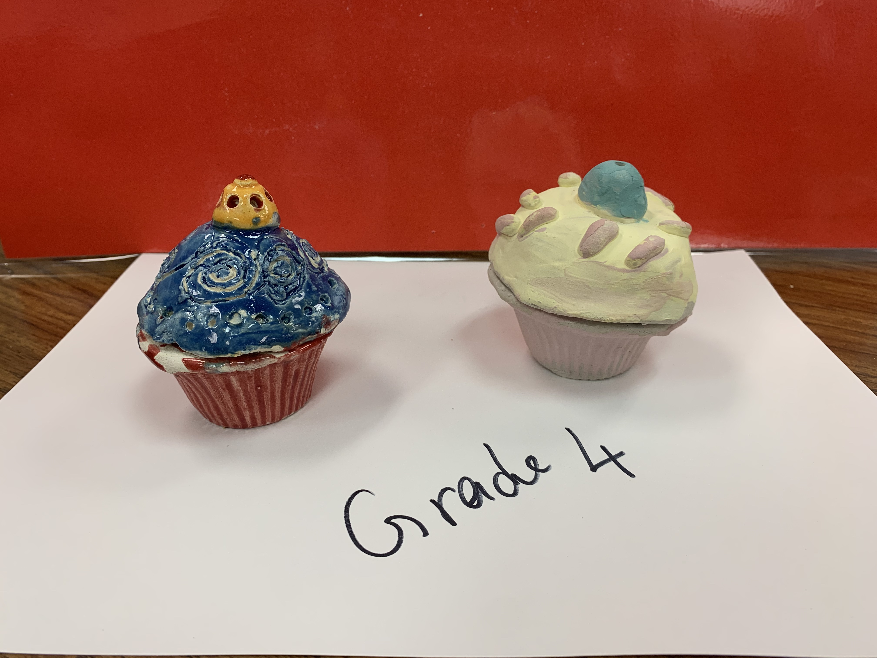
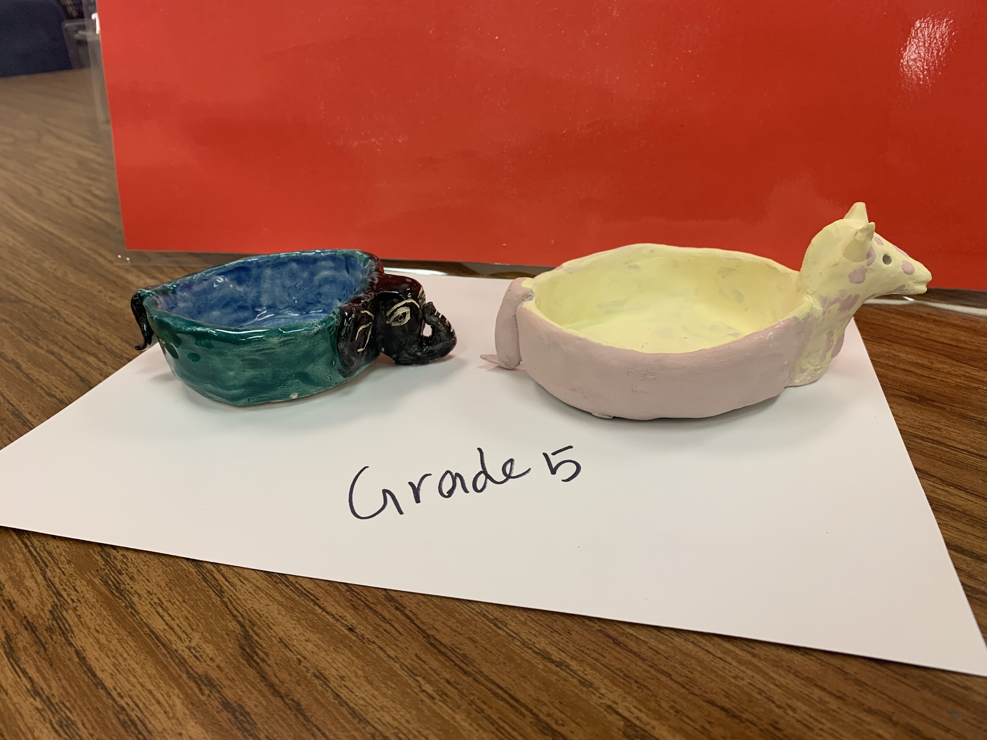
Grade specific clay project
Tk, Kinder, Grade 1
Grade 1 can also make Grade 2 project
TK – Grade 2 no need to fire in the kiln

Slide 7
Materials
Grade 4 & 5
Kiln fire clay 2 pieces – slightly bigger than a size of a cuties(2nos) (orange)
Skewer sticks
Place mat
Piece of white construction paper
One brush per student
Glaze pigment (paint)
Plastic water cups to moisturize the clay and use it for slip
Paper napkin

Slide 8
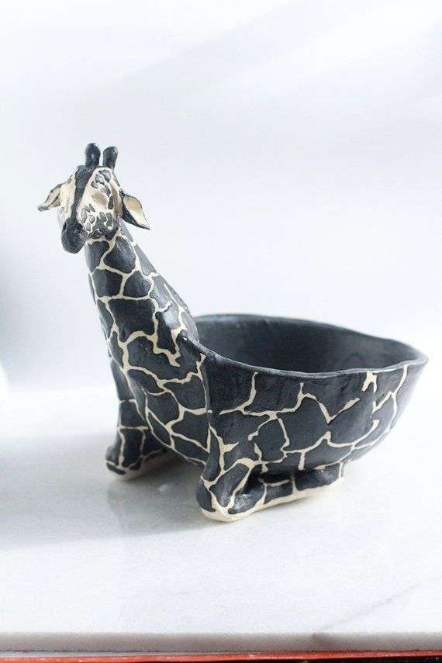
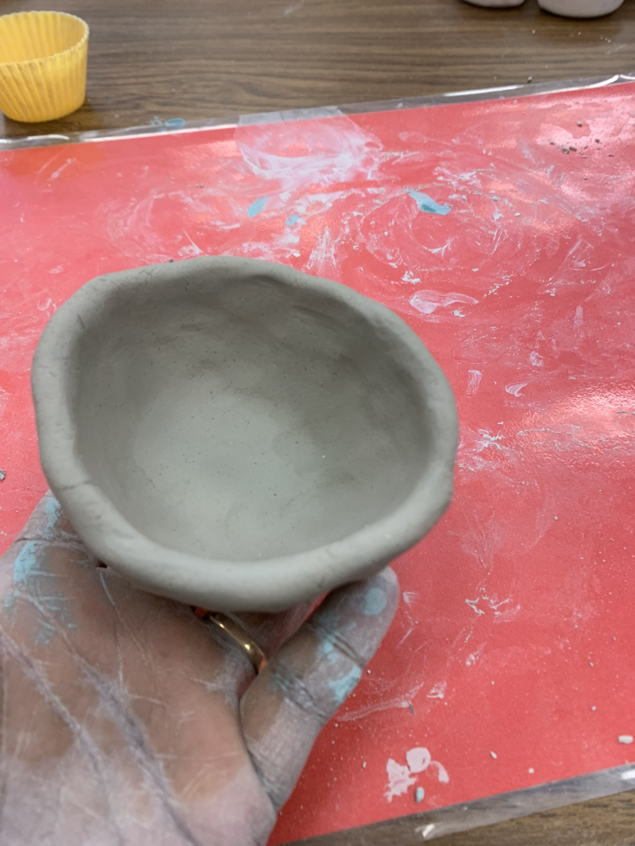
grade 5 Procedure
Hold the clay in the less dominant hand. The thumb of the most dominant hand should be pushed into the center of the clay then work your clay to make the walls, use the duck beak fingers to make the pinch pot
Once you have a small bowl smooth the cracks by touching a little water from the cup. If there are any major cracks or air pockets the piece will explode in the kiln while baking
Roll the clay into a smooth ball, use pressure
Initials on the back of he bowl
Giraffe’s head
Video hyperlinked above
Video hyperlinked above Video hyperlinked above

Slide 9
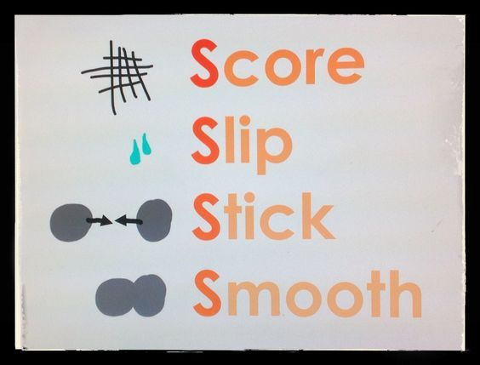
grade 5 Procedure – Very important to learn to glue the clay or it will break off while baking
See this video at least twice
How to glue the clay pieces together, very important pottery technique. Video hyperlinked in the image above
Video hyperlinked above in both the images

Slide 10
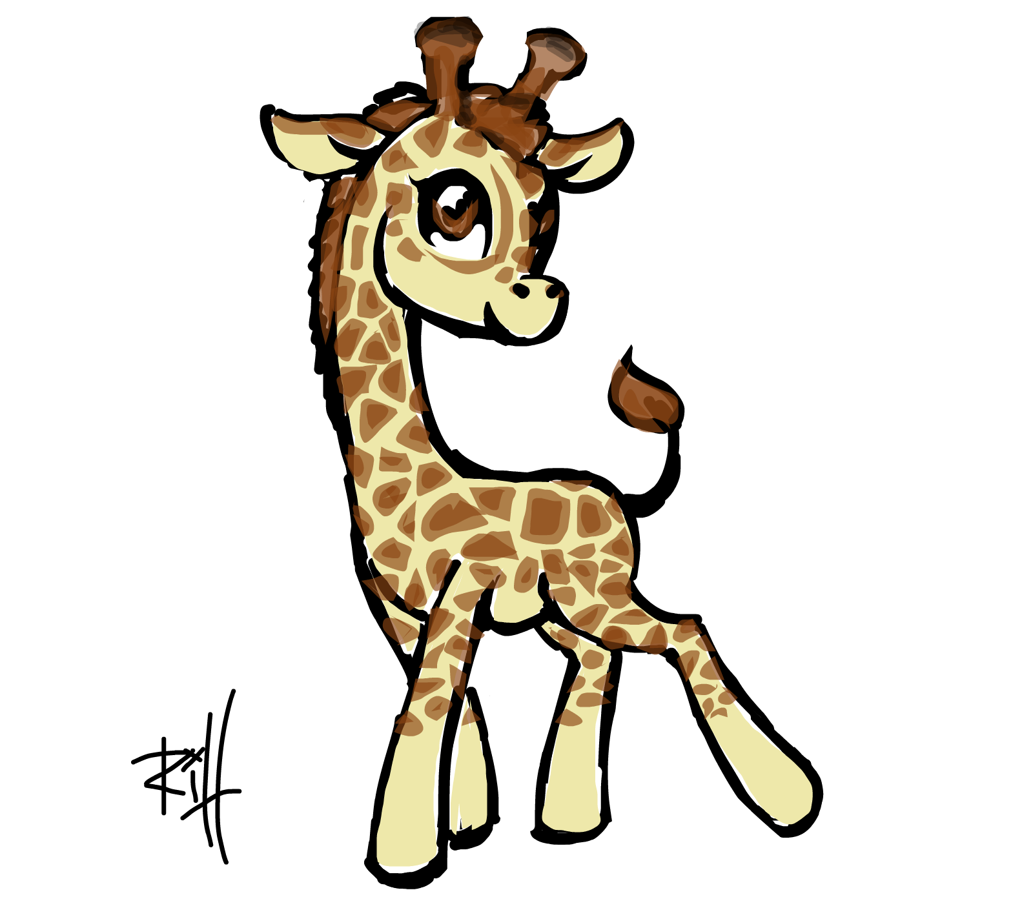
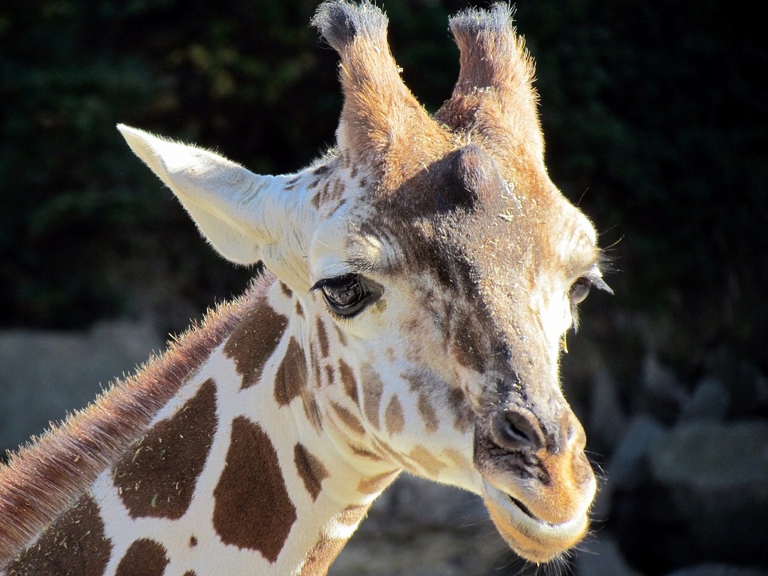
grade 5 Procedure - Giraffe
Giraffe’s tail
How to glue the clay pieces together, very important pottery technique. Video hyperlinked in the image above
Giraffe’s ear video, make eyes and mouth. Then Glaze it.
Video hyperlinked above in both the images

Slide 11
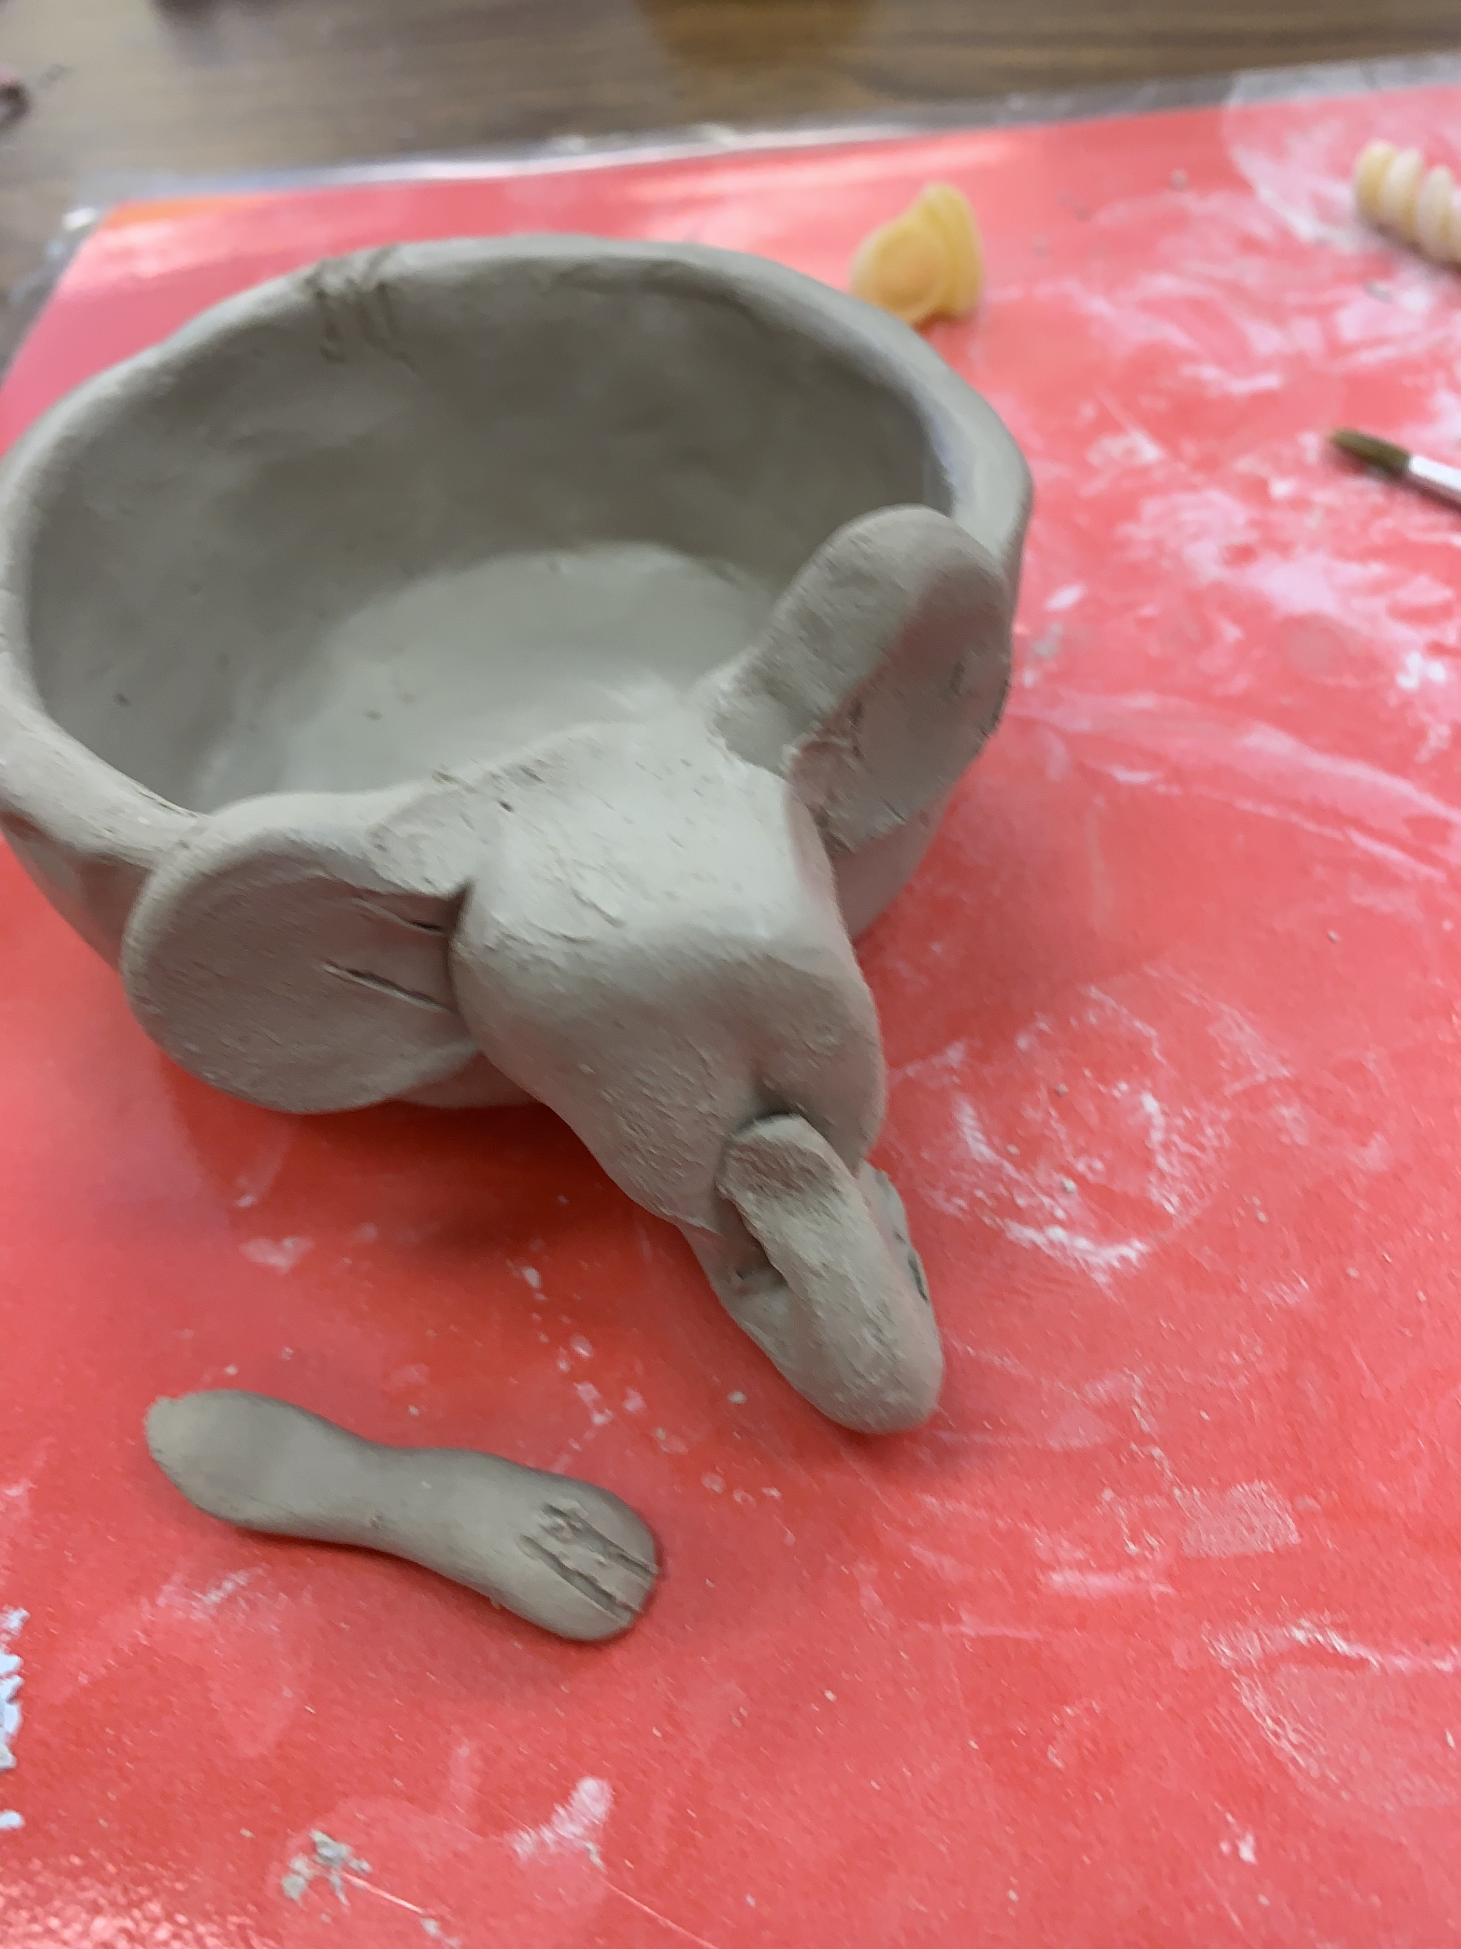
Elephant

