Slide 1
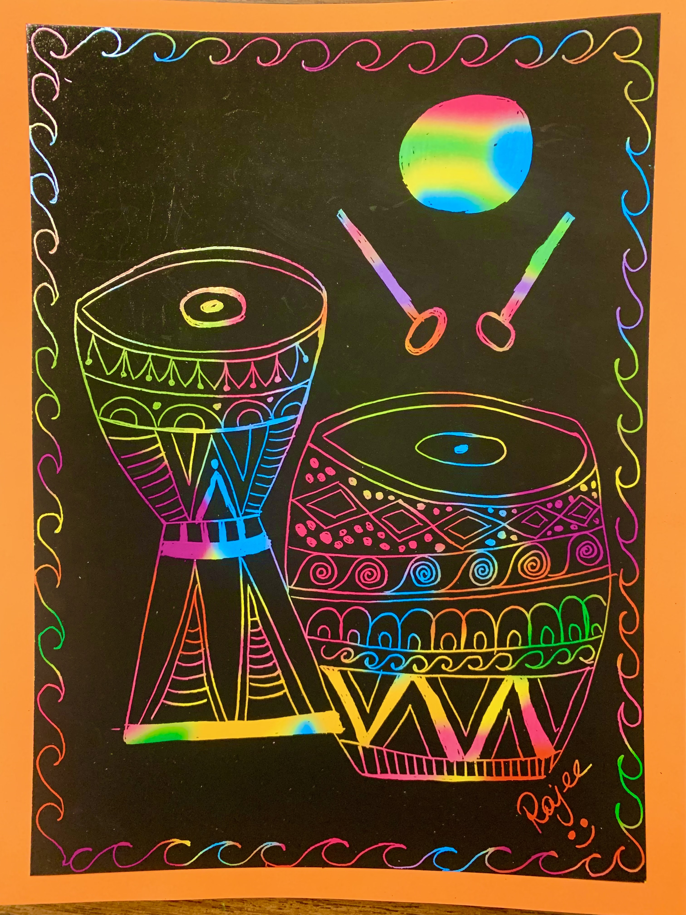
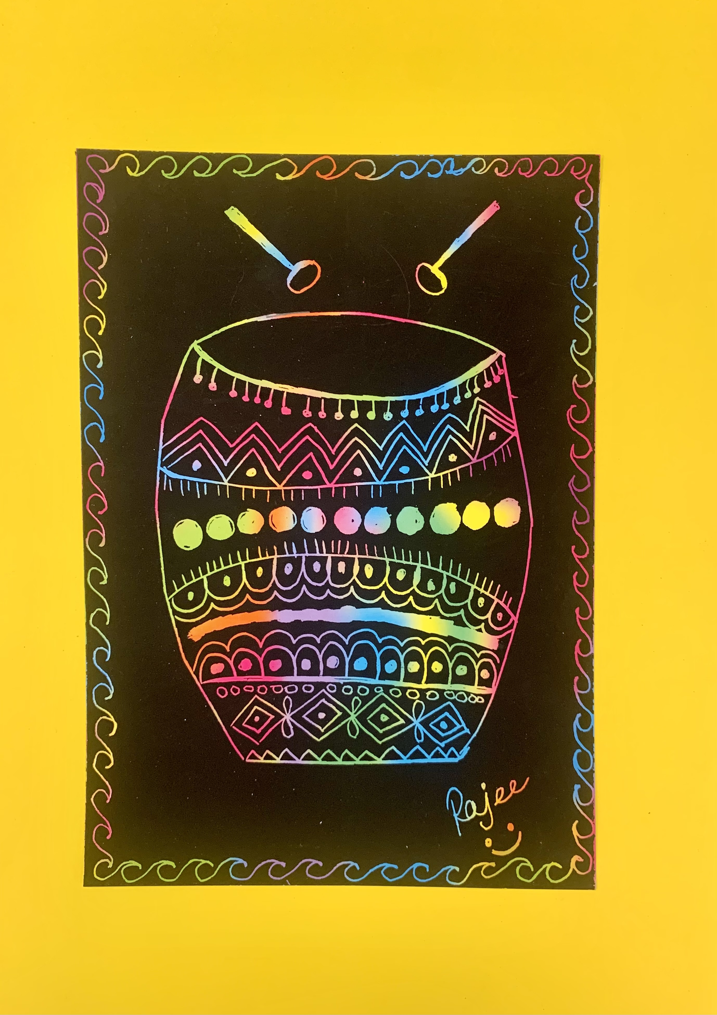
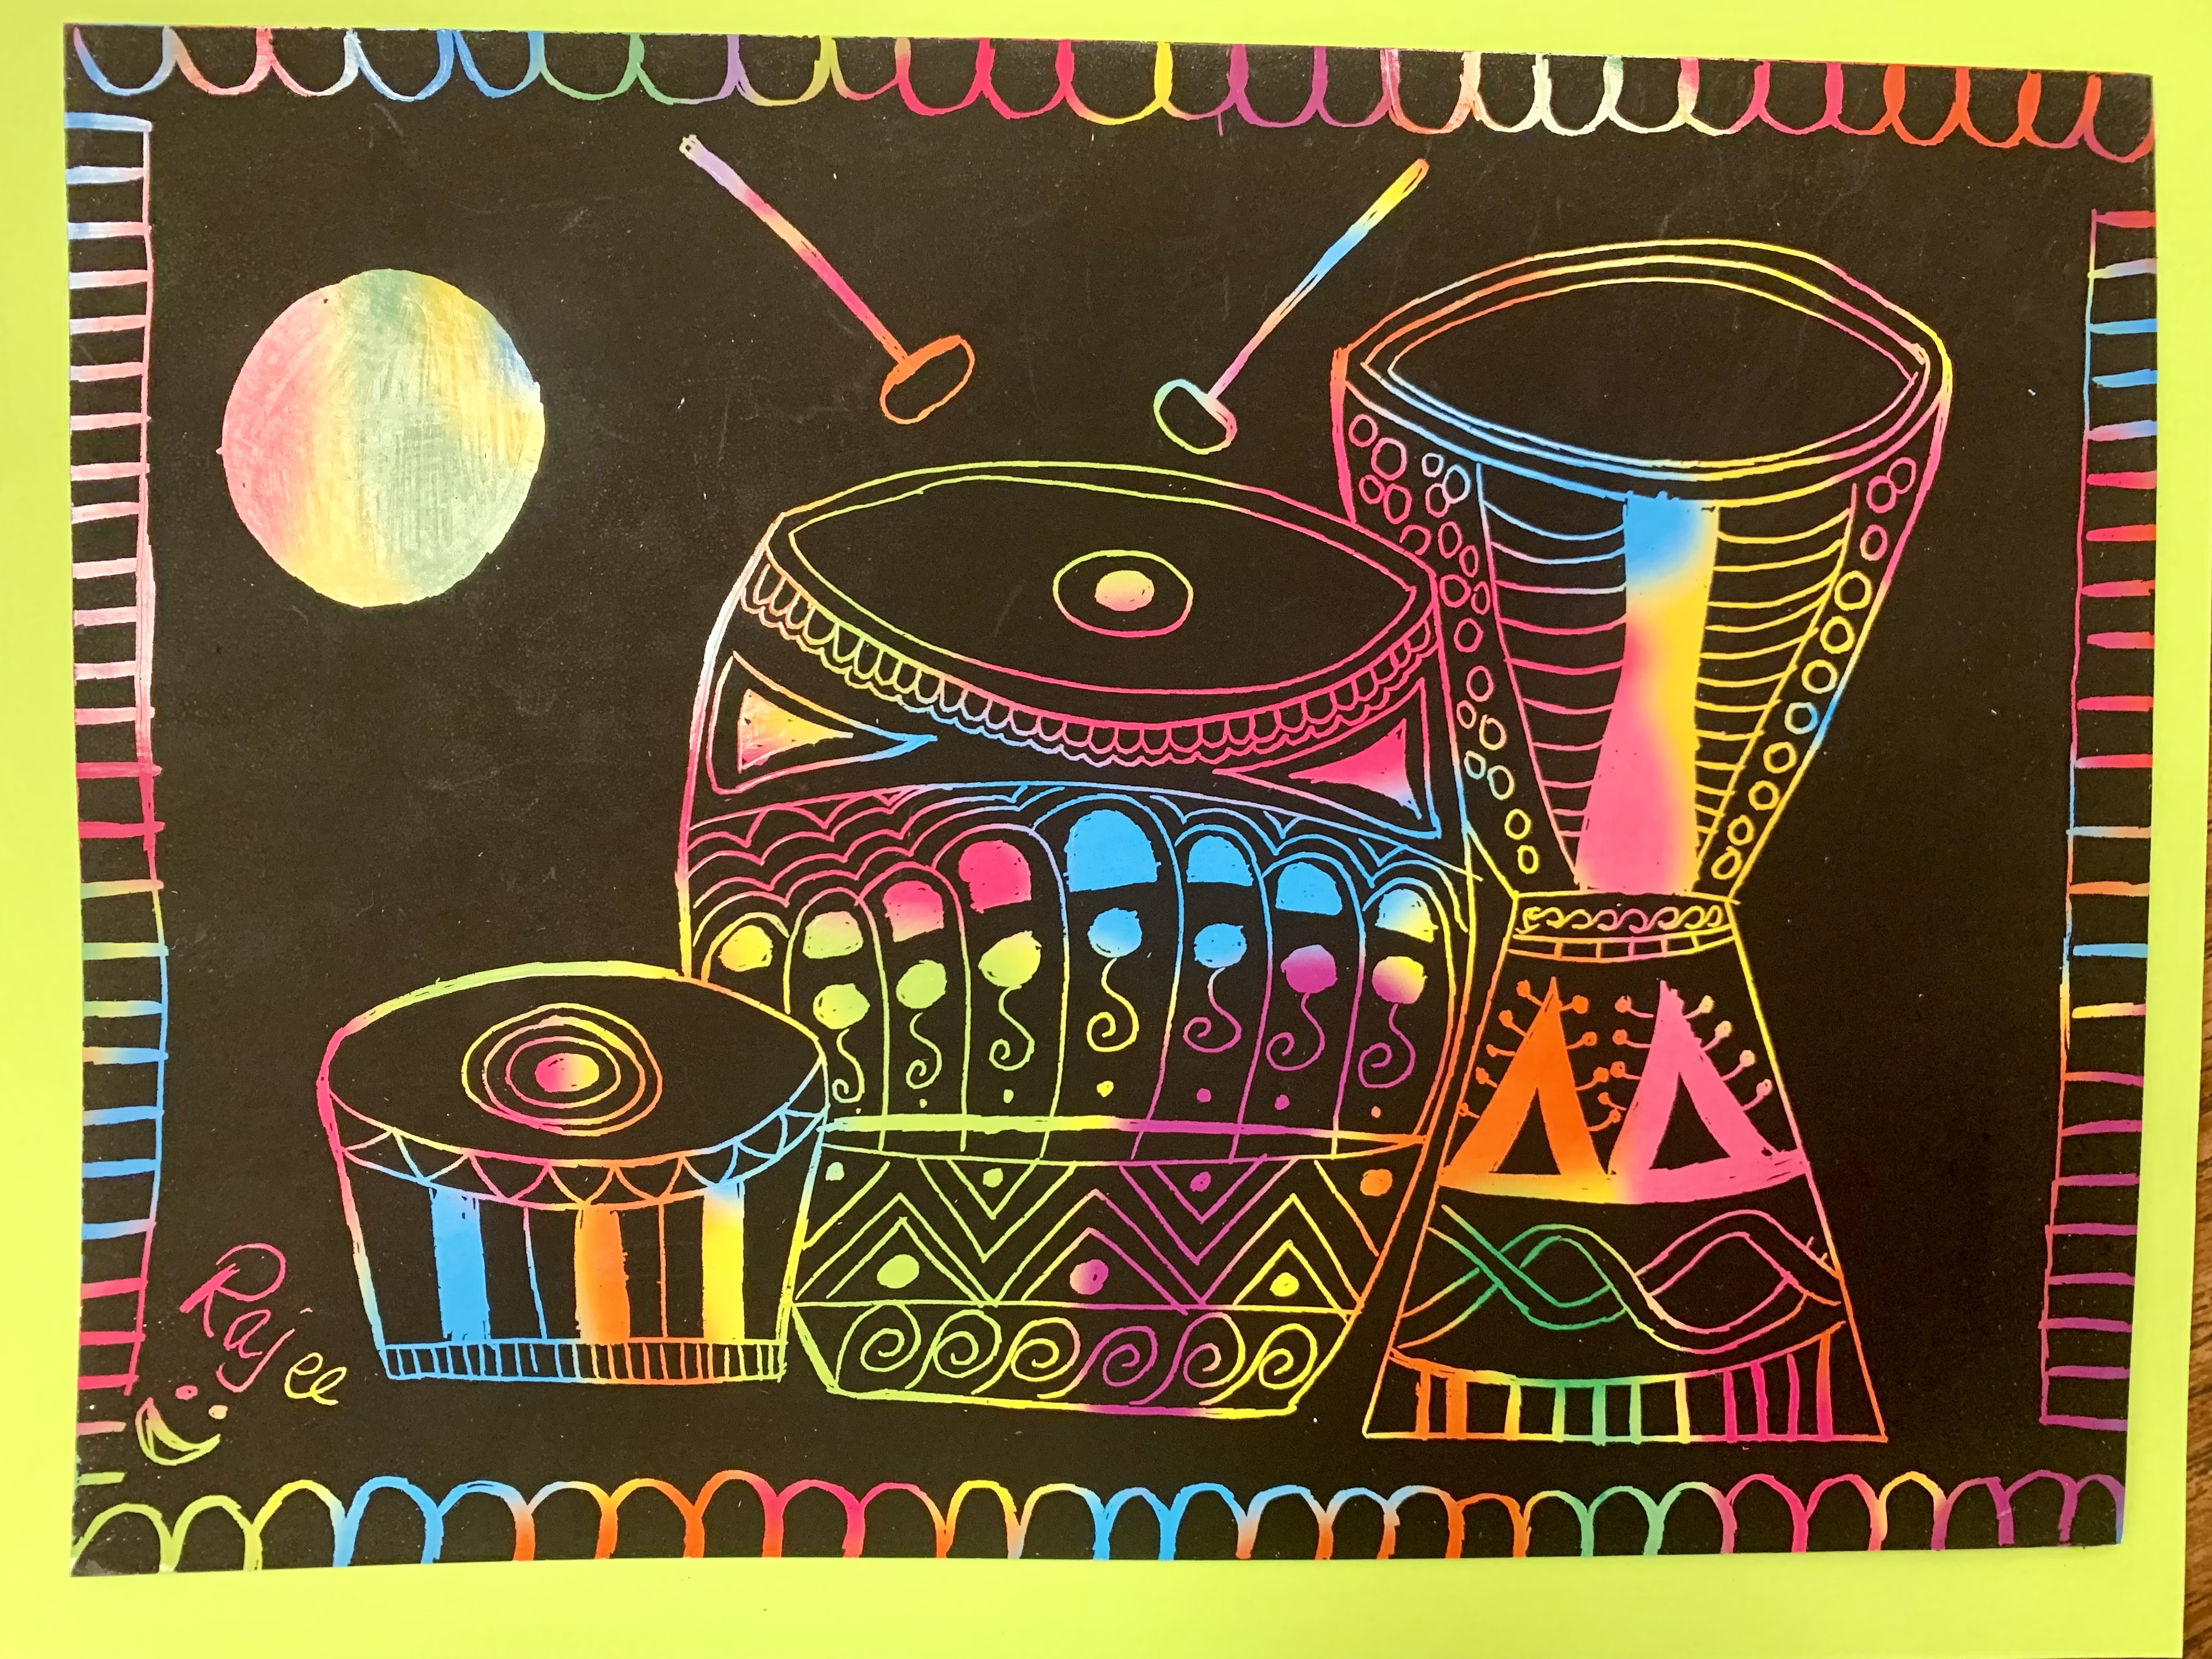
Rhythm for all! – Feel it!
Rajee Subramanain
April 2022
Quail Run Elementary

Slide 2
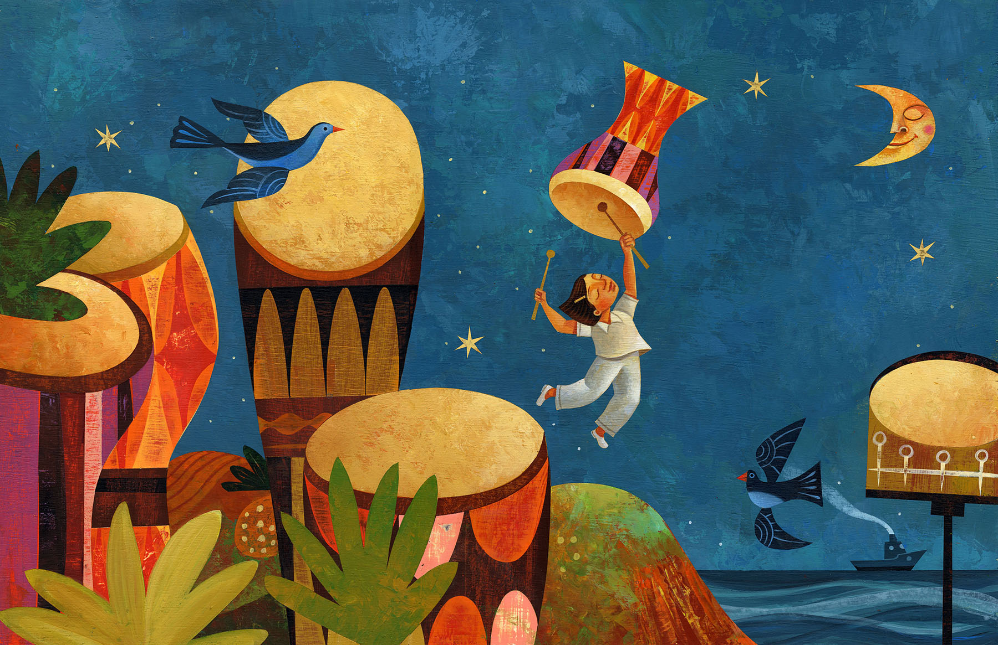
Inspiration – April – National poetry month
This book is in a poetry format.
It’s a true story inspired by Millo Castro Zaldariaga!
Written by Margarita Engle
Margarita Engle presented the story in a poetry format because the story is all about music and it needed the rhythm, tempo, beats and a little bit of rhyme too.
This is because Millo’s talent was boom boom boom booming…
A few lines from the book “of pounding tall congo drums taping small bongo drums and boom boom booming with the long, loud sticks on big round, silvery, moon bright timbales”
The illustration also matched the dream of the girl ”Millo”
https://www.youtube.com/watch?v=cfMSbC7T6Jw

Slide 3
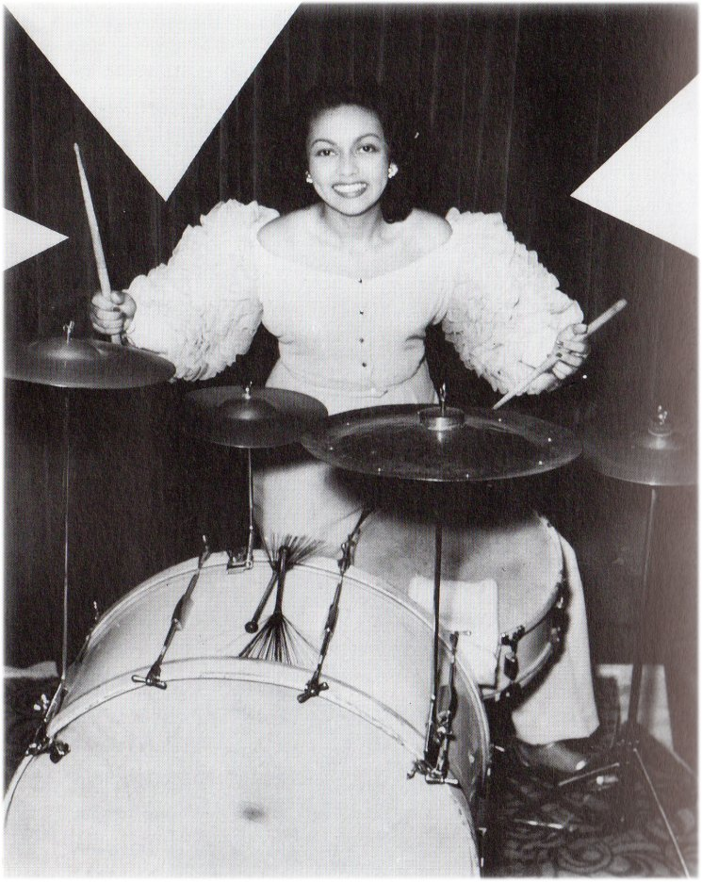
Inspiration – April Character trait - Perseverance
This poem tells a real story of perseverance.
Millo overcame challenges, persevered through and become a famous drummer.
Millo at age of 10 she played the drums in the first all girls band
Millo became world famous.
At the age of 15 she was invited to play in the birthday party of the US President Franklin Roosevelt
Millo Castro Zaldarriaga

Slide 4
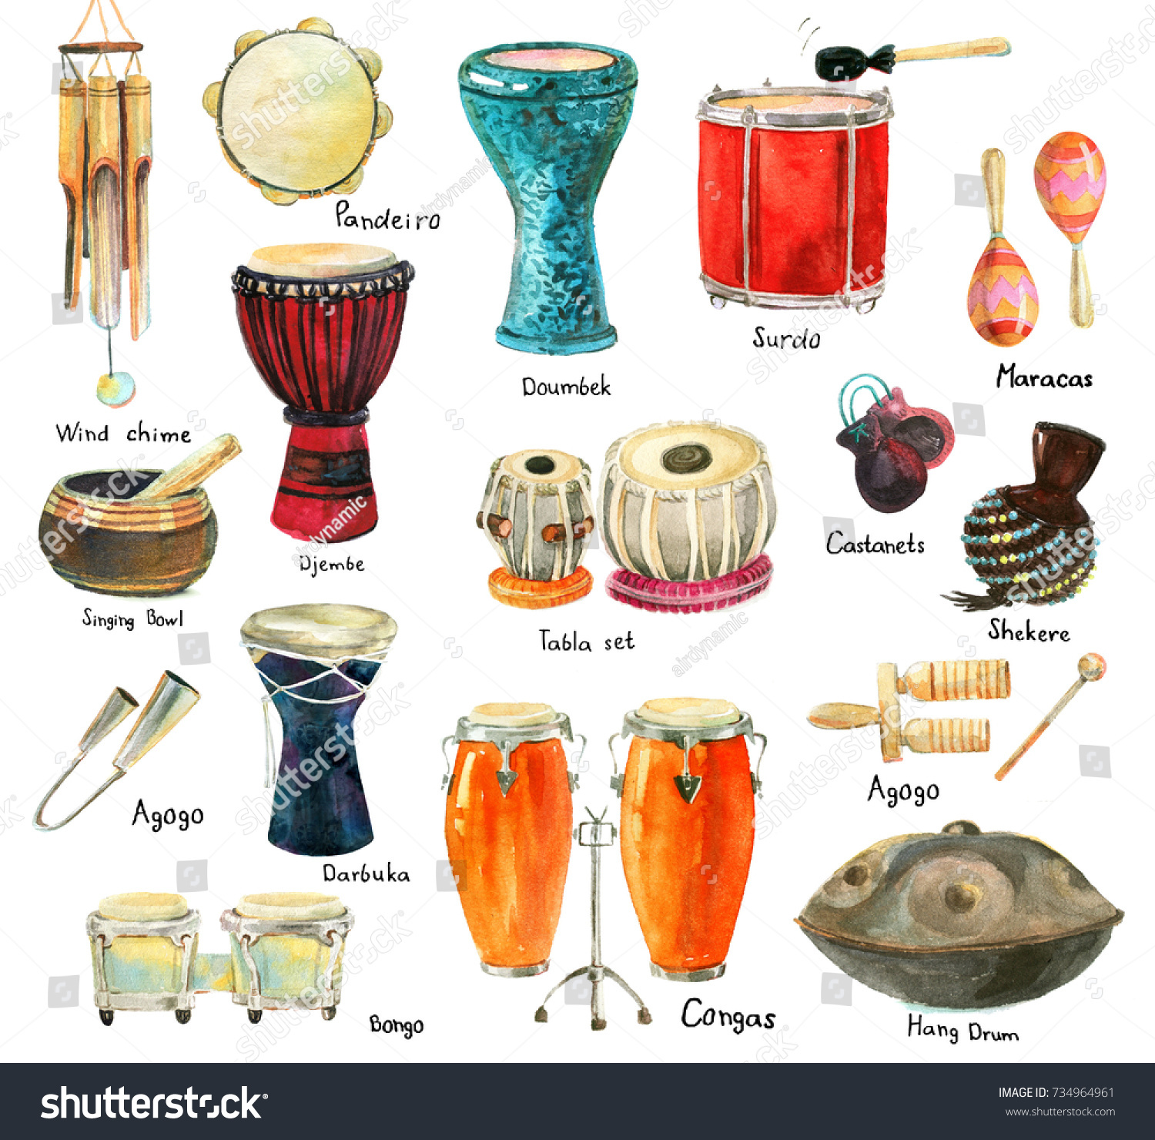
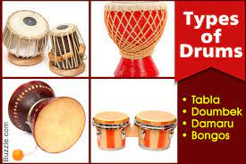
History of drums
Modern Drums

Slide 5
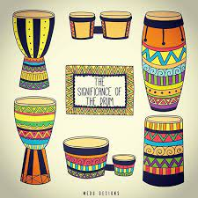
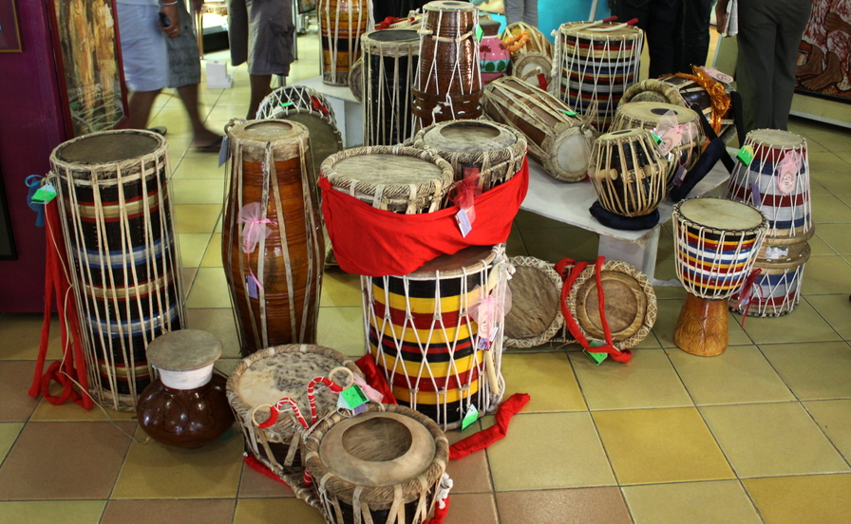
Types of drums

Slide 6
Art Element - Patterns Folk patterns Samples
What is a pattern?
A pattern is a series or sequence that repeats in a space

Slide 7
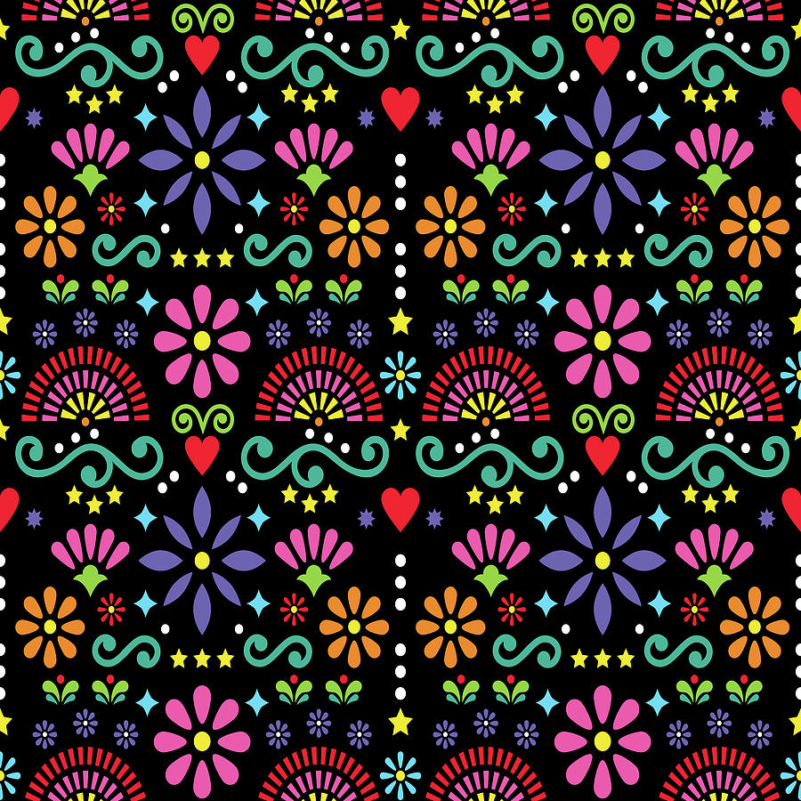
Folk patterns Samples

Slide 8
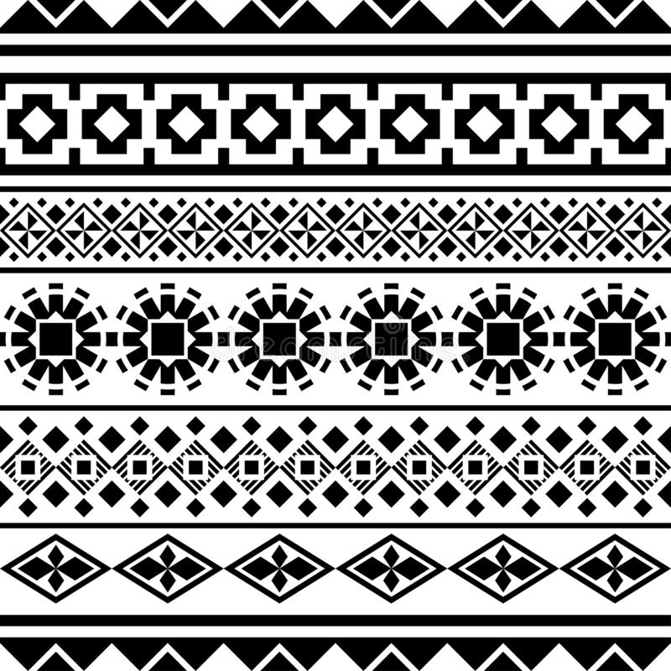
Folk patterns Samples

Slide 9
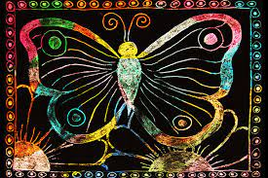
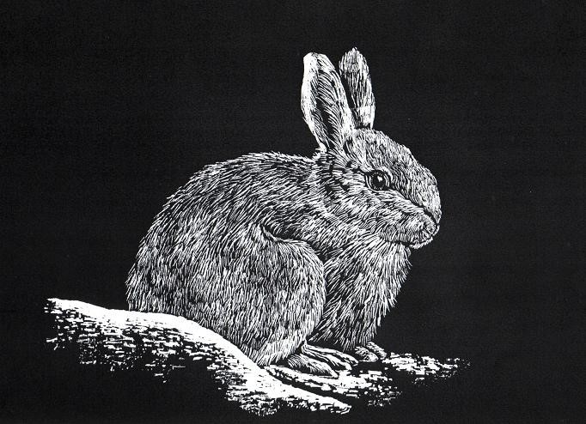
Art Technique – Scratch art
Scratch art is a graphic technique
It is also called Foil Art or Engraving Art
Scratchboard art is a way to create an image using a special board with a black surface layer and white or colored under layer
Scratching the board using a sharp tool will reveal the light colored layer
The image is created completely by making repeated small lines, marks and strokes.

Slide 10
Materials
Scratch pad – 5x8 (Grades TK, K, GRADE 1 & 2)
Skewer sticks
Craft sticks
Tissue paper
Backing sheet(Mounting paper)
Glue sticks
Drum template to outline the image

Slide 11
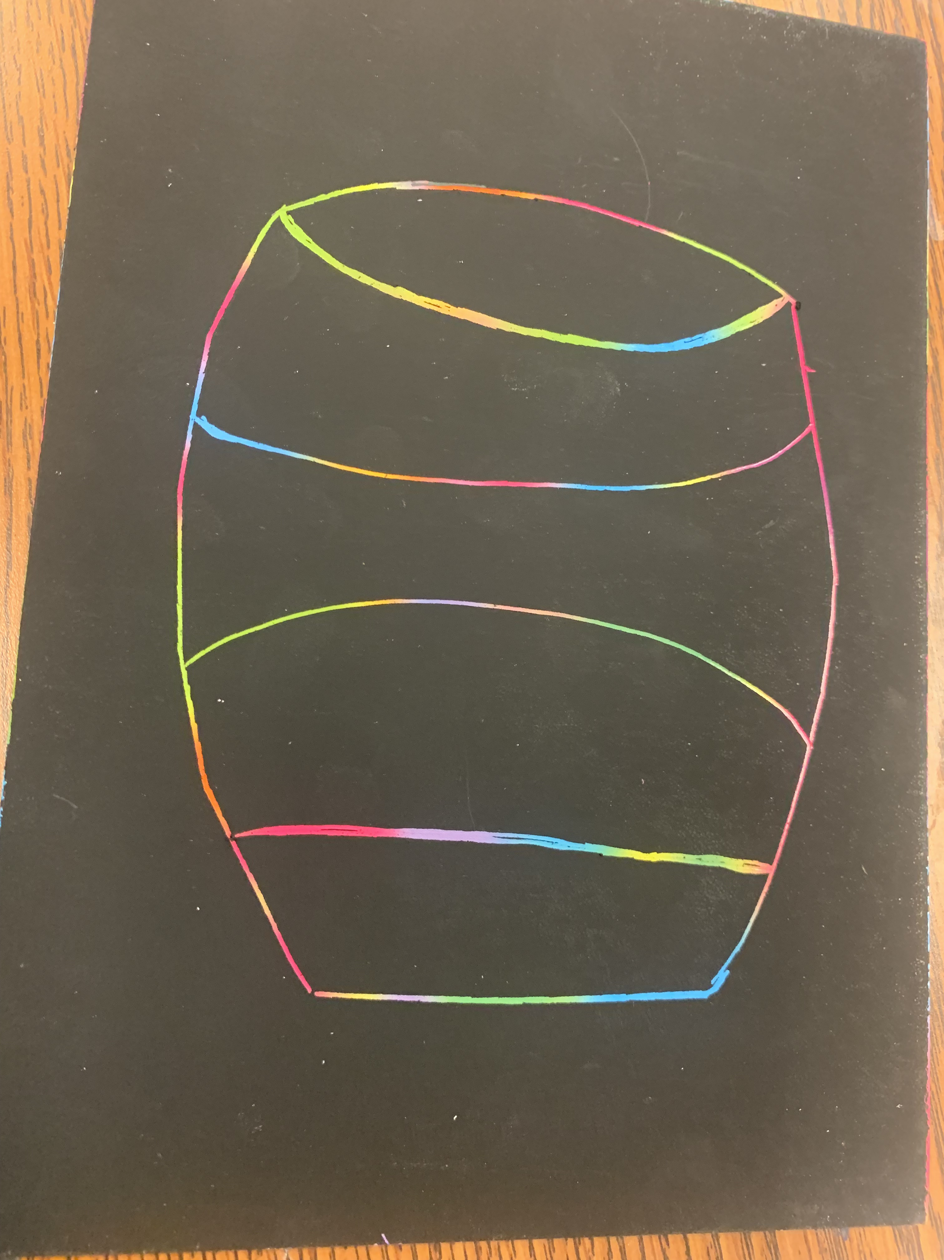
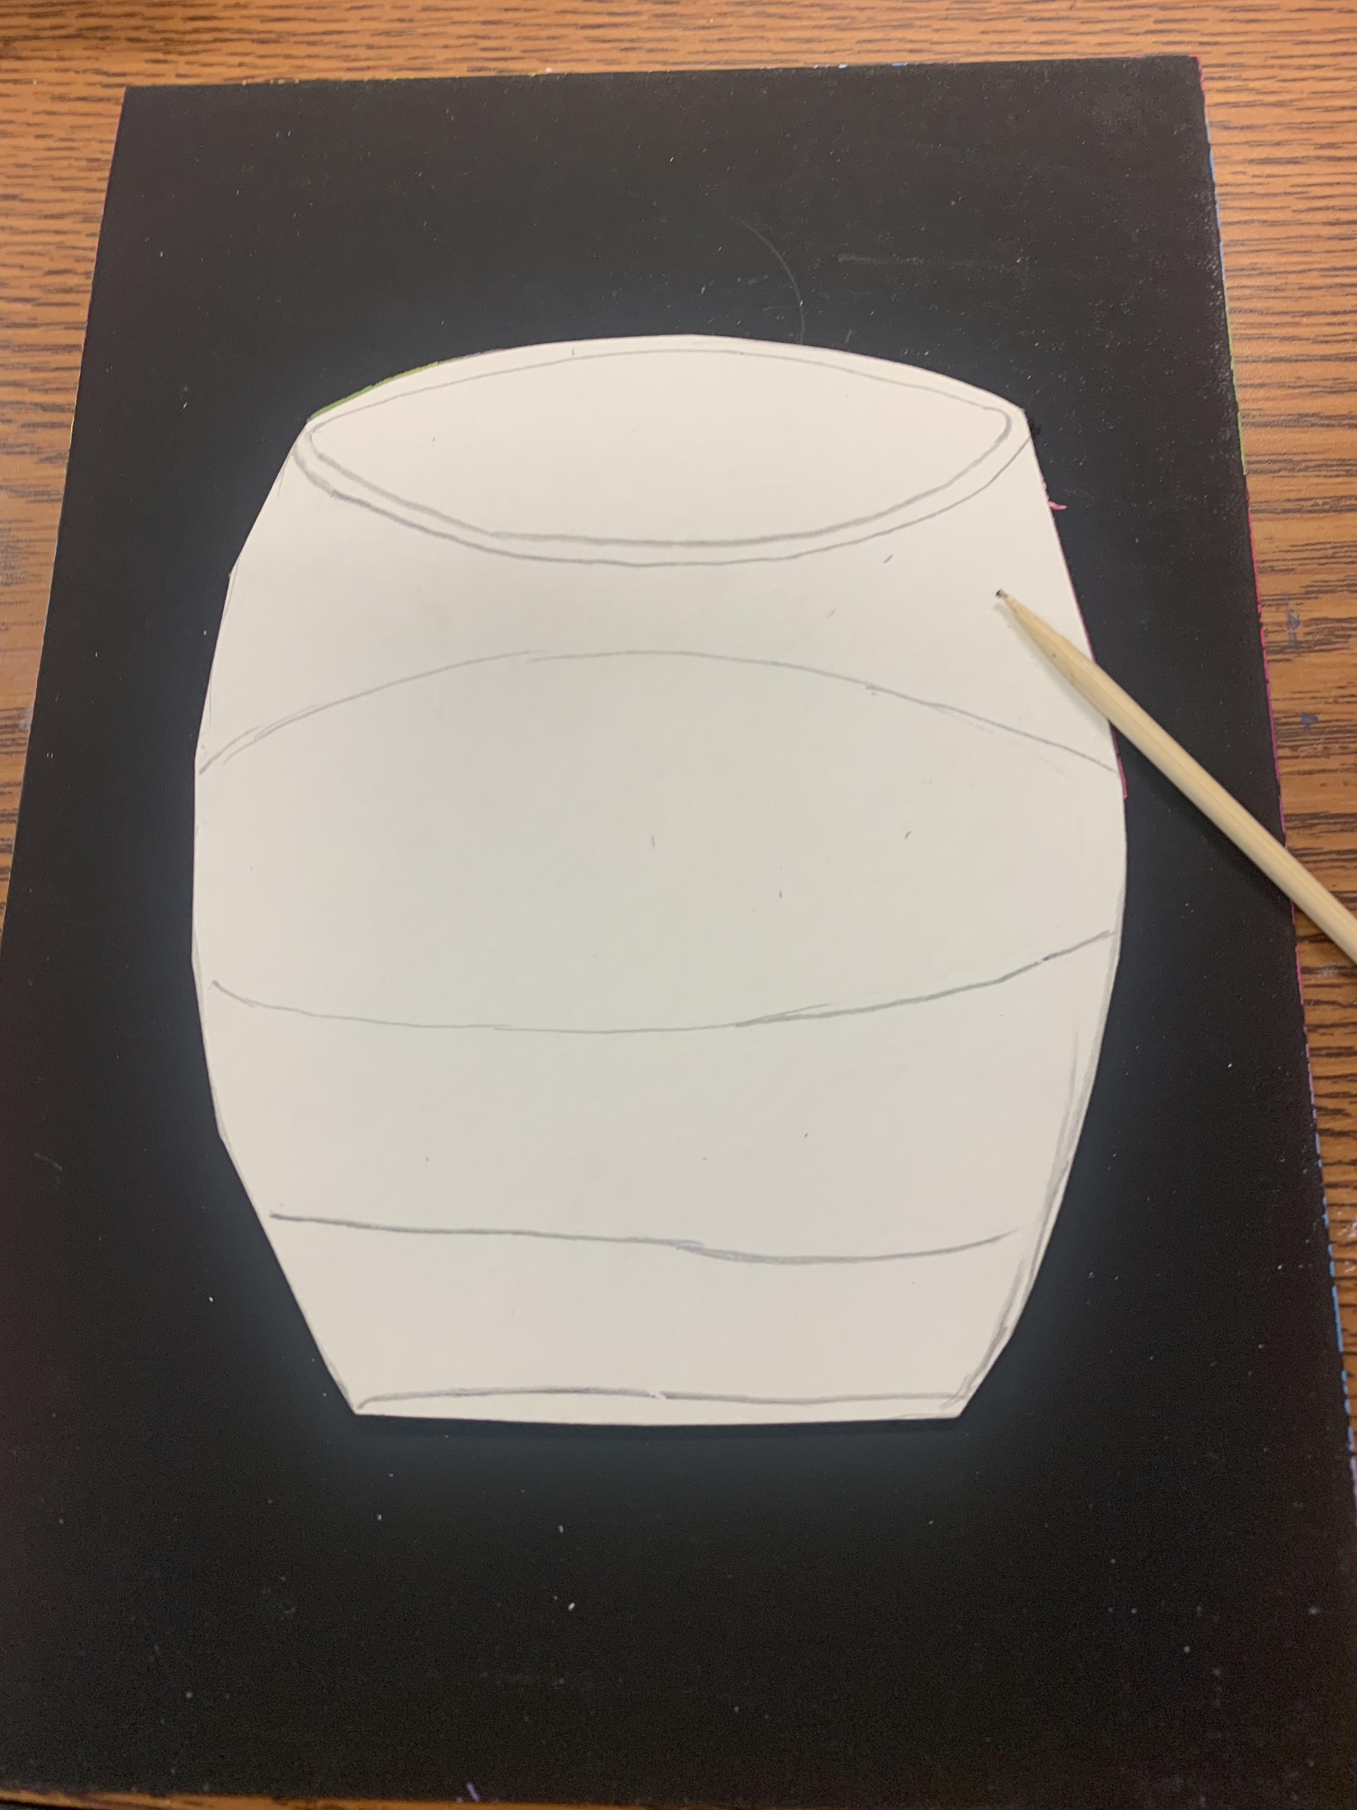
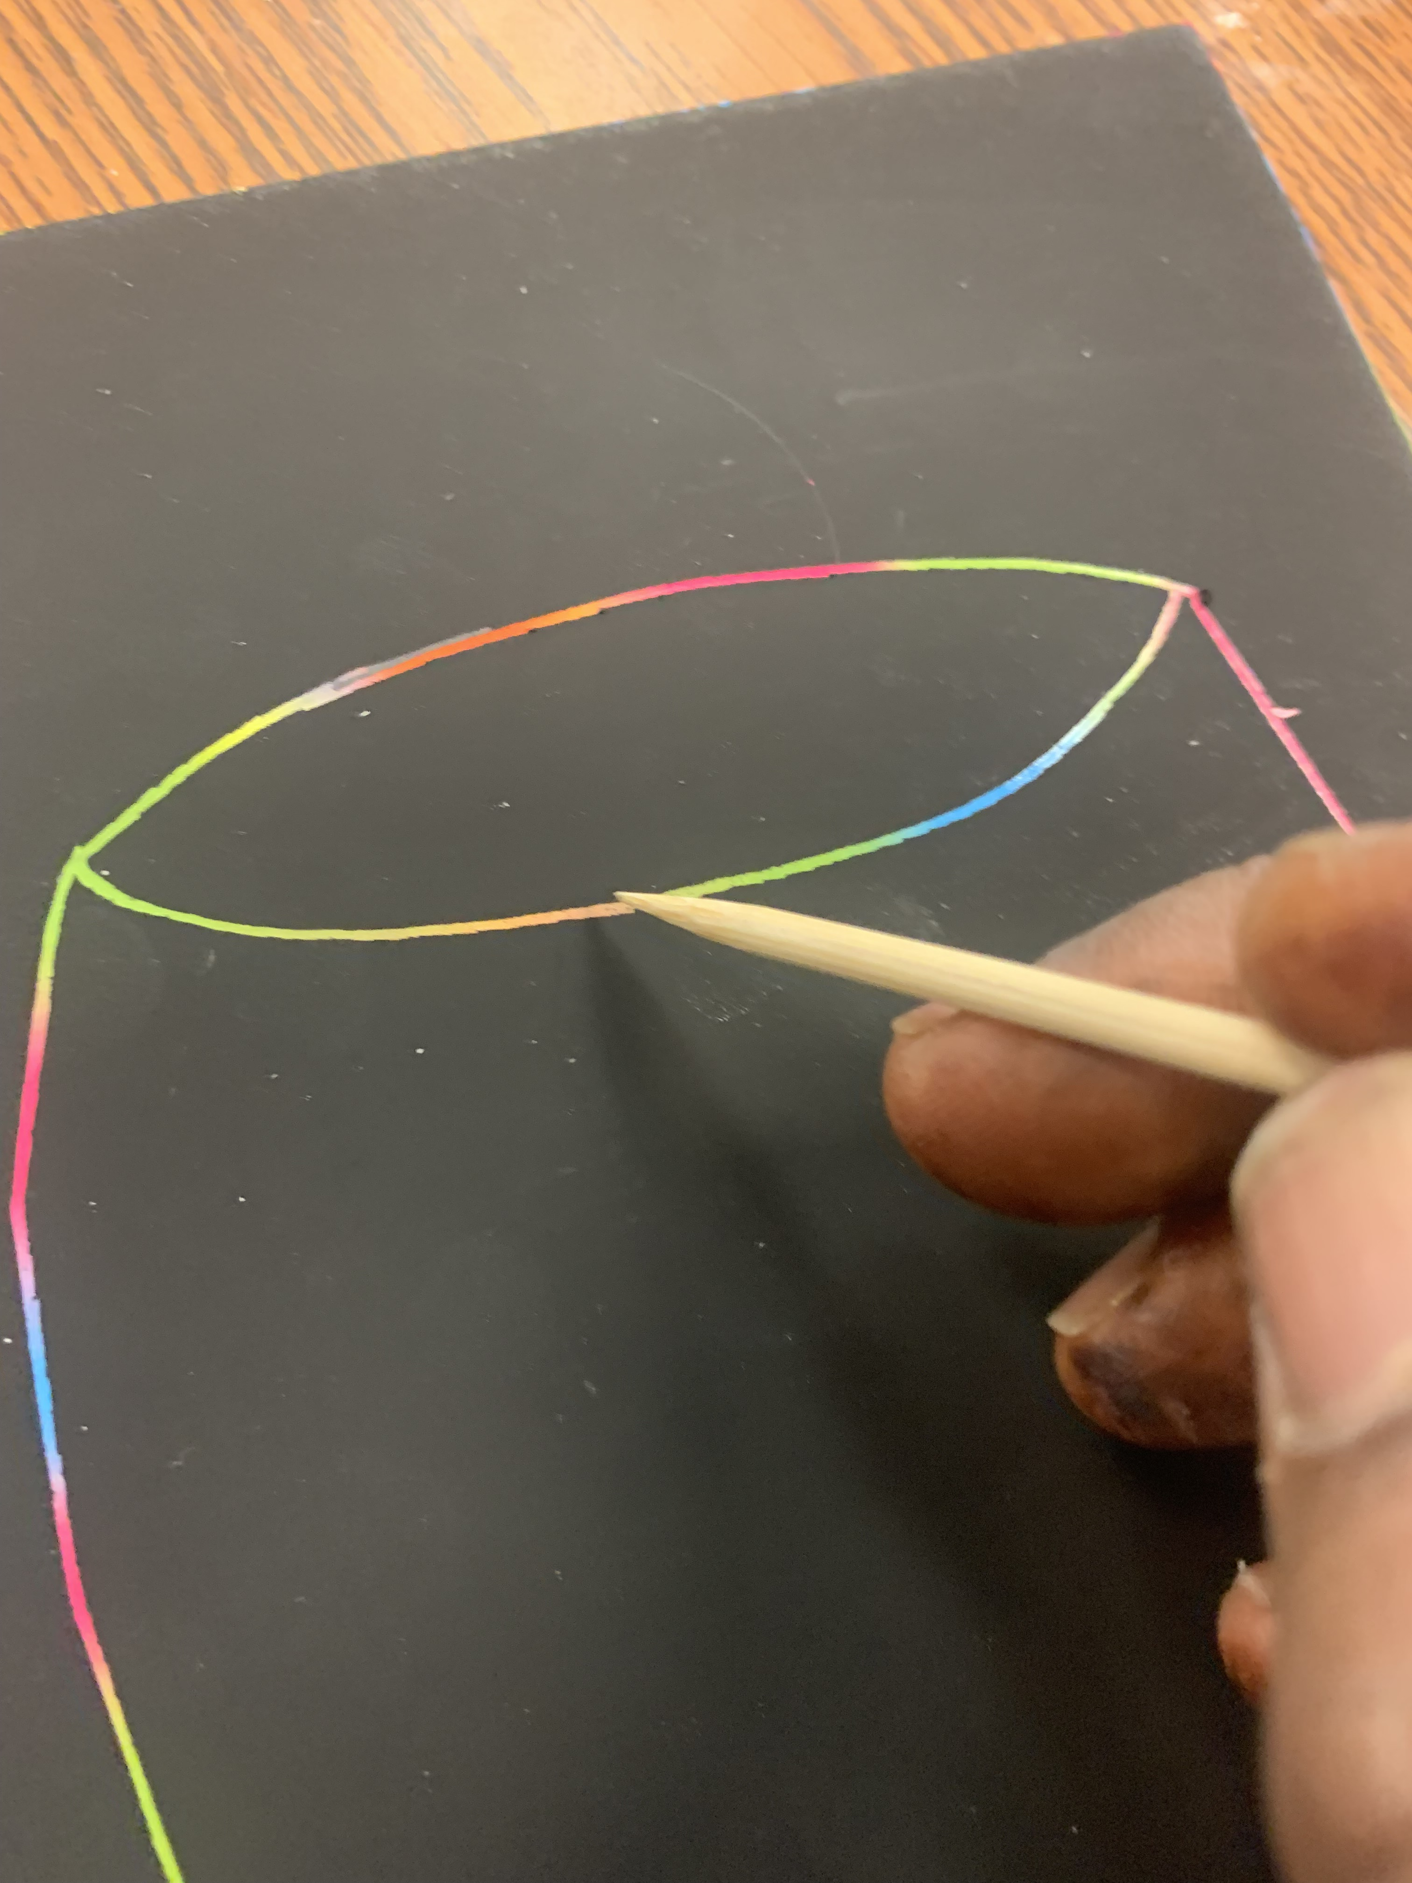
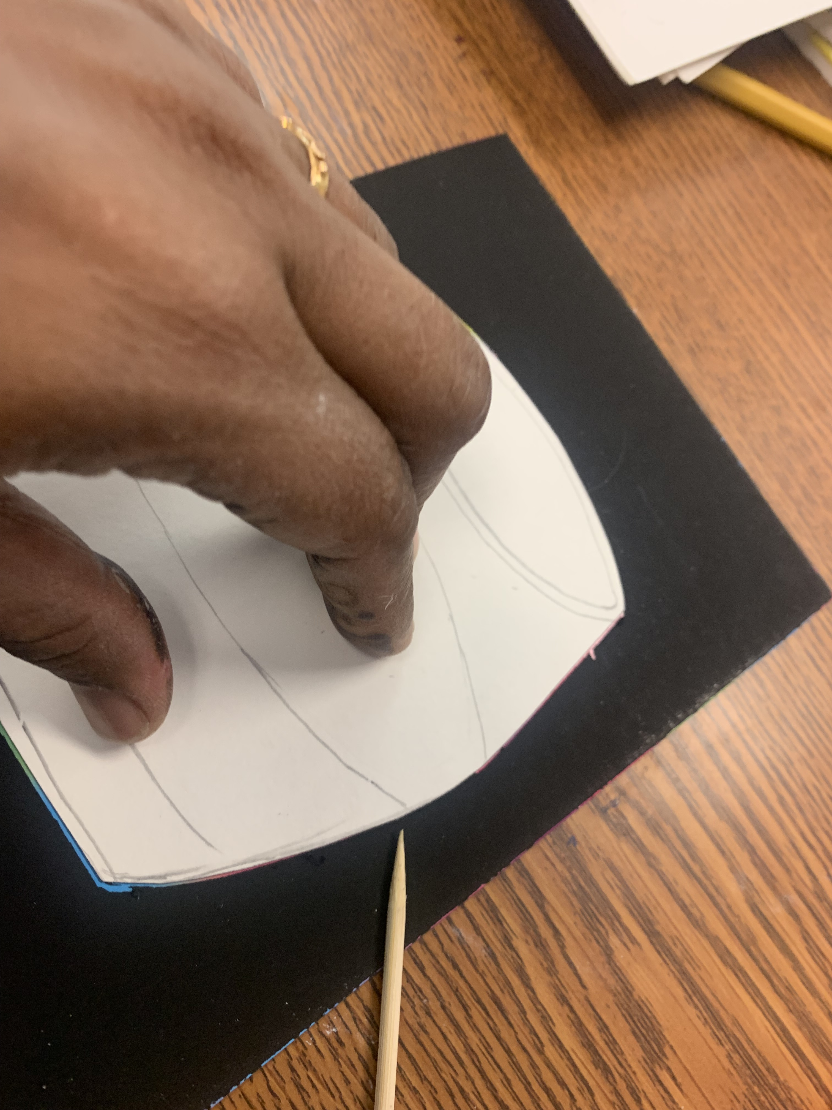
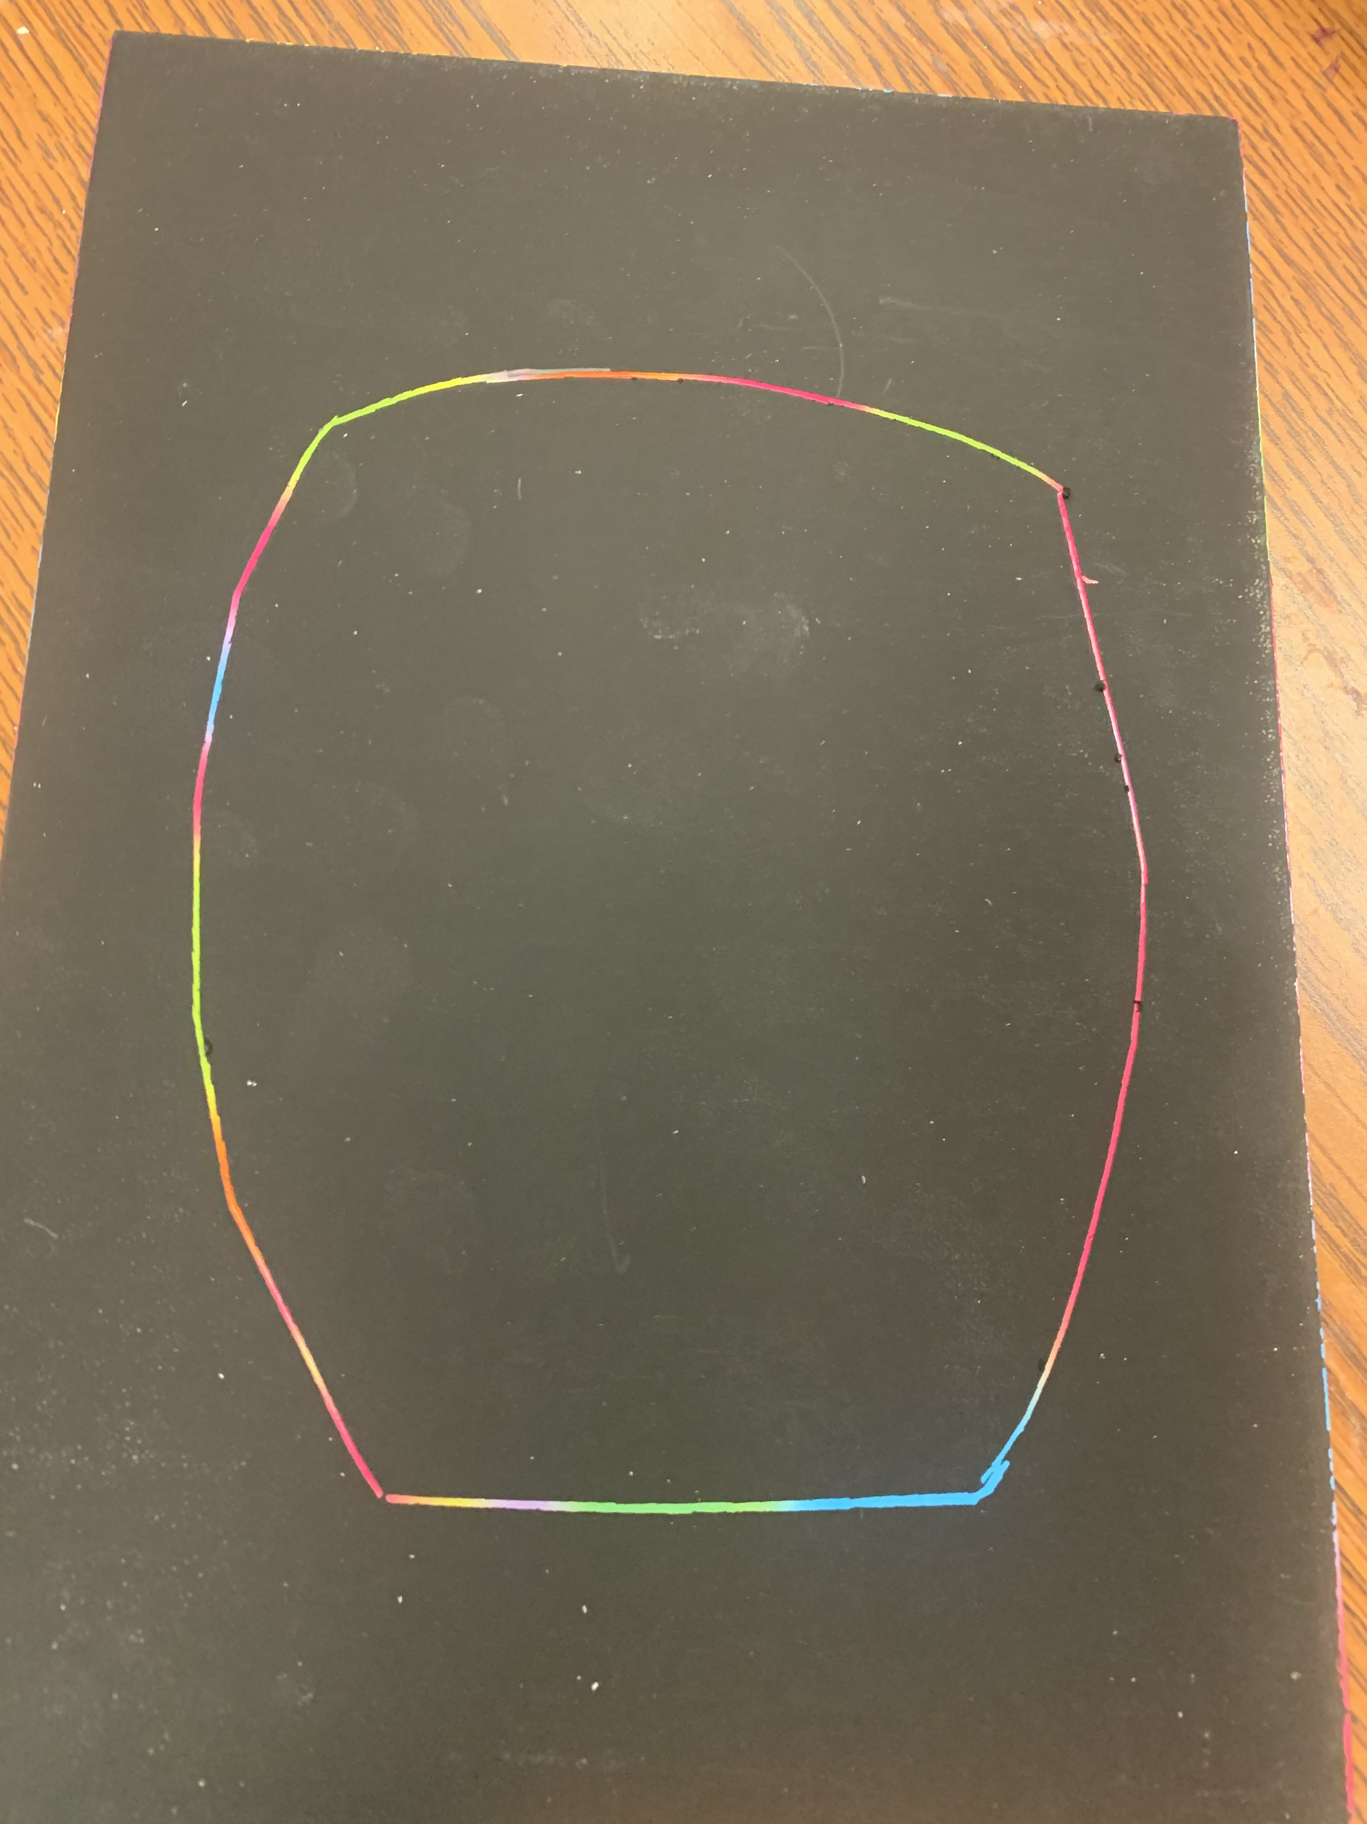
Procedure TK, K Grade 1 & 2
Place the drum template and trace around using the skewer stick
Draw the drum head - an oval
Draw lines to split the drum shell to add folk patterns (designs)

Slide 12
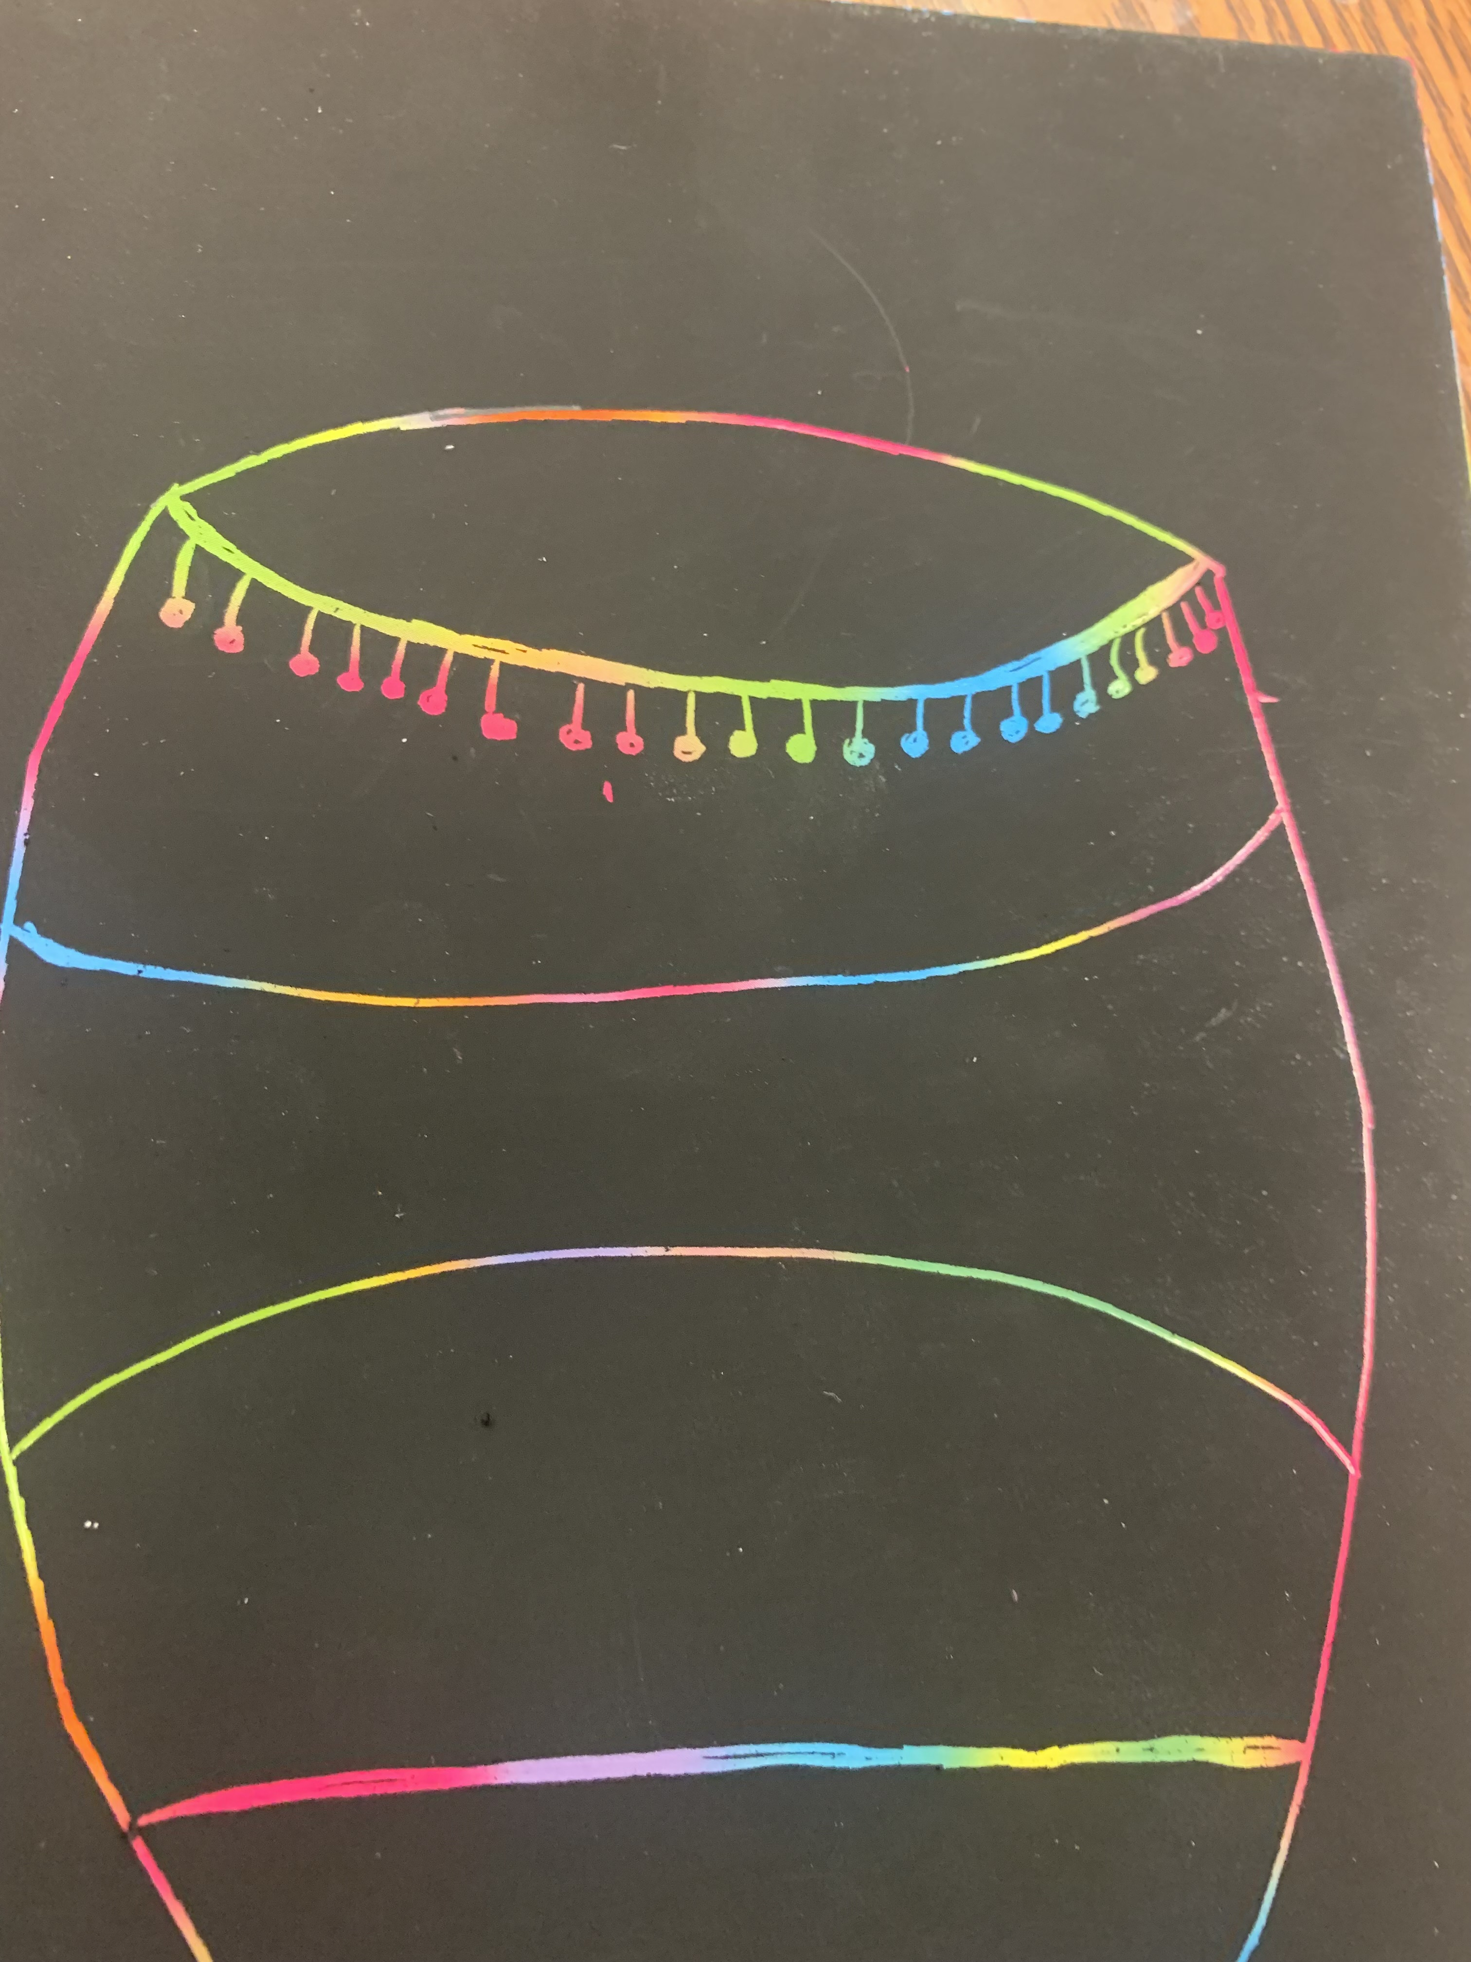
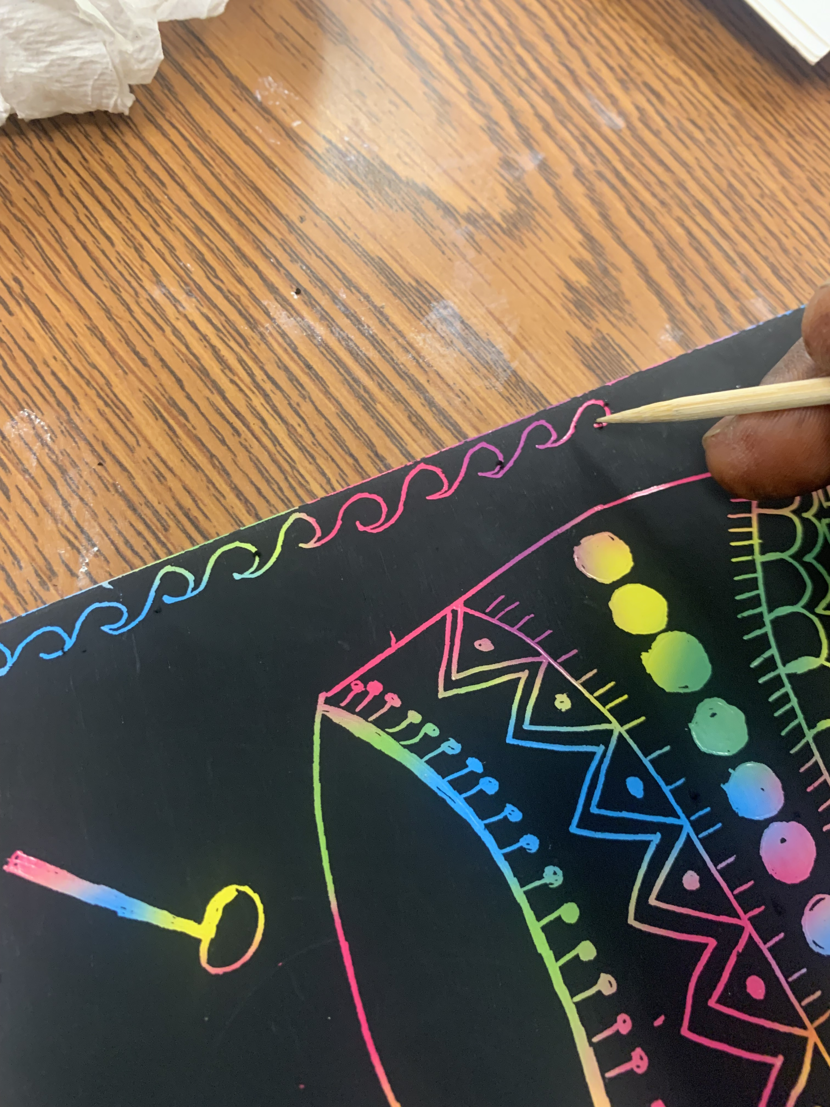
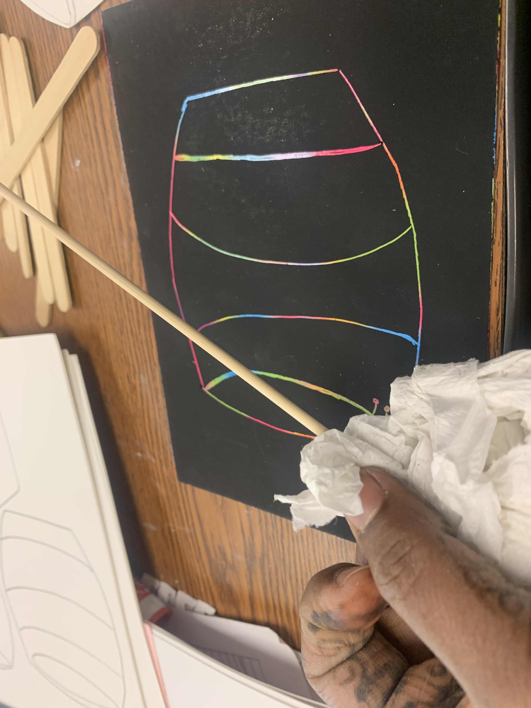
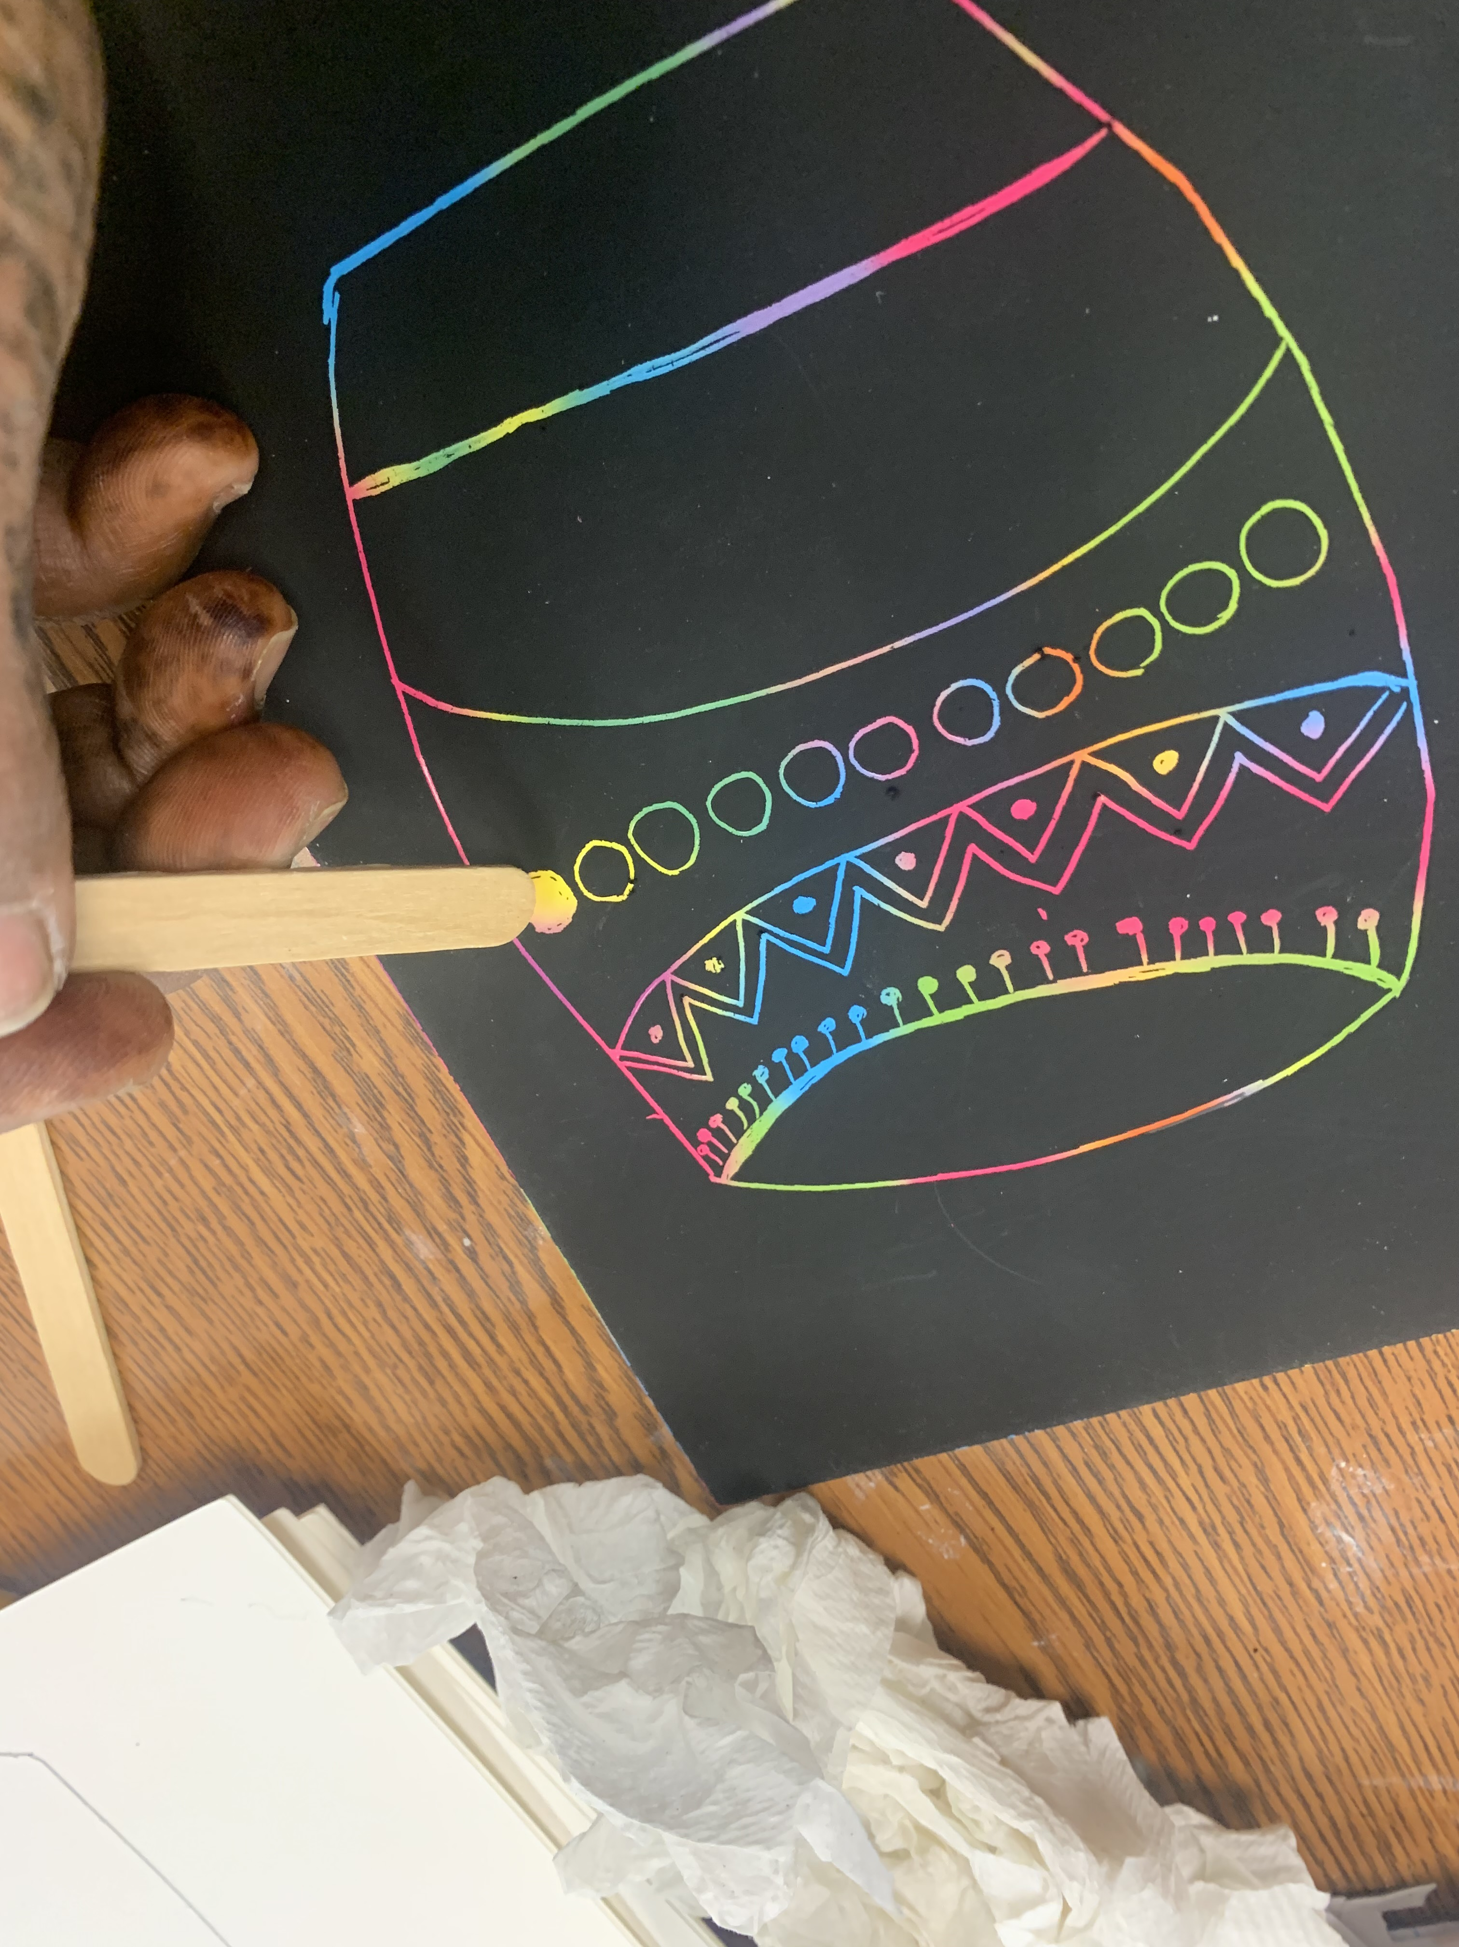
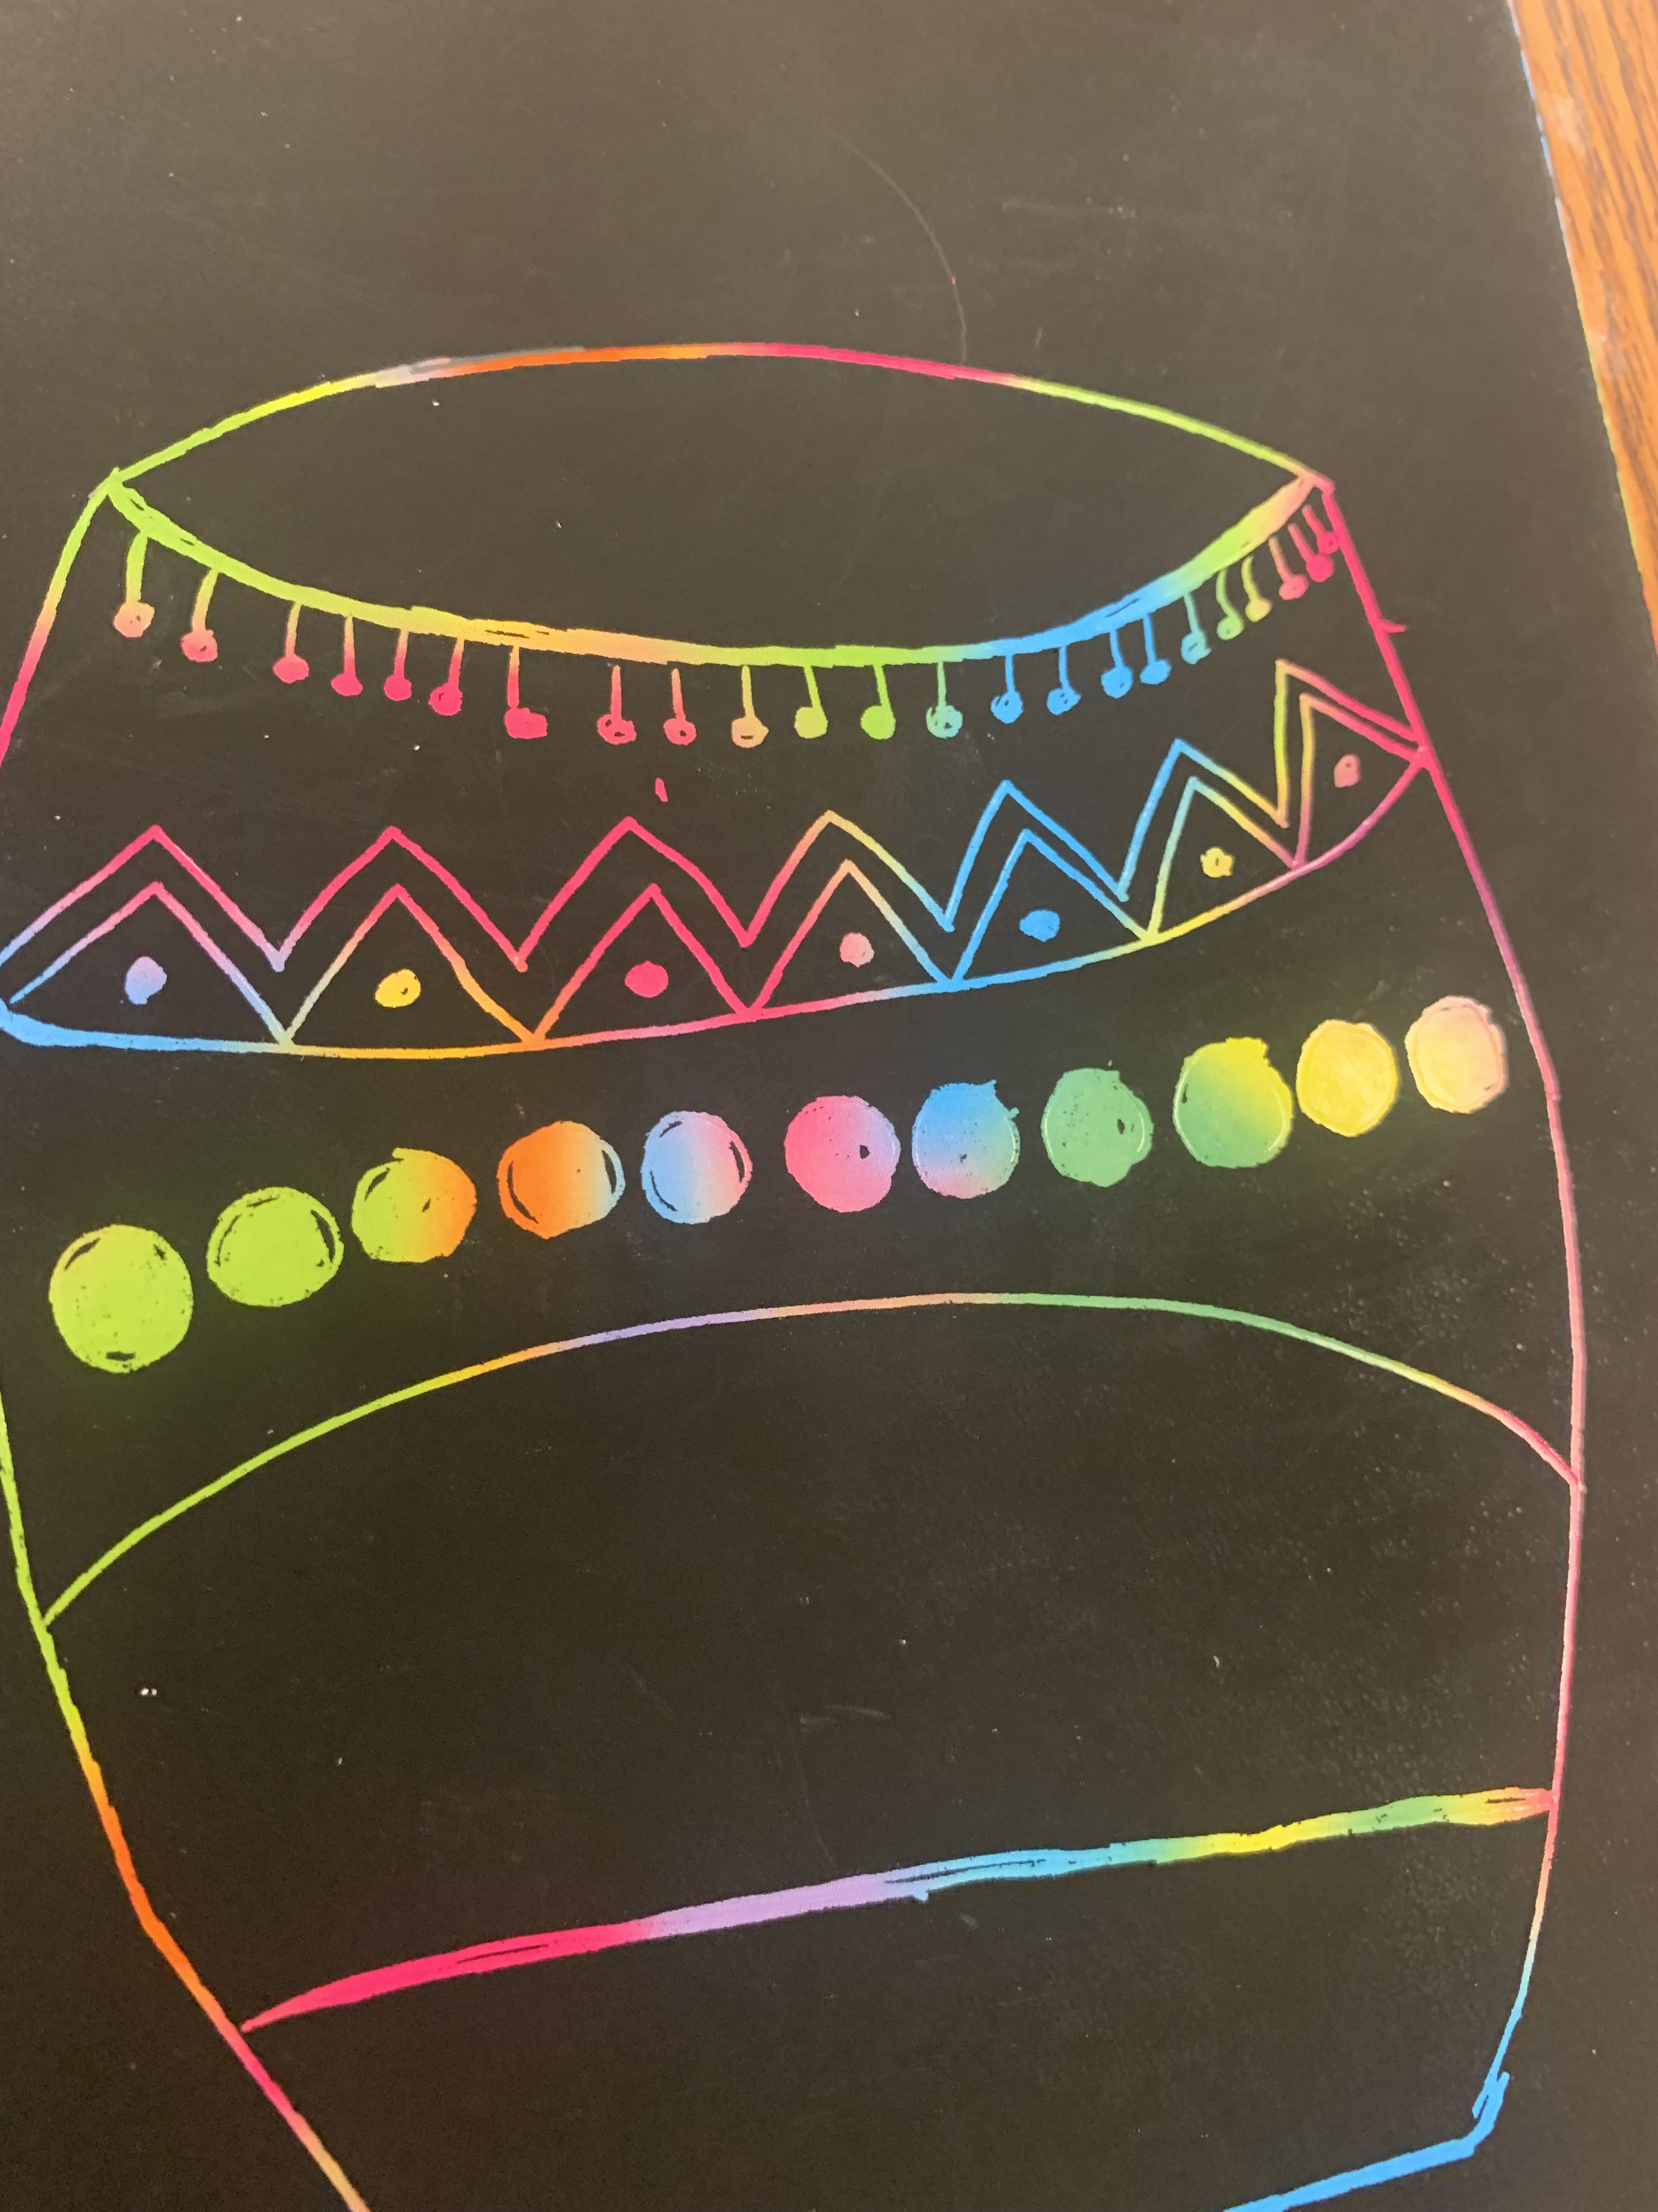
Procedure TK, K Grade 1 & 2
Wipe the skewers now and then to take away off the excess scrap
Add designs/folk patterns on the drum refer to the slides for inspiration
Use the craft stick to to scratch away a lager area
You will need some larger areas so it is colorful
Draw the drumsticks, add simple border design
Engrave your name on the right hand side
Mount the art on a bright colored paper

