Slide 1
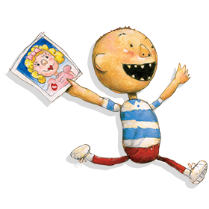
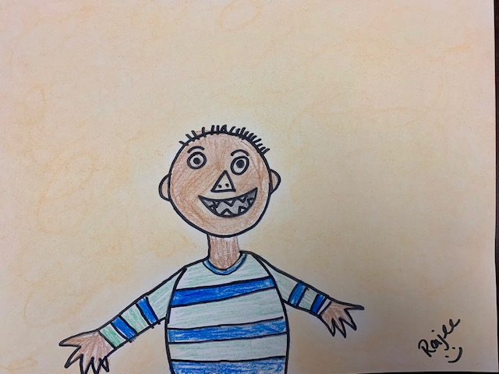
Silly David Tk, K & Grade 1
September Art Project 2019
Quail Run Elementary
Art Coordinator – Rajee Subramanian

Slide 2
David Shannon
Born on Oct 5, 1960 in Washington D.C.
Lives in Los Angeles, California
Loves to do art and play base ball
Illustrator, Artist, Writer
He was an editorial illustrator (illustrates for newspaper, articles, posters, albums covers etc.)

Slide 3
David Shannon
Scholastics illustrator for children's books
illustrators) in 1999 for his his book “No David” No David illustrations came from his sketch book from when he was 7 years old
He wanted to make art easy and motivate children to start drawing
He uses simple lines and shapes to create his art
He uses a lot of bright colors yellow, orange, green etc.
Children where able to relate very well to the story and images
His stories helped teachers and parents implement good behavior and character traits

Slide 4
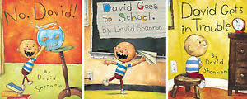
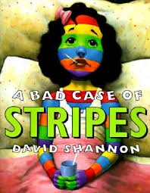
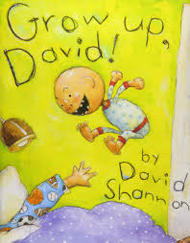
Inspiration – David Shannon books

Slide 5
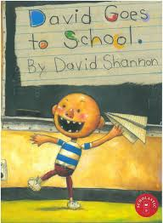
Books – Literature
TK, K & 1st
https://www.youtube.com/watch?v=JTUR5L8pOV8
https://www.youtube.com/watch?v=9Wsod3lPlYY

Slide 6
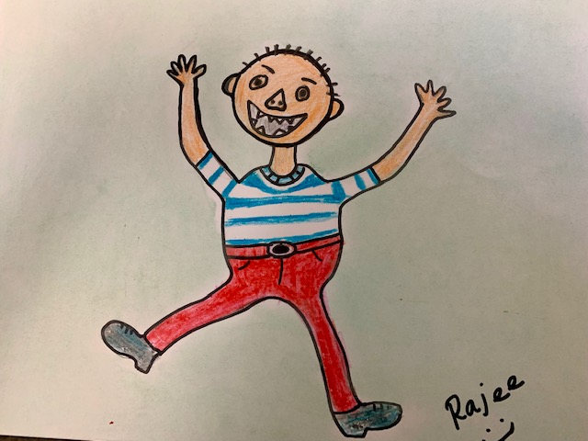
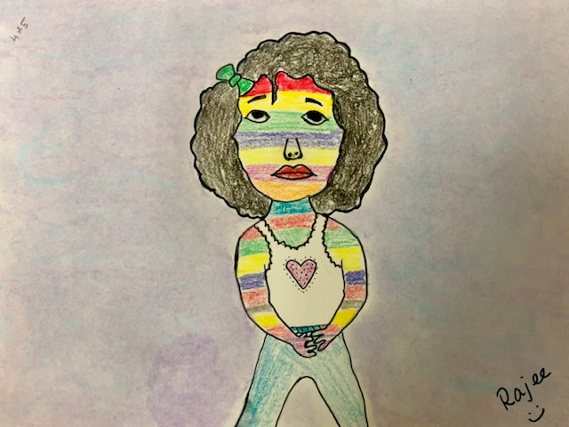
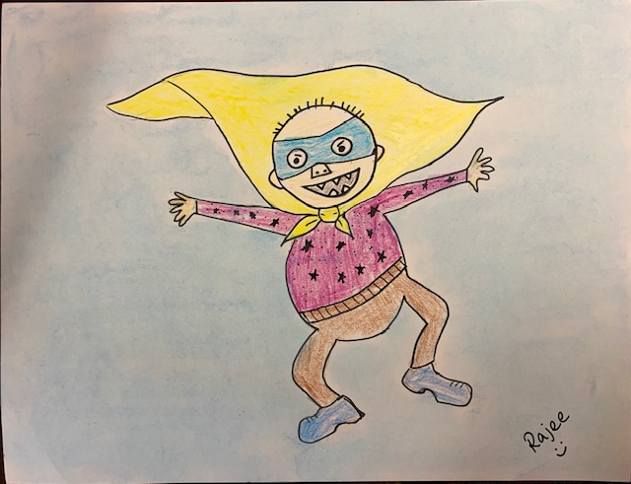
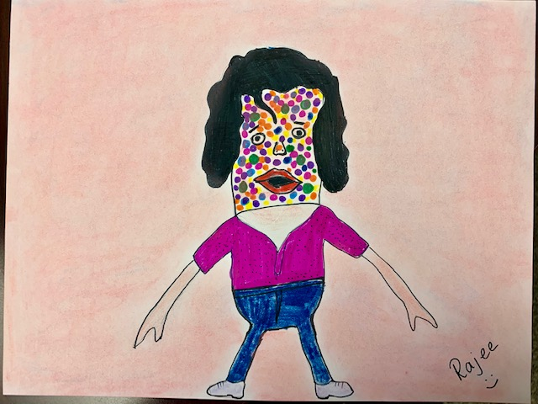
September 2019
Grade 2
Grade 4 & 5
Tk, K, Grade 1
Grade 3
Grade 4 & 5

Slide 7
QR Character Trait of the Month - Respect
Respect is thinking and acting in a positive way about yourself or others.
Respect is thinking and acting in a way that shows others you care about their feelings and their well-being.
David is constantly reminded to follow the rules, and shows respect to the teachers, parents and his classmates.

Slide 8
art elements in this project
We will use lines, shapes and colors to make this art project.

Slide 9
Materials
9x12 construction sheet with right in the center of the page (TK – Grade 1)
Black Marker/sharpie from classroom
Crayons from classroom
Pencil
Colored chalk
Cotton balls
Q tips

Slide 10
David (TK, K & 1^{st )}

Slide 11
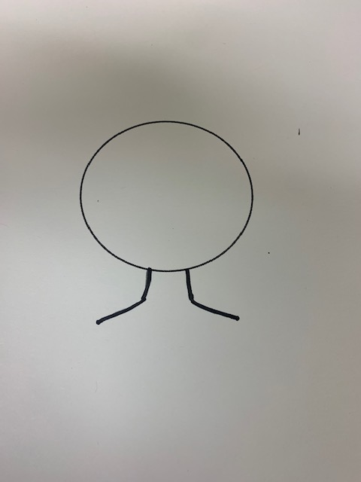
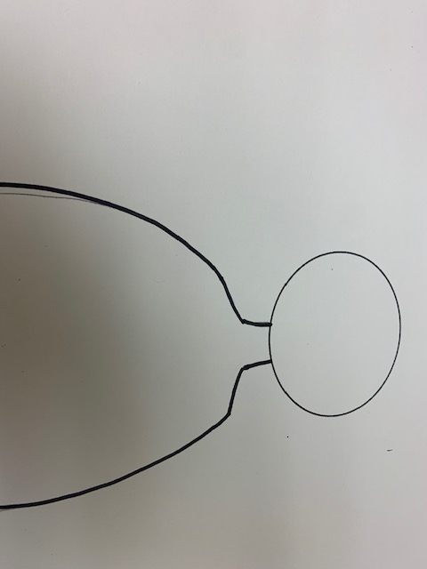
Procedure – David (TK, K & 1^{st )}
On the 9x12 constructions paper with the circle on the center of the paper, draw 2 lines to make the neck
Add a slanted line from both sides of neck to form the shoulder
From each side of the shoulder make the curved line to make the body. Extend the line to the end of the paper

Slide 12
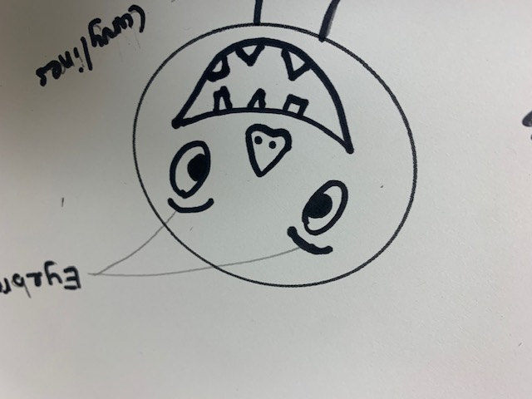
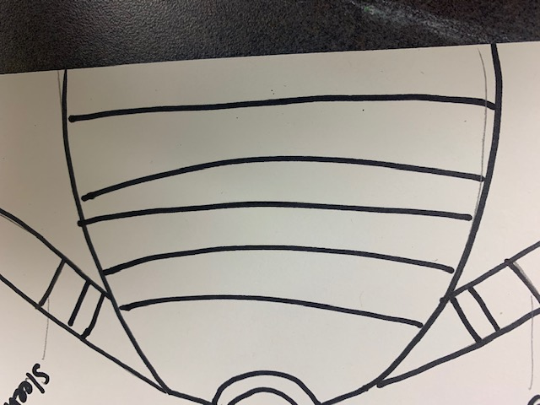
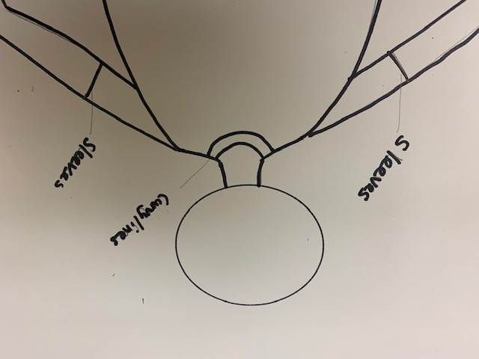
Procedure – David (TK, K & 1^{st )}
Add the hands and fingers on either side of the body
Add the curved line for the collar and the sleeve on the hand
Add the eye brows, circle eye balls, triangle nose, open smile mouth, sharp teeth and the hair
Draw lines on the T shirt to make the stripes for the T shirt
Trace everything in sharpie, color the body, T shirt etc.
Use crayons to color.

Slide 13
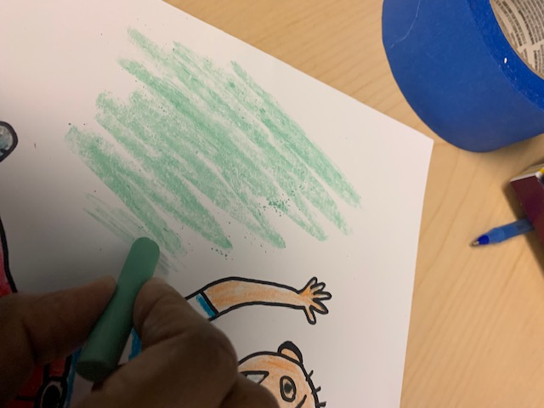
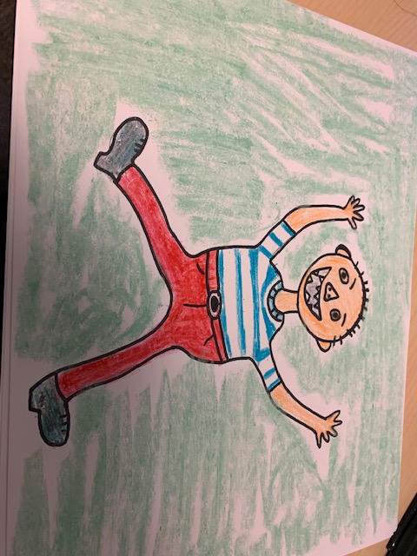
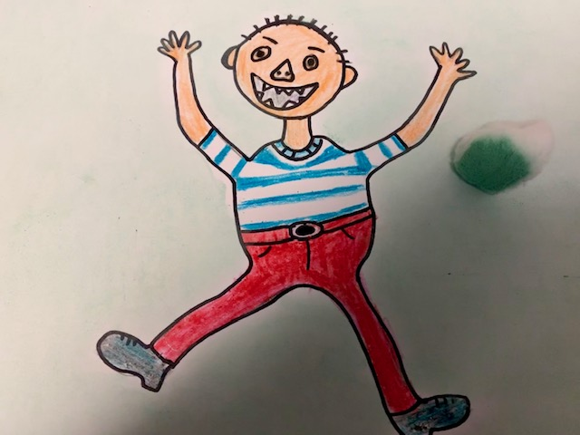
Procedure for chalk back ground All Grades
Apply a light color of chalk around the image (a little goes a long way)
Use a cotton ball to spread it around to get the same value around
Use a Qtip to go spread the chalk color in the narrow areas
Write your name on the right corner

Slide 14
Be respectful Have fun!

