Slide 1
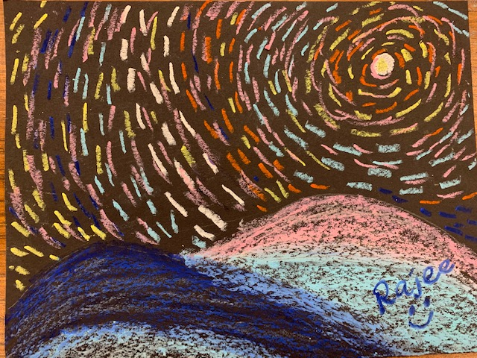
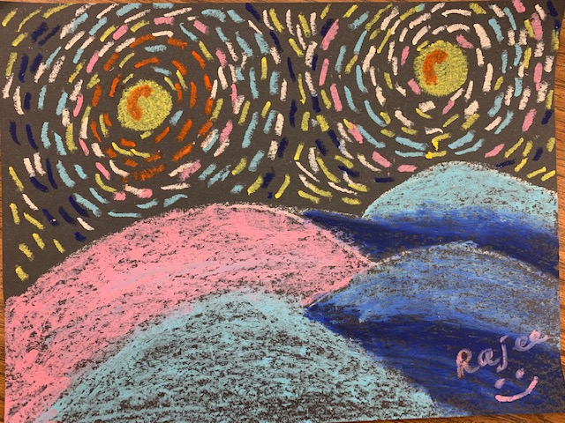
Starry Night – Vincent Van Gogh Grade(TK,K&1)
April 2020 Art project
Quail Run Elementary
Rajee Subramanian

Slide 2
Inspiration: Vincent Van Gogh
Dutch Painter, 1853 – 1890 (37years)
Impressionists artist
Color was his chief symbol of expression, bold brushstrokes & colors, layers of paint
Highly intelligent, emotional and had a difficult life
His painting career was only for 10 years but he produced over 900 art pieces
His paintings were recognized only after his death
He died as a poor man

Slide 3
Starry Night (June 1889) in motion (Video) Worth - $100 million Lives in Modern Museum in New York

Slide 4
Art Principle – Rhythm in visual art
RHYTHM is created when one or more elements are used repeatedly to create a feeling of movement.
Rhythm creates a mood like music or dancing

Slide 5
Art Technique – Art Moment What is impressionism?
- Impressionism is an art movement in 18th century
- Started by a group of French artists who decided to discard old ways of doing art.
Lines were replaced by rounded shapes, dashes or tiny dots. Dark shadows became colourful and bright.
These painters often enjoyed painting outside.
Van Goghh’s last painting “Wheatfield with crows”, that lives in his museum in Amsterdam

Slide 6
Vincent Van Gogh – Impressionism
Small brush strokes giving texture

Slide 7
Landscape – Background, Middle Ground & Fore Ground
One way to show space and depth is to over lap parts of an artwork to create the various grounds

Slide 8
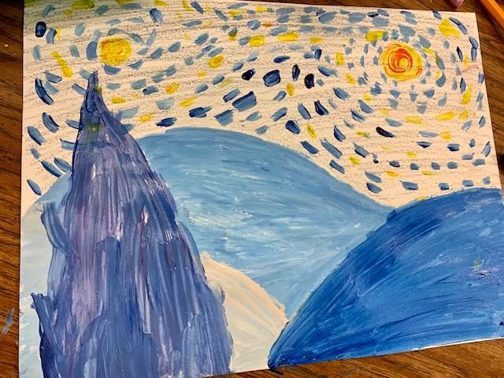
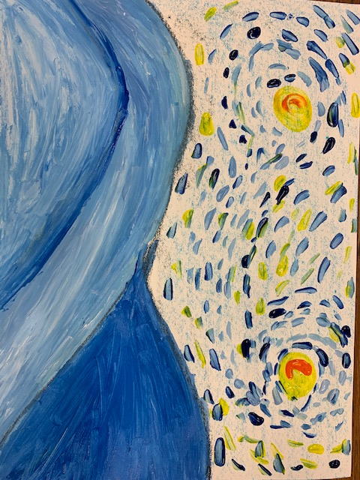
Starry Night@ QR
Grade 1 &2
Tk & K
Grade 2 &3
Grade 4&5

Slide 9
Materials
9X12 black construction paper(Grades TK, K, Grade 1/2)
Oil pastels (Grades TK, K, Grade 1/2)
Pencil

Slide 10
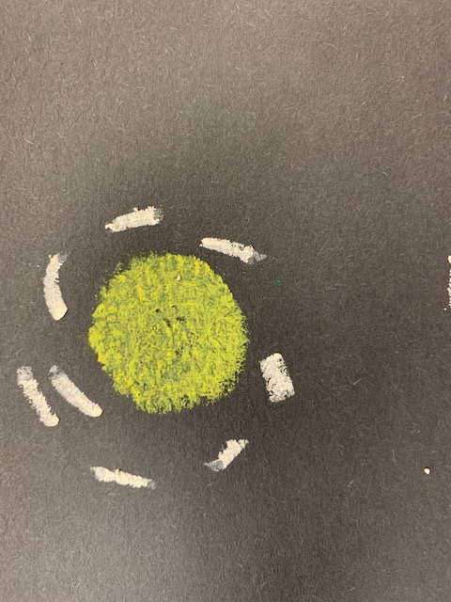
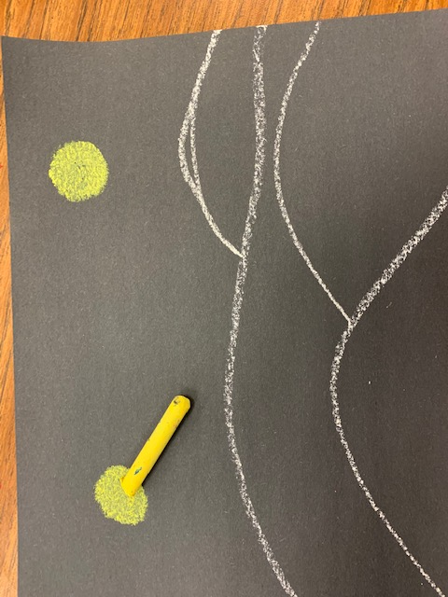
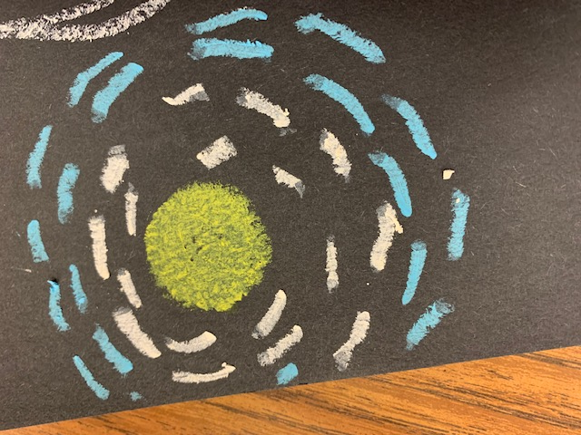
Procedure (Tk, K, Grade 1)
Start adding small stroke like lines around the moon in a circular motion using different color pastels mostly blues, white and yellow
Draw hills using white or light colored oil pastel, this will be the middle and foregrounds
Add 2 yellow moons on the background

Slide 11
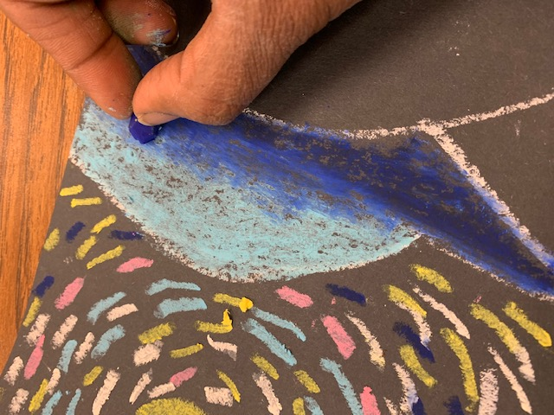
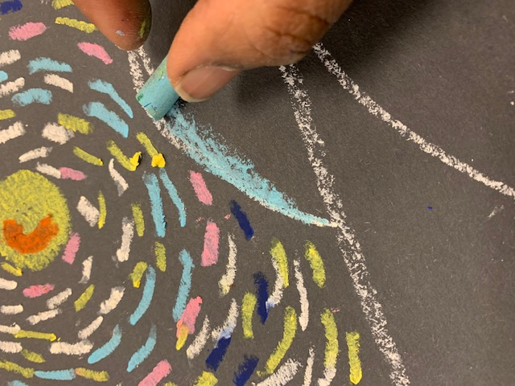
Procedure (Tk, K, Grade 1)
Overlap the colors a little and blend it using your finger
Keep filling the dashes in circular motion until the 2 big circles collide
Fill in the rest of the empty places with the dashes
Color the hills using light blue, dark blue, white, pink etc…
Write your name using a contrast color oil pastel (dark/light)

