Slide 1
Rolling Hills of San Ramon & Quail Run School spirit
TK, K & Grade 1
November 2021 Art Project
Quail Run Elementary
Rajee Subramanian

Slide 2
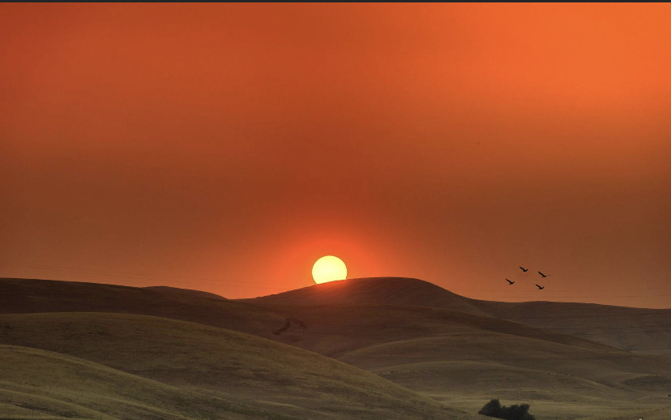
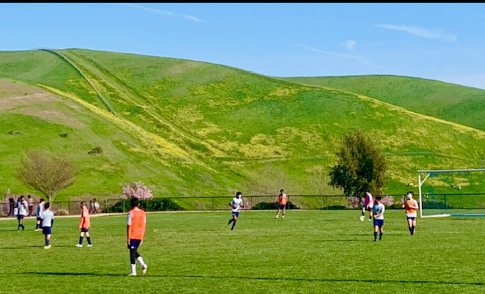
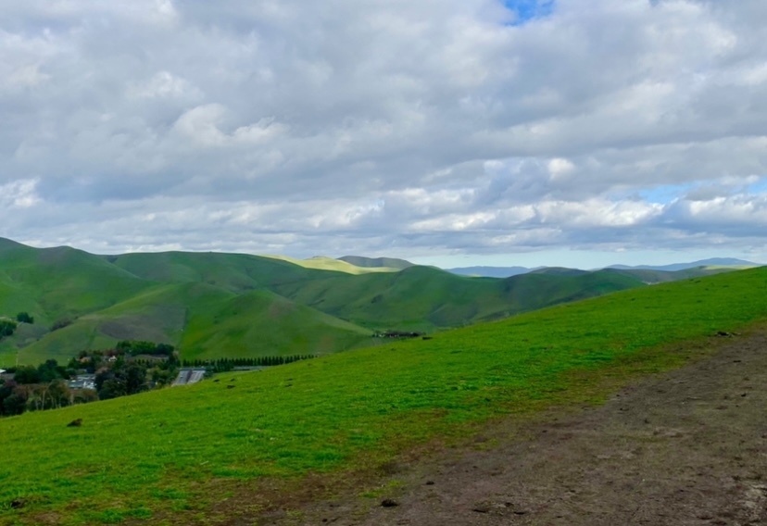
Beautiful San Ramon – Rolling Hills and Valley

Slide 3
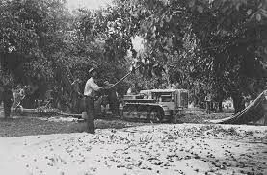
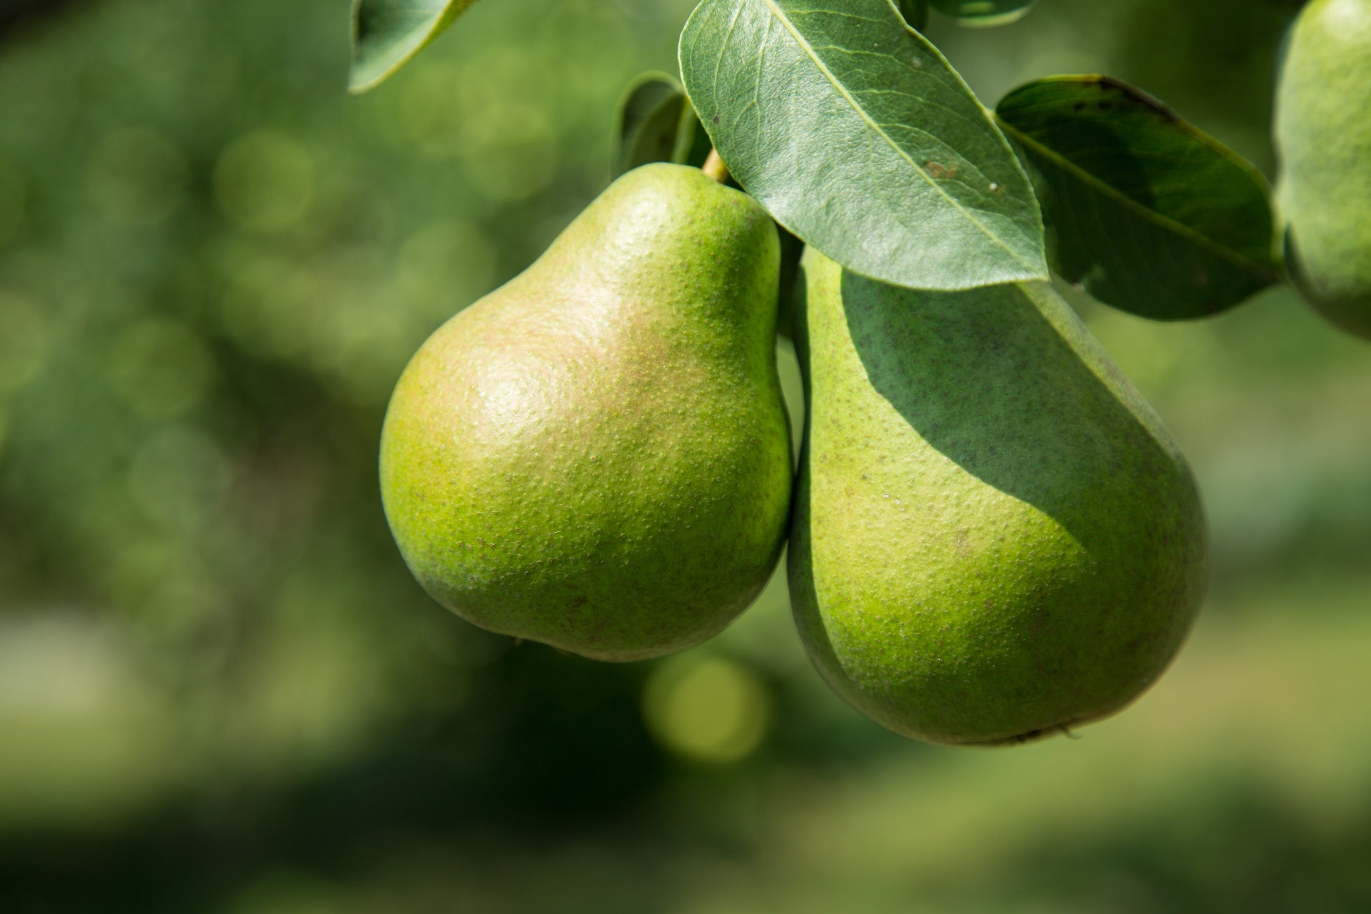
World Famous
Thomas B. Bishop Company
The Bartlett Pear Orchard at the Bishop Ranch, begun in 1911
Known as the largest single orchard of Bartlett pears in the world.

Slide 4
San Ramon Logo
The San Ramon Logo has the little hills
City became legally incorporated in 1983
City approved 11,000 homes and parks, schools, shopping area for the new homes
Quail Run was the 3rd school in the area built by Shapell builders

Slide 5
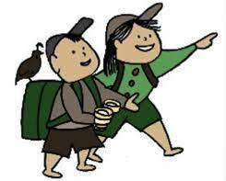
Quail Run – Inauguration
on August 25, 2005
School Logo – Explorers
Before the new place it was in portables on Coyote Creek black top with 10 Staff and 127 students
New building had 30 staff and 570 students in its first year
Currently, 17 years old school has approx. 850 students
School colors Green and white

Slide 6
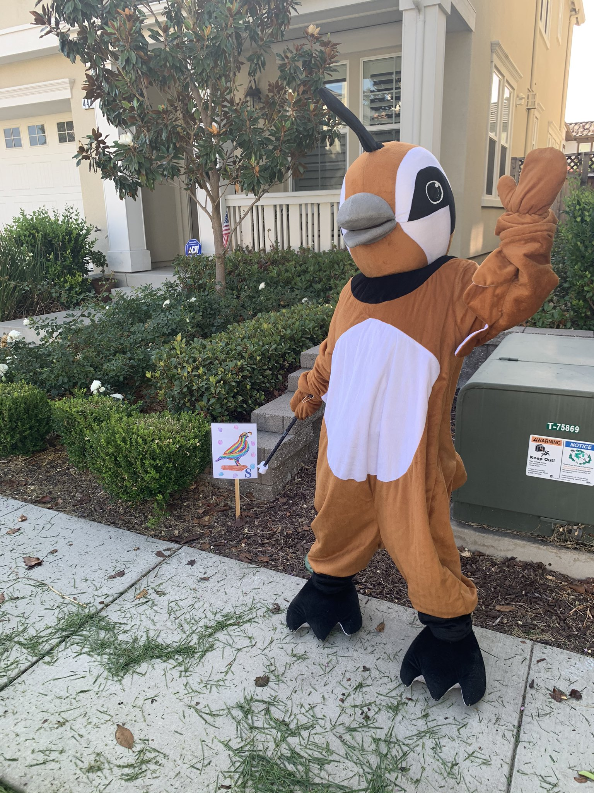
Quail Run – Mascot
School Logo is usually the mascot – Explorers
For convenience purpose the quail on the explorer was chosen as mascot in the recent years
Quinn the Quail came alive just 5 years back
Quail is also the California State Bird
Quail eats seeds, grains, berries small insects
It has a special feathers on the top of the head called Plume or Crest
Nest under the shrubs on the ground
Runs fast and flies occasionally mostly in danger

Slide 7
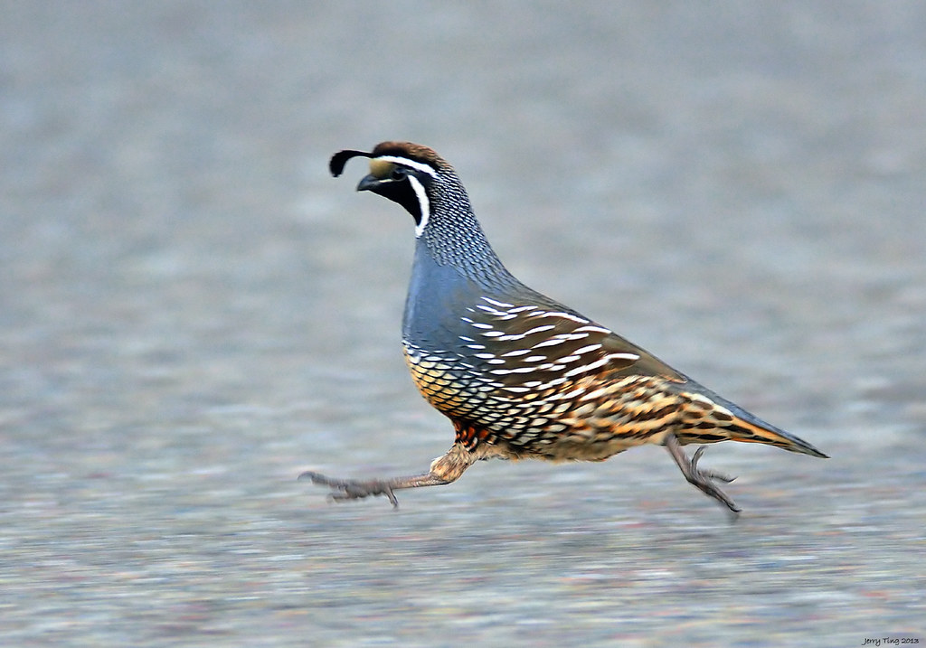
How did Quail Run get its name?
New school ground breaking
Quails were all over the ground and was running all around
They live in huge groups called covey
Video of Quail Running embedded in the picture on the right, if it doesn’t play, please click below!
https://www.youtube.com/watch?v=HHLOeNT511E

Slide 8
Art Elements
Collage making (Overlapping)
Background – Blue Sky
Middle Ground – Rolling hills
Foreground – Quail

Slide 9
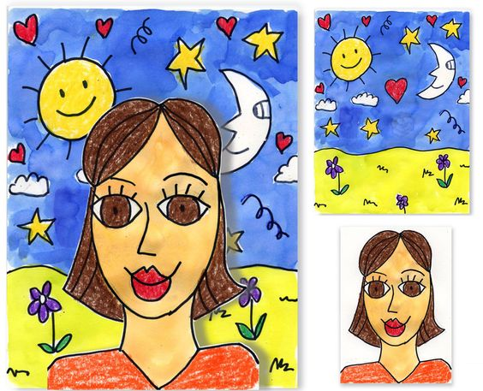
Art Element
Collage making (Overlapping)
Back ground, Foreground, Horizon
Background
Background
Fore ground
Horizon
Overlapping Image

Slide 10
Materials – Tk, Kinder & Grade 1
9x12 White construction paper QR Quail cut and craft sheet
9X12 Green construction paper
9x12 Blue construction paper
Crayons – Blue and Browns
Sharpie (Classroom)
Blue and Brown Markers
Glue Sticks (Classroom)
Scissors (Classroom)

Slide 11
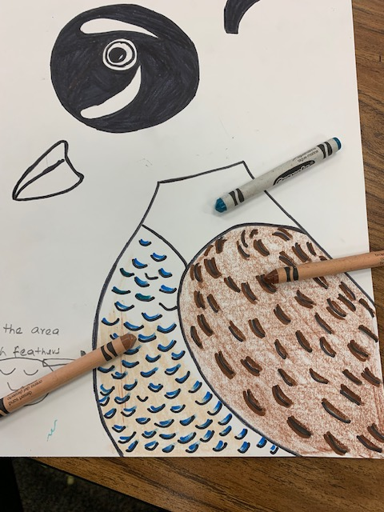
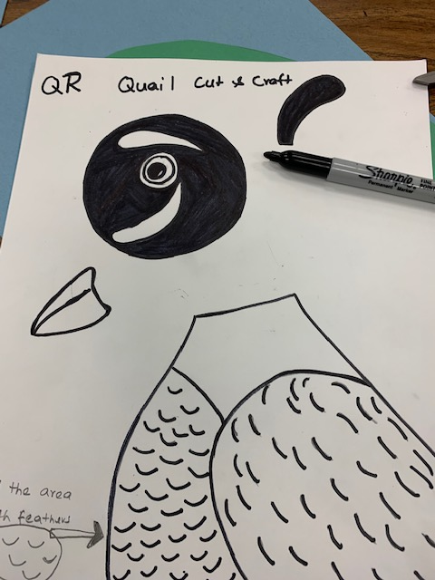
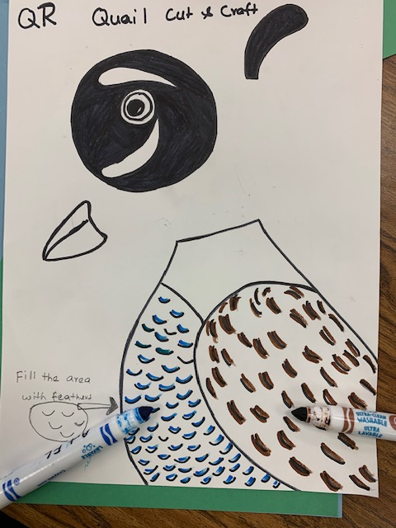
Kinder – Procedure
Use crayons to color the body of the Quail
Blue and light brown for the tummy
Dark Brown for the wings
Blue for the neck
Add additional feathers on the Quail
Copy the feather lines in brown to add texture

Slide 12
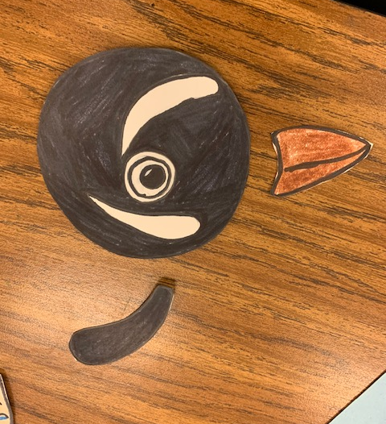
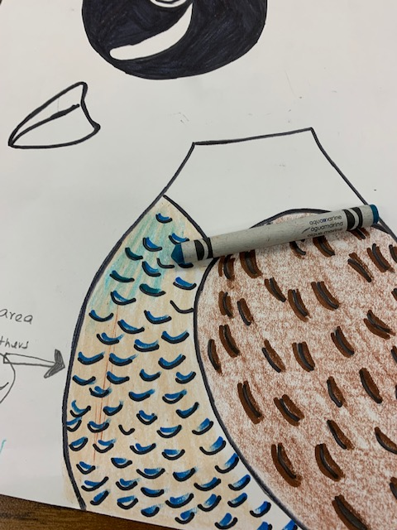
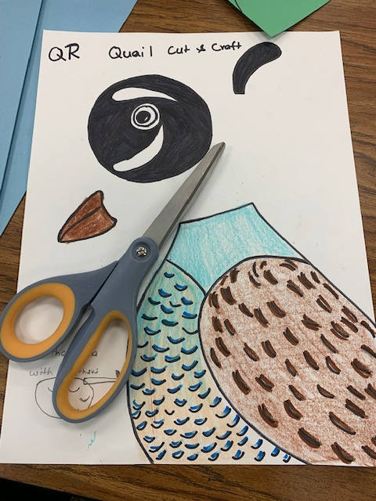
TK, Kinder, Grade 1, 2 & 3 – Procedure
We will collage the head first
Mix blue and brown for the tummy
Cut them out

Slide 13
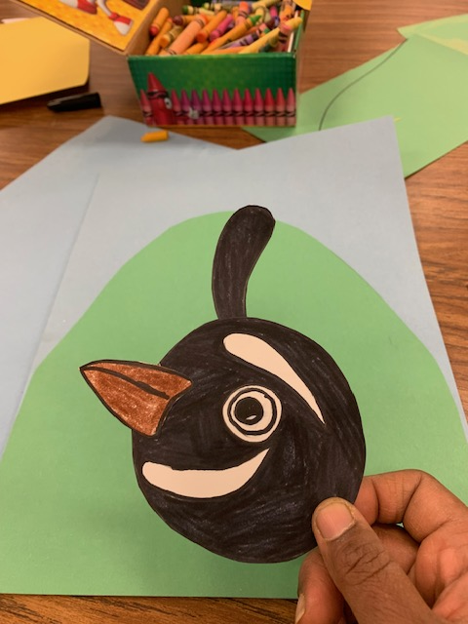
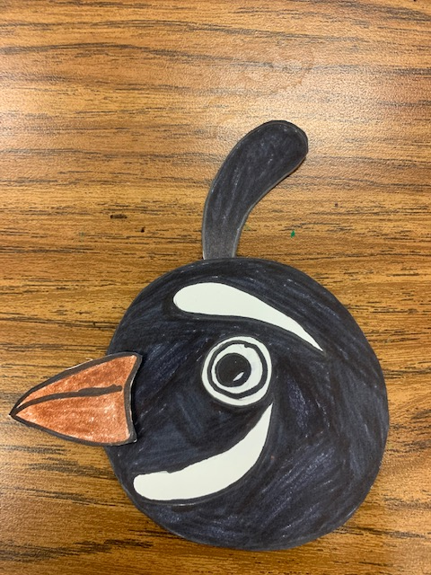
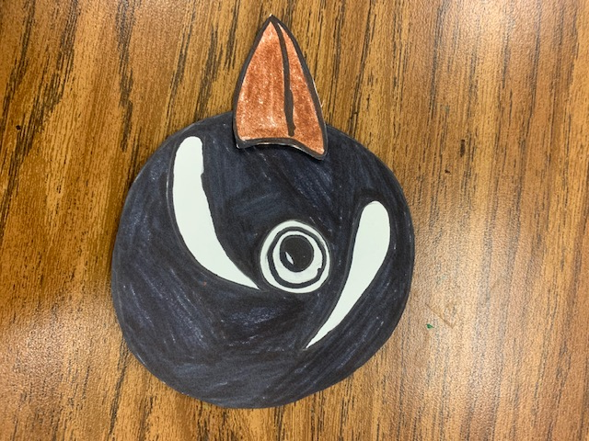
TK, Kinder, Grade 1, 2 & 3 – Procedure
Draw a huge mountain on the green sheet
Glue it on to the blue sheet
Beak is glued on top of the head
In front of the eyes (above the smile
The feather on the top goes under the head
Glue it down

Slide 14
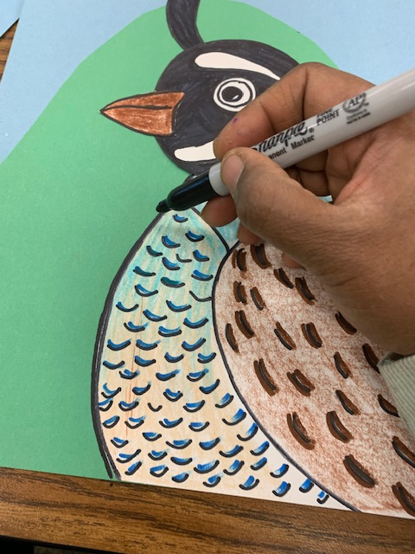
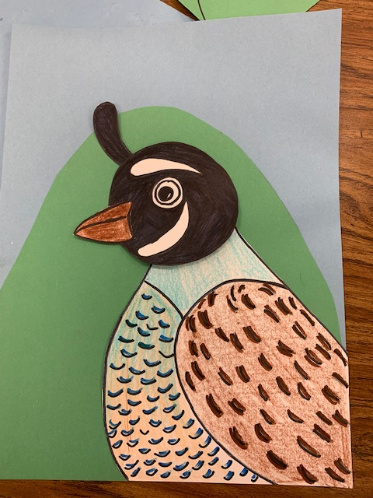
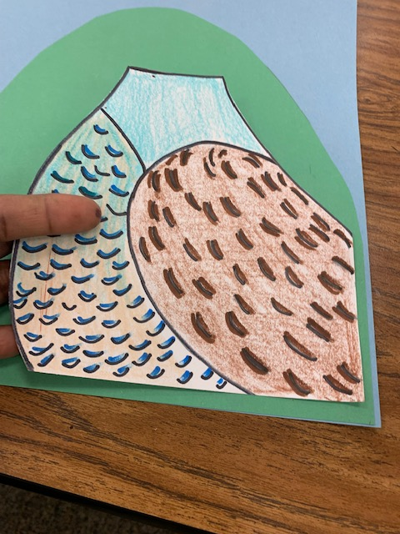
Kinder – Procedure
Trace around the outer parts of the quail after it has been glued down
Write your name on the green hill away from the Quail
Position the head the way you want (looking up/down)
Glue it on top of the neck overlapping some of the neck
Find and match the corners on the quail body and glue it down

