Slide 1
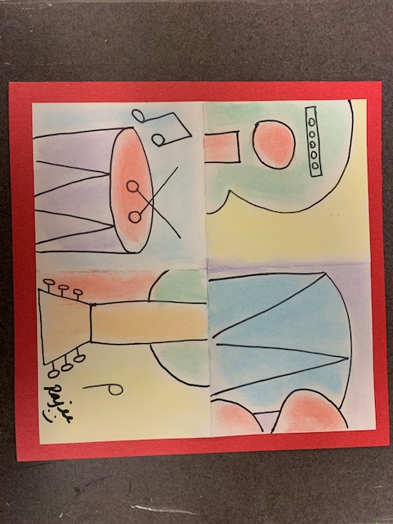
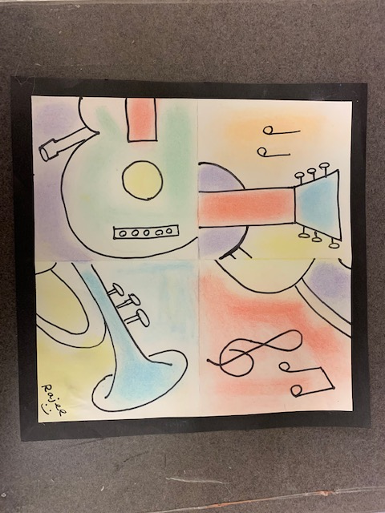
Puzzled Music
Grade 2
Grade 3
January 2020 project
Rajee Subramanian
Quail Run Elementary

Slide 2
Inspiration
1881 – 1973
Spanish Painter, Sculptor, printmaker, ceramicist, stage designer
Lived in France
Child prodigy, in age 13 he went to college of arts
His first word was “piz” in Spanish meaning Pencil
Father was an art teacher
Guiness Record - Picasso produced about 13,500 paintings and designs, 100,000 prints and engravings, 34,000 book illustrations and 300 sculptures and ceramics.
His work of art is worth approx $780 billion
Pablo Piccaso

Slide 3
Pablo Picasso’s work
Blue Period
Early art
The Science and Charity (Age - 15)
Rose Period – The Peasants
Breakfast of a Blind man

Slide 4
Pablo Picasso’s work
Classical Period
Cubist period
Mandolin & Guitar
The classical head

Slide 5
Cubism – Reasons to evolve
Early 19th century is when the cameras started evolving
People interest in looking at artist creation decreased as they were able to see the realistic images through the camera
Then evolved the cubism art as it had

Slide 6
Cubism - Art movement
Cubism has been considered the most influential art movement of the 19th century
In Cubist artwork, objects are analyzed, broken up and reassembled in an abstracted form
In 1911 Picasso was recognized as the inventor of Cubism
Cube has 6 sides with 3D effect

Slide 7
Cubism - Art movement
The artist depicts the subject from a multitude of viewpoints to represent the subject in a greater context
Artists focus was to show many sides in his art
Simplification of geometric forms
Brain teaser (puzzled art)

Slide 8
Musical instruments
Clarinet
Saxophone
Guitar

Slide 9
Pablo Picasso
Three Musicians, Weeping Woman, Seated Woman, Portraits

Slide 10
Materials
9X9 white construction paper
Printed sample sheet
10X10 Colored constriction paper
Tissue
Colored Chalk
One 8X12 scarp paper
Glue stick (Classroom)
Pencil (Classroom)
Sharpie (Classroom)
Prep needed: Cut the 9X9 white paper, Printed sample and 10X10 Colored sheet

Slide 11
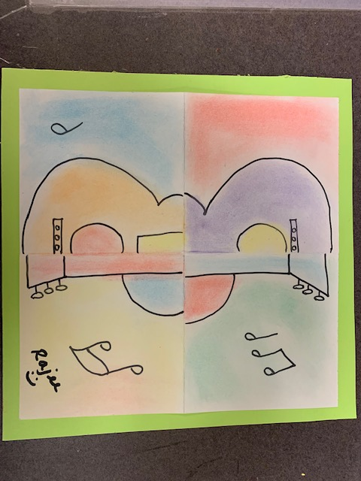
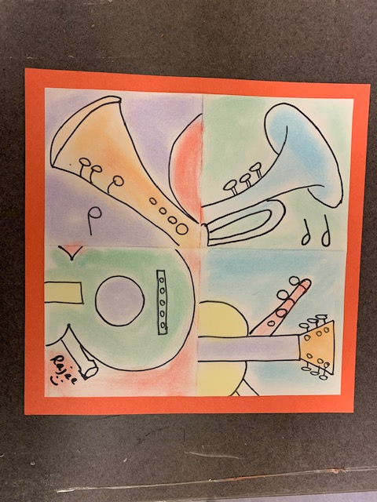
Puzzled Music @ QR
Grade 3
Grade 4 & 5
TK & K
Grade 1 & 2

Slide 12
Grade 2 – Guitar & Percussion -Drum
Grade 3 – Guitar & Saxophone

Slide 13
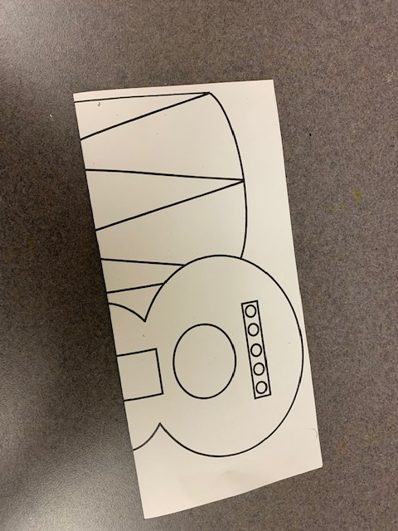
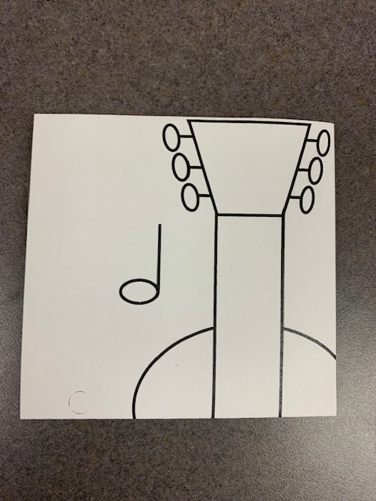
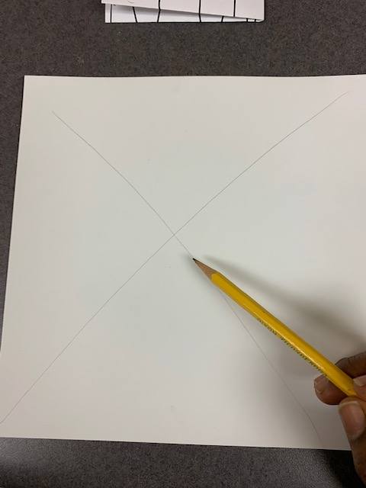
Instruction
Fold the printed paper corner to corner with the image showing out
Fold the 9X9 white sheet corner to corner with the ”X” mark inside
Make an “X” on one side of the 9X9 white sheet with a pencil lightly
FOLD AGAIN Second fold to make it a square
FOLD AGAIN Second fold to make it a square

Slide 14
Which side of brain are you today?
Left Brain – Analytical & Logic
Right Brain – Creative Side

Slide 15
Right brain learning -
We will use only our right brain for this activity
The right brain is an important part of who we are, but is often pushed to the side with the dominant left-brain taking control. ...
The right brain offers skills that will help promote and create a smarter and more productive adult better suited for the future workplace

Slide 16
Left Vs Right
Left brain controls our logic, numbers, speaking etc. Right brain dose not judge and be creative, express emotions the way it is
Today we will use right brain only
So NO TALKING, NO THINKING TOO MUCH, No REASONIG, NO JUDGING IF ITS RIGHT OR WRONG. Just express what you thing the lines represent to you

Slide 17
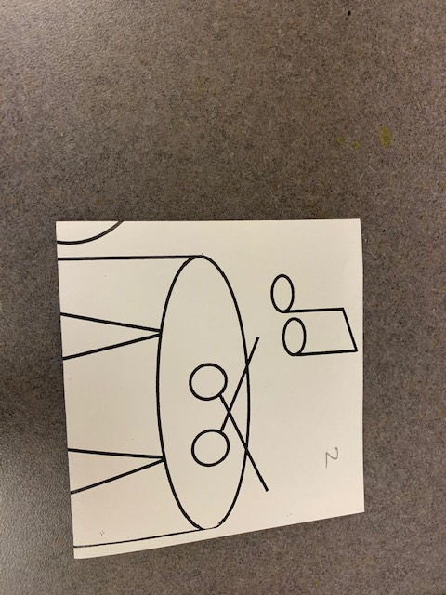
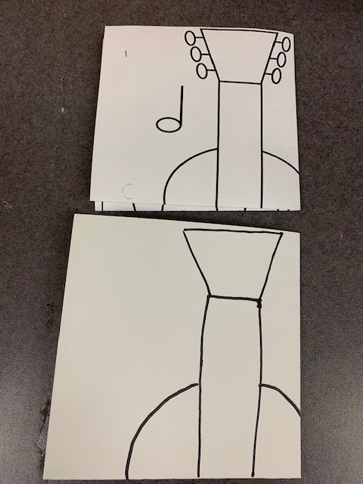
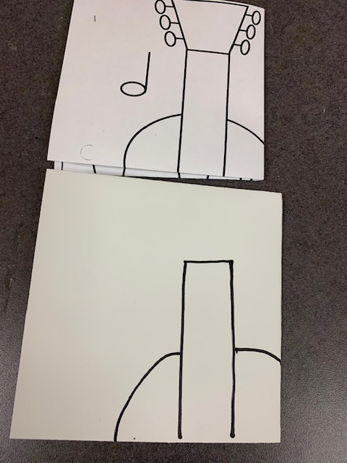
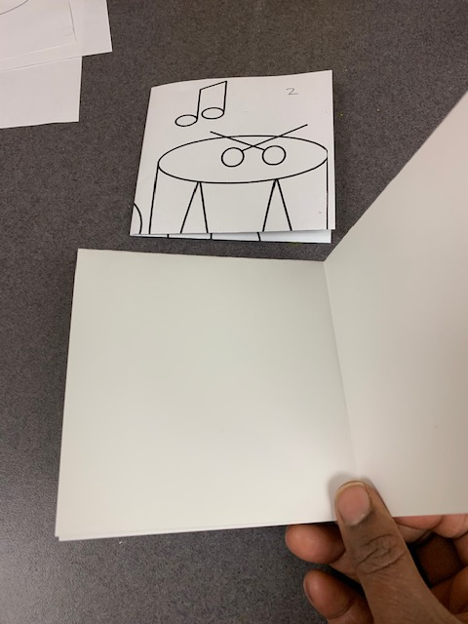
Instruction
Number each square (1,2,3,4) and cross out each one after completing the square
Copy the lines to your knowledge, use pencil
First copy the big lines and then the add the small lines
Move to the next square, you can do any square in any order or the sides. Just make sure you do not do it in the “X” mark

Slide 18
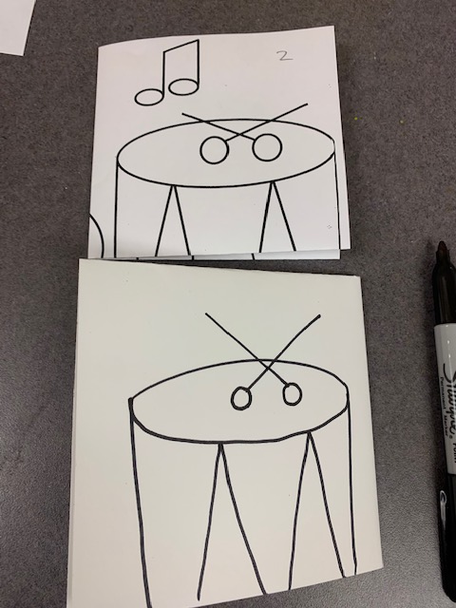
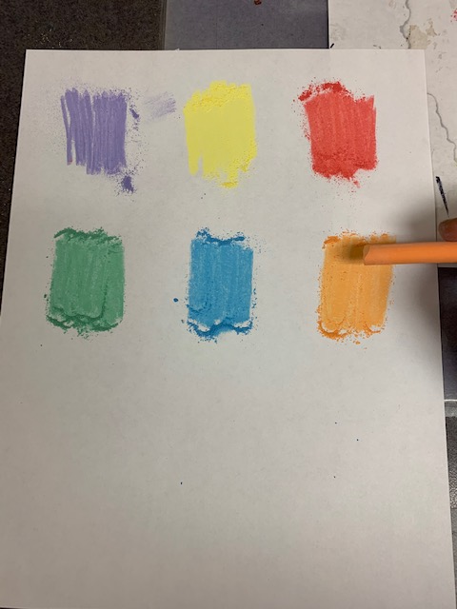
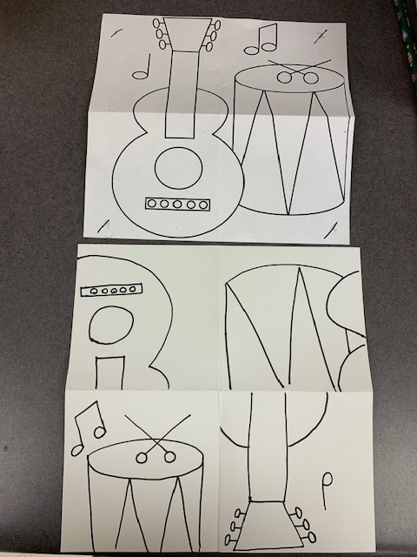
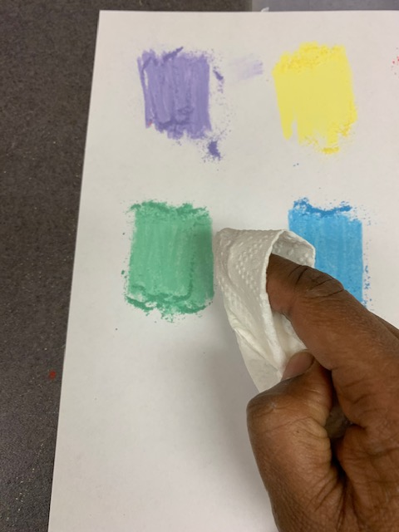
Instruction
Complete all 4 squares using pencil first
Trace with all the lines with sharpie, you will notice the composition is completely different from the original and it is a puzzle
Make a chalk palate for yourself on a scrap paper, do not color on using the chalk stick. We will be using the chalk powder to color
Use a tissue, fold the tissue and load it with a chalk powder

Slide 19
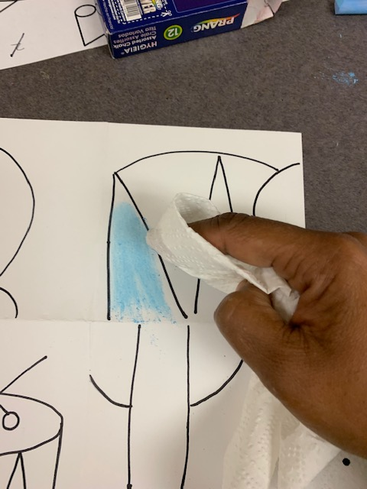
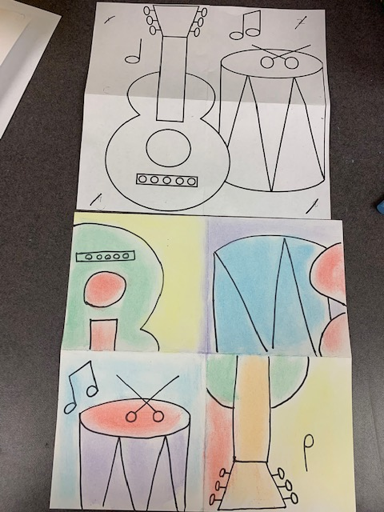
Instruction
Apply the chalk powder and its okay to have some white areas, you do not have to go very close to the lines
Rub more chalk to the pallet if you need more color powder
You can color over the black lines.
Once coloring done, write your name using a black sharpie
Mount it on 10x10 sheet using glue stick

