Slide 1
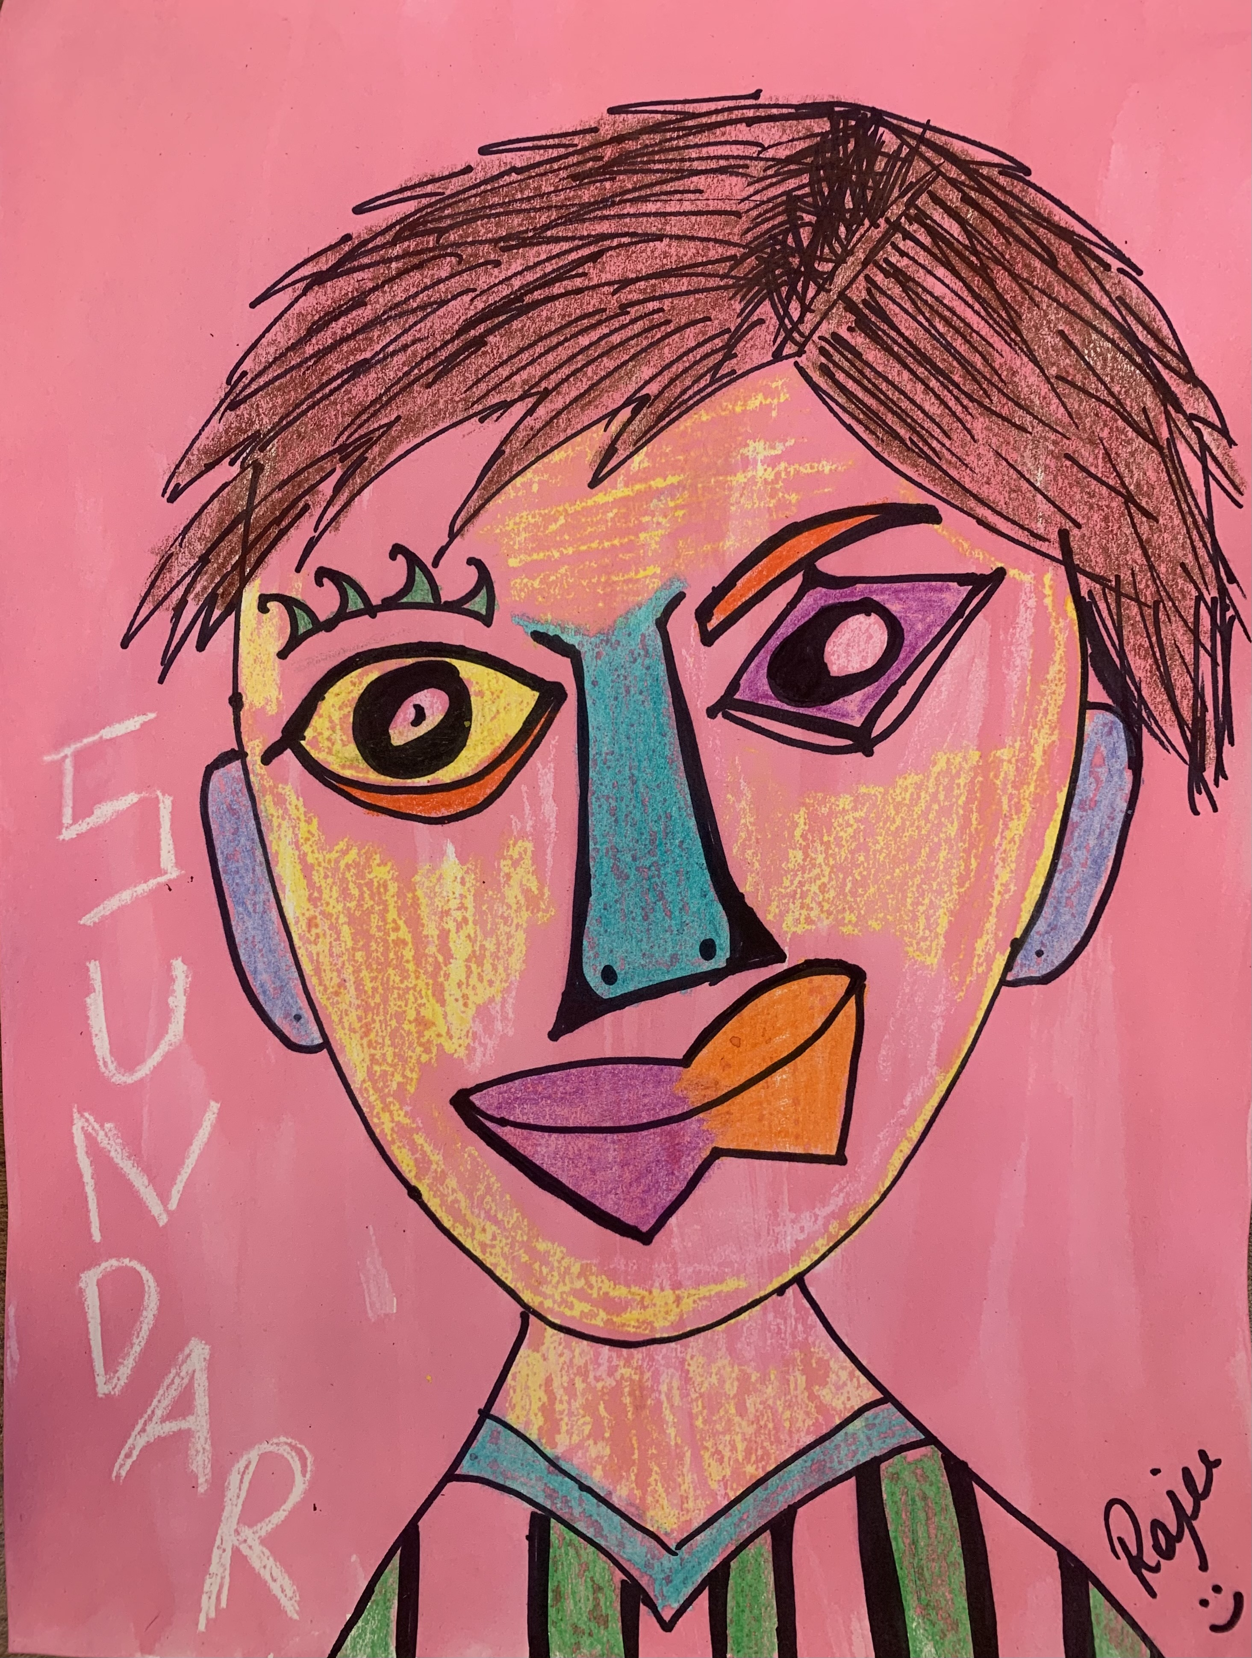
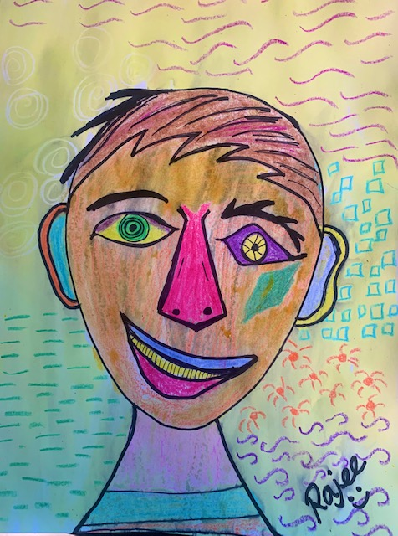
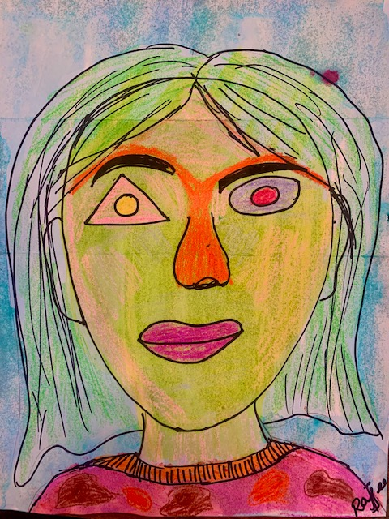
Identity Self portraits Grades (K-2)
September 2021 project
Rajee Subramanian
Quail Run Elementary
Inspired by Pablo Picasso

Slide 2
Inspiration – Character Trait of the month (Identity)
Share your story through the self portrait
Be brave to share your identity through this art
Use the shapes & colors you like
Gather ideas, Focus on the animated facial features in the book

Slide 3
Inspiration
1881 – 1973
Spanish Painter, Sculptor, printmaker, ceramicist, stage designer
Lived in France
Child prodigy, in age 13 he went to college of arts
His first word was “piz” in Spanish meaning Pencil
Father was an art teacher
His work of art is worth approx $780 billion
Pablo Picasso

Slide 4
Pablo Picasso’s work
Blue Period
Early art
The Science and Charity (Age - 15)
Rose Period – The Peasants
Breakfast of a Blind man

Slide 5
Pablo Picasso’s work
Classical Period
Cubist period
Mandolin & Guitar
The classical head

Slide 6
Cubism – Reasons to evolve
Early 19th century is when the cameras started evolving
People’s interest in looking at artist creation decreased as they were able to see the realistic images through the camera
Then came cubism

Slide 7
Pablo Picasso
Three Musicians, Weeping Woman, Seated Woman, Portraits

Slide 8
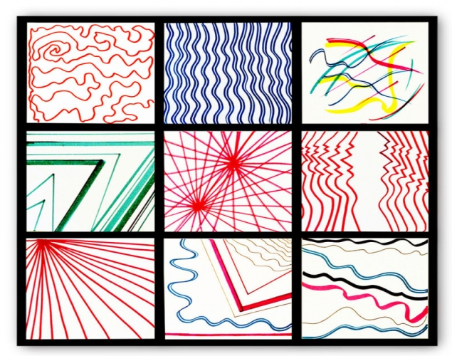
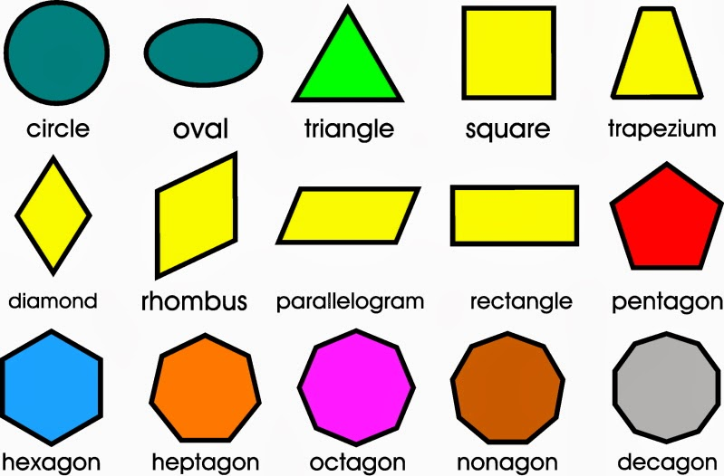
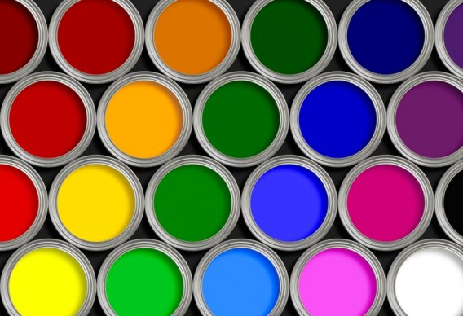
Elements of Art

Slide 9
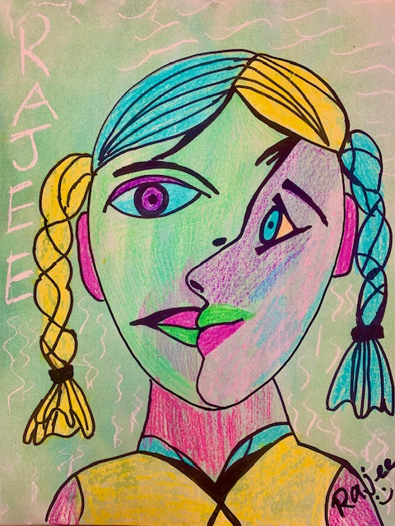
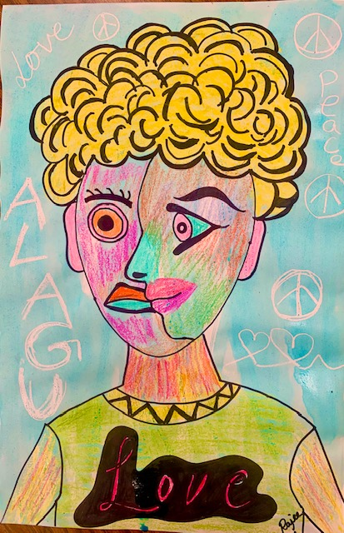
Identity Self Portraits
Grade 3
K - 2
Grade 4&5

Slide 10
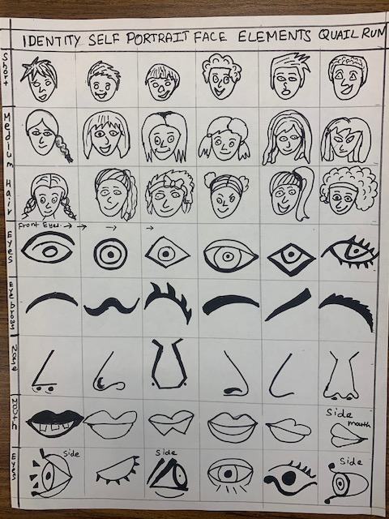
Materials needed
Kinder - 2
9x12 printed paper (entire head) (2nd grade can also choose to do 3rd grade U printed paper)
Water colors & Brush
Black Sharpie
Crayons(from classroom)
Pencil/eraser(from classroom)
Cups for water color station
Face elements sample paper

Slide 11
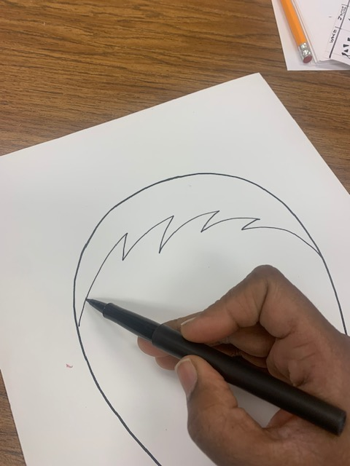
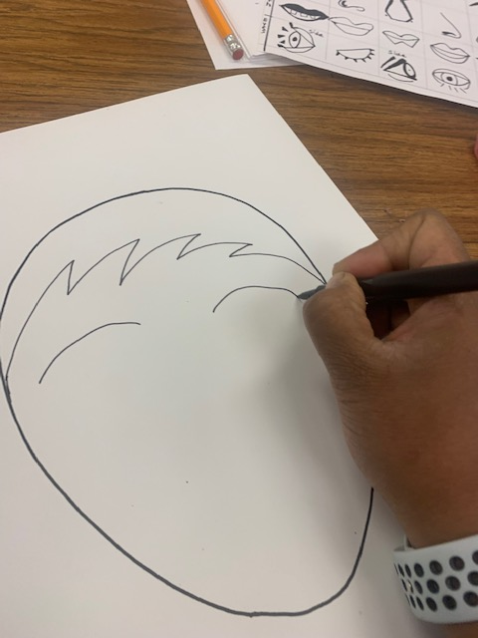
Procedure K-2
Take 9X12 printed head paper, orient it with broader side of the oval on the top. The top of the head is the broader than the chin .
Add the hairline using sharpie
Refer the face element sample sheet
Choose the eyebrows you like.
The eyebrows can be different on either side (Picasso style)
Draw the eyebrows

Slide 12
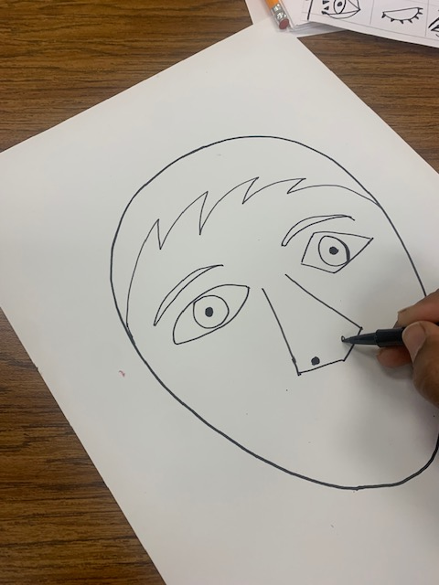
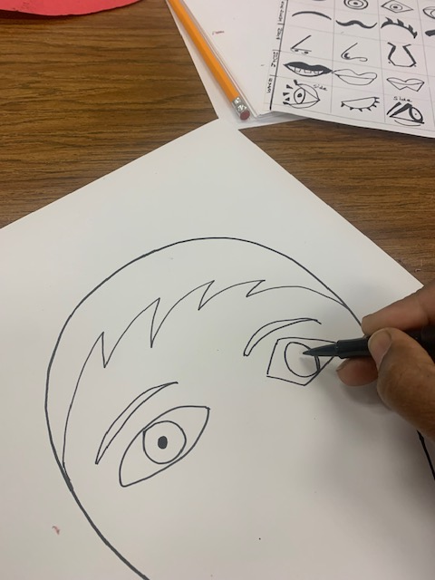
Procedure K-2
Think about the different geometric shapes.
The eyes should be different shape on each side (Picasso style)
Draw and Color some part the eye with black
Remember it is Picasso style, think of the shape, choose the nose you like
Draw the nose
Instruct on how to draw the nose refer to Alphabet shapes (L, J, S etc)

Slide 13
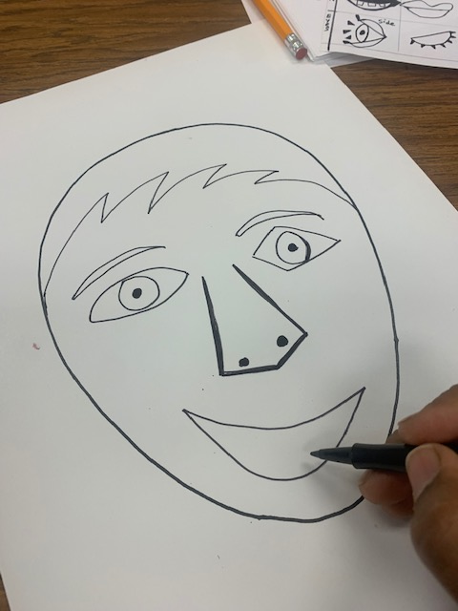
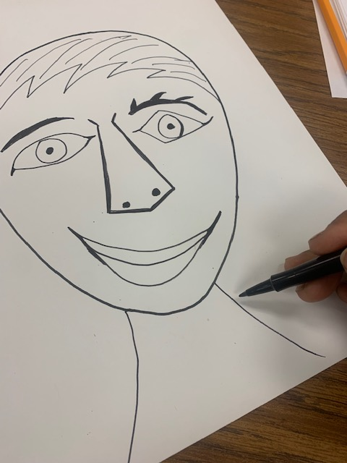
Procedure K-2
Choose the mouth on the sample sheet. Add the mouth under the nose
Add teeth if you like
Remember to show how you like others to see. You can add open mouth with teeth, smile, etc
Add 2 parallel lines to the neck.
Add the T.Shirt collar)
Add designs on the T.Shirt if you have space

Slide 14
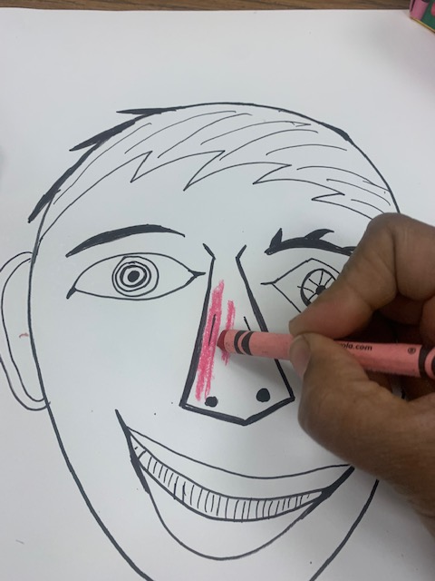
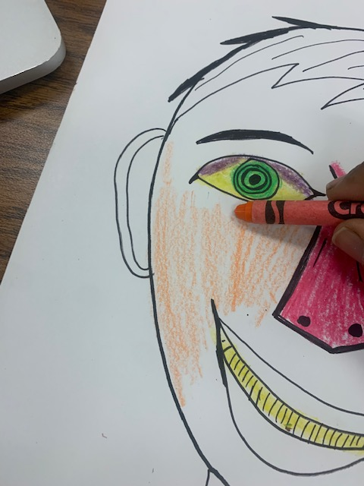
Procedure K-2
Color the nose. Use bright colors
Darken the nose so it will pop out of the face
Remember it is Picasso style, think of very different combination of colors on the face
Hold the crayon in a slanted position
Instruct on how to shade by holding the crayon far away and flat

Slide 15
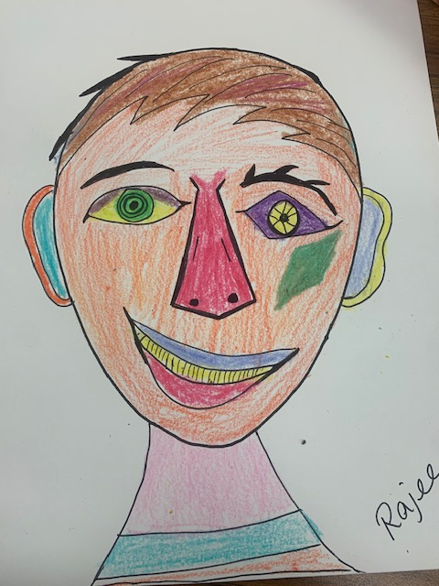
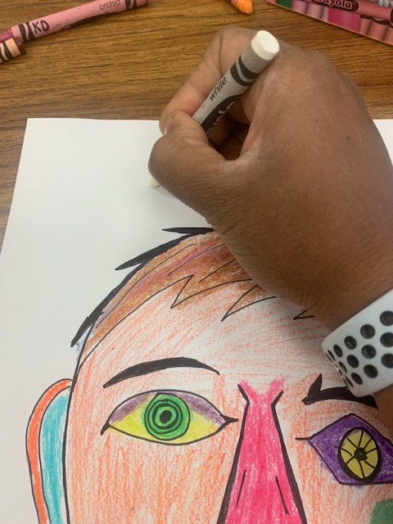
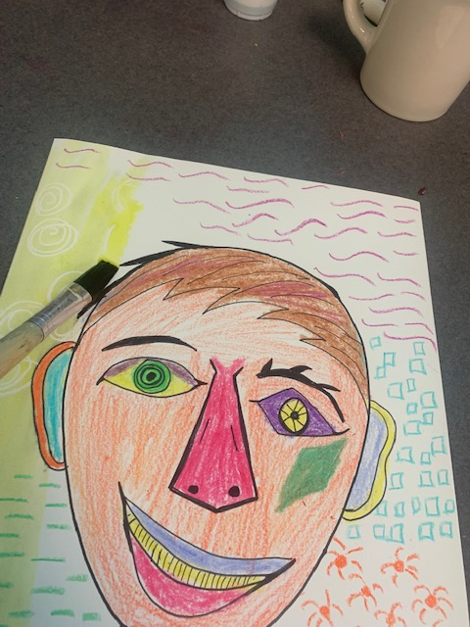
Procedure K-2
After you add color the to the face, add simple lines on the background
Use different color crayons, fill the space.
white stands out but cannot see while drawing
Color everywhere on the face using different colors.
Write your name on the left corner using the sharpie
Add additional shapes on the face if you like (Picasso style)
Go to the water color station
Choose one color only and wash all over the paper
See how the washed color shows up on the paper where there is no crayon. It is called crayon resist
Let it dry and you have your own Picasso style self portrait

Slide 16
Reflect
“So DID you succeed in portraying who you are in this art?”

