Slide 1
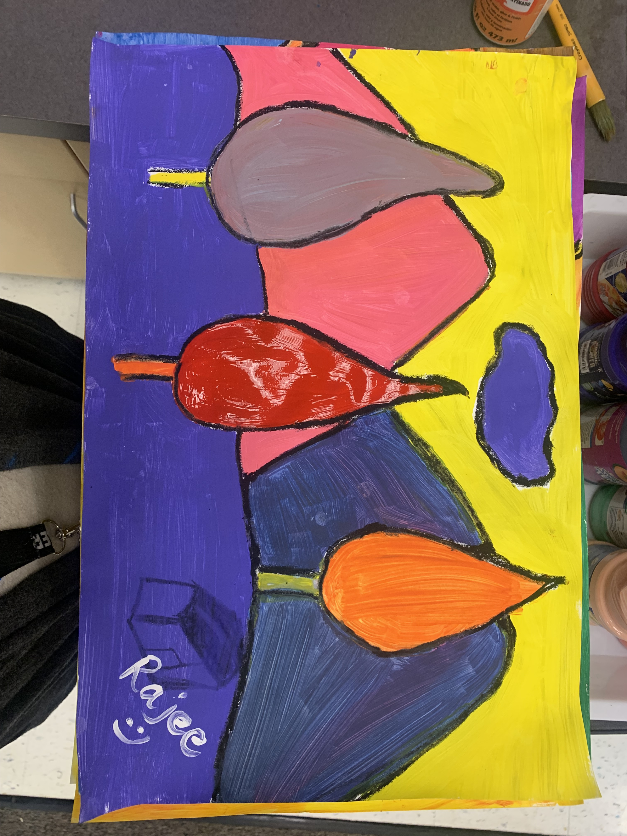
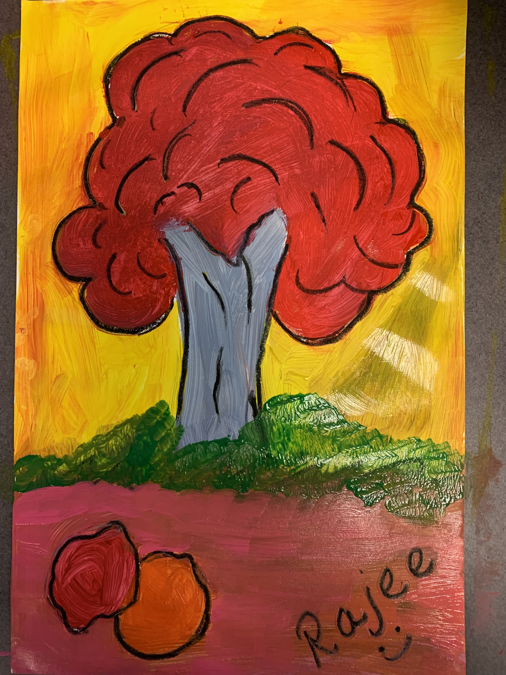
Color your world with joy Grade 2&3!
January 2022 Art Project
Quail Run Elementary
Rajee Subramanian
Grade 2&3

Slide 2
Colorful Holiday season
Winter – No leaves on trees
Color brightens the cold weather
Brings warmth
Green & Red in holiday colors in western countries (Green relates to growth/hope in winter and Red to joy)
Color symbolism - Marketing
Around the world festivals are celebrated in various colors
Being aware of colors and culture makes us a inclusive person

Slide 3
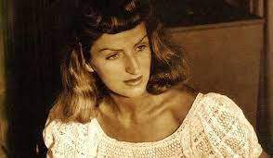
Inspiration
Mary Blair
1911 – 1978
Artist, animation, concept art
Walt Disney
Creator of character designs for “It’s a small world” attraction
Fond of bright colors
Uses primary colors to form intense contrast colors to attract and make it interesting for eyes
Worked in famous animation movies - Alice in the wonderland, Cinderella, Peter pan, Lady and tramp, Dumbo, Fantasia etc…
Disney Legend
https://www.youtube.com/watch?v=VHmYRRd0oAs

Slide 4
Color your world with joy!
Inspiration – Art Movement - Fauvism

Slide 5
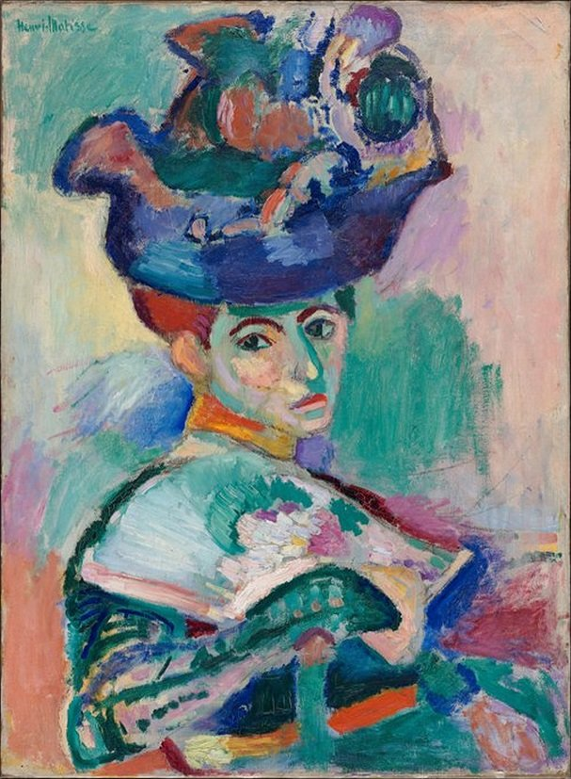
What is Fauvism?
Fauvism is an art movement
Originated in France in 1905
Uses bright, wild, vivid, intense color to help convey a mood
Lines are simplified as much as possible as unnatural
Usually has no reality especially in colors creating eye appealing interesting scenes
It also has some wild brush strokes
Les Faves in French means “the wild beasts”
Major Artist: Andre Derain along with Henri Matisse
Mary Blair

Slide 6
ART ELEMENT - Warm, Cool and Neutral Colors
Warm colors are related to the high energy, warmth of the sun and are bold like Yellow, Red, Orange etc.
. Cool colors are calm and relaxing like Green, Blue, Purple etc
Neutral colors like Black, Brown, Grey, White are not present in the color wheel and are called earth tone colors

Slide 7
UNIVERSAL MEANING - Emotions and colors psychology
In visual art the colors are used to describes the emotions.
Inside Out
Angry Danger
Brave
Fear
Sad
Calm Relaxed
Happy
Peace
Hope

Slide 8
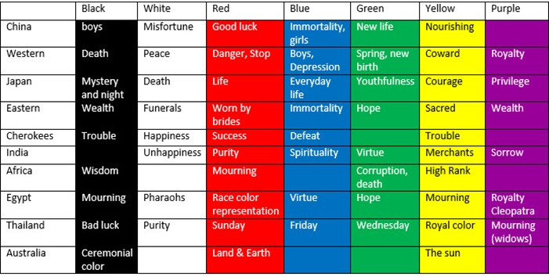
Colors and Culture around the world

Slide 9
Materials(Grades 2,3,4 & 5)
12X 18 white paper
Neutral color oil pastels (Black, Grey, brown)
Tempera Paints ( Grades 2, 3, 4 & 5)
Pencil, eraser
Paint brushes(Thick flat brush and one thin brush per student)
Tissue paper
Water cup to wash the brush in between colors
Paint pallet/paper plate (One per table)

Slide 10
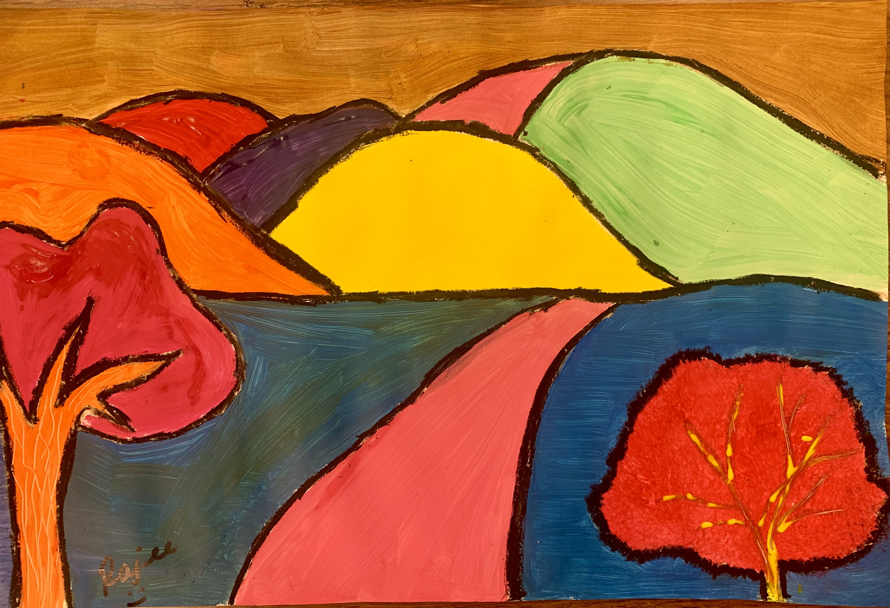
Grade 2&3

Slide 11
Procedure (Grade 2, 3)
The 12x18 paper is placed in landscape orientation(sleeping paper) Write your name on the back.
Draw a horizon line with pencil in the middle of the paper
Grade 2 & 3 - draw 2 mountains in the background above the horizon line
Make simple pine cone trees in the foreground overlapping on the mountains
Erase the overlapping mountain lines that collide with the tree
Trace the pencil lines with a neutral color oil pastel so the paint will not spread into the rest of the areas(black, brown, grey, dark blue)
Use varied color and thick brush to to paint the larger area
The colors dose not have to be match the natural world (the sky dose not have to be blue, mountains dose not have to be green)
Once all the paint is applied use a thin brush to outline the objects with black paint over the oil pastel

