Slide 1
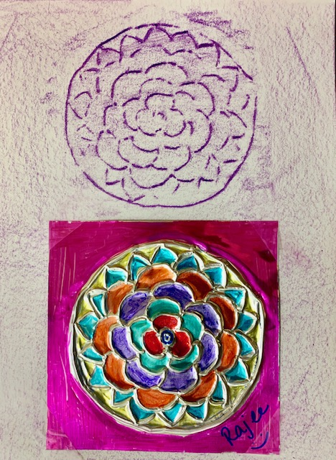
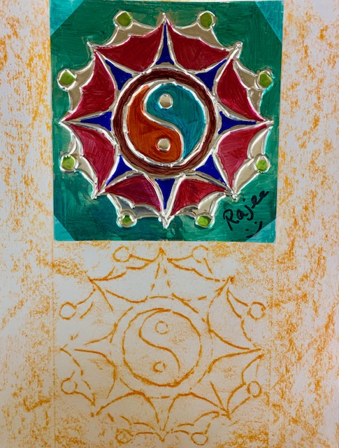
Embossed Mandalas Grade 4 & 5
November 2019 art project
Quail Run Elementary
Rajee Subramanian

Slide 2
Inspiration – SRVUSD 2019 Priority(SEL), mindfulness activities, art therapy
Learning emotions – How do you feel?
It’s common to think that mindfulness is only about meditation, but in reality is simply means focusing your awareness on the present moment
Siting quietly, eating calmly, focusing on an image, closing your eyes, breathing in and out, drawing, coloring, doing a yoga pose, even jumping jacks
Doing things with out judging if it is right or wrong
Doing things like this keeps you happy forever

Slide 3
Mindfulness Based art Therapy activities improves
Emotional competencies
Self awareness
Self management
Set and achieve positive academic goals
Increase concentration and focus
Social awareness
Responsible decision making skills
Reduce stress related issues

Slide 4
Why and what are Mandalas?
Mandalas are circular designs that start from a center point which emanates an array of symbols, shapes & forms.
Kids learn to develop
Mindfulness & concentration
Strengthen Focus Skills
Enhance Creativity & relaxation

Slide 5
what are Mandalas? Origin?
Mandalas extremely popular expression that helps countless individuals regain their focus, their confidence, and their concentration by forming a deeper connection with their real self
Originated from many countries Tibet, India, Nepal, China, Japan, Ireland,
Britain, Bhutan, and Indonesia and
date from the 4th century to present.
Creating Mandalas Helps...
Calm your mind,
Quiet your emotions,
Increase concentration,
Uplift your soul,
Promote greater awareness of self and Life,
Make meditation easier and more accessible,
Reduce stress and lower blood pressure,

Slide 6
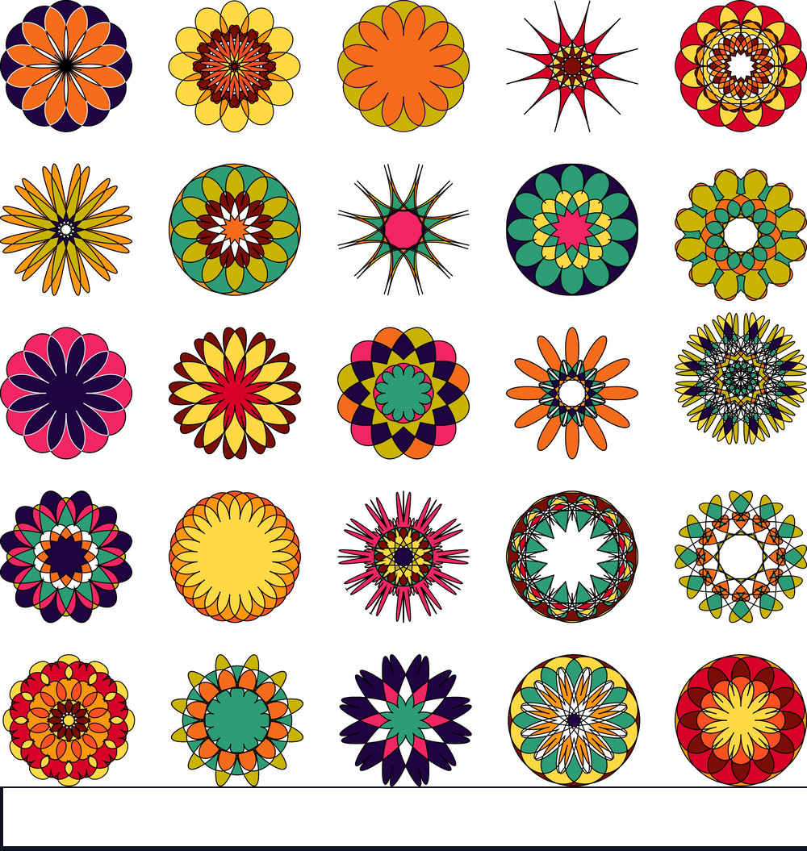

Slide 8
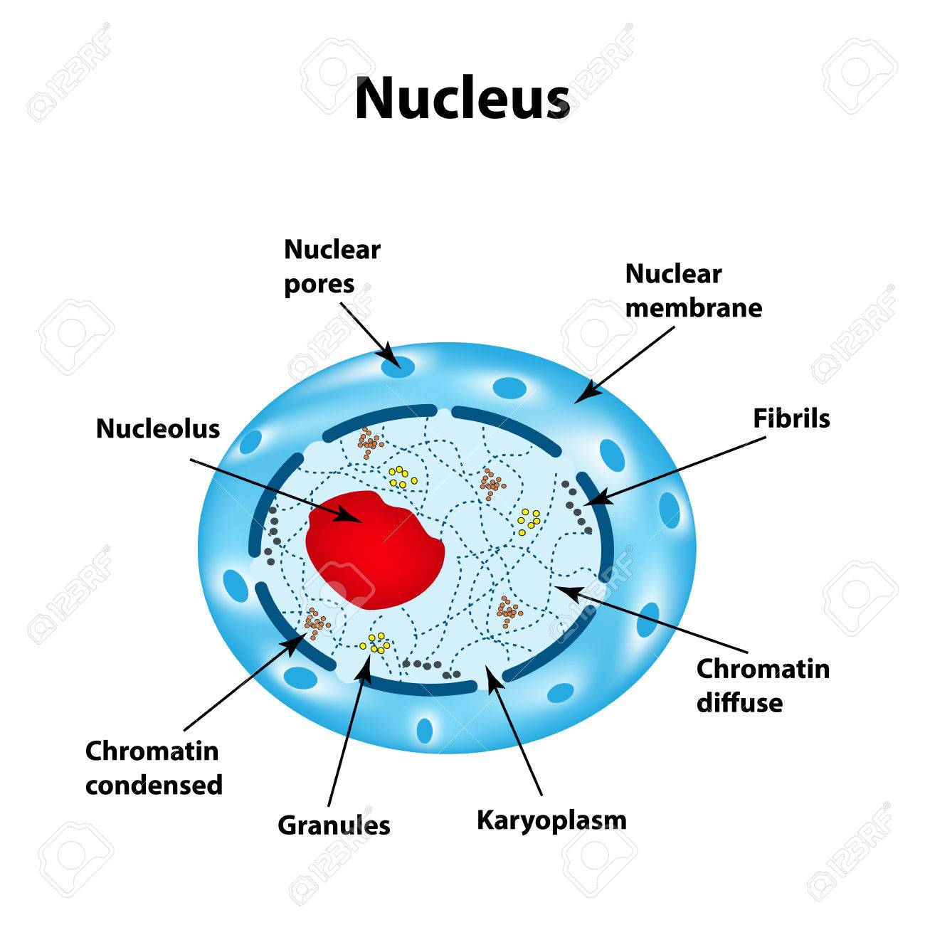
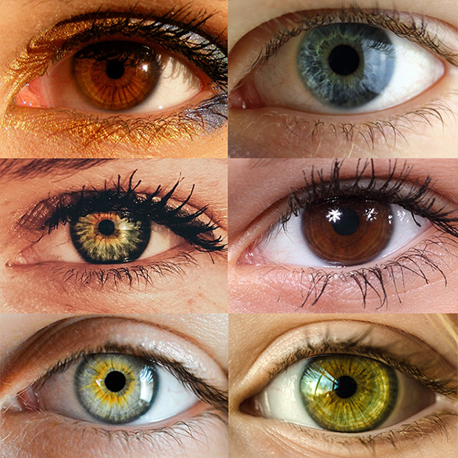
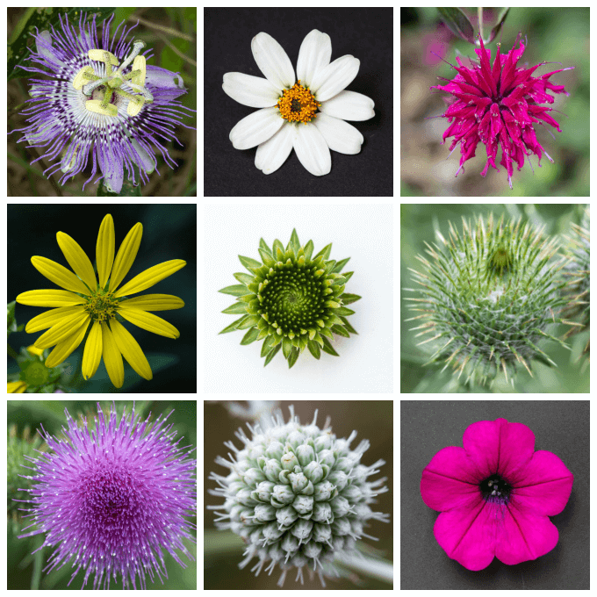
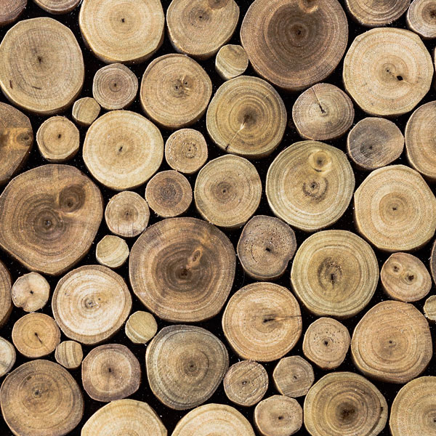
Mandalas in nature – Look for items in Nature

Slide 9
Art Learning - Linear symmetry vS Radial symmetry

Slide 10
Art technique - Metal Tooling
Metal tooling is a centuries-old art in which a soft metal is worked with a rounded tool on the back side in order to create a raised design on the front. Mexican and South American artists call this art form repajado

Slide 11
Art technique - Embossing
An embossed pattern is raised against the background, while a debossed pattern is sunken into the surface of the material (but might protrude somewhat on the reverse, back side).
So you tool on one side (debossed) and the other side is embossed
Color on the embossed side

Slide 12
Art technique - Print making (grades 4 & 5)
Printmaking is an artistic process based on the principle of transferring images from a matrix onto another surface, most often paper or fabric. Traditional printmaking techniques include woodcut, etching, engraving, and lithography, while modern artists have expanded available techniques to include screenprinting

Slide 13
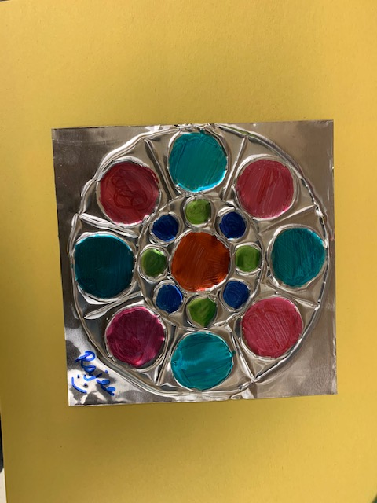
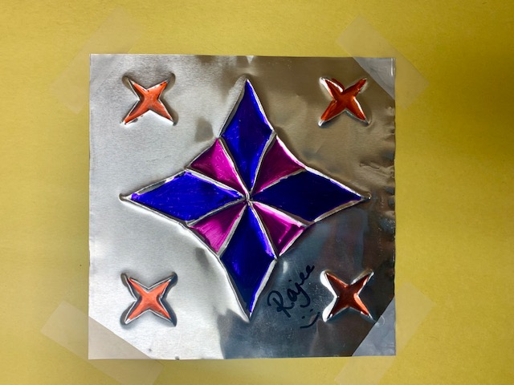
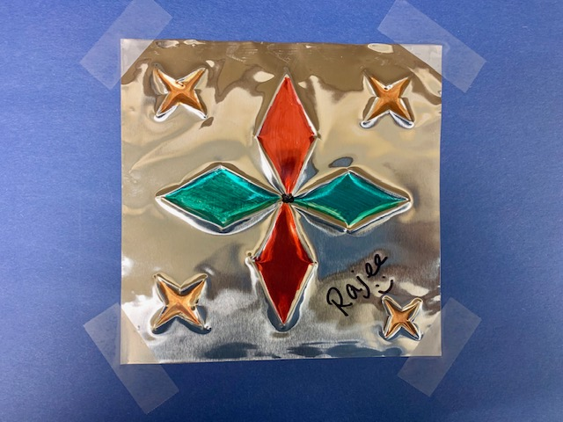
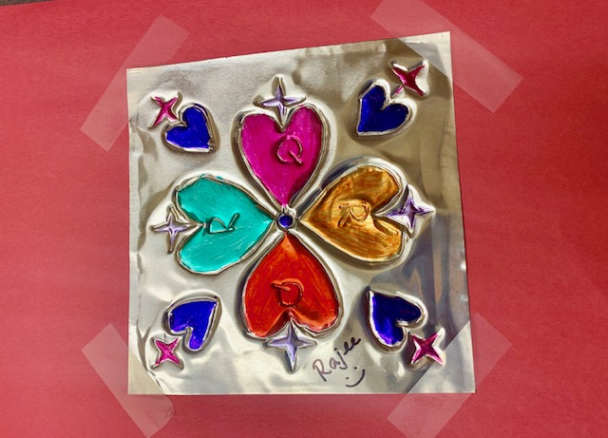
Embossed Mandala @ QR
Grade 2/3
Tk , K, 1
Grade 4 & 5

Slide 14
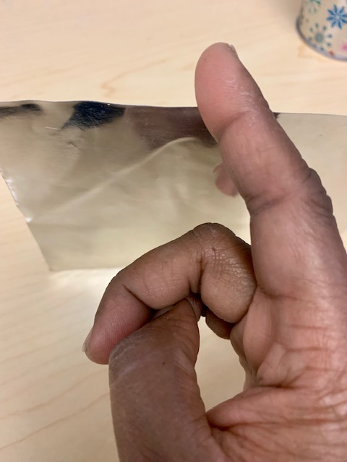
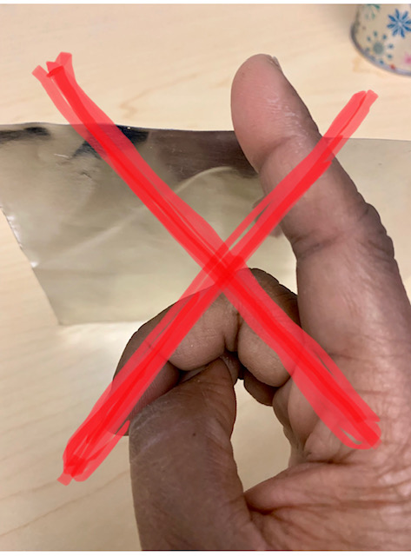
Safety guidelines - working with metal foil
Metal foil can be sharp at the edges
It may be tempting to touch and feel the metal foil
Be gentle. Do not grasp/snatch the metal.
Never run your fingers along the edges of the metal foil
Just like paper cut it can cut your self

Slide 15
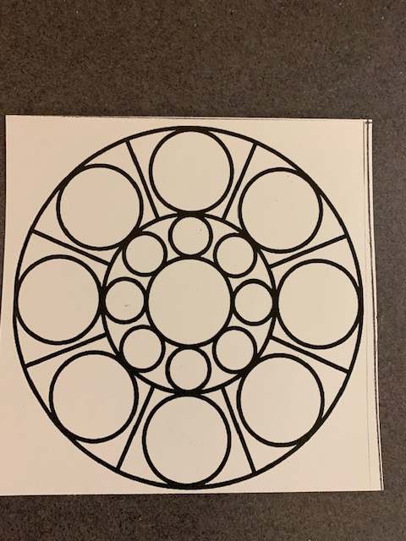
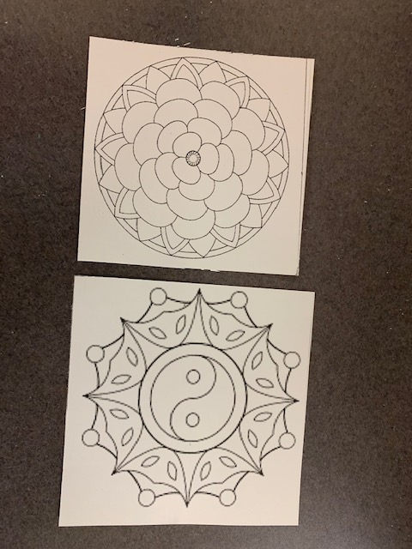
Materials
6x6 tin foil
Grade specific Template
Ball point pen
Blunt pencil
Tape
Foam sheets
Colored sharpies
Colored construction sheet (Grades TK to 3)
White 9x12 construction sheets (Grades 4 & 5)
Unrolled crayons (Grade 4 & 5)

Slide 16
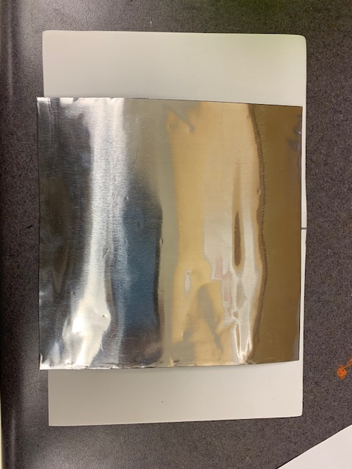
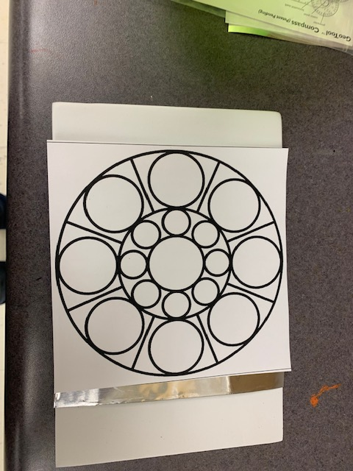
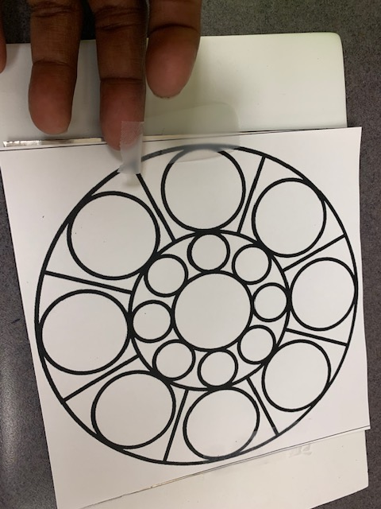
Procedure for Tooling (All grades)
Step 4: Tape the template and the foil on the both sides on the foam sheet
Step 1: Tape the 2 4x6 foam sheet
Step 2: Place the tin foil on the foam sheet
Step 3: Place the template on the foam sheet

Slide 17
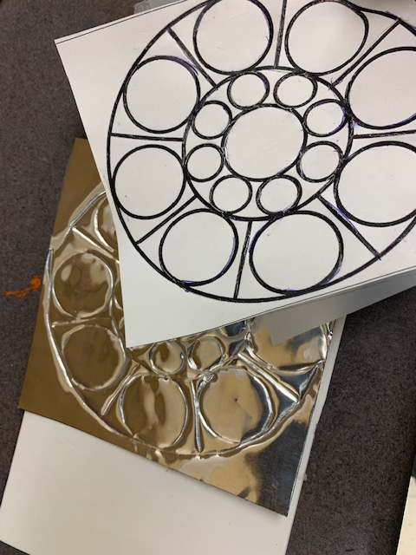
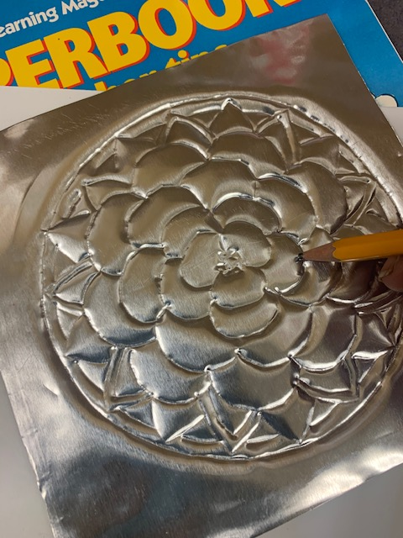
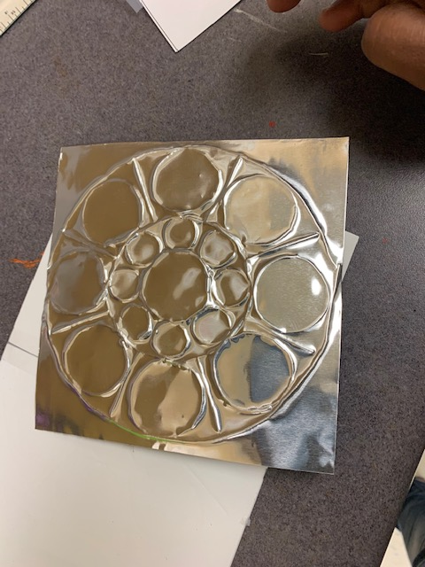
Procedure for Tooling & Embossing (All grades)
Step 7: Retrace the lines using pencil to make sure the tooling has depth
Step 5: trace the image hard using a ball point pen
Step 6: Remove the tape once completed
Step 8 : Flip the foil to see the embossed side

Slide 18
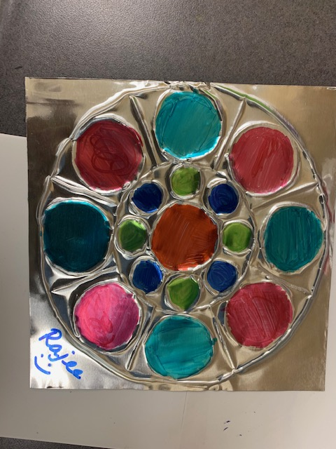
Procedure for Tooling & Embossing (All grades)
Step 11: Write your name and tape four corners
Step 9: color only the area that has depth and leave the lines that has been made. Use sharpie to color
Step 10: Please leave some uncolored space so the embossing is seen clearly

Slide 19
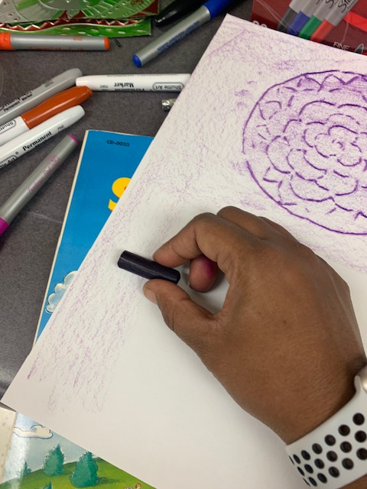
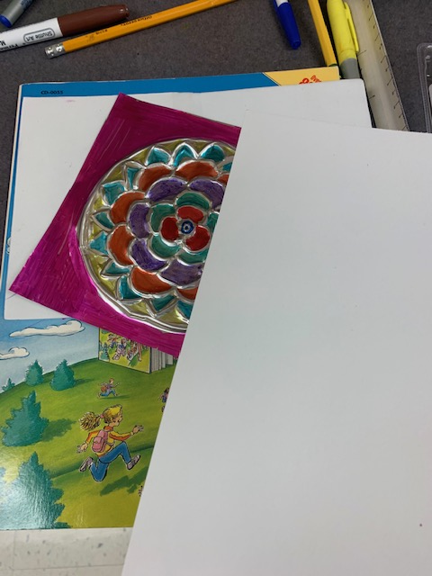
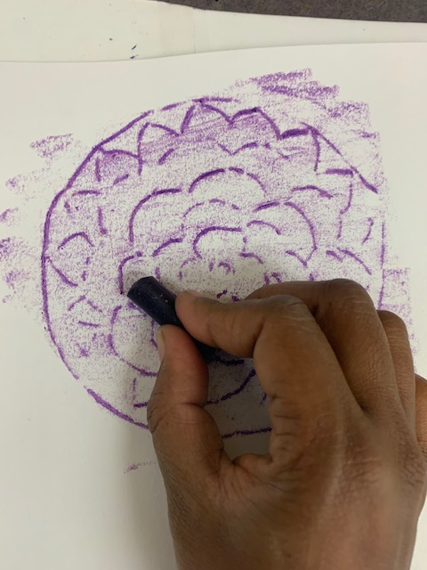
Procedure for Print making (Grades 4&5)
Step 2: Place the white construction paper on to of the embossed foil on the top or bottom corner
Step 3: Use the flat side of the crayon and rub against the paper to reveal the imptints of the embossed ridges
Step 4 : spread the crayon on the other parts of the paper to give the same background
Step 1: color the back ground on the tin too

Slide 20
Procedure for Print making (Grades 4&5)
Use contrast color crayon for the back ground so it stands out
Step 5: color the entire back ground of the paper too
Step 6: tape the finished tin foil next to the print made on the paper

