Slide 1
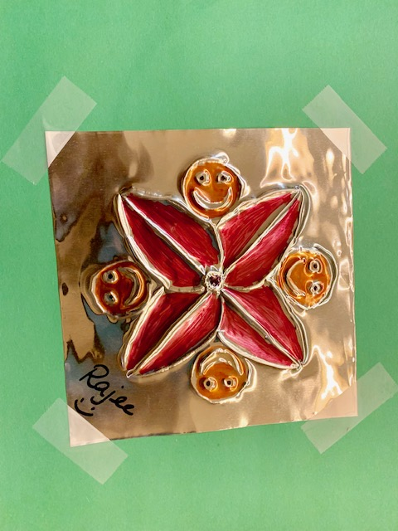
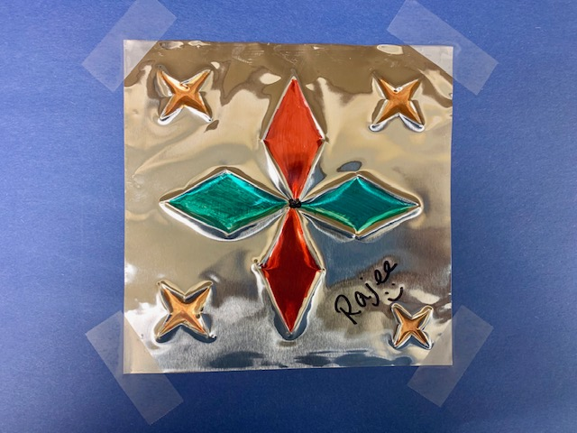
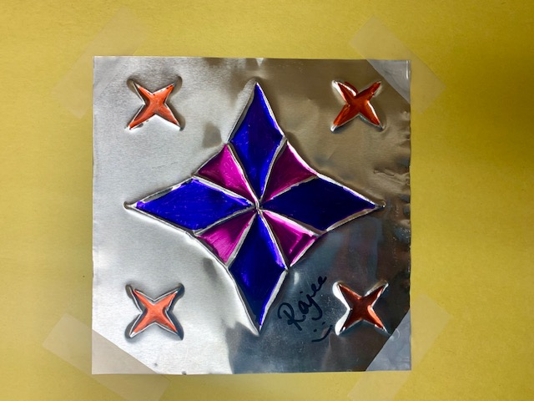
Embossed Mandalas Tk, K, 1
November 2019 art project
Quail Run Elementary
Rajee Subramanian

Slide 2
Inspiration – SRVUSD 2019 Priority, mindfulness and art therapy
Learning emotions – How do you feel?
It’s common to think that mindfulness is only about meditation, but in reality is simply means focusing your awareness on the present moment
Siting quietly, eating calmly, focusing on an image, closing your eyes, breathing in and out, drawing, coloring, doing a yoga pose, even jumping jacks
Doing things with out judging if it is right or wrong
Doing things like this keeps you happy forever

Slide 3
Why and what are Mandalas?
Mandalas are circular designs that start from a center point which emanates an array of symbols, shapes & forms.
Kids learn to develop:
Mindfulness & concentration
Strengthen Focus Skills
Enhance Creativity & relaxation
Mandalas are found in many countries
like India, Nepal, China, Japan, Ireland, Britain,
Bhutan, and Indonesia

Slide 6
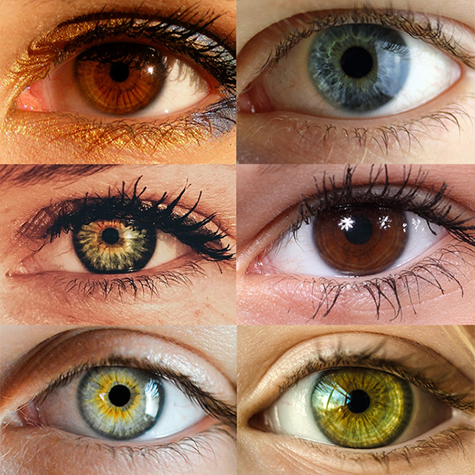
Mandalas in nature – Look for items in Nature

Slide 7
Art technique - Metal Tooling & embossing
Metal tooling is a centuries-old art in which a soft metal is worked with a rounded tool on the back side in order to create a raised design on the front. Mexican and South American artists call this art form repajado
Embossing is the raised edges that is made in the foil. Gives a textured feeling.

Slide 8
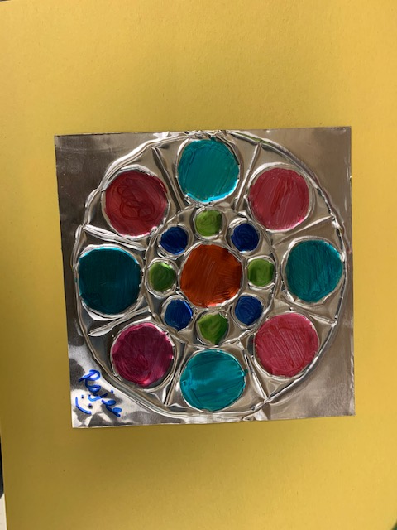
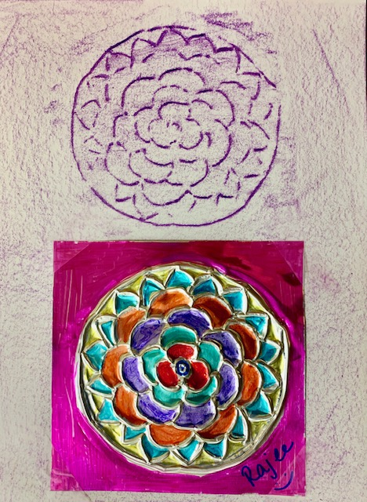
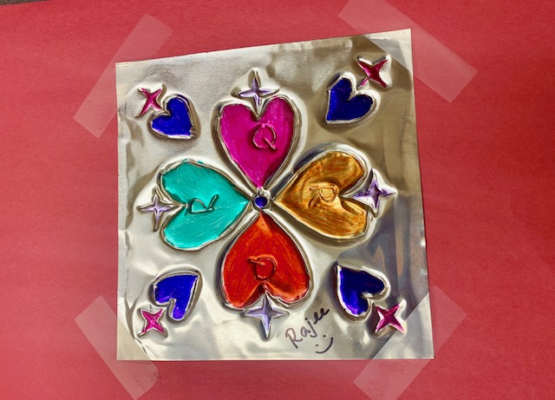
Embossed Mandala @ QR
Grade 2/3
Tk , K, 1
Grade 4 & 5

Slide 9
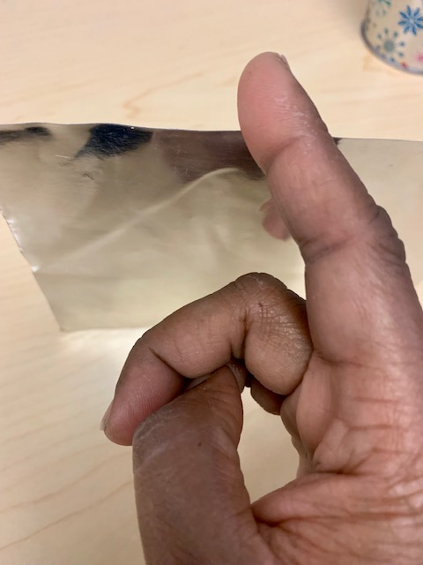
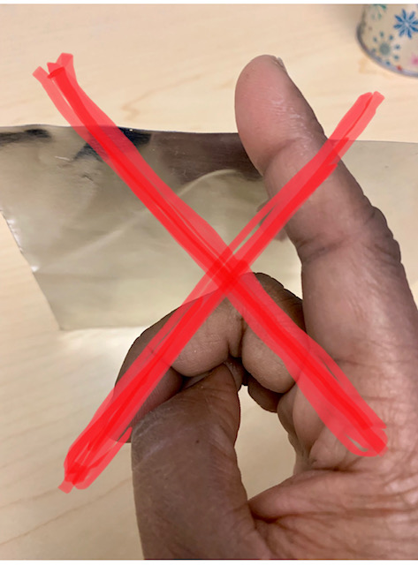
Safety guidelines - working with metal foil
Metal foil can be sharp at the edges
It may be tempting to touch and feel the metal foil
Be gentle. Do not grasp/snatch the metal.
Never run your fingers along the edges of the metal foil
Just like paper cut it can cut your self

Slide 10
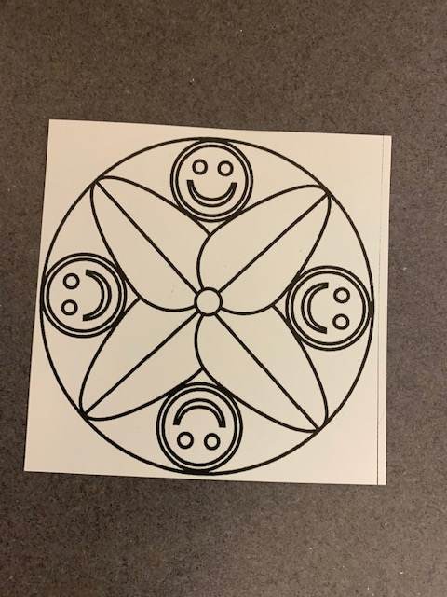
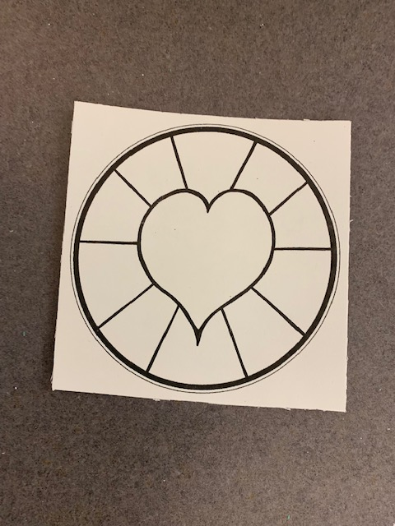
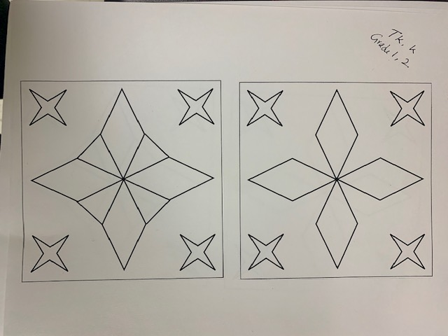
Materials
6x6 tin foil
Grade specific Template
Ball point pen
Blunt pencil
Tape
Foam sheets
Colored sharpies
Colored construction sheet (Grades TK to 3)

Slide 11
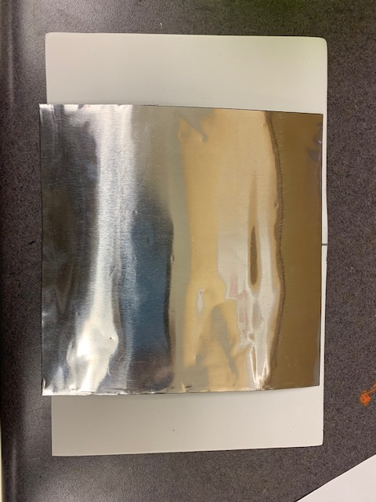
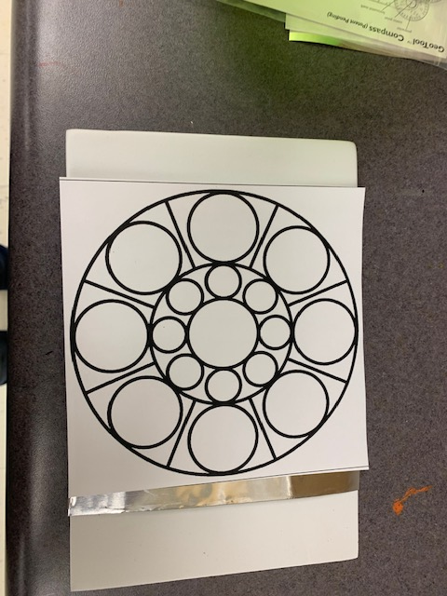
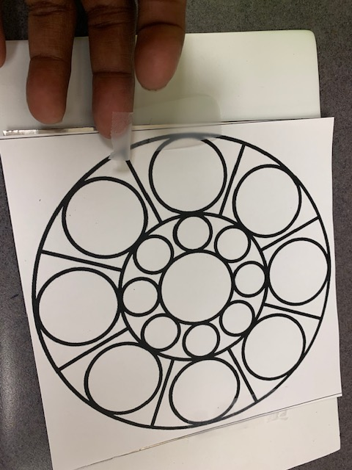
Procedure for Tooling (All grades)
Step 4: Tape the template and the foil on the both sides on the foam sheet
Step 1: Tape the 2 4x6 foam sheet
Step 2: Place the tin foil on the foam sheet
Step 3: Place the template on the foam sheet

Slide 12
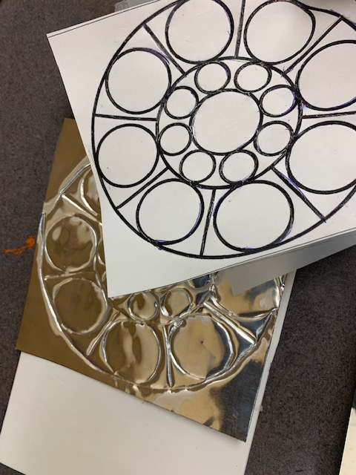
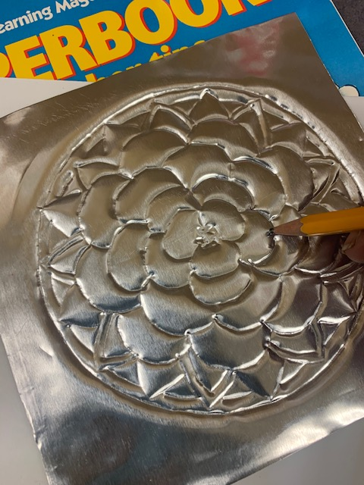
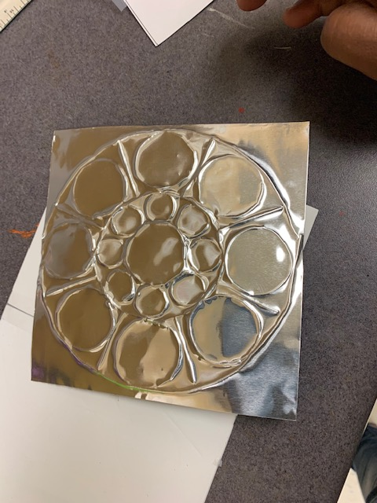
Procedure for Tooling & Embossing (All grades)
Step 6: Remove the tape once completed
Step 7: Retrace the lines using pencil to make sure the tooling has depth
Step 8 : Flip the foil to see the embossed side
Step 5: trace the image hard using a ball point pen

Slide 13
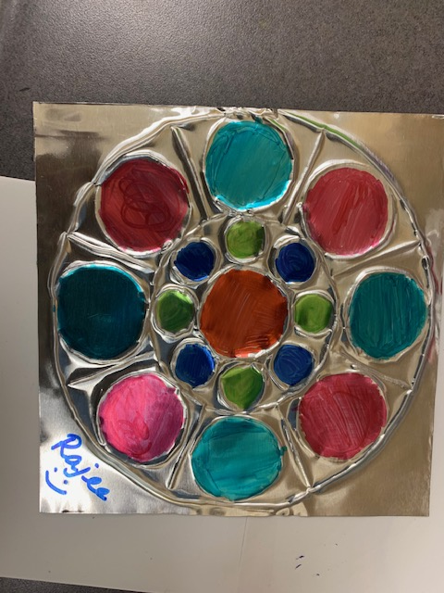
Procedure for Tooling & Embossing (All grades)
Step 11: Write your name and tape four corners
Step 9: color only the area that has depth and leave the lines that has been made. Use sharpie to color
Step 10: Please leave some uncolored space so the embossing is seen clearly

