Slide 1
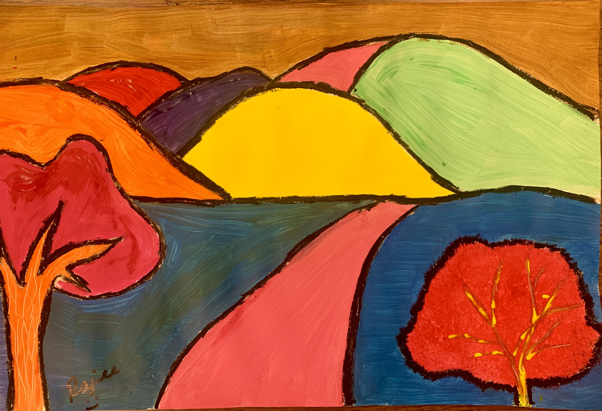
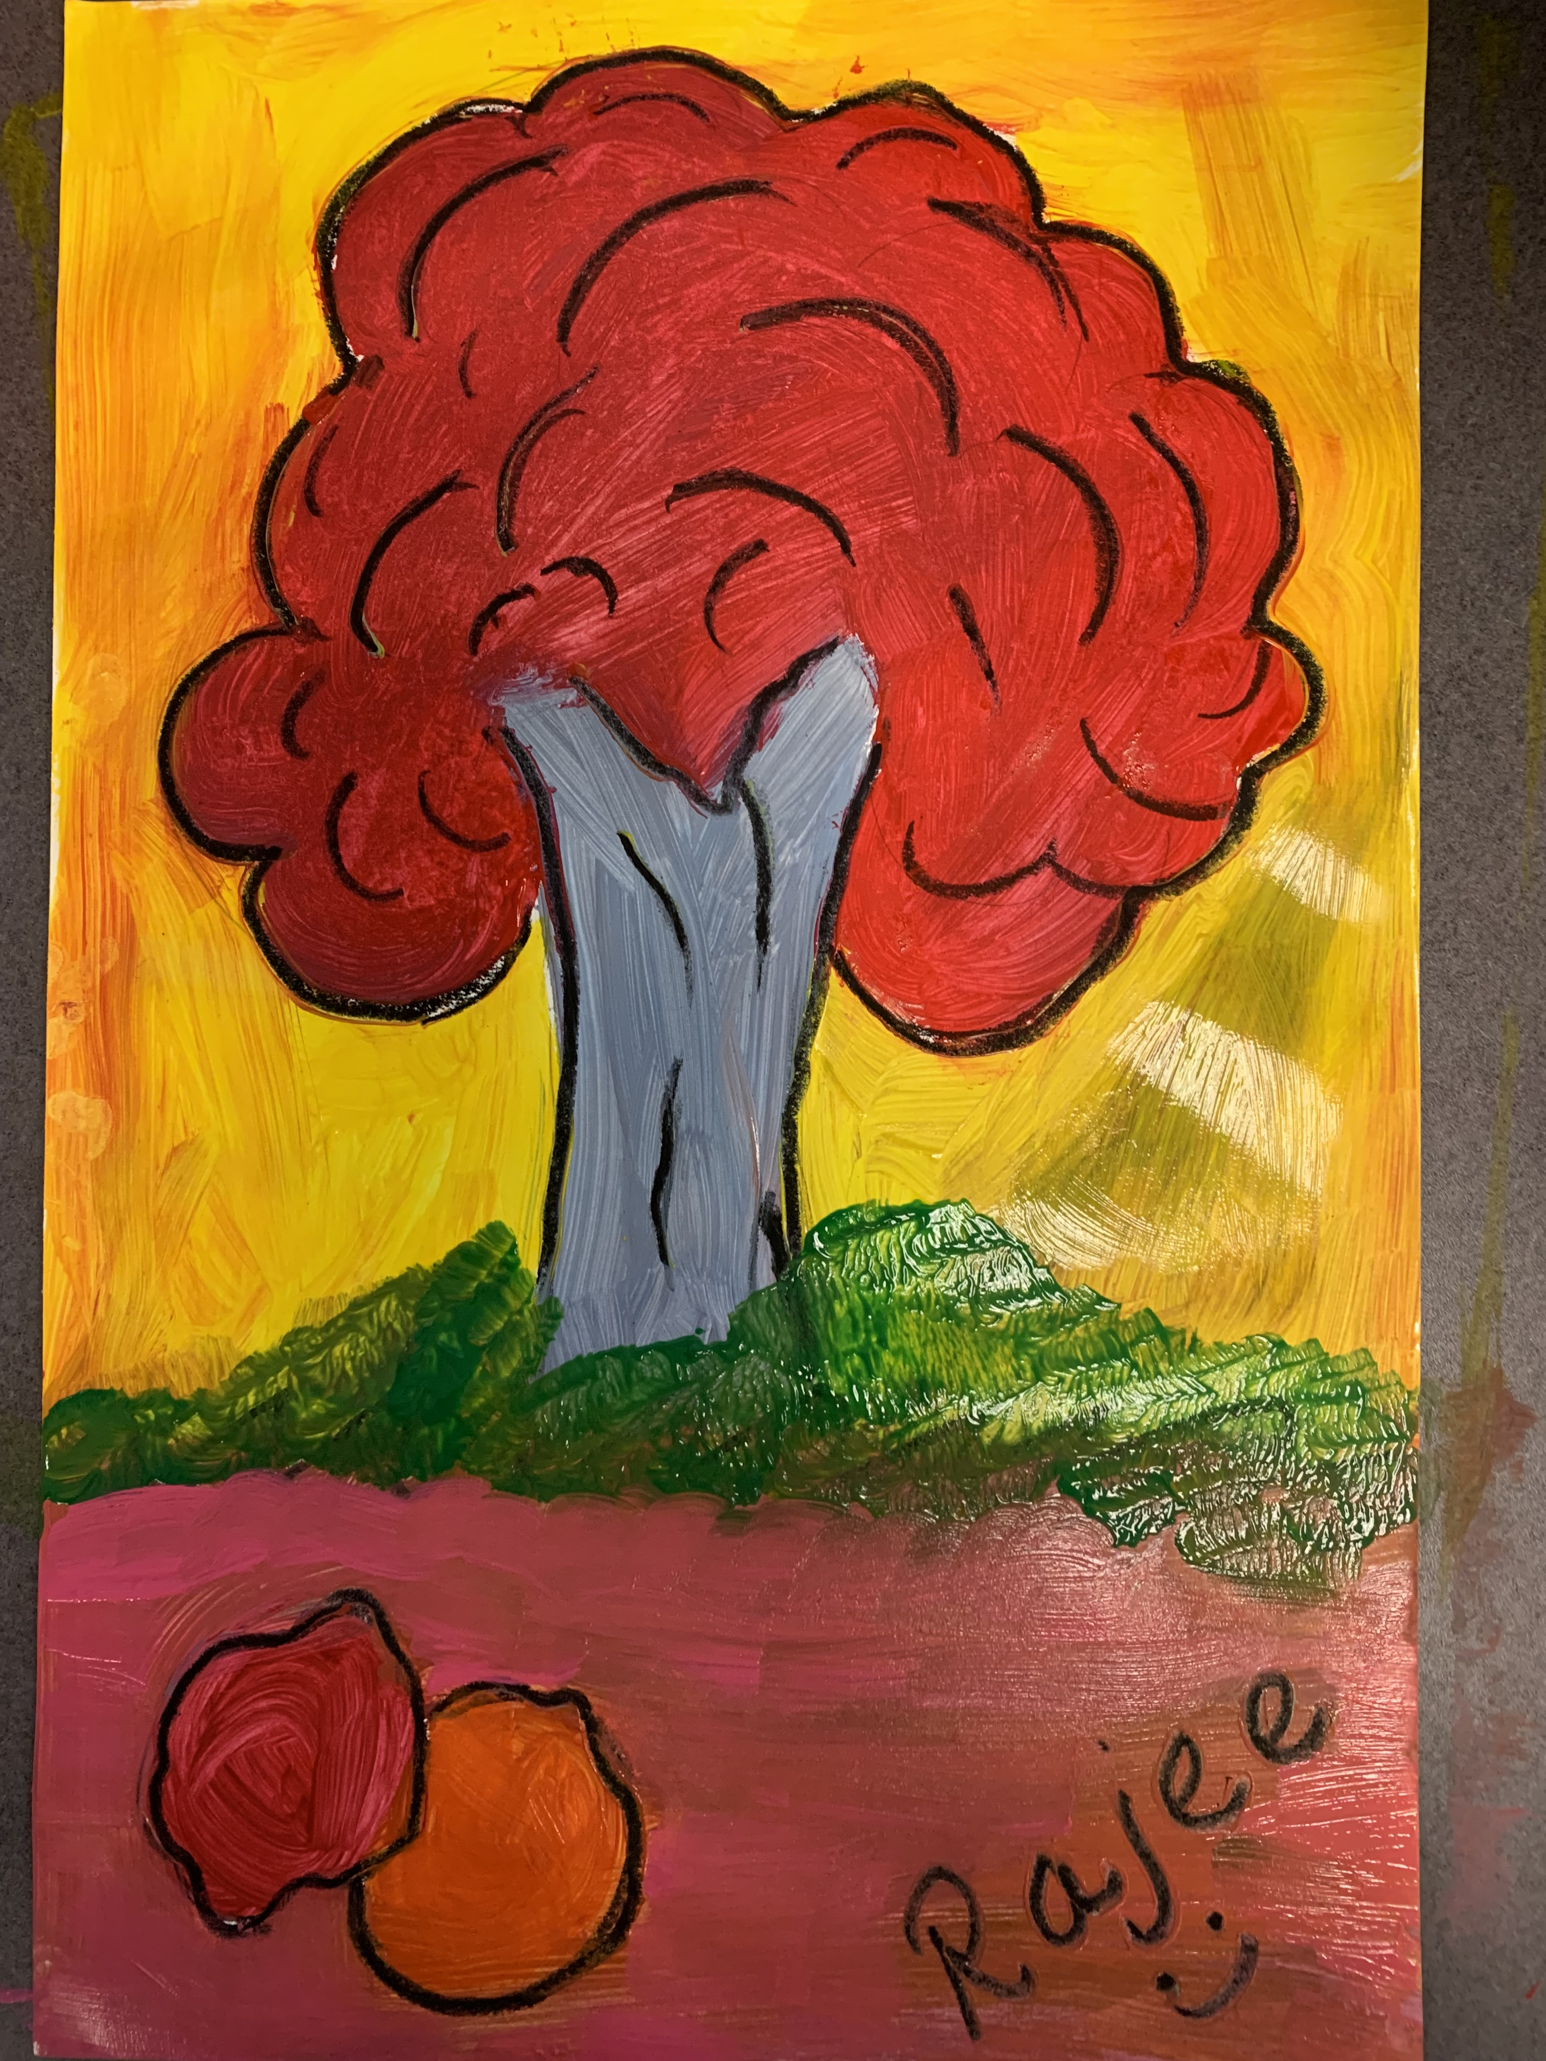
Color your world with joy!
January 2022 Art Project
Quail Run Elementary
Rajee Subramanian

Slide 2
Colorful Holiday season
Winter – No leaves on trees
Color brightens the cold weather
Brings warmth
Green & Red in holiday colors in western countries (Green relates to growth/hope in winter and Red to joy)
Color symbolism - Marketing
Around the world festivals are celebrated in various colors
Being aware of colors and culture makes us a inclusive person

Slide 3
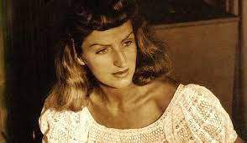
Inspiration
Mary Blair
1911 – 1978
Artist, animation, concept art
Walt Disney
Creator of character designs for “It’s a small world” attraction
Fond of bright colors
Uses primary colors to form intense contrast colors to attract and make it interesting for eyes
Worked in famous animation movies - Alice in the wonderland, Cinderella, Peter pan, Lady and tramp, Dumbo, Fantasia etc…
Disney Legend
https://www.youtube.com/watch?v=VHmYRRd0oAs

Slide 4
Color your world with joy!
Inspiration – Art Movement - Fauvism

Slide 5
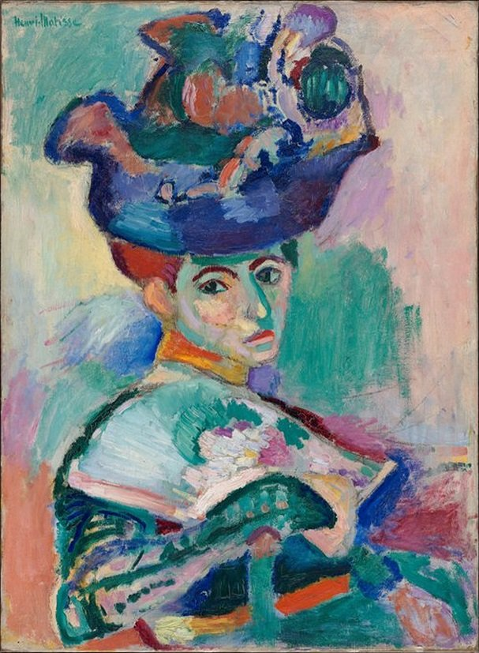
What is Fauvism?
Fauvism is an art movement
Originated in France in 1905
Uses bright, wild, vivid, intense color to help convey a mood
Lines are simplified as much as possible as unnatural
Usually has no reality especially in colors creating eye appealing interesting scenes
It also has some wild brush strokes
Les Faves in French means “the wild beasts”
Major Artist: Andre Derain along with Henri Matisse
Mary Blair

Slide 6
AndrE Derain
Mary Blair

Slide 7
Art Element – COLOR
WHAT IS COLOR?
Color or colour is the visual property
It gives us the ability to interpret things
It actually dose not exist
You can see color because of the presence of light
Our brain interprets the light rays reflecting on the objects
Rainbow – VIBGYOR

Slide 8
ART ELEMENT - Warm, Cool and Neutral Colors
Warm colors are related to the high energy, warmth of the sun and are bold like Yellow, Red, Orange etc.
. Cool colors are calm and relaxing like Green, Blue, Purple etc
Neutral colors like Black, Brown, Grey, White are not present in the color wheel and are called earth tone colors

Slide 9
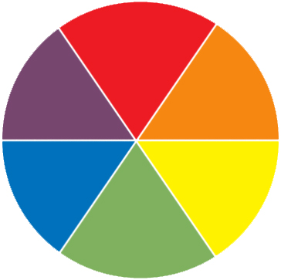
UNIVERSAL MEANING - Emotions and colors psychology
In visual art the colors are used to describes the emotions.
Inside Out
Angry Danger
Brave
Fear
Sad
Calm Relaxed
Happy
Peace
Hope

Slide 10
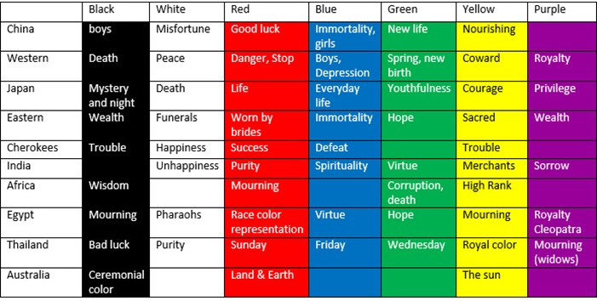
Colors and Culture around the world

Slide 11
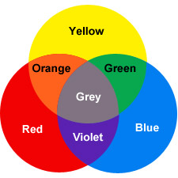
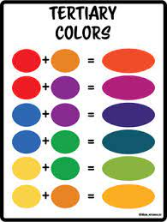
Color Mixing

Slide 12
Materials (TK, K &1)
12X 18 white paper
Crazy dots (TK, K & 1)
Neutral color oil pastels (Black, Grey, brown)
Pencil, eraser
Tissue paper

Slide 13
Materials(Grades 2,3,4 & 5)
12X 18 white paper
Neutral color oil pastels (Black, Grey, brown)
Tempera Paints ( Grades 2, 3, 4 & 5)
Pencil, eraser
Paint brushes(Thick flat brush and one thin brush per student)
Tissue paper
Water cup to wash the brush in between colors
Paint pallet/paper plate (One per table)

Slide 14
Grade 2&3

Slide 15
Procedure (TK, K, Grade 1)
The 12x18 paper is placed in portrait orientation(standing paper)
Write your name on the back
Give one hand space from the bottom of the paper
Draw a horizon line with pencil
Make a thick tree bark with pencil above the horizon line
Draw the curvy lines around the tree trunk to make the fluffy tree top
The tree top has to fill the entire page leaving only 2 finger space on the top
Trace the pencil lines with a neutral color oil pastel(black, brown, grey, dark blue)
Use varied color crazy dots to color the areas(background, tree trunk, tree top)
The colors dose not have to be match the natural world, remind that the trees dose not have to be green and brown and sky can be red or pink or orange.

Slide 16
Paint Technique (Grades 2,3,4&5)
Dry brush – For larger area(mountains, trees, foreground, background)
This is quite self-explanatory – simply apply paint onto your canvas with almost dry. This technique gives us highly pigmented stroke of color that is very bright. Make sure to wash and wipe the brush with tissue after every color. Paint should be applies gently
Detailing – For outlining all the larger areas above
Detailing is accomplished by using a fine brush, moderately wetting it so it maintains a pointy form. The brush is used in a similar way as a pen or pencil. You can use this technique to add intricate detail to your paintings.
Need a lot of patience for the detail outlining.

Slide 17
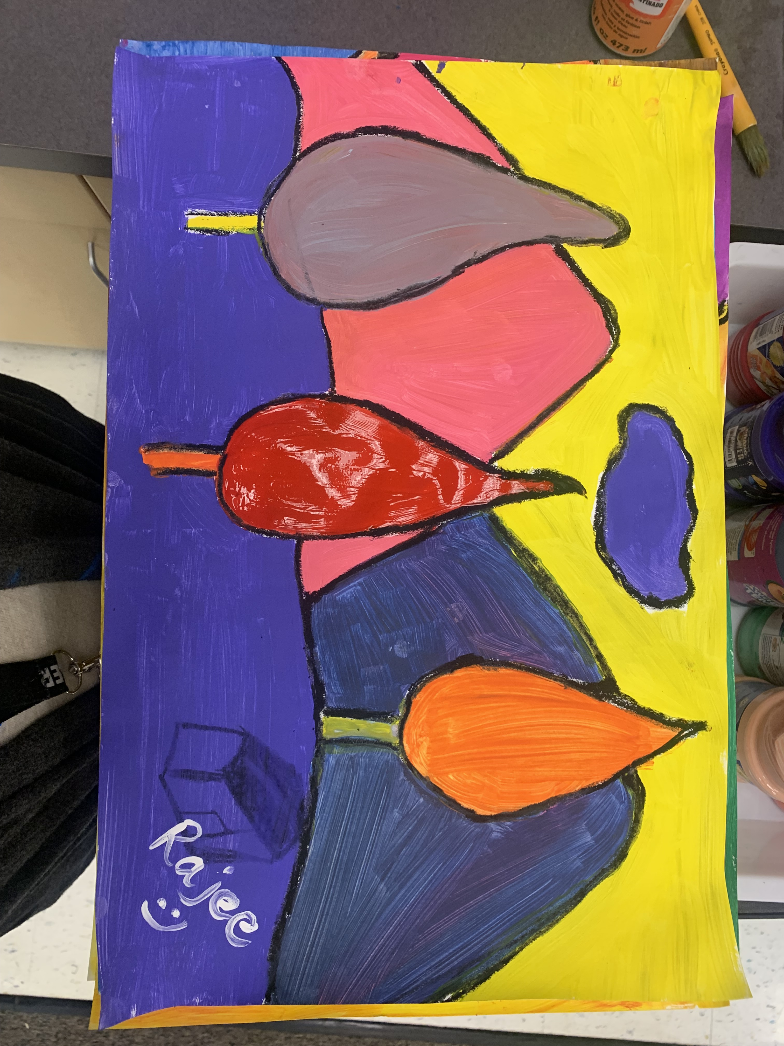
Procedure (Grade 2, 3)
The 12x18 paper is placed in landscape orientation(sleeping paper) Write your name on the back.
Draw a horizon line with pencil in the middle of the paper
Grade 2 & 3 - draw 2 mountains in the background above the horizon line
Make simple pine cone trees in the foreground overlapping on the mountains
Erase the overlapping mountain lines that collide with the tree
Trace the pencil lines with a neutral color oil pastel so the paint will not spread into the rest of the areas(black, brown, grey, dark blue)
Use varied color and thick brush to to paint the larger area
The colors dose not have to be match the natural world (the sky dose not have to be blue, mountains dose not have to be green)
Once all the paint is applied use a thin brush to outline the objects with black paint over the oil pastel

Slide 18
Procedure (Grade 4 & 5)
The 12x18 paper is placed in landscape orientation(sleeping paper)
Write your name on the back.
Draw a horizon line with pencil in the middle of the paper
Grade 4 & 5 - draw 3 or 4 mountains overlapping in the background above the horizon line
Draw simple pine cone trees/fluffy trees( or both) in the foreground overlapping the mountains
Draw the pathway (trail) leading into the mountain (wide to narrow)
Erase the overlapping mountain lines that collide with the tree
Trace the pencil lines with a neutral color oil pastel so the paint will not spread into the rest of the areas(black, brown, grey, dark blue)
Use varied color and thick brush to to paint the larger area
The colors dose not have to be match the natural world (the sky dose not have to be blue, mountains dose not have to be green)
Once all the paint is applied use a thin brush to outline the objects with black paint over the oil pastel

