Slide 1
Clay Mural Painting
Tk, Kinder & Grade 1
March 2022 Art project
Quail Run Elementary
Rajee Subramanian

Slide 2
Art Show – May 19 – Open house
2019 – 2000 plus art pieces
Art submissions due on April 29 need 2 art projects from each class
2 pieces each student
Art has to be mounted/ backing needed
Select 2 art from your class
Below is the link to 2019 Art Show!
https://www.youtube.com/watch?v=tdcMVUSEcc4

Slide 3
Artist : Vincent Van Gogh
Dutch Painter, 1853 – 1890 (37years)
Impressionists artist
Color was his chief symbol of expression, bold brushstrokes & colors, layers of paint
Van Gogh specializes in oil paintings
Highly intelligent, emotional and had a difficult life
His painting career was only for 10 years but he produced over 900 art pieces
His paintings were recognized only after his death
He died as a poor man
Van Gogh’s Biography https://www.youtube.com/watch?v=qv8TANh8djI

Slide 4
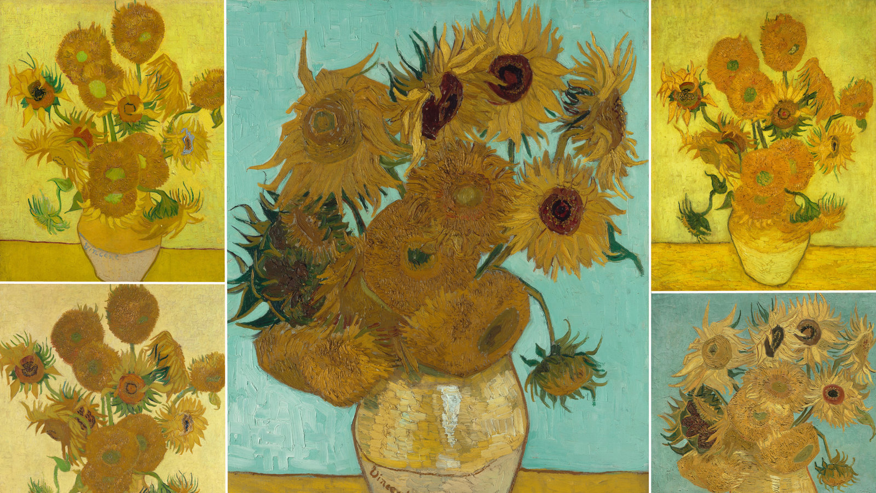
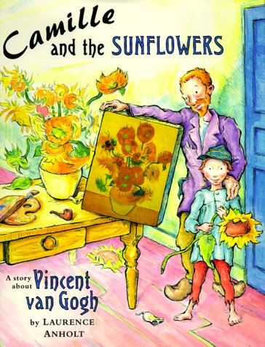
Inspiration : Vincent Van Gogh & Sun flowers
Sunflower means gratitude for Van Gogh
Video book link: https://www.youtube.com/watch?v=dJQEdMtGJsE

Slide 5
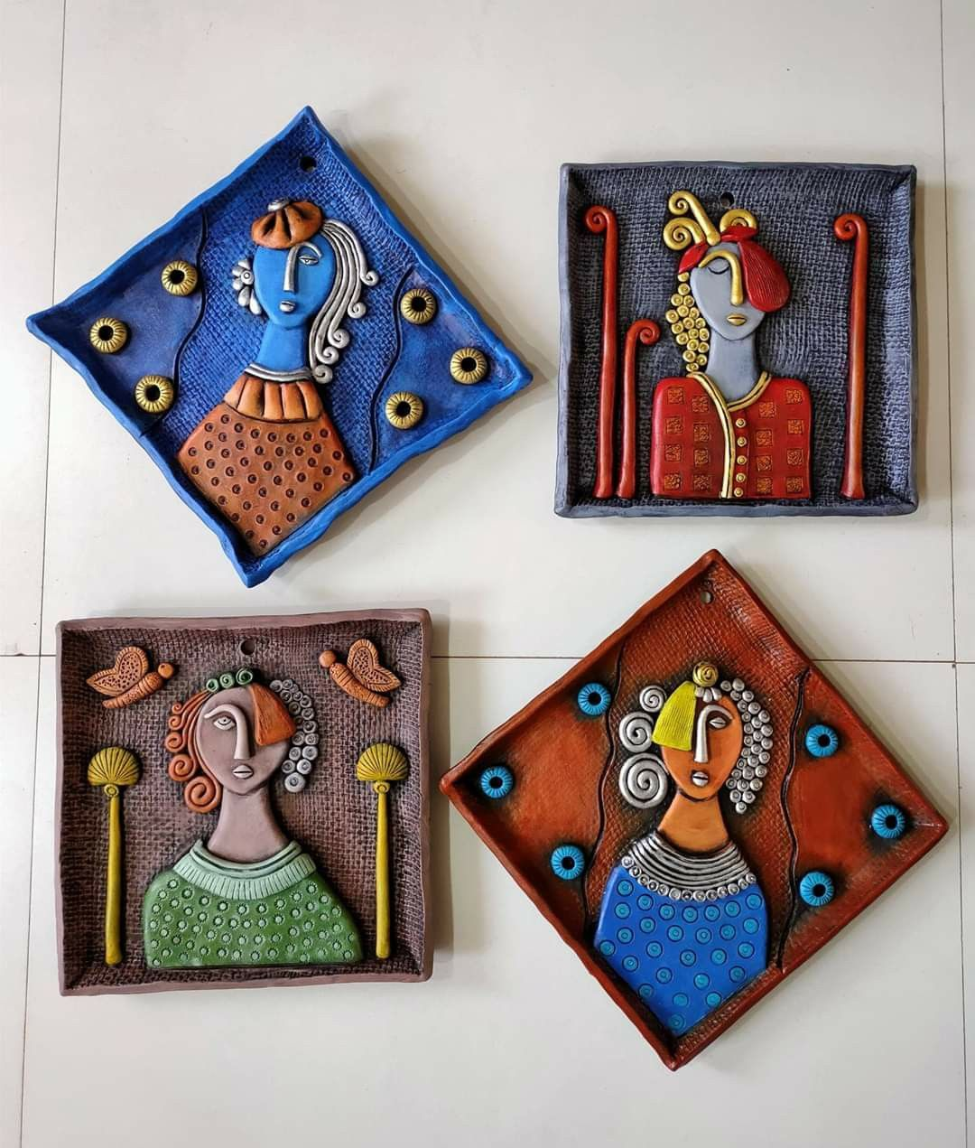
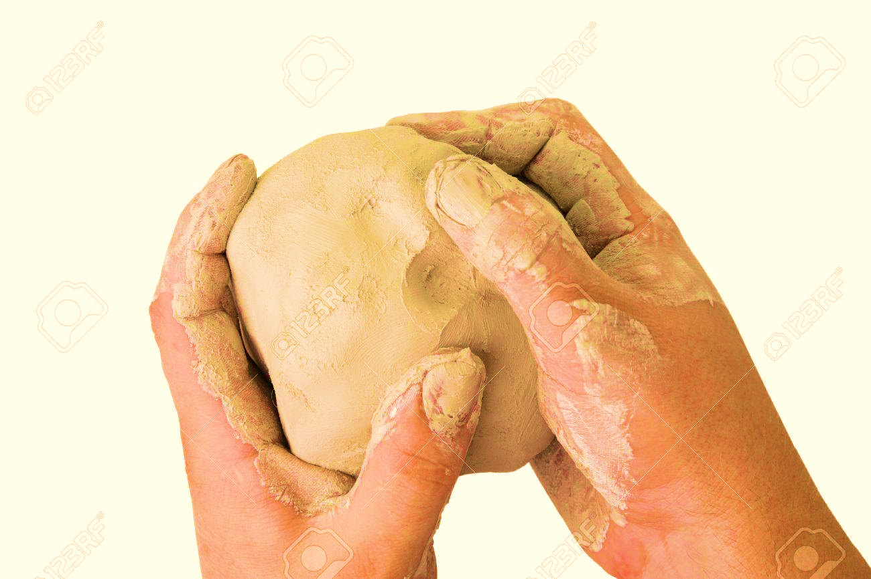
Art Technique
Clay Painting – Adding clay to the CARDBOARD and then paint on it.

Slide 6
Materials
Cardboard
--5 X 5 rectangle – Grades 2 & 3
All Grades
Clay
Mod podge
Acrylic paints
Sponge (optional)
Craft sticks (Optional)
Tissue paper
Paper plates
Thick brush – 1 per student
Thin brush – 1 per student

Slide 7
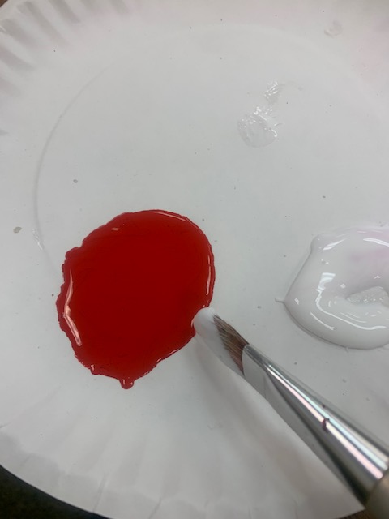
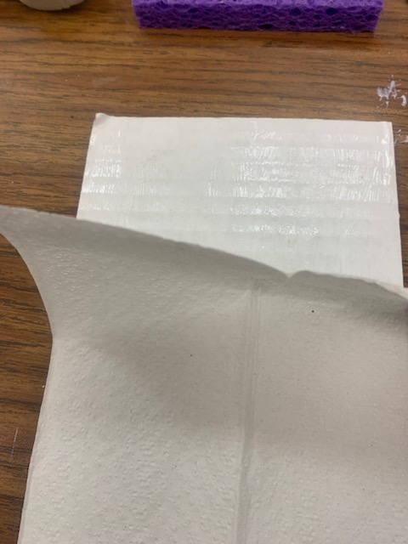
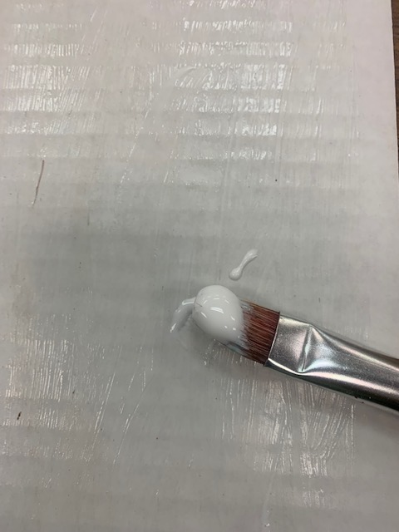
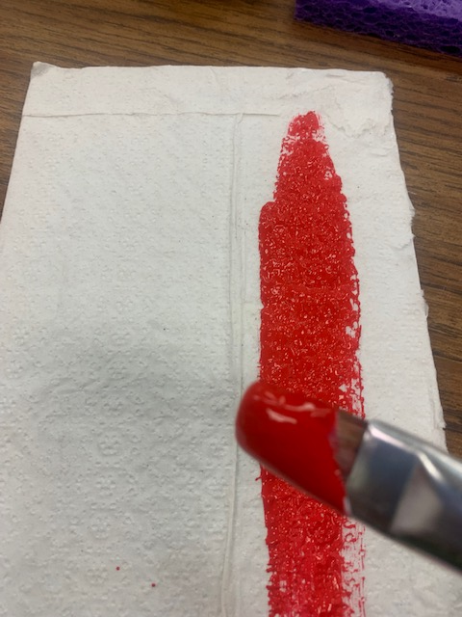
Procedure
Mix mod podge and background color and apply the mixture all over the tissue
Lay the tissue paper over the mod podge, cut excess tissue paper or add more to cover the entire cardboard
Apply mod podge on the cardboard

Slide 8
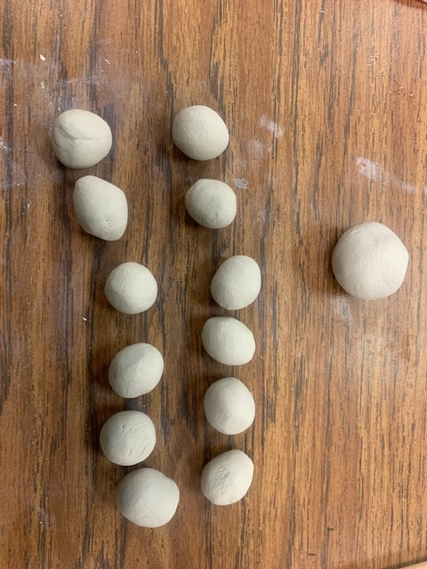
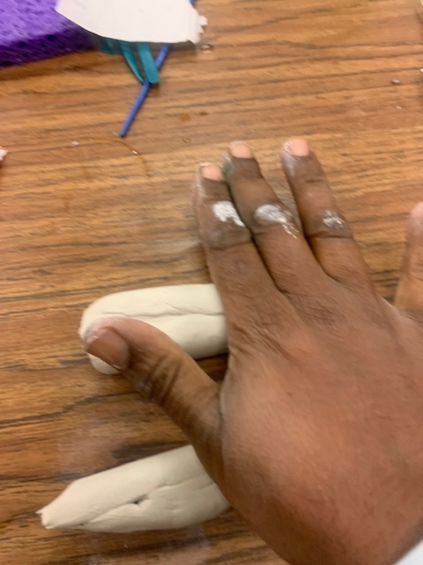
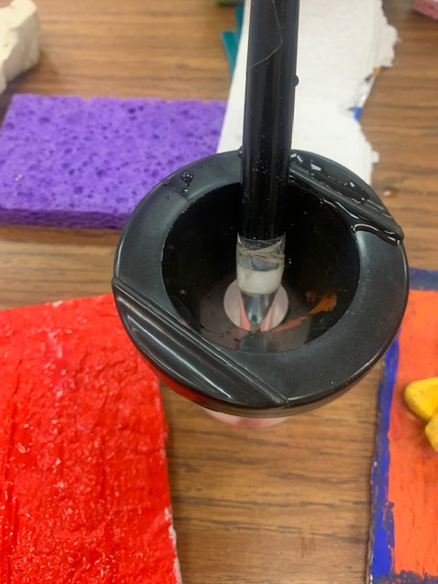
Procedure
12 small balls size of a peanut M&Ms
And one slightly bigger size for the center dial
Split the given clay in two equal portions and roll on the table using your hand
Once you are done with the background put the brush in the water cup

Slide 9
How do I make the petals?
The petals has to be thick on the front edges, if the petals are thin then it will break off during the drying process
Make all the petals first

Slide 10
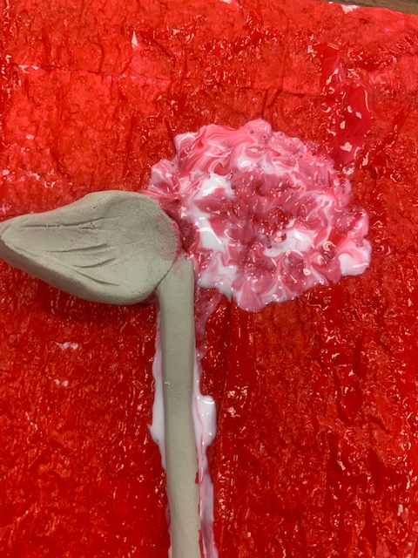
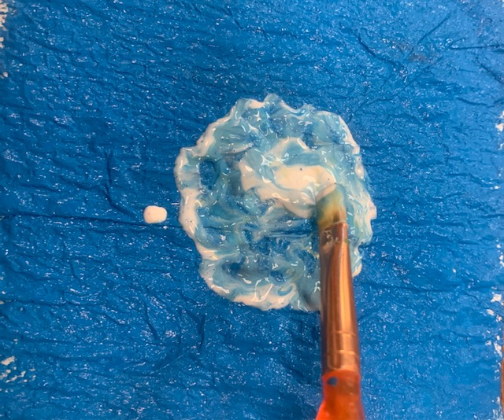
Procedure
Use small brush to roughly put some mod podge in the center of the cardboard
Place the petal on the edge of the center and gently press down on the inside edges of the petal

Slide 11
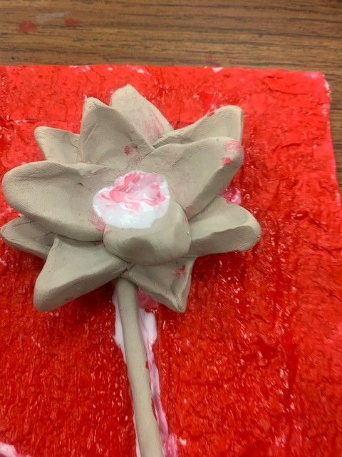
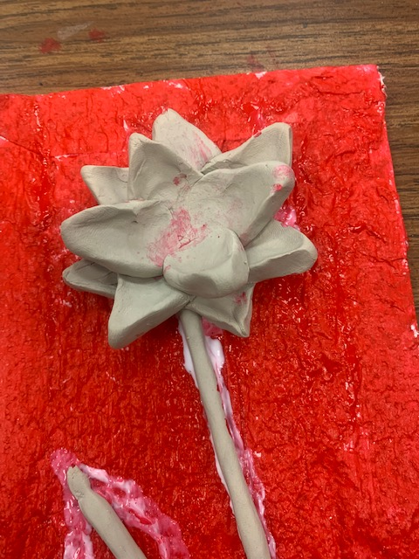
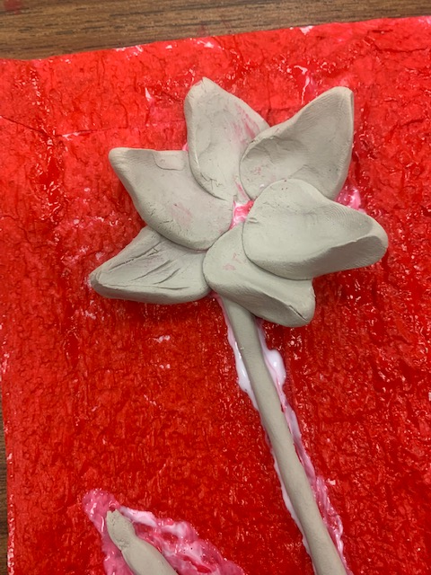
Procedure
Put some more mod podge in the center of the flower
Brush more mod podge on the lover petal
Add 3 or 4 more petals over the bottom layer of the petal.
Make sure it is overlapped in between the individual lower petals
Slightly over lap and press down 5 or 6 petals on the inside edge

Slide 12
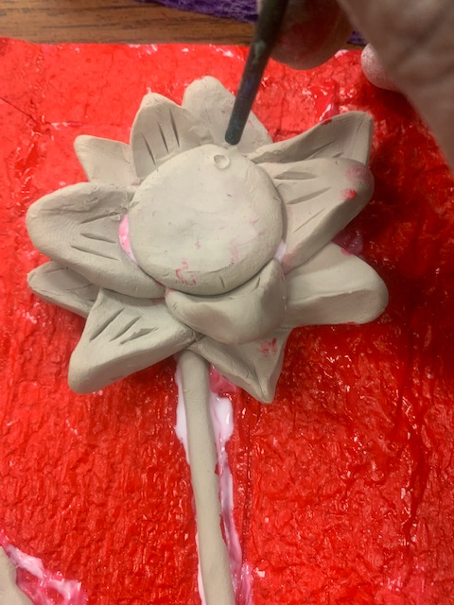
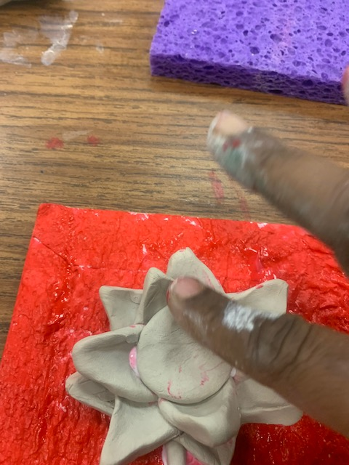
Procedure
Flatten the big ball and place it in the center of the flower and smoothen it
Use the back of the small brush or the blunt pencil to make the dots in the center if the flower

Slide 13
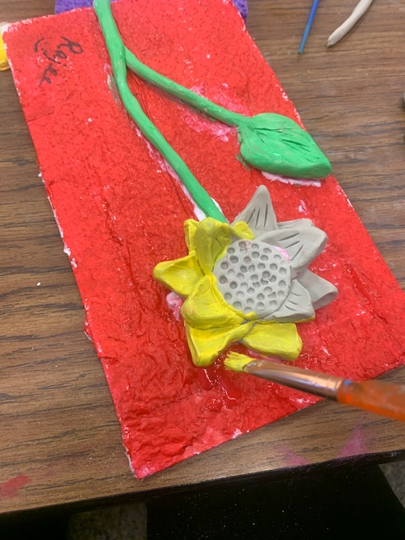
Procedure
The craft stick or paint border is optional
Once painted wash the small brush and apply mod podge over the clay parts to seal it and make it glossy.
Paint the flower using the same small brush.
Make sure to color the sides of the flower too as it is 3 D form. Turn clockwise to color all hidden spots

Slide 14
Procedure
Grade 4 & 5 makes the 2 flowers, stem and one leaf on the 10 X 10 cardboard
Grade 2 & 3 makes one flower, stem and one leaf on the 10 X 5 cardboard
Tk, Kinder & Grade 1 will only make the flower on the 5 X5 cardboard

